Slide 1
AI Training
(Brief Introduction)
By Lev Selector
Updated April 2024

Slide 2
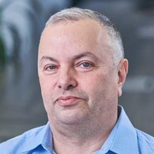

About the Speaker
Lev Selector, Ph.D.
40+ years of software engineering, data science, and building teams (hiring, training, and managing)
Ph.D. in mathematical modeling and computer simulations
Interests:
Generative AI, Using LLM with your data
Local AI for Local Private Data
Cloud architecture, fin-tech, application security
Find/connect: Linkedin, GitHub, YouTube, Google
https://eais.ai
Enterprise AI Systems

Slide 3
"Recent advancements in generative AI have sparked a massive surge of interest in AI technologies among software engineering leaders and business leaders alike. The number of Gartner inquiries about generative AI has increased by over 1,300% year over year."
2023 Gartner® Magic Quadrant™
Generative AI = systems which enable users to quickly generate new content based on a variety of inputs (text, images, sounds, animation, 3D models, or other types of data)
LLM = Large Language Models (text-to-text, text-to-image, etc.)
GPT = Generative Pretrained Transformer - an LLM by OpenAI
ChatGPT = a chat web-app based on GPT model (November 2022)
Foundation Model = an AI neural network trained on lots of data (usually with unsupervised learning) which can be used as a foundation of variety of systems
AGI = Artificial General Intelligence

Slide 4



Recent Rise of ChatGPT
Interest since 2004:
deep learning
machine learning
data science
OpenAI
ChatGPT (fastest growing)
Chat = Chatbot = chat software
GPT = Generative Pre-trained Transformer
LLM = Large Language Model (text-to-text)
ChatGPT from Open AI is taking the world by storm.
People find more and more creative uses for it.
writing posts, articles, books, summaries
planning
research
software engineering
resolving problems (support)
sales
etc etc
Interest since 2004 without ChatGPT:

Slide 5
What is "Generative AI" ?
Generative AI is a type of Machine Learning (ML)
that generates/creates text, video, images, and other types of content.
Generative AI models learn the patterns and structure of their input training data, and then generate new data that has similar characteristics.
Classical ML | > | Predict
Generative AI | > | Create
regression, classification, ...
text, code, images, ...

Slide 6
Does Generative AI Create New Content?
Question:
How Generative AI works?
How it generate new content? (text, image, music, ...)
Is it created from nothing?
Answer:
It is not created from nothing.
Generative AI system first learns from large amounts of existing data,
and then it can use the latent representation of this data and some randomness
to generate new examples that are similar to the data it has seen before.

Slide 7
Generative AI Models Today
There are multiple Generative AI models for different purposes
LLM - Large Language Models (OpenAI GPT, Google Gemini, Claude, Mistral, Llama, ... )
FM = Foundation Models - all kind of complex models that can be a foundation for specific models
Technologies:
GAN (Generative Adversarial Network)
GPT (Generative Pre-trained Transformer)
VAE (Variational Autoencoder)
Examples:
DALL-E from Open AI, Stability.AI, Midjourney - create realistic images from text descriptions
ChatGPT - generate text, translate languages, and write different kinds of creative content
Gemini - a large language model from Google AI (similar to ChatGPT)

Slide 8
Massive investments in Generative AI.
The cost of creation of GPT models (including ChatGPT) is estimated at ~ $500,000,000 !
According to PitchBook data (https://pitchbook.com),
the generative AI market is predicted to reach $42.6 Billion by 2023
and exceed $98 Billion by 2026
Some Big Players:
OpenAI ChatGPT
Google’s Gemini
Baidu’s Ernie Bot
Salesforce’s CRM Einstein GPT
Microsoft Copilot, Bing, 365 apps
etc.
https://www.morningstar.com/funds/how-invest-future-generative-ai

Slide 9
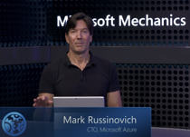
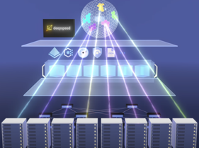

Microsoft AI Supercomputers
What runs ChatGPT? Inside Microsoft's AI supercomputer | Featuring Mark Russinovich
https://www.youtube.com/watch?v=Rk3nTUfRZmo
massive self-supervised learning, petabyte scale projects
Microsoft + OpenAI + NVIDIA
NVIDIA GPU servers, NVSwitch, NVLink (fast NVIDIA wiring)
High bandwidth network - InfiniBand
huge scale, models 175 - 500 Bln parameters
dealing with failures - management layer, containers, checkpoints
distributed parallelized training (deepspeed training framework)
virtual clusters, global model portability
project Forge - managing checkpoints and GPU utilization
CRIU - Checkpoint and Restore in Userspace
LoRA = Low Rank Adaptive fine tuning - customizing the model using smaller number of GPUs and storage
Confidential computing, encryption, confidential "clean rooms"

Slide 10
It is Risky to Invest into Creating a New Foundation Model
If you invest $100s of millions into training new large models, most of this money will probably go into paying for infrastructure (NVIDIA GPUs on cloud).
This is risky, because in 2 years the price of training will go down from $100M to $5M.
It is safer to invest money into building a road or a building.
It is Safe to Invest into Building Apps for Clients
Using Existing Foundation Models
A less risky approach is to use existing LLMs and other foundation models (via APIs, plugins, etc) to build business applications for clients.
Fine-tuning existing fondation models is difficult and not very reliable.
A better approach is to use "embeddings" approach and vector databases
An "embedding" is a way of representing complex data in a lower-dimensional space that is more suitable for processing. Typically as a vector.

Slide 11
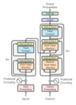


Main Three Models' Architectures:
Transformer
GAN
Diffusion

Slide 12
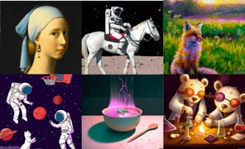
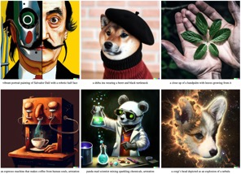
Transformers, GANs, Diffusion Models are everywhere
Example - DALL-E 2 uses all three types of these model types in one system.
.. https://openai.com/dall-e-2
DALL-E 2 is a large language model (LLM) developed by OpenAI that can generate realistic images from text descriptions.
It was first announced in April 2022, and is a successor to the original DALL-E model, which was released in January 2021.
DALL-E 2 is trained on a massive dataset of images and text descriptions. This allows it to learn the relationship between words and images, and to generate images that are both realistic and visually appealing.
To use DALL-E 2, you simply need to provide a text description of the image you want to generate. For example, you could type in "a cat sitting on a couch" or "a painting of a sunset over the ocean." DALL-E 2 will then generate an image that matches your description.
DALL-E 2 uses two main models: a text encoder and a diffusion model.
Text encoder is a transformer GPT-3 language model (developed by OpenAI)
Diffusion model is based on the BigGAN generative model (developed by Google AI)
Note: BigGAN is a deep convolutional generative adversarial network that has been trained on a massive dataset of images. This allows BigGAN to generate images that are both realistic and high-quality

Slide 13
Path to Transformers
Transforming sequences (text or code).
Translation is a famous example.
Word
Dictionary
Naively translating each word
if-else models
Large programs written by linguists
Word2Vec (Google, 2013)
Words are presented by vectors (embeddings). These vectors are obtained by training the 2-layer network on large number of texts. These vectors capture semantic meaning based on context; words appearing in similar contexts have vectors close to each other in this space. This enables the model to infer word relationships, like "king" is to "queen" as "man" is to "woman".
Attention (Google, 2016)
GNMT = Google Neural Machine Translation
Attention is a technique that helps the model focus on relevant parts of the input when processing data.
Attention assigns different weights or "attention scores" to different parts of the input, highlighting what is important for the task at hand.
This is especially useful in tasks involving sequential data like text or time series, where certain elements in the sequence may be more relevant than others depending on the context.
Transformer (Google, 2017)
Transformer is a type of model architecture introduced in a paper called "Attention is All You Need" by Vaswani et al.,. It's a model that uses attention mechanisms 2017exclusively, doing away with the need for recurrence or convolutions entirely, as seen in previous models like RNNs and CNNs.
The Transformer model employs a special kind of attention mechanism called self-attention (or scaled dot-product attention) to weigh the importance of different elements in the input data.
This enables the model to consider the full context of a sequence in parallel, making it very effective for many tasks involving sequential data, such as language translation, text generation, and more.

Slide 14
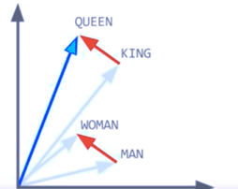
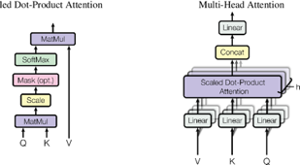
From Word2Vec to Attention
Word2Vec (2013)
Tomas Mikolov published word2vec in 2013.
Typically word2vec maps each word to a vector of ~100 numbers.
This mapping is found iteratively (starting with random vectors). The process approximates a word from the words before and after it in text. Similar words would have similar "neighbours".
Once vectors are found, they represent the meaning of words. SO you can do vector operations with them, for example: V(King) – V(Man) + V(Woman) ~ V(Queen)
Attention Mechanism (2016-2017)
Words are represented by vectors based not only on the word, but also on its position and neighbours in specific phrase/text.
Not just nearest neighbours – but from the whole text!
Positionall encoding is done using sin()/cos() functions.
We encode words into a list of those vector representations.
Then we process this memory of vectors while putting attention on
the content of one or few memory element(s),
and finaly decode to generate the translated sentence.
"Attention Is All You Need" (2017) – Google, eight authors
.. https://arxiv.org/pdf/1706.03762.pdf
.. https://medium.com/data-science-in-your-pocket/attention-is-all-you-need-understanding-with-example-c8d074c37767

Slide 15
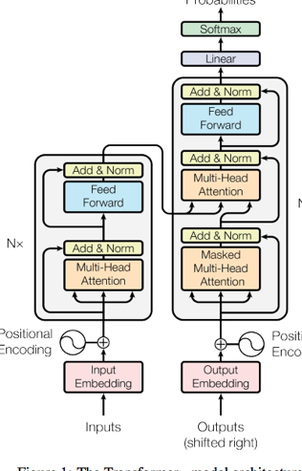

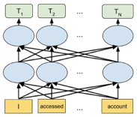
Transformers, BERT
Transformer (Google, 2017):
Deep Neural Network for language models
replaces sequential models (like RNN,LSTM),
allows parallel processing
multi-head Attention.
encoder: self-attention + Feed-Forward Network
decoder: self-attention, attention over encodings, and a feed-forward Network
BERT (Google 2018):
"Bidirectional Encoder Representations from Transformers"
a language representation model
designed to pre-train deep bidirectional representations from unlabeled text
Bert
(Sesame Street)

Slide 16
Transformer - sizes of the matrices?
The input sequence length N and the hidden size H are two important hyperparameters. For example, the standard size N=64, hidden vector size H=512
In the original Transformer model, the sizes of the query, key, and value matrices are the same: NxH.
The size of the "Attention Matrix" is NxN
If the input sentence is short - it can be padded to standard length N.
If the input sentence is longer than N, the algorithm needs to use one of methods to fit into N.
Truncate the input sentence at the beginning or at the end
Sliding Window - the input sentence is divided into smaller segments or windows, and the model processes each segment separately.
Chunking - split into smaller chunks or sub-sentences. Each chunk can be processed independently, and the outputs can be combined or aggregated to obtain the final representation.
The GPT 3.5 model restricts user questions to 4,097 tokens (~ 3,000 words).
The hidden vector size is 12,288.
Number of layers: 96
Number of attention heads: 96
Dimensions of its hidden layers: 12288
Sequence length: 2048
Number of parameters: 175B
The ChatGPT 4.0 can process up to 25,000 words of text from the user (depending on the model):
Model Max Tokens
Ada, Babbage, Curie 2048
DaVinci, ChatGPT 4096
GPT-4 8k context 8192
GPT-4 32k context 32768

Slide 17

GANs
Generative Adversarial Networks (GANs) (2014)
Police Detective
(recognizes images)
Artistic Criminal
(generates fake images)
Ian Goodfellow
Both Detective and Criminal receive the same set of images (for example, pictures of cats and dogs).
Criminal randomly generates “fake” images (cat with 6 legs and two tails, etc.).
Detective learns to discriminate real images from fakes and becomes better and better.
Criminal learns to make better and better fakes.
Adversarial relationship helps both become better very fast.
Thesis (2014): https://papyrus.bib.umontreal.ca/xmlui/bitstream/handle/1866/11674/Goodfellow_Ian_2014_these.pdf
Generative Adversarial Nets, 2014 (8 authors)
https://papers.nips.cc/paper_files/paper/2014/file/5ca3e9b122f61f8f06494c97b1afccf3-Paper.pdf
Unreal Person:
https://www.unrealperson.com

Slide 18
BigGAN
GigaGAN
BigGAN (Google, 2018) - used by DALL-E 2
The base for the model is the Self-Attention GAN, or SAGAN for short, described by Han Zhang, et al. in the 2018 paper tilted “Self-Attention Generative Adversarial Networks.”
Can generate larger and higher-quality images, such as 256×256 and 512×512 images
https://machinelearningmastery.com/a-gentle-introduction-to-the-biggan/
GigaGAN (2022) is a large-scale generative adversarial network (GAN) that was developed by researchers at POSTECH, CMU, and Adobe
It can generate high-quality images at a much faster rate than previous GANs
GigaGAN is built on top of the StyleGAN architecture (NVIDIA) by using a larger and more diverse training dataset, a more powerful discriminator, a new more effective and more efficient training algorithm
1+ Bln parameters
Can generate high-quality images very fast: 512x512 px output generated in 0.13 sec, which is orders of magnitude faster than previous generations
Can synthesize high-resolution images (16-megapixels in 3.66 sec)
Supports various latent space editing applications such as latent interpolation, style mixing, and vector arithmetic operations
Popular GANs
CycleGAN
StyleGAN
pixelRNN
text-2-image
DiscoGAN
lsGAN

Slide 19

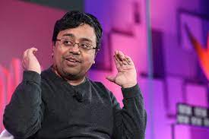
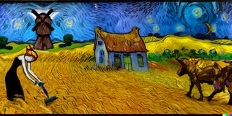
Stable Diffusion - Emad Mostaque
Mohammad Emad Mostaque is the founder (2019) and CEO
of Stability AI, (London, England, UK, ~170 employees),
the company that developed Stable Diffusion
(Original authors: Runway, CompVis, and Stability AI)
Good short video: https://www.youtube.com/watch?v=WgIlAB3cS6U
Stable Diffusion is a deep learning, text-to-image model released in 2022. It is primarily used to generate detailed images conditioned on text descriptions, though it can also be applied to other tasks such as inpainting, outpainting, and generating image-to-image translations guided by a text prompt.
It was developed by the start-up Stability AI in collaboration with a number of academic researchers and non-profit organizations.
It is open source.
https://en.wikipedia.org/wiki/Stable_Diffusion
https://github.com/Stability-AI/stablediffusion
https://replicate.com/stability-ai/stable-diffusion/examples
Emad Mostaque

Slide 20
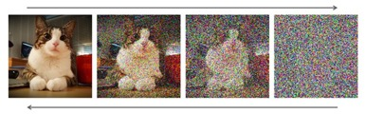
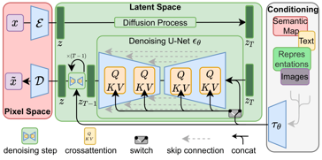
How Stable Diffusion Works
Stable Diffusion creates images from text descriptions.
Stable Diffusion can generate high-quality images that are indistinguishable from real photos - while using less than 1 Bln parameters
https://towardsdatascience.com/stable-diffusion-best-open-source-version-of-dall-e-2-ebcdf1cb64bc
https://jalammar.github.io/illustrated-stable-diffusion/
https://www.youtube.com/watch?v=J87hffSMB60
When we train the Stable Diffusion model,
we give it pairs of (text, image).
We train the text encoder and image encoder neural networks to encode the text and image into latent vectors, and we use contrastive learning to minimize the distance between these vectors. This means that the model learns to associate text and image, because they being encoded into the same latent vector.
The vector is a 2D tensor (typically with 77 rows and 768 columns)
We also train the decoder to generate images from latent vectors - using VAE (Variational Auto-Encoder) architecture.
So overall it is a supervised learning using VAE (Variational AutoEncoder) architecture.
When we use the trained model, we
encode the text into latent vector
use this vector to condition the latent-to-latent diffusion process to add noise (to avoid overfitting to training data)
use denoiser part of VAE to remove noise from latent vector
compare the output latent vector to the latent vector from text
iteratively repeat the process until we get good fit and the sufficiently low level of noise in the output latent vector
decode the output latent vector into image
repeat until the image is satisfactory

Slide 21

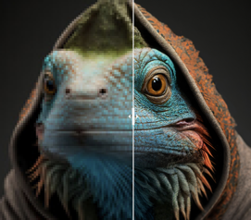
Generating Images from Text
OpenAI DALL-E and DALL-E 2
- https://openai.com/product/dall-e-2
- https://en.wikipedia.org/wiki/DALL-E
2021 - DALL-E, multimodal GPT-3 with 12B parameters
2022 - DALL-E-2, 3.5B parameters
Midjourney - independent research lab, creates images from text, similar to OpenAI's DALL-E and Stable Diffusion
- https://midjourney.com
Stable Diffusion text to image model
- https://stablediffusionweb.com
GigaGAN - 1B parameter model.
very fast (only 0.13 seconds to synthesize a 512px image
can synthesize high-resolution images (16-megapixel pixels in 3.66 sec)
supports latent interpolation, style mixing, and vector arithmetic operations
- https://mingukkang.github.io/GigaGAN/

Slide 22
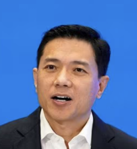

Systems with a Brain in the Middle.
From Hardwired Rules to Generic Systems
Input
Output
"Foundation models have condensed human understanding of the entire world, showing us the path toward achieving AGI," says Baidu CEO Robin Li
In nature we use generic system - human brain

Slide 23
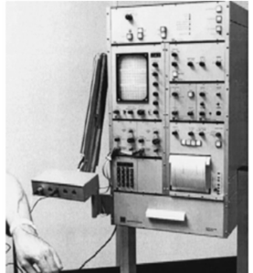
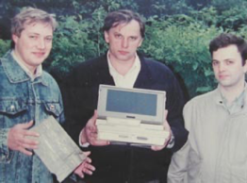

Brain in the Middle
In 1989-1991 I participated in designing a portable myograph. As you see, the device was very small and integrated with a laptop computer. Compare it with a prototype which was the size of a table (b/w photo on the left).
Custom Electronics
Hardware
Computer "brain"
Inputs
Ouputs
Inputs
Ouputs

Slide 24


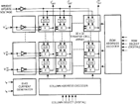
Classical ML Models
Modern Foundation Models
Data
Custom function or network
Action/Decision
Data
LLM / text
Action/Decision
Foundation model
as "brain" of ML models
The models without language.
They can learn - and act.
Like baby or an animal.
The foundation models may use language.
They can handle complex topics/situations.
Like an adult.

Slide 25
ChatGPT plugins
"GPT in the middle" approach

Slide 26





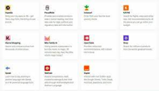
iPhone
Android
ChatGPT
app store
2 Mln apps
Google Play Store
3 Mln apps
ChatGPT Plugins
70 plugins

Slide 27
What are ChatGPT Plugins
May 19, 2023 - ChatGPT Plugins have become available to all "Plus" subscribers ($20/mo).
Here is a short video explaining how to start using them: https://www.youtube.com/watch?v=0brJr6HnX7M
There were ~70 plugins, and two weeks later ~200. A month later - more than 400. The number will grow fast because anybody can develop and post a plugin
Plugins allow ChatGPT to browse internet, read PDF documents, look at images, access 3rd party data and business systems, etc.
OpenAI itself originally has offered two plugins:
.. web browsing plugin allows to scrape data from web
.. Code Interpreter - allows to run Python code
https://www.pcmag.com/how-to/what-are-chatgpt-plugins-the-next-phase-of-conversational-ai-is-here
https://beebom.com/best-chatgpt-plugins/
https://beebom.com/best-chatgpt-chrome-extensions/
https://artificialcorner.com/i-tried-84-chatgpt-plugins-these-are-the-best-3b3be6b1cb7b

Slide 28
Transitions:
from tabular labeled data - to big unstructured data
from exact calculations - to approximate calculations
and similarity search
from tabular SQL databases - to vector databases
from hardwired specific systems - to generic "brain" systems

Slide 29

Current trend is replacing task-specific models with so called "foundation models"
which are more generic and are trained on a broad set of unlabeled data.
As the name suggests, they can be the foundation for many applications.
Typical foundation models:
text-to-text
text-to-embedding
multimodal
"embedding" is a way of representing complex data in a lower-dimensional space that is more suitable for processing. Typically as a vector.
GPT-3.5 and GPT-4 | ChatGPT | Codex | DALL-E 2
Text | Conversation | Code | Images
Prompt: Write a tagline for on ice cream shop. | Prompt: I'm having trouble getting my Xbox to turn on. | Prompt: Table customers, columns = [id, fname, name, state] Create a SQL query for all customers in Texas named Jane | Prompt: A ball of fire with vibrant colors to show the speed of innovation at our media and entertainment company
Response: We serve up smiles with every scoop! | Response: There are a few things you can try to troubleshoot this issue ... | Response: SELECT * FROM customers WHERE state = 'TX' AND fname = 'Jane' | Response:

Slide 30
Tree of Thought (ToT Prompting)
Tree of Thoughts - GPT-4 Reasoning is Improved 900%
https://www.youtube.com/watch?v=BrjAt-wvEXI
ChatGPT-4 Prompt Engineering: The Tree of Thoughts Method - WOW!
https://www.youtube.com/watch?v=PFK5g_kxhVM
“Tree of Thoughts: Deliberate Problem Solving with Large Language Models”
https://arxiv.org/pdf/2305.10601.pdf
“Chain of Thought” - sequential prompting, no backtracking
"Tree of Thoughts” (ToT) - explore multiple options in parallel, consider multiple different reasoning paths and self-evaluating choices to decide the next course of action, as well as looking ahead or backtracking when necessary to make global choices.
"Our experiments show that ToT significantly enhances language models’ problem-solving abilities on three novel tasks requiring non-trivial planning or search: Game of 24, Creative Writing, and Mini Crosswords.
For instance, in Game of 24, while GPT-4 with chain-of-thought prompting only solved 4% of tasks, our method achieved a success rate of 74%.
Code repo with all prompts: https://github.com/ysymyth/tree-of-thought-llm ."

Slide 31
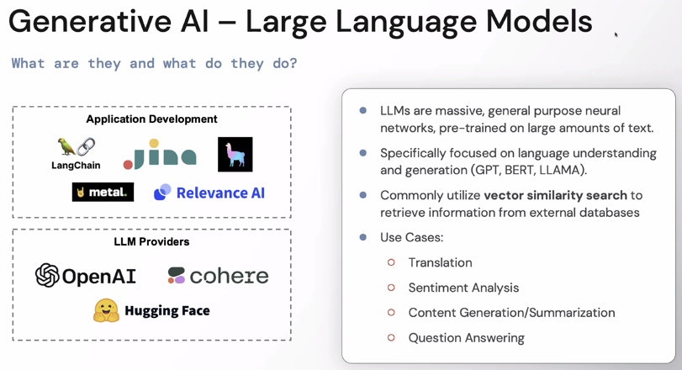
LLMs: Text In => Text Out

Slide 32
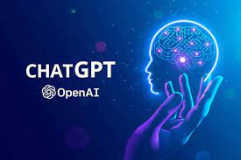
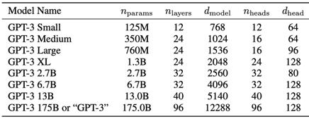
Size of OpenAI ChatGPT
GPT-3 (released in 2020) was the largest non-sparse language model in 2020
It has 175 billion parameters - and needs 700 GB of memory (4 Bytes per parameter)
You would need at least five 80Gb Nvidia A100 GPUs just to load the model and text
GPT-3 was trained on 45 TB of data (books, wikipedia, internet archive, GitHub, NYTimes, Web crawls, Google Patents, etc.)
ChatGPT-4 - size is not publicly known, but it is probably about the same as GPT-3. It has multiple improvements, but most importantly it was designed not for research, but as a business product - to be safe and not biased
LLaMA (Large Language Model Meta AI)
from Facebook - 65 Bln parameters
MT-NLG (The Megatron-Turing Natural Language Generation) model by NVIDIA & Microsoft - 530 Bln parameters

Slide 33
Recent Developments
Google:
Bard - Google's experimental, conversational, AI chat service https://bard.google.com
AI in Google Workspace - "Collaborative Partner" https://workspace.google.com/blog/product-announcements/generative-ai
Microsoft:
New Bing - AI Chat in Bing https://www.bing.com/new
Microsoft 365 Copilot - AI in Microsoft Office - https://blogs.microsoft.com/blog/2023/03/16/introducing-microsoft-365-copilot-your-copilot-for-work/
GitHub Copilot https://github.com/features/copilot
Nvidia:
Conversational AI https://www.nvidia.com/en-us/deep-learning-ai/solutions/conversational-ai/

Slide 34
What AI (ChatGPT) can do today
ChatGPT knows a lot of facts. It can answer questions and explain terms and concepts. It is a good encyclopedia, a good tutor.
ChatGPT is not always correct. It may be correct only 80% of the time. But so are most of other sources of information.
ChatGPT usually gives you the most common answer, which may be wrong, because there are many common misconceptions. Be careful.
ChatGPT may give you biased or politicized answers.
ChatGPT helps with doing simple technical tasks including software, writing, planning, research, graphics, formatting. Lawyers can ask it about existing laws on a subject. Software engineer can ask to recommend tools and libraries to solve specific problem.
ChatGPT can be easily confused trying to solve real-life problem. It is still not a good substitute for a human.

Slide 35
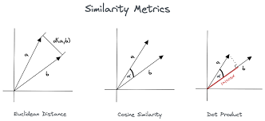
Approximate Analysis
Similarity Search
Vector Databases
Embedding Vectors
Similarity Search
Data

Slide 36
Vector Databases
The exponential growth of vector embeddings in NLP, computer vision, Generative AI and other AI applications has resulted in the emergence of vector databases
Vector Databases are used to store and query vector embeddings.
For example, they can find vectors similar to a given vector
They offer features typical for databases: Data management (inserting, deleting, updating), metadata storage, scalability, real-time updates, backups, easy integration into ETL systems, data security and access control
A vector database uses pipelines of different algorithms (vector indexing, hashing, quantization, graph-based search, ...) to do an Approximate Nearest Neighbor (ANN) search. This is area of active research!
Similarity measures: Cosine similarity (-1..1), Euclidean distance (0..∞), Dot product (-∞ .. ∞)
Since the vector database provides approximate results, the main trade-offs are between accuracy and speed
Here is a good article explaining different algorithms: https://www.pinecone.io/learn/vector-database/
Here is a list of some vector databases (2023) https://sourceforge.net/software/vector-databases/
Here is a nice short video: https://www.youtube.com/watch?v=dN0lsF2cvm4
Vector Databases:
Pinecone
Weaviate
Chroma
Redis Vector Database
Qdrant
Milvus Project
Vespa.ai
More:
Zilliz Cloud
Nomic Atlas
Vald
pgvector
Faiss
Metal
MyScale
Deep Lake
Supabase
Embeddinghub

Slide 37
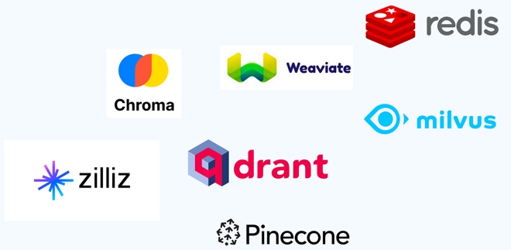

Some Vector Databases

Slide 38

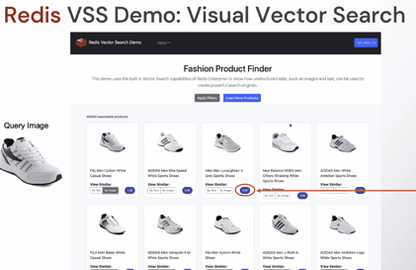
Example: search by image using Redis Vector Database

Slide 39
Dangers of AI

Slide 40
Open Letter: pause AI for at least 6 months
Open letter (March 22, 2023)
https://futureoflife.org/open-letter/pause-giant-ai-experiments/
Tech luminaries, renowned scientists, and Elon Musk warn of an “out-of-control race” to develop and deploy ever-more-powerful AI systems.
AN open letter signed by hundreds of prominent artificial intelligence experts, tech entrepreneurs, and scientists calls for a pause on the development and testing of AI technologies more powerful than OpenAI’s language model GPT-4 so that the risks it may pose can be properly studied.
It warns that language models like GPT-4 can already compete with humans at a growing range of tasks and could be used to automate jobs and spread misinformation. The letter also raises the distant prospect of AI systems that could replace humans and remake civilization.
Very good video by Yann LeCun and Andrew Ng (April 7, 2023):
https://www.youtube.com/watch?v=BY9KV8uCtj4
They explain "Why the 6-month AI Pause is a Bad Idea". They say that it is important to regulate the products, but they don't agree with stopping the research

Slide 41
Open Letter - full text
Therefore, we call on all AI labs to immediately pause for at least 6 months the training of AI systems more powerful than GPT-4. This pause should be public and verifiable, and include all key actors. If such a pause cannot be enacted quickly, governments should step in and institute a moratorium.
AI labs and independent experts should use this pause to jointly develop and implement a set of shared safety protocols for advanced AI design and development that are rigorously audited and overseen by independent outside experts. These protocols should ensure that systems adhering to them are safe beyond a reasonable doubt.[4] This does not mean a pause on AI development in general, merely a stepping back from the dangerous race to ever-larger unpredictable black-box models with emergent capabilities.
AI research and development should be refocused on making today's powerful, state-of-the-art systems more accurate, safe, interpretable, transparent, robust, aligned, trustworthy, and loyal.
In parallel, AI developers must work with policymakers to dramatically accelerate development of robust AI governance systems. These should at a minimum include: new and capable regulatory authorities dedicated to AI; oversight and tracking of highly capable AI systems and large pools of computational capability; provenance and watermarking systems to help distinguish real from synthetic and to track model leaks; a robust auditing and certification ecosystem; liability for AI-caused harm; robust public funding for technical AI safety research; and well-resourced institutions for coping with the dramatic economic and political disruptions (especially to democracy) that AI will cause.
Humanity can enjoy a flourishing future with AI. Having succeeded in creating powerful AI systems, we can now enjoy an "AI summer" in which we reap the rewards, engineer these systems for the clear benefit of all, and give society a chance to adapt. Society has hit pause on other technologies with potentially catastrophic effects on society.[5] We can do so here. Let's enjoy a long AI summer, not rush unprepared into a fall.
March 22, 2023
AI systems with human-competitive intelligence can pose profound risks to society and humanity, as shown by extensive research[1] and acknowledged by top AI labs.[2] As stated in the widely-endorsed Asilomar AI Principles, Advanced AI could represent a profound change in the history of life on Earth, and should be planned for and managed with commensurate care and resources. Unfortunately, this level of planning and management is not happening, even though recent months have seen AI labs locked in an out-of-control race to develop and deploy ever more powerful digital minds that no one – not even their creators – can understand, predict, or reliably control.
Contemporary AI systems are now becoming human-competitive at general tasks,[3] and we must ask ourselves: Should we let machines flood our information channels with propaganda and untruth? Should we automate away all the jobs, including the fulfilling ones? Should we develop nonhuman minds that might eventually outnumber, outsmart, obsolete and replace us? Should we risk loss of control of our civilization? Such decisions must not be delegated to unelected tech leaders. Powerful AI systems should be developed only once we are confident that their effects will be positive and their risks will be manageable. This confidence must be well justified and increase with the magnitude of a system's potential effects. OpenAI's recent statement regarding artificial general intelligence, states that "At some point, it may be important to get independent review before starting to train future systems, and for the most advanced efforts to agree to limit the rate of growth of compute used for creating new models." We agree. That point is now.

Slide 42
Example of LLM Usage - Writing
Writing plans, outlines, summaries, legal contracts, lists of topics, posts, articles, books
For example, we want to write a book.
We ask ChatGPT to give us 10 titles, then we select a title.
Then we ask ChatGPT to give us 10 chapters for this title.
Then for each of those 10 chapters we ask for 10 topics.
So we have 100 topics.
Now we ask ChatGPT to write 1 page for each topic.
And voila - we have 100-page book!
Great feature of ChatGPT that it can write text, and then you can direct it to improve it over and over again
The trick is to include a request for ChatGPT to generate a hierarchical table of contents before providing the answer.
This causes the AI to carefully analyze the structure of the issue at hand and organize its thoughts in a logical manner, much like a human writer would create an outline to plan and organize their ideas before composing an essay or speech.
You can ask ChatGPT
to write for different ages
using language of different complexity
in style of known authors
write poems

Slide 43
Example of LLM Usage - Software
"If you don't learn these new tools (ChatGPT, ...) - you will not be able to compete with other developers"
Best practices for prompt engineering with OpenAI API
https://help.openai.com/en/articles/6654000-best-practices-for-prompt-engineering-with-openai-api
OpenAI and Andrew Ng Just Released a FREE ChatGPT Prompt Engineering Course
https://artificialcorner.com/openai-and-andrew-ng-just-released-a-free-chatgpt-prompt-engineering-course-b0884c03e946
https://artificialcorner.com/4-free-prompt-engineering-courses-to-join-the-top-1-of-chatgpt-users-bceca39f17e4
"Fastest growing programming language in 2023 is ... English.
It is actually human language"
"Prompt engineering"
Using ChatGPT3 as a Data Engineer .. https://medium.com/@menon.ab/using-chatgpt3-as-a-data-engineer-913f9d5d9c7e .. Building boilerplate code .. Add comments to your code .. Debug basic errors on your scripts
.. Convert code from one language to another
.. Create flow chart of the process/code

Slide 44
"How I Save Over 5 Hours Every Week Using ChatGPT as a Data Scientist"
https://levelup.gitconnected.com/how-i-save-over-5-hours-every-week-using-chatgpt-as-a-data-scientist-715fb5fd68d
1. Visualizations
2. Conversions to Other Languages From Python
3. Code Summarization
4. Optimization of Code
5. Generate README.md
6. Creating Regex
7. Refactor Code
8. Code Comments

Slide 45
AutoGPT - Automate Using GPT APIs
AutoGPT is Taking Over the Internet: Here Are the Incredible Use Cases That Will Blow Your Mind
https://levelup.gitconnected.com/autogpt-is-taking-over-the-internet-here-are-the-incredible-use-cases-that-will-blow-your-mind-ac31ea94e06e
AutoGPT can act as an intelligent intern that works for you!
Can browse the web to discover the next upcoming event and invent a unique and original recipe
AutoGPT can do AI-Powered Research
It can build a website in just 3 minutes
Can automate your work on Discord with AI agents
Can automate your podcast creation with AutoGPT

Slide 46
Some Hidden Gems
Transform your life with these ChatGPT’s hidden gems
https://artificialcorner.com/i-used-chatgpt-every-day-for-5-months-here-are-some-hidden-gems-that-will-change-your-life-a451e2093097
Use ChatGPT as your private teacher
Ask ChatGPT for advice (life, health)
Scan and Describe Images with ChatGPT (put image on the web - and then give its URL to ChatGPT - and ask it to describe this image for you)
Summarize articles, papers and posts (you can provide text or a link to the text)

Slide 47
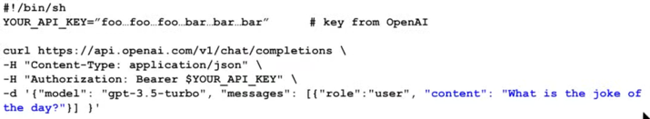
GPT Automation with Python API
A Simple Guide to The (New) ChatGPT API with Python .. https://medium.com/geekculture/a-simple-guide-to-chatgpt-api-with-python-c147985ae28 .. https://www.youtube.com/watch?v=XxIfSkkyAaQ
https://beebom.com/how-build-own-ai-chatbot-with-chatgpt-api/amp/
Auto-GPT: https://artificialcorner.com/how-to-easily-install-auto-gpt-the-autonomous-gpt-4-everyone-is-talking-about-5a0ee4e1f39e
https://platform.openai.com/docs/introduction
How to Build Your Own AI Chatbot With ChatGPT API: A Step-by-Step Tutorial: .. https://beebom.com/how-build-own-ai-chatbot-with-chatgpt-api/amp/

Slide 48

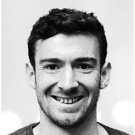

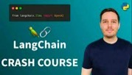
LangChain
LangChain is a software development framework designed to simplify the creation of applications using large language models
.. https://en.wikipedia.org/wiki/LangChain
.. https://github.com/hwchase17/langchain
.. https://langchain.com
.. https://python.langchain.com
First released in October 2022
Created by Harrison Chase
Written in Python and JavaScript
Harrison Chase
Co-Founder & CEO
Multiple YouTube tutorials

Slide 49
ChatPDF
Model reads and parses PDF, and then can summarize, answer your questions, etc.
https://github.com/Anil-matcha/ChatPDF
https://www.chatpdf.com
https://pdf.ai

Slide 50
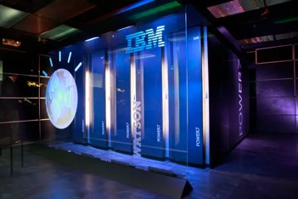




Modern Foundation Models Moved into Clouds
IBM Watson in 2011:
was running on IBM mainframe computer.
was named after IBM's first CEO, Thomas J. Watson
competed and won on the Jeopardy! quiz show in 2011
IBM Watson uses ML, NLP, and other techniques to understand natural language questions and content, and to give answers based on large amounts of data.
Nowadays Models Live in Clouds

Slide 51
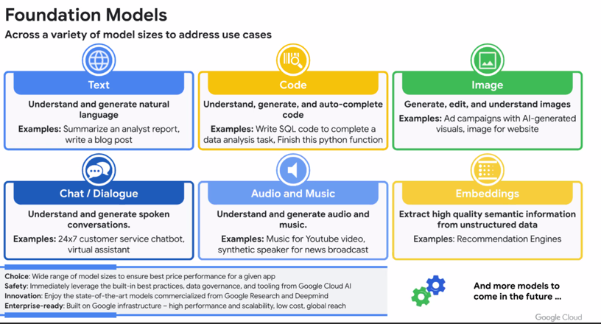
At Google

Slide 52
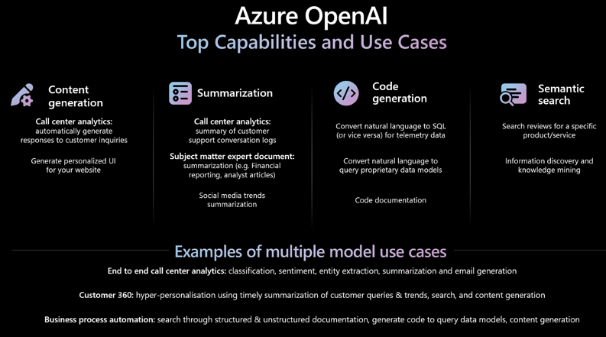
Azure OpenAI Top Capabilities and Use Cases

Slide 53
Example - Automated Money Machines
Just search Google you YouTube for how to make money with ChatGPT
Possibilities are endless.
You can create and sell products ( books, reviews and summaries, music, plans, contracts, ...)
find - and recommend and sell bestsellers, save money on consulting and software, etc. etc.

Slide 54
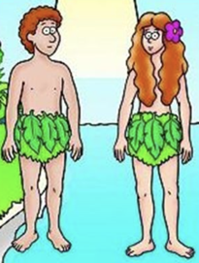
AI Models are Getting Better Fast
And they will develop even faster because we can ask AI to:
design new AI architectures
train them, improve them
select the best by competing against each other
God has created Adam as an Intelligent Being.
And gave him the Free Will.
Do we want to copy the God's parth and give AI the Free Will ?

Slide 55
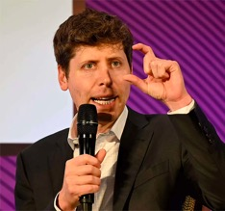
Intelligence as a Fundamental Property of Matter ...
I grew up implicitly thinking that intelligence was this, like really special human thing and kind of somewhat magical.
And I now think that it's sort of a fundamental property of matter ...
The history of scientific discovery is that humans are less and less at the center. We used to think that Sun rotates around us, and that we are the center of the Galaxy ...
Even if, like, humans aren't special in terms of intelligence, we are incredibly important. We are on an exponential curve, truly ... we have an algo that can genuinely and truly learn, ... and it gets predictably better with scale.
The rate of progress in coming years is going to be significant.
Sam Altman OpenAI CEO and co-founder

Slide 56
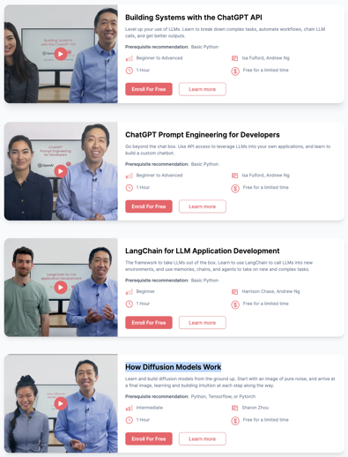
Learn Generative AI
Short Courses from DeepLearning.AI
Building Systems with the ChatGPT API
ChatGPT Prompt Engineering for Developers
LangChain for LLM Application Development
How Diffusion Models Work
https://www.deeplearning.ai/short-courses/

Slide 57
Generative AI "Themes" Today
Automation - decision-making systems and workflow optimization. Example - Tesla self-driving technology; Salesforce - CRM workflows automation.
Content creation - music, text, art. Example - Adobe Photoshop and Adobe Experience Manager tools; Roblox, Tencent, and Unity Software U are collaborating to create highly realistic virtual characters that can be used in video games, virtual reality, and other contexts.
Personalization - personalize user experiences (content moderation, digital assistants, recommender systems, etc.). Examples - Netflix and Spotify recommendations; Meta - content moderation.
Generative design - create tools that generate designs, models, and prototypes for applications including architecture and graphic design. Example - Siemens - industrial automation; Autodesk - optimizing structural design for strength and efficiency; Hitachi - optimizing manufacturing and supply chains.
Platform and solutions - building platforms, interfaces, and solutions that other businesses can use to create their own applications and products. Alphabet, Microsoft, and Nvidia NVDA (LLMs). Darktrace - building threat-prevention solutions that enable fair usage of Generative AI.

Slide 58
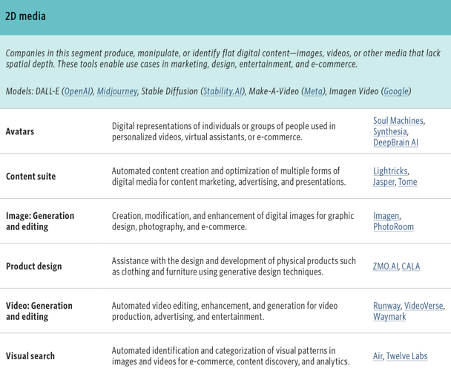
2D media
Avatars
Content Suite
Image: Generation and editing
Product Design
Video - Generation and Editing
Visual Search
3D media
Avatars and NPCs
Object Synthesis
Product Synthesis
Space Synthesis
Code
Assistant
Documentation
Web app building
Vertical Applications
Health tech
Prop tech
Legal tech
Infosec
HR tech

Slide 59
Examples of AI-based Apps & Services
Translating languages (websites, PDFs, emails, posts, etc.) - can help a business to reach a wider audience and to make their work more accessible to people from all over the world. Expected 10-20% increase in business. Nonpofits may be eligible to sign up for the Google Translate Website Translator shortcut https://support.google.com/translate/answer/2534559 - this tool translates web content into over 100 languages. There are many other tools and APIs
Generating content - LLMs can be used to generate content for a variety of purposes, such as blog posts, social media posts, videos, educational materials, infographics, interactive learning tools, and fundraising materials. This can help to save time and money, and to produce high-quality content that is more likely to engage target audience. Expected 10-20% increase in business
Communicating with clients in a clear and concise way - can help to build trust and rapport with clients
Personalizing communications with clients/donors (email, direct mail). This may increase responsiveness by at least 10-20%
Answering questions - provide better customer service, and to build relationships
Automating tasks - data entry, invoice processing, expense reporting, and CRM - can free up staff time to focus on other activities
Predicting future revenues/donations - can be used for more targeted and personalized marketing
Identifying trends (financial) - help accountants to make better decisions about investments, budgeting, and risk management
Researching topics - can help the organization to make better decisions, and to develop more effective programs and services
Generating reports tailored to the specific needs, saving time and improve the accuracy of reports
Staying up-to-date on regulations (accounting, legal) - helps to avoid costly mistakes

Slide 60
Examples of AI Usage by Nonprofits
American Red Cross used an LLM to generate personalized emails for donors. This resulted in a 20% increase in donations
World Wildlife Fund used an LLM to create an interactive learning tool about climate change. These engaging videos have been viewed over 10 million times and have generated over $1 million in donations
United Nations used an LLM to translate its website into over 60 languages - made it more accessible
United Nations used generative AI to predict future donations, to target donors with more personalized communications, and to develop more effective fundraising strategies. As a result, the UN was able to increase its annual budget by 10%.
Deloitte used an LLM to automate the process of data entry for expense reports. This saved the company $1 million per year.
KPMG used an LLM to identify trends in financial data, thus making better decisions about investments and risk management
PwC used an LLM to generate reports that were tailored to the specific needs of its clients
EY used an LLM to communicate with clients in a clear and concise way - building trust and rapport with its clients
Grant Thornton used an LLM to stay up-to-date on changes in accounting regulations to avoid costly mistakes
Botkeeper uses generative AI to automate the process of data entry for it clients
BlackLine uses generative AI to identify trends in financial data (used in investments and risk management)
Workiva uses generative AI to generate reports that are tailored to the specific needs of its clients
Xero uses generative AI to communicate with clients in a clear and concise way - building trust and rapport with its clients
Thomson Reuters uses generative AI to stay up-to-date on changes in accounting regulations - avoiding costly mistakes

