Slide 1
What is Cryptocurrency ?
Why you need to know about Cryptocurrency?
Crypto-currencies - growth
Criticism of Crypto
Crypto-currencies vs Central banks currencies
Bitcoin history
Electricity usage
Look into the future

Slide 2
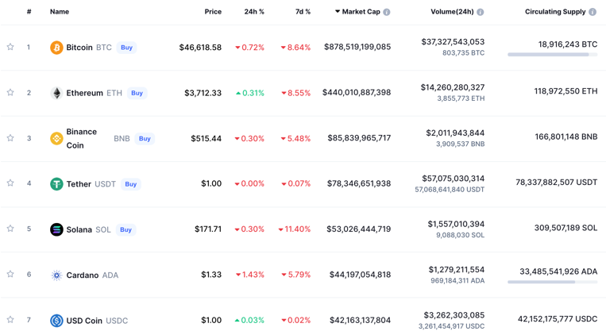
As of the end of 2021 there are approx 8,000 crypto-currencies
- https://coinmarketcap.com

Slide 3
Top 25 Cryptocurrencies as of mid-February, 2022
 | Name | Market Cap
1 | BTC = Bitcoin | $761,038,243,091
2 | ETH = Ethereum | $334,141,565,566
3 | USDT = Tether | $78,738,030,288
4 | BNB = BNB | $65,864,119,793
5 | USDC = USD Coin | $52,494,970,088
6 | XRP = XRP | $36,922,069,357
7 | ADA = Cardano | $33,850,389,831
8 | SOL = Solana | $28,991,691,641
9 | AVAX = Avalanche | $20,896,330,175
10 | LUNA = Terra | $19,861,982,821
11 | DOGE = Dogecoin | $18,447,068,758
12 | BUSD = Binance USD | $18,185,409,339
13 | DOT = Polkadot | $17,719,838,307
14 | SHIB = Shiba Inu | $15,511,500,430
15 | MATIC = Polygon | $12,169,172,624
16 | UST = TerraUSD | $11,947,612,991
17 | CRO = Crypto.com Coin | $11,053,395,927
18 | WBTC = Wrapped Bitcoin | $10,533,626,439
19 | DAI = Dai | $10,197,240,111
20 | LTC = Litecoin | $8,130,543,341
21 | ATOM = Cosmos | $7,833,196,168
22 | LINK = Chainlink | $7,161,689,625
23 | NEAR = NEAR Protocol | $6,574,018,803
24 | UNI = Uniswap | $6,496,617,082
25 | TRX = TRON | $6,423,796,753

Slide 4
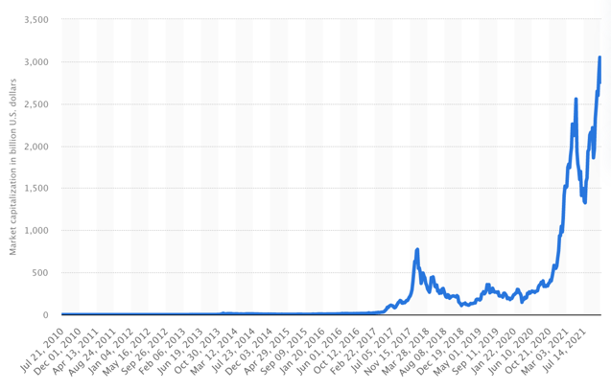
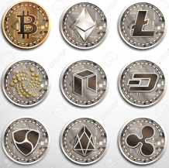
In 2021 total crypto market was worth more than 3 Trillion dollars
https://www.statista.com/statistics/730876/cryptocurrency-maket-value/

Slide 5
Criticism of Crypto
Proof of Stake Validation makes Crypto faster than VISA – and takes little electricity:
Cardano
Solana
Algorand
Ethereum
Cryptocurrencies failed at their main design intent of creating a distributed anonymous currency not controlable by any government. Nowadays every crypto transaction is a taxable event in US (similar to trading stocks or bonds)
Crypto networks consume ~ 1% of planet's electricity and cause electronic chips shortages (this is being fixed by "proof of stake")
Crypto networks are slow (being fixed by "proof of stake" and layer-2 networks)
Crypto caused lots of fraud and criminal activity
Crypto is very volatile
Some countries prohibit crypto (like China)
Billionaire John Paulson Calls Crypto "A Limited Supply of Nothing"
Billionaire Warren Buffet advises against it as well: “It does not meet the test of a currency, ... it is not a durable means of exchange, it's not a store of value.”
""" The world has never been fond of crypto. Famous economists have called it a Ponzi scheme, notable investors have called it “rat poison squared,” the Fed president described it as a “giant garbage dumpster,” and governments around the world have banned, financially strangled and booted out crypto companies. """
Total TPS (Transactions Per Second):
Solana: 65,000
Ethereum: 20 (will be 100,000)
Cardano – 250 (will be Millions)
Visa: 24,000
Algorand: 1,300
Ripple: 1,500
PayPal: 193
Bitcoin Cash: 60
Litecoin: 56
Dash: 48
Bitcoin: 7 (slow!!)
https://www.fool.com/investing/2018/01/14/which-cryptocurrencies-have-the-fastest-transactio.aspx -

Slide 6
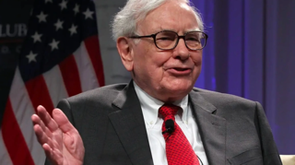
But ...
Years after calling Bitcoin "rat poison", Warren Buffett just invested $1 Billion in a crypto-friendly bank. February 2022
https://fortune.com/2022/02/16/warren-buffett-invested-1-billion-crypto-bank/

Slide 7
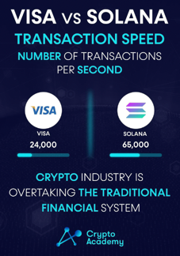
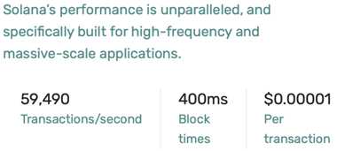
Revolution in Cryptocurrencies
Shifting validation from "proof-of-work" to "proof-of-stake"
increases speed of crypto-transactions x1000s times
(Etherium 2.0 projected speed ~ 100,000 transactions/sec),
and correspondingly decreases transaction fees to small fractions of a cent.
Fast speed and low transaction costs is already a reality for some networks, like, for example, Solana:

Slide 8
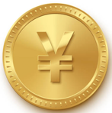


China - Digital Yuan
China has released the new digital yuan app , e-CNY, for iOS and Android.
It is NOT a decentralized cryptocurrency
It does NOT operate on a blockchain
It is controlled and issued by the China's central bank – PBOC (The People’s Bank of China). It was developed since 2014
It is designed to replace the cash and coins already in circulation
China is pushing for broader use of its digital currency
China is way ahead of its global peers. The US Federal Reserve is only discussing the idea of issuing a U.S. digital currency similar to China's CBDC (Central Bank Digital Currency)
The two dominant payment systems in China are:
Tencent’s WeChat Pay anounced support of digital yuan for its morethan a Billion WeChat users
Alipay (Alibaba) is also a partner for the digital yuan.

Slide 9
Central banks strike back against crypto
with their own digital currencies.
Almost 100 countries are actively investigating launching their own digital currency, according to the IMF (Inernational Monetary Fund).
If you can’t beat them, copy them. Some central banks have decided to create crypto competitors that they control. The value of this CBDC (Central Bank-controlled Digital Currency) mirrors the price of its physical equivalent.
CBDC is not similar to cryptocurrencies like Bitcoin and Ethereum, which are distributed (not centrally-controlled) and whose values aren’t pegged to any fiat currency (thus can swing wildly).
Benefits of CBDCs could include letting people without bank accounts use digital payments, and giving central banks a lower-cost alternative to cash for providing a national payment method.

Slide 10
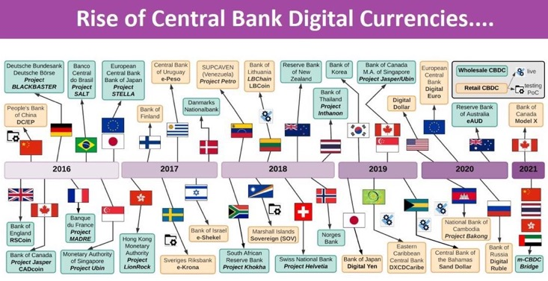
When USA Government will get into Crypto?
As of 2022, there are only discussions of launching a "Digital Dollar" in the USA:
- https://www.investopedia.com/fed-to-release-paper-exploring-launch-of-digital-dollar-5204490

Slide 11
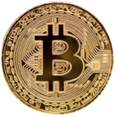
Cryptocurrency - History
A cryptocurrency is a digital asset designed to work as a medium of exchange (currency) that uses cryptography to secure its transactions, to control the creation of additional units, and to verify the transfer of assets.
The first widely successful and well known cryptocurrency is Bitcoin developed in 2007-2009 by Satoshi Nakamoto (a person or a group).
Before Bitcoin:
Digicash (David Chaum, 1989-1998, electronic anonymous crypto money)
Hashcash (Adam Back, 1997, a proof-of-work system used to limit email spam and denial-of-service attacks, later has become a part of bitcoin mining algorithm)
B-Money (1998, Wei Dai, anonymous, distributed electronic cash system)
Bit Gold (1998, Nick Szabo, decentralized, blockchain)
E-gold (1996-2009) - digital gold currency, was incorporated on one of Caribbean Islands, in 2006 was processing more than $2 Bln worth of transactions per year, grown to 5 Mln accounts by 2009, was shut down due to legal issues (under US Patriot Act)
Bitcoin, 2009

Slide 12
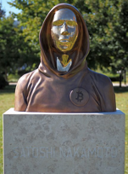
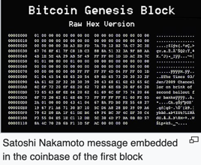
Bitcoin History
Satoshi Nakamoto is the name of a person(s) who invented blockchain and created bitcoin. Nobody knows his/theirs true identity.
- https://blog.bitstamp.net/post/who-is-satoshi-nakamoto –
- https://en.wikipedia.org/wiki/Satoshi_Nakamoto -
2007 - the work has begun
2008 - domain bitcoin.org
2008 October - whitepaper on metzdowd.com "Bitcoin: A Peer-to-Peer Electronic Cash System"
2009 January - Bitcoin software released on SourceForge, network launched with the block #0 with 50 bitcoins reward
On 17 Mar 2010 bitcoinmarket.com starts operating
On 22 May 2010, Laszlo Hanyecz made the first real-world transaction by buying two pizzas in Jacksonville, Florida for 10,000 BTC
2010 - Nakamoto released control to Gavin Andresen and other members of bitcoin community
2011 April – Nakamoto wrote "I’ve moved on to other things…" and disappeared
Nakamoto owns between 750-1,100K bitcoin (~$73 Bln in Nov 2021).

Slide 13
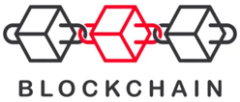
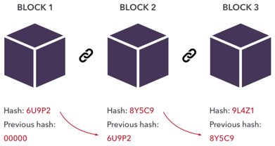
Blockchain
"Blockchain is a system of recording information
in a way that makes it difficult or impossible
to change, hack, or cheat the system.
A blockchain is essentially a digital ledger of transactions
that is duplicated and distributed across the entire network
of computer systems on the blockchain."
BCT = Block Chain Technology
DLT = Distributed Ledger Technology
GitHub:
Bitcoin (C++ mostly):
https://github.com/bitcoin
Simple blockchain in python:
https://github.com/dvf/blockchain
Ethereum in Golang:
https://github.com/ethereum/go-ethereum
https://github.com/ripple -

Slide 14
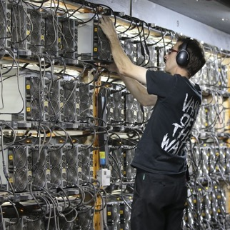
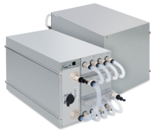
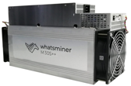
Blockchain mining hardware
Crypto networks consume ~ 1% of planet's electricity and cause electronic chips shortages. This is being fixed by switching to "proof of stake" consensus mechanism.
ASIC = Application-Specific Integrated Circuit.
Your regular computer can calculate at speeds ~ 2 Kilo-hashes per second.
The specialized devices (an ASIC bitcoin miner) - will do 200 Terahashes per second (1 Terahash = 1 trillion hashes) while consuming 5.5KWatts of electricity.
Bitmain, one of the world’s largest bitcoin mining rig manufacturers, has launched the Antminer S19 Pro+ Hyd.
This new mining machine will have a hashrate of 198 TH/s (Tera-Hash/sec) and consume 5.5 KW. It uses liquid cooling.

Slide 15
What is Next
Bitcoin launched in 2009
Ethereum went live in 2015
Currently (2022) there are tens of independent blockchains / networks and tens of thousands of coins/tokens
There are multiple centralized and decentralized crypto exchanges
There are 100+ types of wallets
Modern networks are "green" - use Proof-of-Stake or other methods to reduce electricity usage
There are multiple "layer-2" technologies allowing fast, cheap, and "green" transactions
Decentralized "Liquidity Pools" can be used as investment and allow cross-chain transactions
Stable coins serve as buffered crypto currencies (to reduce volatility)
Algorithm-backed stable coins serve as central banks (injecting coins into platforms as needed)
Futures and other derivatives instruments exists on top of crypto
Decentralized Finance (DeFi) slowly takes over all banking functions (saving, transfering, paying, investing, lending)

