Slide 1
Thousands of Crypto-Currencies
Coins and Tokens
Solana
Cardano
Uniswap Protocol
NFT = Non-fungible token
Stable Coins
Bitcoin Cash, Bitcoin SV
Avalanche, AVAX
Helium
Dogecoin
Monero
Million token
...

Slide 2

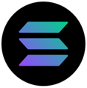
Solana
blockchain platform – using Proof of Stake, written in Rust
Solana is a public blockchain platform
Very fast: 50,000/sec (vs 15 ETH or 7 BTC)
Very cheap: 0.00025 per transaction (vs $2-$50 for ETH,BTC)
Initial – 2019, growing very fast
Written in Rust, developer friendly
It achieves consensus using the proof of stake mechanism.
Its internal cryptocurrency is SOL (Symbol: ◎)
Developer(s): Solana Labs & Solana Foundation
In 2021, Bloomberg journalist Joanna Ossinger described Solana as "a potential long-term rival for Ethereum", citing superior transaction speeds and lower associated costs.
https://en.wikipedia.org/wiki/Solana_(blockchain_platform)
https://whitepaper.io/document/602/solana-whitepaper
https://solana.com –
https://www.youtube.com/watch?v=knBQXU7fetA – 3 min
Market cap: $46B (September 2021)
Circulating supply: 308,704,493.99 SOL (as 24th Dec 2021)
Exchange rate: US$203 (October 2021)
Anatoly Yakovenko
San Francisco Bay Area
anatoly@solana.io
https://www.linkedin.com/in/anatoly-yakovenko/
 | Solana | Ethereum
transactions per sec | 50,000 | 15
cost per transaction | $0.00025 | $70

Slide 3

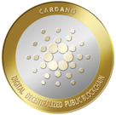
Cardano
Blockchain platform – using Proof of Stake, written in Haskell
Cordano is a public blockchain platform, smart contracts
Fast: 250 /sec (it will be Millions)
Relatively cheap: $0.4 per transaction (will be much lower soon)
Initial – 2017, growing very fast
Written in Haskell, developer friendly
It achieves consensus using the PoS (Proof of Stake) mechanism
Its internal cryptocurrency is ADA
Developer(s): Charles Hoskinson, Ethereum co-founder
Cordano is named after famous italian scientist Gerolamo Cardano (1501-1576)
ADA is named after Ada Lovelace (1815-1852) - English mathematician and writer
Charles Hoskinson
Colorado,
Cardano Foundation based in Switzerland.

Slide 4


Uniswap Protocol
https://uniswap.org/
https://github.com/Uniswap/v3-core
Uniswap (2018) is a decentralized open source finance protocol that is used to exchange cryptocurrencies on Ethereum blockchain. Written in Solidity.
Uniswap is also the name of the company that initially built the Uniswap protocol.
The Uniswap protocol facilitates automated transactions between cryptocurrency tokens on the Ethereum blockchain through the use of smart contracts.
As of October 2020, Uniswap was estimated to be the largest decentralized exchange and the fourth-largest cryptocurrency exchange overall by daily trading volume
Uniswap has been one of the shining stars of the crypto market. Investors are looking to buy UNI due to its impressive performance.
Hayden Adams
Inventor of Uniswap Protocol
CEO at Uniswap Labs
New York
https://www.linkedin.com/in/haydenadams/

Slide 5
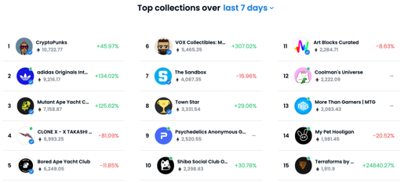


NFT = Non-fungible token
https://en.wikipedia.org/wiki/Non-fungible_token
NFTs can be sold or bought on many crypto market places https://www.fool.com/investing/stock-market/market-sectors/financials/non-fungible-tokens/nft-marketplaces/
OpenSea - https://opensea.io - first and largest. Helps to mint yor own NFTs, supports 150+ different payment tokens.
Axie Marketplace - video game Axie Infinity. Ethereum.
Larva Labs/CryptoPunks - digital art, Ethereum
NBA Top Shot Marketplace (Basketball collectibles), Flow blockchain
Rarible - similar to OpenSea, its own token Rarible built on Ethereum
SuperRare - similar to Rarible. Ethereum. New token announced
Foundation.app - use Etherium to buy/sell digital art
Nifty Gateway - the art curation platform, uses Gemini. Ethereum
Mintable - similar to OpenSea. Ethereum. Minting of NFTs
Theta Drop - video and TV, its own blockchain, Theta Token
With NFTs, artwork can be "tokenised" to create a digital certificate of ownership that can be bought and sold (sometimes for millions of $$)
NFTs are cryptographic assets on a blockchain with unique identification codes and metadata that distinguish them from each other
NFT provide a public certificate of authenticity or proof of ownership
NFT is separate from a copyright
NFT differ from crypto-currencies: there is no trading, no interchangeability (fungibility)
NFT do not restrict the sharing or copying of the underlying digital files

Slide 6
Stable Coins
- https://www.investopedia.com/terms/s/stablecoin.asp -
Stablecoins are cryptocurrencies
that attempt to peg their market value
to something external, like a currency (USD),
or commodity's price (gold), etc.
Stablecoins achieve their price stability via
either collateralization (backing)
or through algorithmic mechanisms of buying
and selling the reference asset or its derivatives
Currency | Market value
Tether / USDT | $ 73.32 billion
USD Coin / USDC | $ 34.35 billion
Binance USD / BUSD | $ 13.54 billion
Dai / DAI | $ 6.47 billion
TerraUSD / UST | $ 2.88 billion
TrueUSD / TUSD | $ 1.25 billion

Slide 7
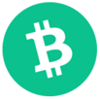
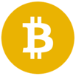
Bitcoin Cash, Bitcoin SV
https://en.wikipedia.org/wiki/Bitcoin_Cash
Bitcoin Cash:
2017 – hard fork of Bitcoin (spin-off, altcoin)
increased block size to 8 MB
faster throughput for transactions (60 tr/sec)
BCH – currency code
Bitcoin Cash
BCH
Prices (1/31/2022):
BTC – $38,300
BCH – $288
BSV - $91
Bitcoin SV:
2018 – hard fork chain split of Bitcoin Cash .. Bitcoin ABC (Adjustable Blocksize Cap) - 32 MB blocks .. Bitcoin SV (Satoshi Vision) – up to 128 MB blocks
2019 - Bitcoin SV expanded block size to 2 GBytes, enabling (theoretically) 10-15K transactions per second
The Bitcoin SV blockchain is the largest of all Bitcoin forks
Bitcoin SV
BSV

Slide 8
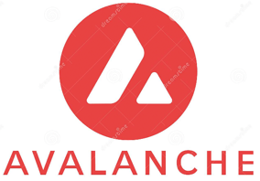

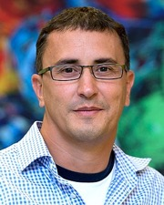
Avalanche, AVAX
https://www.avax.network
https://www.avalabs.org
Avalanche (AVAX) – since 2020 - a cryptocurrency and blockchain smart-contracts platform that rivals Ethereum
$16 Bln Market Cap (April 2022)
Avalanche is the fast – 4,500 transactions per second
Avalanche is open and open-source
Avalanche is low cost and eco-friendly
AVAX is the native token of the Avalanche blockchain
You can launch Ethereum dApps that confirm transactions instantly and process thousands of transactions per second
Deploy blockchains that fit your own application needs on your own virtual machine
Deploy subnets that allow developers to define rules that can vary from the rule of the Primary Avalanche blockchain
Stake, or lock up, your AVAX to help process transactions and further secure the platform
Emin Gün Sirer
Founder @ Ava Labs

Slide 9
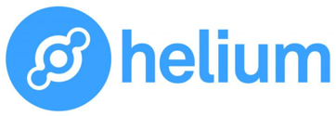
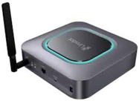
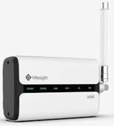
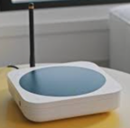
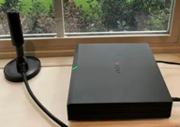
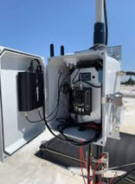
Helium
Helium provides low-cost connectivity for IoT devices (much cheaper than WiFi). Individuals can install Helium routers or, "hot spots," at their homes or offices and earn HNT (crypto token) for providing connectivity.
HNT token - the 46th-largest cryptocurrency by market cap (~3 Bln)
Helium Inc. was founded in 2013 in San Francisco, CA. It specializes in IoT, blockchain technology development, routers and networks
The Helium hot spots provide a long-range form of WiFi called LongFi that reportedly reaches 200 times farther than a traditional WiFi hot spot, or as much as 10 miles depending on environmental conditions.
In October 2021, DISH Network said it was partnering with Helium to "support open source and low-cost wireless connectivity ecosystems" and utilizing Helium to roll out 5G . The city of San Jose, California, became the first city to officially join the Helium network and will use Helium to provide internet access for low-income residents.
Helium is energy efficient. It uses "proof of coverage consensus" (essentially verifying that routers are located where they claim and that they are running and providing coverage). It uses much less energy: about five watts to run, or the equivalent of having an LED light bulb on.
One big risk – ISPs (internet service providers) may prohibit their customers from using Helium hot spots because reselling their bandwidth could violate their terms of service.

Slide 10
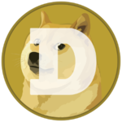
Dogecoin
https://en.wikipedia.org/wiki/Dogecoin -
https://dogecoin.com -
https://www.reddit.com/r/dogecoin/ -
Dogecoin - cryptocurrency created as a joke in 2013
started growing via online community (Reddit, ...)
Market cap $85 Billion in 2021
authors - Billy Markus and Jackson Palmer
known as a "meme coin" or "dog coin"
(Shiba Inu dog from the "Doge" meme)

Slide 11
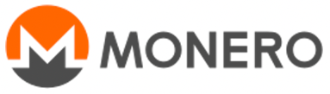
Monero
https://www.getmonero.org
https://en.wikipedia.org/wiki/Monero
Monero is a private, decentralized cryptocurrency.
Monero uses a public distributed ledger with privacy-enhancing technologies that obfuscate transactions to achieve anonymity and fungibility.
Observers cannot decipher addresses trading monero, transaction amounts, address balances, or transaction histories.
2013 – original paper by Nicolas van Saberhagen (CryptoNote)
2014 – Monero mainnet deployed
Monero uses ring signatures, zero-knowledge proofs, "stealth addresses", and IP address obscuring methods to obfuscate transaction details
Transactions are validated through a miner network running RandomX, a proof of work algorithm. The algorithm issues new coins to miners, and was designed to be resistant to ASIC mining
Monero has the third largest developer community among cryptocurrencies, behind bitcoin and Ethereum
Its privacy features have attracted cypherpunks and users desiring privacy measures not provided in other cryptocurrencies. It is increasingly used in illicit activities such as money laundering, darknet markets, ransomware, and cryptojacking. The United States Internal Revenue Service has posted bounties for contractors that can develop monero tracing technologies

Slide 12
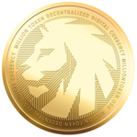
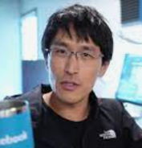
Million token
https://www.milliontoken.org
Million is a cryptocurrency:
limited supply of 1 Mln tokens, min $1 each
no upper bound on price
fully Web 3.0 capable
multi-chain currency supported across 6+ different blockchains
unlike first-gen memecoins (like Dogecoin or Shiba), Million is serious about supporting smart-contracts, DeFi, staking, NFTs, DAOs, Proof-of-Stake high scalability, fast transactions, and the gaming metaverse.
Decentralized Finance staking with the Million Pool, including a decentralized governance DAO for stakeholder rights
Metaverse - strong community, developer ecosystem of social media, digital art, gaming, chat spaces, avatars, and NFT metaverse
Transparency & Trust - 100% transparent with code fully audited by Certik, Million was founded by ex-Google/ex-Facebook TechLead
The Web 3.0 memecoin ("King of the Jungle of dog coins")
Patrick Shyu
TechLead
QUICKSTART GUIDE
Create a Metamask Wallet using either a desktop computer or mobile device. http://metamask.io
Send Ethereum to your wallet. You can buy Ethereum on MetaMask directly, or through sites like Coinbase, Crypto.com, or Binance and then send them to your wallet.
Connect to Uniswap and trade for Million.

