Slide 1
Crypto: buy, sell, keep, swap, convert
You can create accounts directly at multiple blockchain networks like Bitcoin, Ethereum, etc. These accounts will allow you to send messages and crypto currency between accounts. For example, person A gives dollars to person B, in exchange B sends Bitcoin to A via blockchain network. So one transaction consists of two transfers: crypto and dollars. How do we do it in practice?
How to find buyers/sellers?
How to do transactions?
How to make sure transaction fees are paid?
How to handle accounting?
Bitcoin
Ethereum
Other
Networks
Wallet
The easiest way is to link your regular bank account or credit/debit card to a crypto "wallet" at one of the existing services (or use independent wallet):
crypto brokers (like Robinhood, SoFi, etc.)
crypto exchanges (Coinbase, Gemini, Binance.US, etc.)
crypto wallets (Guarda, Exodus, Electrum, Mycelium, Coinbase, MetaMask/Ethereum, etc.)
crypto payment gateways (BitPay, COINQVEST, Coinbase, Coingate, CoinsBank, GoCoin, etc.)
Which service to choose depends on the currencies, amounts, fees, etc.
https://www.forbes.com/advisor/investing/cryptocurrency/how-to-buy-cryptocurrency/
https://www.investopedia.com/best-crypto-software-wallets-5220762
Bank ($)

Slide 2
Convert BitCoin into USD
https://icoholder.com/blog/how-to-turn-bitcoin-into-usd/
If you and your buyer know and trust each other – you can do it by yourselves. Buyer can give you money – and you can send BTC from your account to his. You need to be aware of fees on both sides
You can also use facilitating service like LocalBitcoins which lists buyers (expect 1-3 days to complete transaction) - https://localbitcoins.com/sell_bitcoins
Otherwise you can use some (big) exchange – but for additional fee 1-2% fee. For example, Coinbase Exchange - https://icoholder.com/blog/how-to-turn-bitcoin-into-usd/ , https://www.youtube.com/watch?v=60Rjdv2Z_Gg
You can also trading platforms (like Kraken). Expect more background checks and higher fees. The process also will generally take longer ( ~5 days ) - https://support.kraken.com/hc/en-us
Currency Converters – many places, faster processing - https://wealthpay.org - https://www.bestchange.com - https://www.okchanger.com
Direct Electronic Payment System – like https://www.worldcore.eu - it uses BitPay under the hood - https://bitpay.com

Slide 3
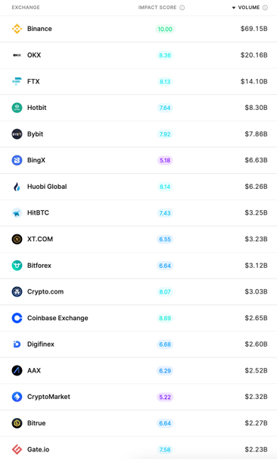
Twenty Largest Crypto Exchanges (2021)
Current List (April 2022):
https://nomics.com/exchanges
Rank | Crypto Exchange | Country/Territory | Daily Volume in $Bln
1 | Binance | Cayman Islands | 24.19
2 | Mandala Exchange (considered to be a scam) | United States | 20.77
3 | Coinsbit | Seychelles | 7.01
4 | Upbit | South Korea | 5.43
5 | OKEx | Seychelles | 4.86
6 | Huobi | Seychelles | 4.22
7 | HitBTC | British Virgin Islands | 4.08
8 | Coinbase | United States | 3.87
9 | ZT | Seychelles | 3.83
10 | BiONE | Singapore | 3.7
11 | Challengy PRO | Hong Kong | 3.68
12 | Crypto.com Exchange | Singapore | 3.1
13 | Ecxx | Singapore | 2.76
14 | IndoEx | United Kingdom | 2.62
15 | Hotcoin Global | Australia | 2.47
16 | TOKENCAN | Hong Kong | 2.38
17 | FTX | Antigua and Barbuda | 2.21
18 | Bitrue | Singapore | 2.03
19 | KuCoin | Seychelles | 1.99
20 | CoinW | Singapore | 1.88
... | ... | ... | ...
... | Binance.US | United States | 0.33

Slide 4
Crypto Exchanges (and Wallets)
Best Crypto Exchanges in 2021: - https://www.investopedia.com/best-crypto-exchanges-5071855 -
Coinbase - 89+ Mln users, 100+ countries, USA-based - https://www.coinbase.com - Transaction Fees: 0.04% to 0.50% (taker orders); 0% to 0.50% (makers orders), Wallet included. Very high liquidity, variety of coins
Binance - https://www.binance.com - Cayman Islands (Caribbean) & Seychelles (island near Africa). Hindreds of cr.currencies. Not available in US. Low fees, large variety of cryptocurrencies and trading pairs, geared for more advanced users
Binance.US - https://www.binance.us – US-regulated, 50 cryptocurrencies, not all states supported
Abra - https://www.abra.com - Mountain View, CA - operates a comprehensive, custodial cryptocurrency wallet and exchange
Cash App - https://cash.app – easy to use, peer-to-peer money transfer (like Venmo or Zelle), ability to withdraw Bitcoin, supports only one crypto-currency – the Bitcoin. has daily and weekly withdrawal limits. Charge when sending money via credit card
bisq – decentralized exchange - https://bisq.network – non-KYC platform, 18 crypto-currencies, but transaction speeds may be slow, trading volumes can be low
Kraken – Bitcoin & Crypto Exchange - https://www.kraken.com -
Gemini - https://www.gemini.com -
Robinhood - https://robinhood.com -

Slide 5
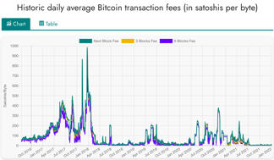
High Fees (Proof of Work)
Bitcoin
Fees are calculated in "satoshi" named after Satoshi Nakamoto, creator of bitcoin.
1 satoshi = 0.00000001 BTC = 1e-8 BTC
(Jan 2022) Estimated transaction fee $2.34 = 5,056 satoshi
https://www.btcsatoshi.com/
https://www.buybitcoinworldwide.com/fee-calculator/
https://bitcoinfees.earn.com/
https://mempool.space/
https://bitcoinbriefly.com/how-to-use-mempool-space-block-explorer/
Miners are rewarded for calculating next block
in a blockchain's mempool. The reward is calculated per the length of the record and complexity of calculation – and in values native to the blockchain.
When converting to dollars, the fees are very volatile.
Here is what Wall Street Journal says about fees in 2021:
""" On the Bitcoin network, the average daily transaction fee this year has been as low as $1.78 and as high as $62, according to bitinfocharts. On Ethereum, the average fee has been as low as $1.59 and as high as $70. """
https://www.wsj.com/articles/crypto-and-its-many-fees-what-to-know-about-the-hidden-costs-of-digital-currency-11639825202
Ethereum
https://cryptotesters.com/blog/ethereum-gas
https://automatedwebtools.com/usd-eth-gas-fee/
https://etherscan.io/
Cost of transaction is measured in "Gwei" – named after Wei Dai, best known as the creator of the bitcoin predecessor "b-money" and as the developer of the Crypto++ library.
1 gwei = 0.000000001 ether = 1/1Bln part of Ether
(Jan 2022) Estimated transaction fee $5.61 = 70 Gwei

Slide 6

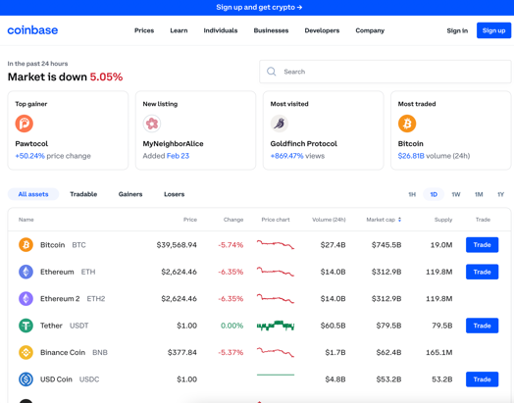
Coinbase
https://www.coinbase.com
https://en.wikipedia.org/wiki/Coinbase
buy, sell, and manage crypto
90 Mln users in 100+ countries
Public company (traded on Nasdaq)
Founded in 2012 by Brian Armstrong
1000+ employes
https://github.com/coinbase -
https://github.com/coinbase/coinbase-commerce-python -
https://github.com/coinbase/coinbase-python -
https://github.com/coinbase/coinbase-python/tree/master/coinbase/wallet
The name "coinbase" comes from so called "coinbase transactions".
The first transaction that took place in Bitcoin was not the result of a payment between two people. It was a special transaction of the genesis block that formatted reward transactions for miners.
These reward transactions are called coinbase transactions.
Each coinbase transaction is responsible for transmitting the virgin coins to the miner who has resolved the block.
Coinbase transactions are also known as generating transactions.
In a nutshell, they are the genesis of the currencies that we can handle today across the entire Bitcoin blockchain.

Slide 7


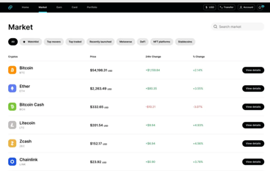
Gemini
https://www.gemini.com
https://en.wikipedia.org/wiki/Gemini_(company)
https://exchange.sandbox.gemini.com/
Gemini Trust Company, LLC (Gemini) – since 2014, New York City, 900+ employees Address: 600 3rd Avenue 2nd Floor New York, NY 10016
Cryptocurrency exchange and custodian, NFT marketplace
Buy, sell, store Bitcoin, Bitcoin Cash, Ethereum, Litecoin, Zcash, Gemini dollar
Gemini means twins - twins founders Cameron Winklevoss & Tyler Winklevoss
Gemini operates in US, Canada, UK, South Korea, Hong Kong, and Singapore.
Primary competitors include Coinbase, Binance, Bitstamp, and Kraken
All users can trade crypto and fiat currency, and transfer USD to/from bank accounts
2017 - Gemini was the first exchange to launch bitcoin futures contracts (Gemini is used by the Chicago Board Options Exchange (CBOE) as the basis for setlement)
2018 – launched stable coin Gemini dollar (GUSD) pegged to USD
2019 – Gemini bought Nifty Gateway – and NFT marketplace
Python client: - https://github.com/mtusman/gemini-python - https://pypi.org/project/gemini/
REST API, Python: - https://docs.gemini.com/rest-api/
Cameron & Tyler Winklevoss (twins)
import requests, json
base_url = "https://api.gemini.com/v1"
response = requests.get(base_url + "/trades/btcusd")
btcusd_trades = response.json()
print(btcusd_trades)

Slide 8



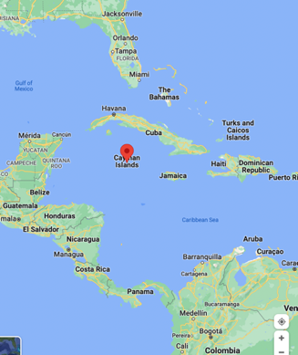
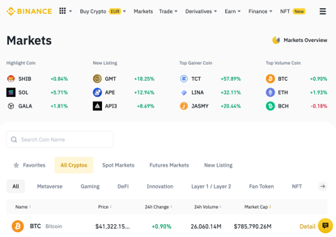
Binance
https://www.binance.com
https://www.binance.us
https://en.wikipedia.org/wiki/Binance
Buy, Sell, and Trade Cryptocurrencies
Binance - cryptocurrency exchange
World largest trading volume
Founded in 2017 by Changpeng Zhao ("CZ") & Yi He
Headquarters at Cayman Islands
Not available in the US and UK In US you can use https://www.binance.us
Python API ( pip install python-binance ) - https://docs.binance.us - https://python-binance.readthedocs.io - https://github.com/sammchardy/python-binance
Changpeng Zhao
net worth ~ $77 Bln
Yi He

Slide 9

Mandala Exchange
https://mandala.exchange/
Mandala Exchange Token – MDX
Daily volume
The latest crypto Mandala Exchange Token review suggests that the company operates illegally and without a proper financial regulatory license

Slide 10

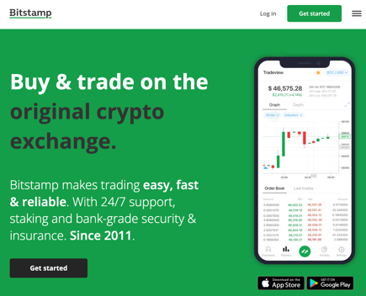
Bitstamp
https://www.bitstamp.net/
https://en.wikipedia.org/wiki/Bitstamp
https://www.bitstamp.net/api/
https://github.com/kmadac/bitstamp-python-client
Bitstamp is a cryptocurrency exchange based in Luxembourg. (London, Luxembourg, Slovenia, New York City)
Founded in 2011
It allows trading between fiat currency, bitcoin and other cryptocurrencies.
USD, EUR, GBP, bitcoin, ALGO, XRP, Ether, litecoin, bitcoin cash, XLM, Link, OMG Network, USD Coin or PAX deposits and withdrawals
# pip install BitstampClient
import bitstamp.client
public_client = bitstamp.client.Public()
print(public_client.ticker()['volume'])
trading_client = bitstamp.client.Trading(
username='999999', key='xxx', secret='xxx')
print(trading_client.account_balance()['fee'])
print(trading_client.ticker()['volume'])

Slide 11



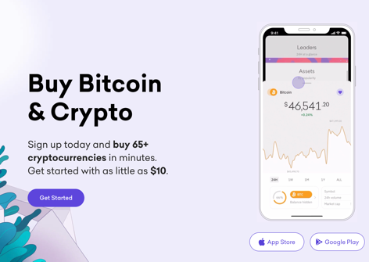
Kraken
https://www.kraken.com
https://en.wikipedia.org/wiki/Kraken_(company)
https://docs.kraken.com/rest/
https://support.kraken.com/hc/en-us/sections/360003946512-Example-API-Code
Kraken is a cryptocurrency exchange in San Francisco, CA since
Founded in 2011 by Jesse Powell
14+ Mln users, 1000+ employees,
Support for 120+ different crypto currencies including Bitcoin, Ethereum (ether), Litecoin, Namecoin, Dogecoin, Ripple, Stellar, Cardano, Polkadot, Polygon, Solana, Sushi, Uniswap
Trading can be executed between digital assets, and between digital assets and national currencies like USD, EUR, GBP, CAD and JPY
Jesse Powell
import sys, time, json, urllib.request
api_domain = "https://api.kraken.com"
# ...
api_data = "?pair=%(pair)s&since=%(since)s" % {"pair":api_symbol, "since":api_start}
api_request = urllib.request.Request(api_domain + api_path + api_method + api_data)
api_data = urllib.request.urlopen(api_request).read()
# ...
The kraken is a legendary sea monster of enormous size said to appear off the coasts of Norway.

Slide 12
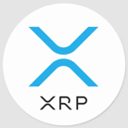

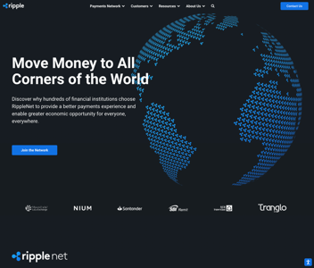




Ripple
https://en.wikipedia.org/wiki/Ripple_(payment_protocol) -
https://en.wikipedia.org/wiki/Ripple_Labs -
https://ripple.com -
https://github.com/ripple/rippled -
https://github.com/ripple/ripple-rest - REST API
https://xrpl.org/get-started-using-python.html - python
https://github.com/arsenlosenko/python-ripple-lib -
Ripple ( RippleNet ) - a real-time gross settlement system, currency exchange and remittance global network. Used by 300+ binancial institutions (banks)
XRP - native Ripple cryptocurrency, price ~ $0.76, in circulation ~48 Bln coins, traded on more than 700 markets, daily trade volume ~ $2 Bln
XRP transactions are confirmed in seconds with little cost
Ripple created by Ripple Labs Inc. (San Francisco, New York), ~ 670 employees
Ripple released in 2012
Ripple is built upon a distributed open source protocol
Ripple supports tokens representing fiat currency, cryptocurrency, commodities, or other units of value such as frequent flier miles or mobile minutes
Ripple purports to enable "secure, instantly and nearly free global financial transactions of any size with no chargebacks"
Ripple was conceived by Jed McCaleb
Original authors: Arthur Britto, David Schwartz, Ryan Fugger
Developed by Ripple Labs Inc., initial release 2012, written in C++
Jed McCaleb,
founder of Ripple, co-founder of Stellar
Arthur Britto
founder of Ripple
David Schwartz
CTO of Ripple
Ryan Fugger
early consultant

Slide 13




Stellar & Interstellar
Open source payment protocol: .. https://www.stellar.org .. https://www.stellar.org/learn/intro-to-stellar .. https://www.youtube.com/watch?v=-u2RCOWxKww – good short video .. https://github.com/stellar/stellar-core .. https://developers.stellar.org/docs/software-and-sdks/ .. https://github.com/StellarCN/py-stellar-base/tree/master/examples .. https://en.wikipedia.org/wiki/Stellar_(payment_network)
.. https://interstellar.com - Company Interstellar
Stellar, or Stellar Lumens tokens (XLM, 50 Bln in circulation) is an open source (Apache), decentralized protocol (exchange) for digital currency to fiat money low-cost transfers, which allows cross-border transactions between any pair of currencies. You can create coins around anything (tokenize). Works like stable coins.
Stellar is a decentralized exchange for crypto, forex, or securities. Users can swap between tokens using simple functions built into the protocol
Stellar is a global public blockchain, a non-stock, non-profit corporation with no shareholders, no owners and no profit motive
In 2020 - over 4.8 million users and ~ 1 Bln transactions
Release in 2014, original authors: Jed McCaleb; Joyce Kim
Written in: C++, Go, Java, JavaScript, Python, Ruby
Fast: 3 to 5-second settlements
Cheap: virtually no transaction fees ($1 for 100,000 transactions)
Scalable: process thousands of transactions per second
Compliant: built-in compliance layer and licensed partners
Secure: built-in security, best-in-class cryptographic techniques, and secure against 51% attacks
Sustainable: green decentralization of the StellarConsensus protocol (no mining or proof of stake needed) - Federated Byzanntine Agreement
Jed McCaleb,
founder of Ripple, co-founder of Stellar and Interstellar
Joyce Kim, co-founder of Stellar
Mike Kennedy
CEO, Interstellar

Slide 14

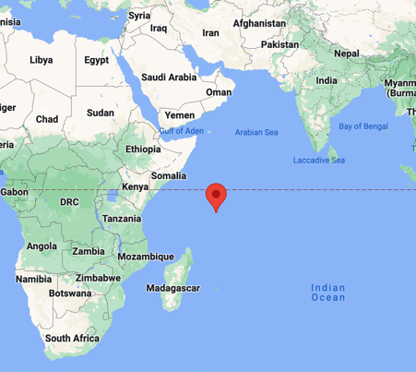
KuCoin
https://www.kucoin.com
Used by 25% of crypto holders worldwide
Located at Seychelles - an archipelago of 115 islands in the Indian Ocean
Daily trading volume ~ $2 Bln
KuCoin is a large cryptocurrency exchange offering the ability to buy, sell, and trade cryptocurrencies.
In addition to basic trading options, the platform offers margin, futures, and peer-to-peer (P2P) trading.
Users can also choose to stake or lend their crypto to earn rewards.
Compared to some competitors, KuCoin offers low trading fees, making it an attractive option.

Slide 15
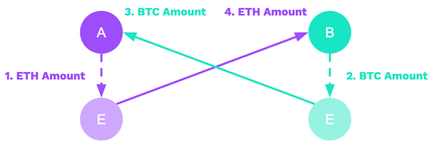
Cryptocurrency exchange / swap
You can buy Ethereum with Bitcoin on nearly any cryptocurrency exchange.
This is because most of the global Ethereum trading volume is actually
done in the ETH/BTC pair, and not the ETH/USD pair.
Coinbase – convert - https://www.youtube.com/watch?v=bzLd7V2ZLp8
BitPay does not directly buy or sell cryptocurrency, therefore, if you want to sell your cryptocurrency (cash your funds out), you need to do it with a third party (an exchange). BitPay can convert Crypto to regular currency - https://bitpay.com/exchange-rates/
https://medium.com/@mark.lasia/how-to-exchange-bitcoin-and-tokens-into-eth-ether-with-shapeshift-io-6a326b339c12
https://www.buybitcoinworldwide.com/ethereum/buy/
https://letsexchange.io/exchange/btc-to-eth
https://simpleswap.io/crypto-to-crypto/btc-eth
https://liquality.io/blog/atomic-swaps-explained/
https://liquality.io/blog/hash-time-locked-contracts-htlcs-explained/
etc. etc.
Atomic Swaps - Swapping Cryptocurrencies Without Trusted Third Party Mediation
using programmable Escrows
(HTLCs = Hash Time Locked Contracts)

Slide 16
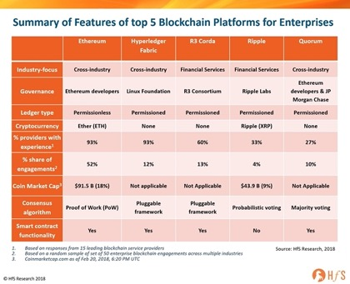
Blockchain networks, platforms, companies
Page Under Construction
Number of nodes (2022):
Bitcoin: ~50K (15K+ full nodes)
Ethereum: 300,000 validators
Some Blockchain companies
BRD
BitMEX
Chainalysis
Coinme
Netki
Paxful
Republic
Spring Labs
SALT Lending
TQ Tezos
Mythical Games
Gemini
Circle
Coinbase
Chronicled
IBM
Voatz
Steem
Shipchain
Some Blockchain Platforms:
IBM Blockchain
Corda
Ethereum
MultiChain
Tron
Stellar

Slide 17
Blockchains
Page Under Construction
public blockchains
- https://www.gartner.com/reviews/market/blockchain-platforms
BitCoin
Etherium
Solana
IBM Blockchain
Hyperledger Fabric
Binance Smart Chain
NEO (Antshares)
WAVES
EOS
Stellar
Monero (XMR)
Bitcoin Cash (BCH)
Ripple ?
private blockchains
consortium blockchains
hybrid blockchains

