Slide 1
Crypto Wallets
Send/Receive Crypto Tokens
"The only thing that ever gets kept in your
hardware / cryptocurrency wallet,
is your private key"

Slide 2

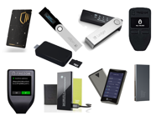
Types of Crypto Wallets
Personal Wallet
vs Exchange Account (Custodial Wallet)
Companies like crypto exchanges or payment services give users accounts or wallets which may contain different types of crypto.
Typically what they call a wallet is not an actual personal wallet on a decentralized blockchain, but rather an account (a.k.a. custodial wallet) which is connected with several wallets owned by the company.
The transactions and storage is done using company owned wallets – for which they charge extra fees.
There are many different blockchain networks.
They have their own "native" wallets.
There are different types of wallets:
Desktop App
Mobile App
Browser plugin
Hardware (usb, ...)
Paper (addresses, keys, QR-codes)
Hot Wallets:
Connected to internet
Can be accessed online or through application
More susceptible to hacking attacks
Cold Wallets:
Wallets that has to be connected to computer first
Also called "offline" wallets
Loosing it or forgetting passwords are biggest risks
Crypto Wallet | Crypto Exchange (custodial wallet)
A program to store crypto and do transactions | A (web) service to buy/sell/convert crypto currency
Full control over your private key | Does NOT allow full access over your private key
Do NOT offer features like selling / buying | Offers crypto selling / buying / trading
https://www.gemini.com/cryptopedia/crypto-wallets-custodial-vs-noncustodial

Slide 3
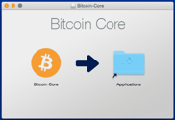
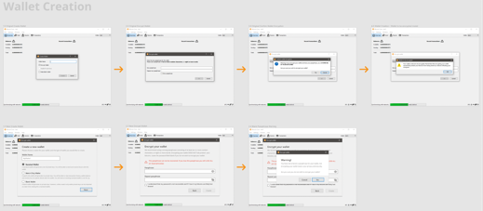
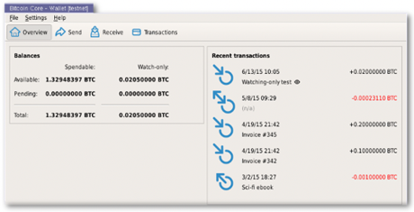
Bitcoin Wallets
Bitcoin Core Wallet
Install
https://github.com/bitcoin – bitcoin source code
https://bitcoincore.org/ - downloadable binaries
https://bitcoin.org
https://bitcoin.org/en/choose-your-wallet -
To send/receive bitcoin on bitcoin network you need a wallet. Bitcoin provides its own wallet called "Bitcoin Core". You can download it from: https://bitcoincore.org/en/download/
Bitcoin Core is an application that provides a personal Bitcoin wallet and allows a user to send and receive bitcoins.
Bitcoin Core is a full Bitcoin client and can download the whole bitcoin blockchain from the beginning of times (~200 GB).
Bitcoin Core nodes build the backbone of the network
Bitcoin Core offers high levels of security, privacy, and stability. However, it has fewer features and it takes a lot of space and memory
Create new wallet
Use it

Slide 4
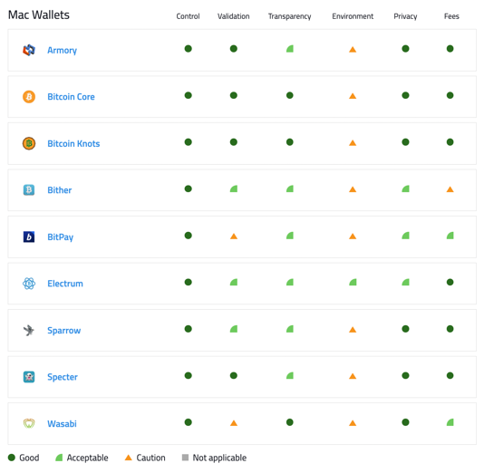
Bitcoin Wallets - continued
Choose your wallet – on bitcoin.org:
https://bitcoin.org/en/choose-your-wallet?step=5&platform=mac
Some Bitcoin wallets listed on bitcoin.org

Slide 5
Ethereum Wallets
https://ethereum.org/en/wallets/
An Ethereum account is an entity that can send transactions and has a balance. An Ethereum account has an Ethereum address, like an inbox has an email address. You can use this to send funds to an account.
A wallet is a product that lets you manage your Ethereum account. A wallet allows you to view your account balance, send transactions, and more. Most wallet products will let you generate an Ethereum account - so you don't need one before you download a wallet.
Some wallets on ethereum.org website:
AirGap
Argent
BitKeep
Pillar
Enjin
MyCrypto

Slide 6


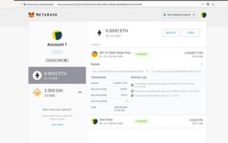
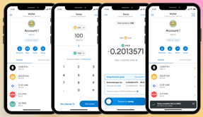
MetaMask
https://metamask.io/
https://en.wikipedia.org/wiki/MetaMask
A software cryptocurrency wallet for Etherium blockchain
A secure browser extension or mobile app (iOS, Android)
Allows to interact with decentralized applications
Since 2016
More than 20 Mln users
Developed by ConsenSys - a blockchain software technology company founded by Joseph Lubin with headquarters in Brooklyn, New York
Bitcoin cannot be stored on MetaMask, but you can store a "Wrapped Bitcoin" (WBTC) – which is an ERC-20 token that represents Bitcoin on the Ethereum blockchain
A software cryptocurrency wallet for Etherium blockchain
Joseph Lubin
ConsenSys
Brooklyn, New York
Browser-based wallets:
not very secure
very convenient, easilly connect to multiple exchanges

Slide 7

Wallet Comparisons
Best
Worst
Analysis done by Veriphi: .. https://www.veriphi.io/en/blog/software-wallet-analysis

Slide 8

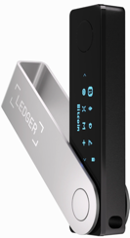
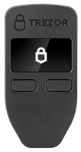
Some Good Wallets
Exodus – free Bitcoin and 180+ crypto Desktop, Mobile and hardware crypto wallets - https://www.exodus.com
Ledger Nano X - $150, hardware wallet 1000+ coins and tokens, - https://www.ledger.com
Trezor One – open source hardware wallet doesn't support XMR (Monero), XRP (Ripple), EOS - https://trezor.io
Exchange-hosted wallets:
Coinbase (50+ cryptos, 90 Mln users) - https://www.coinbase.com
KuCoin (380+ cryptos, 10+ Mln users) KuCoin isn’t licensed to operate in the US - https://www.kucoin.com
Note: You can access the hardware wallets from other types of wallets. For example, you can access your Ledger wallet from your Metamask or Coinbase wallet.

Slide 9
More Wallets / Servcies
Trust Wallet - owned by Binance, mostly Binance/Ethereum, decentralized https://trustwallet.com
Coinbase wallet - mostly Ethereum
MetaMask – Ethereum wallet
Etherscan Blockchain Explorer - https://etherscan.io/ - Etherscan is a Block Explorer and Analytics Platform for Ethereum, a decentralized smart contracts platform.
Celsius – centralized wallet, pays interest
Nexo – centralized wallet, pays interest
Ledger – hardware wallet (with Ledger Live software wallet)
Trezor – hardware wallet (with Exodus software wallet)

Slide 10
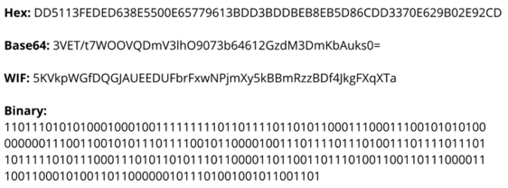
Wallet – keys, address
public key or address – it is like a user name
private key – like a password (to confirm transactions)
Bitcoin keys and address:
private key (256 bits = 32 bytes, randomly generated)
public key (256 bits = 32 bytes, generated from private key)
address (from public key, 160 bits = 20 bytes)
Recovery Phrase - a seed (24 words?) that can be used to restore (regenerate) your private key
WIF = Wallet Import Format (a.k.a. wallet export format) is a way of encoding a private ECDSA key so as to make it easier to copy.
.. https://en.bitcoin.it/wiki/Wallet_import_format
Ethereum keys and address:
private key (256 bits = 32 bytes, randomly generated)
public key (512 bits = 64 bytes, generated from private key)
address (from public key, 160 bits = 20 bytes)
To send Bitcoin:
Enter the "Recipient" Bitcoin public key or address
Enter the amount you’d like to send
Click "Send"
To receive Bitcoin:
Open your crypto wallet and select "Receive" to access your public key
Share your public key with the sender
Sit back and wait for the Bitcoins to appear in your wallet
Most of the encryption in modern cryptocurrencies
are built on elliptic curve cryptography rather than RSA,
especially in the generation of signatures in bitcoin which requires ECDSA. https://www.forbes.com/sites/rogerhuang/2020/12/21/heres-why-quantum-computing-will-not-break-cryptocurrencies/?sh=6d34a72a167b
Elliptical Digital Signature Algorithm
https://en.wikipedia.org/wiki/Elliptic_Curve_Digital_Signature_Algorithm
Keep your private key safe:
Never share your private key with anyone, keep offline (to avoid hacking), backup (seed phrase, a wallet file backup, keeping a copy in a safe)
Note: you almost never need to explicitly use your private key. Private keys are used to sign messages and transaction messages. Your wallet will do it for you - https://en.bitcoin.it/wiki/Transaction

Slide 11
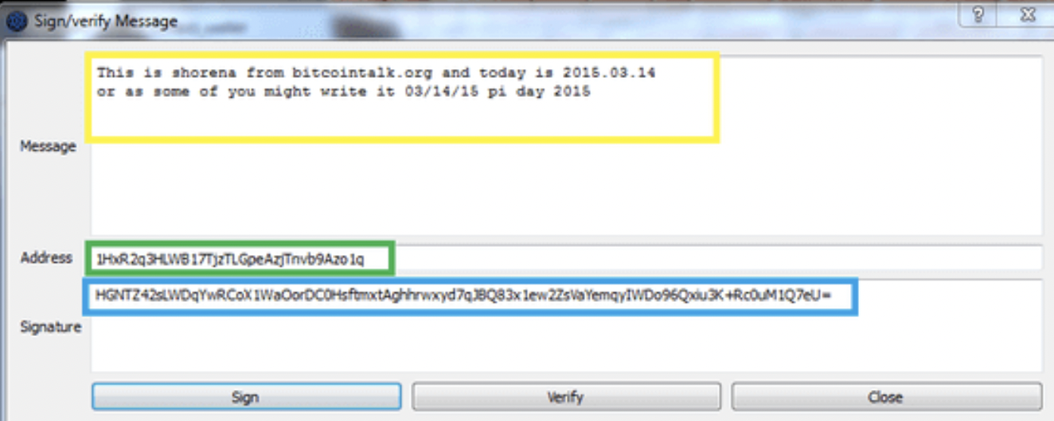
Wallet – signing messages, transactions
To sign a message: (to prove that it is your bitcoin address), open your wallet and go to "Sign/Verify message":
Enter your public wallet address for which you wish to sign
Enter your custom message
Click on "sign" - the signature will be generated in 3rd field
Share contents of all 3 fields with the recipient
To verifty the signature: the recipient enters the provided information using his client and verifies the ownership

Slide 12
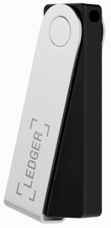

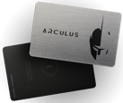
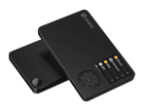
Some Good Hardware Wallets
Ledger Nano X - https://www.ledger.com –
Trezor - https://trezor.io –
Arculus - https://www.getarculus.com –
SafePal - https://safepal.io -

