Slide 1
Crypto Payment Services
The 5 Most Popular Crypto Payment Gateway & Processors
https://www.merchantmaverick.com/best-cryptocurrency-payment-gateway/
Coinbase - mainstream brand in the US market. Integrates with Shopify and WooCommerce - https://www.coinbase.com –
BitPay - Bitcoin and Bitcoin Cash payment services for merchants. US, since 2011. Versatile payout options - https://bitpay.com -
CoinGate - Supports payment in more obscure coins, Integrates with a large number of eCommerce platforms - https://coingate.com –
NOWpayments - Supports payment in more obscure coins, Integrates with a large number of eCommerce platforms, Low fees for simple transactions - https://nowpayments.io –
AlfaCoins - Flexible payment options, Easy to use - https://www.alfacoins.com -

Slide 2

Fees – BitPay.com
BitPay is a payment gateway
since 2011, 100+ Mln global customers,
https://www.owler.com/company/bitpay
https://bitpay.com/blog/welcome-to-the-september-cryptie/
BitPay fees ( https://www.cryptowisser.com/wallet/bitpay/ )
1. Miner fees (unavoidable, built into the blockchain, depends on crypto, very volatile)
2. Network Cost (additional operations' cost imposed by BitPay starting in 2017)
3. Processing Fee (1%) added by BitPay for their service
4. Refund fees (if you receive a refund)
In 2017 when Bitcoin blockchain fee were very high (more than $30),
BitPay made a rule to refuse transactions smaller than $100
Some alternatives to BitPay:
https://www.finextra.com/blogposting/21322/the-best-cryptocurrency-payment-gateways-for-2022
https://technicali.com/top-7-payment-gateways-that-accept-cryptocurrency/
https://wpengine.com/resources/wordpress-and-bitcoin/
https://www.nerdwallet.com/article/small-business/accepting-bitcoin-crypto

Slide 3
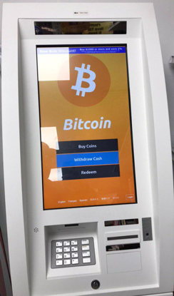
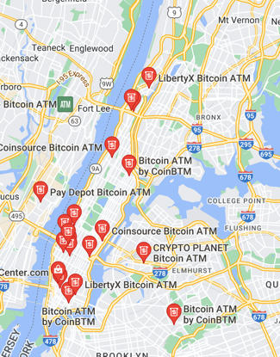
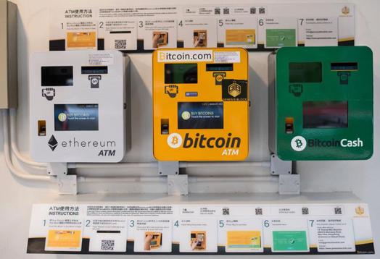
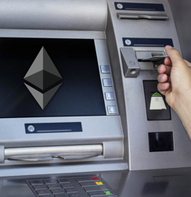
Crypto ATM
A crypto ATM is an Internet-connected kiosk that allows customers to purchase bitcoins and/or other cryptocurrencies with deposited cash and make blockchain-based transactions that send cryptocurrencies to the user's digital wallet, often via the use of a QR code.
There are currently (Summer 2021) more than 14,000 bitcoin ATMs in operation around the world.
A bitcoin ATM is not the same as an automated teller machine (ATM) that allows bank customers to physically withdraw, deposit, or transfer funds in one's bank account.

Slide 4
Pay for Goods using Crypto
Amazon doesn't accept crypto yet (beginning of 2022),
but you can use a debit or gift card.
Load them on BitPay:
BitPay debit card – can be loaded using Bitcoin, Dogecoin, Ethereum, Bitcoin Cash, etc.
Amazon gift card – can be purchased directly in the BitPay Wallet app or Extension
Some companies already accept crypto,
for example:
AT&T
CheapAir.com
Dallas Mavericks
Etsy
Home Depot (using Flexa)
Lush
Microsoft
Namecheap
Newegg
Overstock
Pacsun
PayPal
Rakuten
Starbucks
Tesla
Travala.com
Twitch
Whole Foods (using Flexa)
Wikipedia
BitPay count by wallet:
BitPay
Trust Wallet
Exodus Wallet
Coinbase
Electrum Wallet
Metamask
Blockchain Wallet
Ledger Wallet
Coinbase Wallet
BitcoinCore
Other
BitPay accepts invoice payments in:
Bitcoin (BTC),
Bitcoin Cash (BCH),
Ethereum (ETH),
Wrapped Bitcoin (WBTC),
Dogecoin (DOGE),
Litecoin (LTC),
Shiba Inu Coin (SHIB)
5 USD-pegged stablecoins (GUSD, USDC, USDP, DAI, BUSD)

Slide 5

The Giving Block
- https://thegivingblock.com
Helps to accept donations in Bitcoin, Ethereum, etc.
Automatic conversion to US Dollars
Marketing support
Founded in 2018, Washington DC
1000+ nonprofits use it - https://thegivingblock.com/resources/nonprofits-accepting-crypto-donations/
Donors get big tax incentive when donating cryptocurrencies directly to nonprofits. The IRS classifies cryptocurrencies as property, so cryptocurrency donations to 501c3 charities receive the same tax treatment as stocks
Community to raise awareness of crypto’s potential to fuel social good causes
Viral campaigns that empower nonprofits to connect with this new pool of donors
Example:
Action Against Hunger USA
Accepts regular payments on their website:
https://www.actionagainsthunger.org/
https://www.actionagainsthunger.org/story/donate-crypto
https://thegivingblock.com/donate/action-against-hunger/

Slide 6
How to Accept Donations
Crypto is private
Crypto can have tax advantages
Crypto donations can be cheaper for organizations to process
Stablecoins can make crypto giving less volatile
Which nonprofits accept crypto
Most donations are in Bitcoin (~90%)
Big websites have wizards to create donation pages:
Coinbase Commerce
- https://www.coinbase.com/learn/crypto-basics/how-to-donate-crypto
BitPay
https://bitpay.com/docs/donations
etc.

Slide 7
BitPay API
You can use REST API:
https://bitpay.com/api/#rest-api
To accept payments via BitPay you need to create a business BitPay account
and link your business bank account to it.
Then you get BitPay or test.bitpay merchant account.
You can start here:
https://bitpay.com/dashboard/signup
https://github.com/bitpay - 200+ repositories
https://github.com/warpi/BitPay - android app
https://github.com/bitpay/python-bitpay-client – bitpay client
...
curl -X POST \
-H "X-Accept-Version: 2.0.0" \
-H "Content-Type: application/json" \
--url "https://bitpay.com/tokens" \
-d @- <<'EOF'
{
"id":"someID",
"label": "merchantwebsite.com",
"facade":"merchant"
}
EOF
Alternatively you can use "bitpay" module which allows you to implement blockchain payments on your e-commerce website, authenticate with BitPay, create/retrieve invoices.
https://bitpay.com/integrations/python
https://github.com/bitpay/python-bitpay-client/blob/master/GUIDE.md
# pip3 install bitpay
import bitpay # client config env exceptions models tokens utils
# bitpay.client
Bill LedgerEntry Rate
BillCreationException LedgerQueryException RateQueryException
BillDeliveryException os Rates
BillQueryException Payout Refund
BillUpdateException PayoutBatch RefundCancellationException
BitPayException PayoutBatchCancellationException RefundCreationException
Client PayoutBatchCreationException RefundNotificationException
Config PayoutBatchNotificationException RefundQueryException
Currency PayoutBatchQueryException RefundUpdateException
CurrencyQueryException PayoutCancellationException RESTcli
Facade PayoutCreationException Settlement
Invoice PayoutNotificationException SettlementQueryException
InvoiceCancellationException PayoutQueryException Subscription
InvoiceCreationException PayoutRecipient SubscriptionCreationException
InvoiceNotificationException PayoutRecipientCancellationException SubscriptionQueryException
InvoicePaymentException PayoutRecipientCreationException SubscriptionUpdateException
InvoiceQueryException PayoutRecipientNotificationException Tokens
InvoiceUpdateException PayoutRecipientQueryException Wallet
json PayoutRecipients WalletQueryException
Ledger PayoutRecipientUpdateException
from bitpay.client import Client
# myurl = "https://bitpay.com"
myurl = "https://test.bitpay.com"
client = Client(api_uri=myurl)
client.pair_pos_client("abcdefg")

Slide 8
blockonomics.co - Bitcoin payment gateway & merchant processor. Accept bitcoin payments from your e-commerce shop directly to your wallet.

