Slide 1
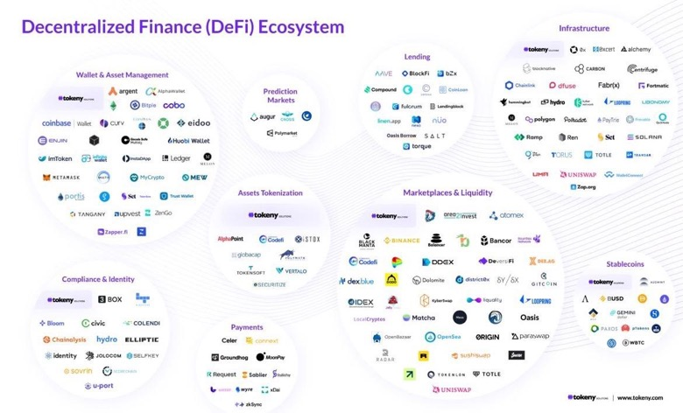

Slide 2

Web 3.0
The term "Web3" was coined by Polkadot founder and Ethereum co-founder Gavin Wood in 2014, referring to a "decentralized online ecosystem based on blockchain."
web1 (1994-2004): content provided by website owner, visitors are consumers.
web2 (a.k.a. Web 2.0, 2004 - present) – "social web", "web as a platform". Content created by website users (social media - blogs, facebook, youtube, etc.). Amazon market place and even Wikipedia can be considered as web2 websites too. Content is stored in big "central" repositories (web sites).
web3 (a.k.a. Web 3.0) – data is stored and interconnected in decentralized way. .. using blockchain and other modern technologies to enable decentralized economics. .. DAOs - decentralized autonomous organizations (DAOs) .. DeFi - decentralized finance .. self-sovereign identity (without the need of authentication server) .. AI-driven interfaces understanding voice, human images, emotions, understand meaning ("semantic web"), 3D-graphics, virtual reality .. AI-driven bots for data discovery and operations
Gavin Wood

Slide 3
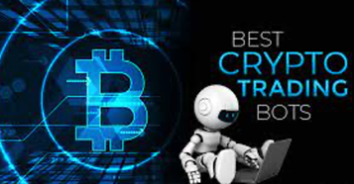
Crypto Trading Bots
Today more than 90% of crypto trading is done using software which automatically trades for you.
This type of software is called "Crypto trading bots".
Today you can trade Bitcoin or any altcoin such as Ethereum, Dogecoin, Litecoin, etc. using these trading bots.
Best 10 Crypto Trading Bots For 2022 [Review And Comparison] - https://www.softwaretestinghelp.com/best-crypto-trading-bots/

Slide 4
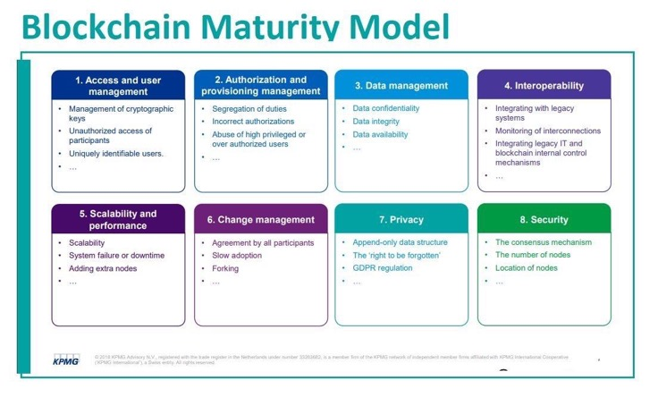

Slide 5
Hyperledger
https://www.hyperledger.org/
open source tools (blockchains and related)
started in December 2015 by the Linux Foundation.
Hyperledger Fabric - a blockchain framework
Hyperledger Sawtooth - modular platform for building, deploying, and running distributed ledgers
Numerai
https://numer.ai/
new type of a hedge fund launched in 2015:
make competitions to do financial predictions
pay winners in cryptocurrency (their own currency - Numeraire)

Slide 6
JP Morgan
JPM Coin - a wholesale payment digital currency that is pegged 1:1 to the U.S. dollar. It is now transacting billions of dollars every day
JP Morgan uses blockchain unit Onyx: https://www.jpmorgan.com/onyx – organization & brand
JPMorgan built the Quorum blockchain using the ethereum network (software behind ether cryptocurrency). Quorum will remain open-source, it is being used by the bank to run the Interbank Information Network, a payments network that involves more than 400 banks. It is supported/developed by ConsenSys – a Brooklyn-based startup - https://github.com/ConsenSys/quorum -
Amazon Web Services (AWS)
AWS provides Ethereum on Amazon Managed Blockchain. AWS customers can easily provision Ethereum nodes in minutes and connect to the public Ethereum main network and test networks such as Rinkeby and Ropsten.

Slide 7


Bram Cohen
- https://en.wikipedia.org/wiki/Bram_Cohen
- https://www.chia.net
Creator of peer-to-peer BitTorrent protocol (2001) (first implemented in Python)
Founder of CodeCon, an annual conference for software hackers in San Francisco Bay Area (2002-2009)
Founded BitTorrent, Inc. with his brother Ross Cohen and business partner Ashwin Navin
Co-author of Codeville (a distributed version control system) with his brother Ross Cohen
Creator of the Chia cryptocurrency (2017) which implements the proof of space-time consensus algorithm
Bram Cohen
originally from New York
Stuyvesant High School
CEO of Chia Network (California, since 2017)

Slide 8
Decentralized Social Media
Decentralized Social Media

Slide 9
Links, Resources
Three main generations of blockchain technologies - https://www.investopedia.com/tech/blockchain-technologys-three-generations/ -
But how does bitcoin actually work? ( youtube channel "3Blue1Brown" ) - https://www.youtube.com/watch?v=bBC-nXj3Ng4 –
Bitcoin Cash, Bitcoin SV - https://en.wikipedia.org/wiki/Bitcoin_Cash
Roger Ver - https://en.wikipedia.org/wiki/Roger_Ver
Cayman Islands and taxes, Binance - https://en.wikipedia.org/wiki/Binance – - https://decrypt.co/19204/top-7-crypto-companies-based-in-tax-havens –
The CHEAPEST Way to Buy Crypto. Period. - https://www.youtube.com/watch?v=D11waRlecrg –
Cardano - public open-source decentralized blockchain platform, internal cryptocurrency called "Ada". founded in 2015 by Charles Hoskinson - https://en.wikipedia.org/wiki/Cardano_(blockchain_platform)
Yield farming = lending or staking cryptocurrency in exchange for interest and other rewards. Yield farmers measure their returns in terms of annual percentage yields (APY). While potentially profitable, yield farming is also incredibly risky.
Crypto Mortgage - https://www.prnewswire.com/news-releases/milo-launches-first-us-crypto-mortgage-301462342.html
. . .

Slide 10
More Links
Melania Trump – NFT - https://blockchain.news/news/former-us-presidents-wife-melania-trump-releases-the-first-nftpriced-at-1-sol
Blockchain explorer - https://www.blockchain.com/explorer
Cryptopedia - https://www.gemini.com/cryptopedia
Book: "Platform Revolution: Blockchain Technology as the Operating System of the Digital Age" - https://www.amazon.com/gp/product/1988025737/
Fed Digital Currency Report - https://time.com/nextadvisor/investing/cryptocurrency/expert-reaction-to-fed-digital-currency-report/amp/
DeFi Decoded - Why fortunes are made in bear markets - 40min video - https://youtu.be/joy4-QbG0Rw
Wharton Accepts Cryptos as Tuition Fees for Blockchain Courses - https://blockchain-news.cdn.ampproject.org/c/s/blockchain.news/postamp?id=wharton-accepts-cryptos-as-tuition-for-blockchain-courses
3 Ways NFT Gaming Is Building New Wealth Opportunities - http://entm.ag/Q1CCQp?fbclid=IwAR0vyM7BHpG6gEk_3y0codMBlgtOB-C_YhJLXGtkILiPSkYJHoqIAE4gdcM
Inidia - tax on crypto in 2022 - https://www.bloomberg.com/news/articles/2022-02-01/india-to-launch-central-bank-digital-currency-next-fiscal-year
Laws for stablecoins - https://www.americanbanker.com/news/democrats-circulate-bill-to-rein-in-stablecoins
Stablecoin - https://www.linkedin.com/posts/theblockchainforum_stablecoin-regulatory-update-feb-2022-activity-6895248259149893632-9Og3
Blockchain glossary for accountants - https://jofacc.libsyn.com/a-blockchain-glossary-the-cpa-firm-of-the-future-and-excel-malware
Feds & Digital Currency - https://news.mit.edu/2022/digital-currency-fed-boston-0203
KPMG is a global network of professional firms providing Audit, Tax and Advisory services - https://www-marketwatch-com.cdn.ampproject.org/c/s/www.marketwatch.com/amp/story/crypto-is-volatile-but-kpmg-canada-just-added-bitcoin-and-ether-to-its-balance-sheet-heres-why-11644270913
Cryptocurrency, Blockchain - IRS forms & how to file - https://open.spotify.com/episode/4BA08KV2257tlygMglcqyc
Google & Crypto - https://sg.finance.yahoo.com/news/google-blockchain-crypto-ecosystem-sundar-pichai-nfts-000111560.html
PayPal & Crypto - https://blockchain-news.cdn.ampproject.org/c/s/blockchain.news/postamp?id=paypal-establishes-advisory-committeefocusing-on-crypto-affairs
Apple and crypto payments - https://finance-yahoo-com.cdn.ampproject.org/c/s/finance.yahoo.com/amphtml/news/apple-enable-crypto-payments-tap-150300322.html
Coinbase - Earn crypto while learning about crypto - https://www.coinbase.com/earn
Coinbase - Get paid in crypto with zero fees, get your paycheck deposited into Coinbase - https://www.coinbase.com/direct-deposit
Ukraine Legalizes Bitcoin amid Intensified Tension with Russia - https://blockchain-news.cdn.ampproject.org/c/s/blockchain.news/postamp?id=ukraine-legalizes-bitcoin-amid-intensified-tension-with-russia
Fed Designs Digital Dollar That Handles 1.7 Million Transactions Per Second - https://www-forbes-com.cdn.ampproject.org/c/s/www.forbes.com/sites/jasonbrett/2022/02/07/fed-designs-digital-dollar-that-handles-17-million-transactions-per-second/amp/
BNB Chain - https://www.binance.com/en/blog/ecosystem/introducing-bnb-chain-the-evolution-of-binance-smart-chain-421499824684903436
Salesforce - NFT cloud service - https://www-cnbc-com.cdn.ampproject.org/c/s/www.cnbc.com/amp/2022/02/09/salesforce-tells-employees-its-working-on-nft-cloud-service.html
JPMorgan - Quantum Key Distribution (QKD) secure network - https://www-pymnts-com.cdn.ampproject.org/c/s/www.pymnts.com/blockchain/2022/jpmorgan-announces-viable-quantum-secure-blockchain-network/amp/
Paris Hilton on Tonight Show - NFTs - https://www.youtube.com/watch?v=5zi12wrh5So
Proof-of-Stake - Cardano, Solana, Algorand, Ethereum - https://www.technologyreview.com/2022/02/23/1044960/proof-of-stake-cryptocurrency/
What's on Tap? - Putin - and Crypto - https://youtu.be/a0ryBK2UgTQ
It's all about crypto and Blockchain - https://www.inaa.org/accounting-industry-trends-for-2022/
Good Glossary - https://data-flair.training/blogs/distributed-ledger-technology/

