Slide 1



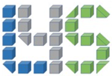
TapestryX - Next Gen Distributed Ledger Technology (DLT)
TapestryX is a real-time, scalable, high-capacity self-synchronizing distributed ledger with full accounting and financing functionality for advanced digital ecosystems
TapestryX can structure and share digital asset records of all forms in secure, confidential networks
TapestryX provides distributed transactions, data structuring, sharing and reporting
TapestryX provides performance, compliance and GAAP (Generally Accepted Accounting Principles) compatibility
TapestryX updates and monitors double-entry accounting trial balances and internal reconciliations on an event-driven basis, while interoperating with legacy platforms and infrastructure.
Paul F. Dowding
Co-Founder
Head of Design
Mark Green
Co-Founder
COO
Paul F. Dowding - Co-Founder and Head of Design
.. pfdowding@L4SCorp.com
.. https://www.linkedin.com/in/paulfdowding/
Mark Green – COO, Co-Founder
.. mark.green@tapestryx.com
.. https://www.linkedin.com/in/markwgreen/
2015 – Paul started pitching DLT
2018 – formed L4S Corporation (L4S = Ledger for Securities)
2019 - Mark Green joined to build technicla prototype
2020 – supply chain use case, Paul Toldalagi joins as Investor & advisor
2021 – TapestryX branding and website
.. https://tapestryx.com
.. https://www.yugenpedia.org/index.php?title=L4S_Corporation
Patent Issue pending - applied in 2017 "Blockchain Solutions For Financial Services And Other Transaction-Based Industries"
Ledger 4 Securities
Blockchain is a record (journal) of transactions. It doesn't have subtotals that accountant may need.
A ledger is a record of transactions by account and often holds summarized numbers.
Tapestry updates ledger (sub)totals in real time – and holds it in blockchain.
Tapestry stores hashes of transactions not in linear chain, but in distributed graph system (thats why the name "Tapestry")

Slide 2
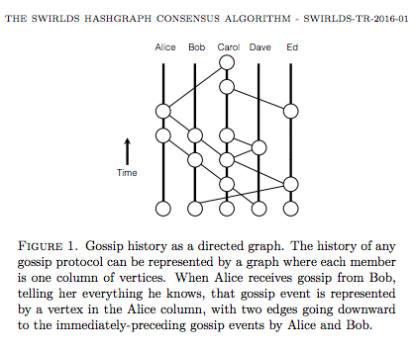
Block Graph instead of Chain
Tangle 2.0 Leaderless Nakamoto Consensus on the Heaviest DAG .. https://arxiv.org/abs/2205.02177
Hashgraph consensus
.. https://www.investopedia.com/terms/h/hashgraph-consensus-mechanism.asp
.. https://en.wikipedia.org/wiki/Hashgraph
.. https://docs.hedera.com/guides/core-concepts/hashgraph-consensus-algorithms
Hedera .. https://hedera.com
Hedera was founded by Hashgraph inventor Leemon Baird and his business partner Mance Harmon .. https://www.swirlds.com/whitepapers/
Block-lattice - Directed Acyclic Graphs (DAGs) .. https://tokens-economy.gitbook.io/consensus/chain-based-dag/block-lattice-directed-acyclic-graphs-dags# .. https://medium.com/swlh/what-you-need-to-know-about-block-lattice-19641a8d8ff1
Nano .. https://nano.org .. https://nano.org/news-resources previously Raiblocks .. https://raiblocks.net Banano (A fork of Nano) .. https://banano.cc

