Slide 1
Crypto: buy, sell, keep, convert
You can create accounts directly at multiple blockchain networks like Bitcoin, Ethereum, etc. These accounts will allow you to send messages and crypto currency between accounts. For example, person A gives dollars to person B, in exchange B sends Bitcoin to A via blockchain network. So one transaction consists of two transfers: crypto and dollars. How do we do it in practice?
How to find buyers/sellers?
How to do transactions?
How to make sure transaction fees are paid?
How to handle accounting?
Bitcoin
Ethereum
Other
Networks
Wallet
The easiest way is to link your regular bank account or credit/debit card to a crypto "wallet" at one of the existing services (or use independent wallet):
crypto brokers (like Robinhood, SoFi, etc.)
crypto exchanges (Coinbase, Gemini, Binance.US, etc.)
crypto wallets (Guarda, Exodus, Electrum, Mycelium, Coinbase, MetaMask/Ethereum, etc.)
crypto payment gateways (BitPay, COINQVEST, Coinbase, Coingate, CoinsBank, GoCoin, etc.)
Which service to choose depends on the currencies, amounts, fees, etc.
https://www.forbes.com/advisor/investing/cryptocurrency/how-to-buy-cryptocurrency/
https://www.investopedia.com/best-crypto-software-wallets-5220762
Bank ($)

Slide 2
Convert BitCoin into USD
https://icoholder.com/blog/how-to-turn-bitcoin-into-usd/
If you and your buyer know and trust each other – you can do it by yourselves. Buyer can give you money – and you can send BTC from your account to his. You need to be aware of fees on both sides
You can also use facilitating service like LocalBitcoins which lists buyers (expect 1-3 days to complete transaction) - https://localbitcoins.com/sell_bitcoins
Otherwise you can use some (big) exchange – but for additional fee 1-2% fee. For example, Coinbase Exchange - https://icoholder.com/blog/how-to-turn-bitcoin-into-usd/ , https://www.youtube.com/watch?v=60Rjdv2Z_Gg
You can also trading platforms (like Kraken). Expect more background checks and higher fees. The process also will generally take longer ( ~5 days ) - https://support.kraken.com/hc/en-us
Currency Converters – many places, faster processing - https://wealthpay.org - https://www.bestchange.com - https://www.okchanger.com
Direct Electronic Payment System – like https://www.worldcore.eu - it uses BitPay under the hood - https://bitpay.com

Slide 3
Crypto Payment Services
The 5 Most Popular Crypto Payment Gateway & Processors
https://www.merchantmaverick.com/best-cryptocurrency-payment-gateway/
Coinbase - mainstream brand in the US market. Integrates with Shopify and WooCommerce - https://www.coinbase.com –
BitPay - Bitcoin and Bitcoin Cash payment services for merchants. US, since 2011. Versatile payout options - https://bitpay.com -
CoinGate - Supports payment in more obscure coins, Integrates with a large number of eCommerce platforms - https://coingate.com –
NOWpayments - Supports payment in more obscure coins, Integrates with a large number of eCommerce platforms, Low fees for simple transactions - https://nowpayments.io –
AlfaCoins - Flexible payment options, Easy to use - https://www.alfacoins.com -

Slide 4
Crypto Exchanges (and Wallets)
Best Crypto Exchanges in 2021: - https://www.investopedia.com/best-crypto-exchanges-5071855 -
Coinbase - 89+ Mln users, 100+ countries, USA-based - https://www.coinbase.com - Transaction Fees: 0.04% to 0.50% (taker orders); 0% to 0.50% (makers orders), Wallet included. Very high liquidity, variety of coins
Binance - https://www.binance.com - Cayman Islands (Caribbean) & Seychelles (island near Africa). Hindreds of cr.currencies. Not available in US. Low fees, large variety of cryptocurrencies and trading pairs, geared for more advanced users
Binance.US - https://www.binance.us – US-regulated, 50 cryptocurrencies, not all states supported
Abra - https://www.abra.com - Mountain View, CA - operates a comprehensive, custodial cryptocurrency wallet and exchange
Cash App - https://cash.app – easy to use, peer-to-peer money transfer (like Venmo or Zelle), ability to withdraw Bitcoin, supports only one crypto-currency – the Bitcoin. has daily and weekly withdrawal limits. Charge when sending money via credit card
bisq – decentralized exchange - https://bisq.network – non-KYC platform, 18 crypto-currencies, but transaction speeds may be slow, trading volumes can be low
Kraken – Bitcoin & Crypto Exchange - https://www.kraken.com -
Gemini - https://www.gemini.com -
Robinhood - https://robinhood.com -

Slide 5
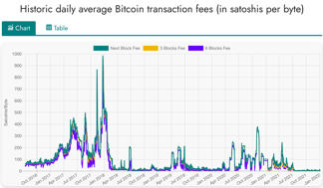
High Fees (Proof of Work)
Bitcoin
Fees are calculated in "satoshi" named after Satoshi Nakamoto, creator of bitcoin.
1 satoshi = 0.00000001 BTC = 1e-8 BTC
(Jan 2022) Estimated transaction fee $2.34 = 5,056 satoshi
https://www.btcsatoshi.com/
https://www.buybitcoinworldwide.com/fee-calculator/
https://bitcoinfees.earn.com/
https://mempool.space/
https://bitcoinbriefly.com/how-to-use-mempool-space-block-explorer/
Miners are rewarded for calculating next block
in a blockchain's mempool. The reward is calculated per the length of the record and complexity of calculation – and in values native to the blockchain.
When converting to dollars, the fees are very volatile.
Here is what Wall Street Journal says about fees in 2021:
""" On the Bitcoin network, the average daily transaction fee this year has been as low as $1.78 and as high as $62, according to bitinfocharts. On Ethereum, the average fee has been as low as $1.59 and as high as $70. """
https://www.wsj.com/articles/crypto-and-its-many-fees-what-to-know-about-the-hidden-costs-of-digital-currency-11639825202
Ethereum
https://cryptotesters.com/blog/ethereum-gas
https://automatedwebtools.com/usd-eth-gas-fee/
https://etherscan.io/
Cost of transaction is measured in "Gwei" – named after Wei Dai, best known as the creator of the bitcoin predecessor "b-money" and as the developer of the Crypto++ library.
1 gwei = 0.000000001 ether = 1/1Bln part of Ether
(Jan 2022) Estimated transaction fee $5.61 = 70 Gwei

Slide 6



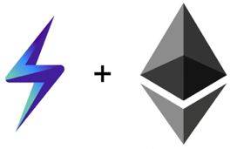
Lightning Network
The Lightning Network is a "layer 2" payment protocol layered on top of a blockchain-based cryptocurrency such as bitcoin or litecoin.
The Lightning Network allows users to send or receive Bitcoin quickly and cheaply by moving transactions off of the main blockchain
The Lightning Network uses smart contracts to establish off-blockchain payment channels between pairs of users. Once these payment channels are established, funds can be transferred between them almost instantly.
2015 - Original paper by Joseph Poon and Thaddeus Dryja
Good videos: - https://www.youtube.com/watch?v=J3cQNpOR_a0 - https://www.youtube.com/watch?v=XCSfoiD8wUA
Wikipedia - https://en.wikipedia.org/wiki/Lightning_Network
Coinbase - https://www.coinbase.com/learn/crypto-basics/what-is-lightning
BitPay - https://bitpay.com/blog/bitpay-supports-lightning-network-payments/amp/
Ethereum Sidechains
Joseph Poon
Thaddeus Dryja
Sidechains are similar to Lightning Network – but for Ethereum: - https://ethereum.org/en/developers/docs/scaling/sidechains/
A sidechain is a separate blockchain which runs in parallel to Ethereum Mainnet and operates independently
It has its own consensus algorithm (e.g. proof-of-authority, Delegated proof-of-stake, Byzantine fault tolerance)
It is connected to Mainnet by a two-way bridge

Slide 7

Fees – BitPay.com
BitPay is a payment gateway
since 2011, 100+ Mln global customers,
https://www.owler.com/company/bitpay
https://bitpay.com/blog/welcome-to-the-september-cryptie/
BitPay fees ( https://www.cryptowisser.com/wallet/bitpay/ )
1. Miner fees (unavoidable, built into the blockchain, depends on crypto, very volatile)
2. Network Cost (additional operations' cost imposed by BitPay starting in 2017)
3. Processing Fee (1%) added by BitPay for their service
4. Refund fees (if you receive a refund)
In 2017 when Bitcoin blockchain fee were very high (more than $30),
BitPay made a rule to refuse transactions smaller than $100
Some alternatives to BitPay:
https://www.finextra.com/blogposting/21322/the-best-cryptocurrency-payment-gateways-for-2022
https://technicali.com/top-7-payment-gateways-that-accept-cryptocurrency/
https://wpengine.com/resources/wordpress-and-bitcoin/
https://www.nerdwallet.com/article/small-business/accepting-bitcoin-crypto

Slide 8

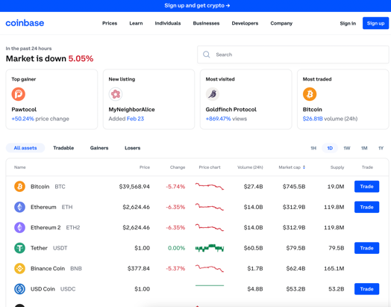
Coinbase
https://www.coinbase.com
https://en.wikipedia.org/wiki/Coinbase
buy, sell, and manage crypto
89 Mln users in 100+ countries
Public company (traded on Nasdaq)
Founded in 2012 by Brian Armstrong
1000+ employes
https://github.com/coinbase -
https://github.com/coinbase/coinbase-commerce-python -
https://github.com/coinbase/coinbase-python -
https://github.com/coinbase/coinbase-python/tree/master/coinbase/wallet
...

Slide 9


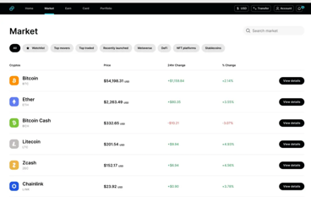
Gemini
https://www.gemini.com
https://en.wikipedia.org/wiki/Gemini_(company)
https://exchange.sandbox.gemini.com/
Gemini Trust Company, LLC (Gemini) – since 2014, New York City, 900+ employees Address: 600 3rd Avenue 2nd Floor New York, NY 10016
Cryptocurrency exchange and custodian, NFT marketplace
Buy, sell, store Bitcoin, Bitcoin Cash, Ethereum, Litecoin, Zcash, Gemini dollar
Gemini means twins - twins founders Cameron Winklevoss & Tyler Winklevoss
Gemini operates in US, Canada, UK, South Korea, Hong Kong, and Singapore.
Primary competitors include Coinbase, Binance, Bitstamp, and Kraken
All users can trade crypto and fiat currency, and transfer USD to/from bank accounts
2017 - Gemini was the first exchange to launch bitcoin futures contracts (Gemini is used by the Chicago Board Options Exchange (CBOE) as the basis for setlement)
2018 – launched stable coin Gemini dollar (GUSD) pegged to USD
2019 – Gemini bought Nifty Gateway – and NFT marketplace
Python client: - https://github.com/mtusman/gemini-python - https://pypi.org/project/gemini/
REST API, Python: - https://docs.gemini.com/rest-api/
Cameron & Tyler Winklevoss (twins)
import requests, json
base_url = "https://api.gemini.com/v1"
response = requests.get(base_url + "/trades/btcusd")
btcusd_trades = response.json()
print(btcusd_trades)

Slide 10



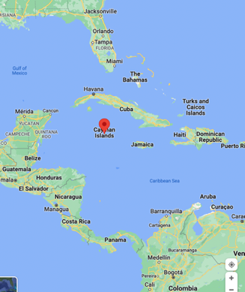
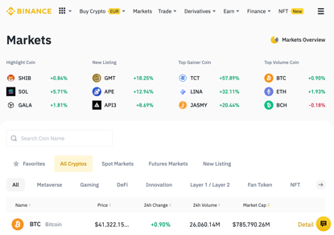
Binance
https://www.binance.com
https://www.binance.us
https://en.wikipedia.org/wiki/Binance
Buy, Sell, and Trade Cryptocurrencies
Binance - cryptocurrency exchange
World largest trading volume
Founded in 2017 by Changpeng Zhao ("CZ") & Yi He
Headquarters at Cayman Islands
Not available in the US and UK In US you can use https://www.binance.us
Python API ( pip install python-binance ) - https://docs.binance.us - https://python-binance.readthedocs.io - https://github.com/sammchardy/python-binance
Changpeng Zhao
net worth ~ $77 Bln
Yi He

Slide 11

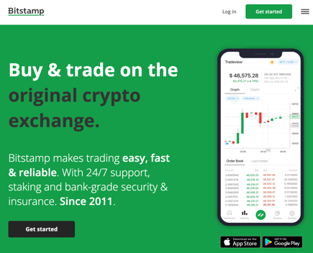
Bitstamp
https://www.bitstamp.net/
https://en.wikipedia.org/wiki/Bitstamp
https://www.bitstamp.net/api/
https://github.com/kmadac/bitstamp-python-client
Bitstamp is a cryptocurrency exchange based in Luxembourg. (London, Luxembourg, Slovenia, New York City)
Founded in 2011
It allows trading between fiat currency, bitcoin and other cryptocurrencies.
USD, EUR, GBP, bitcoin, ALGO, XRP, Ether, litecoin, bitcoin cash, XLM, Link, OMG Network, USD Coin or PAX deposits and withdrawals
# pip install BitstampClient
import bitstamp.client
public_client = bitstamp.client.Public()
print(public_client.ticker()['volume'])
trading_client = bitstamp.client.Trading(
username='999999', key='xxx', secret='xxx')
print(trading_client.account_balance()['fee'])
print(trading_client.ticker()['volume'])

Slide 12



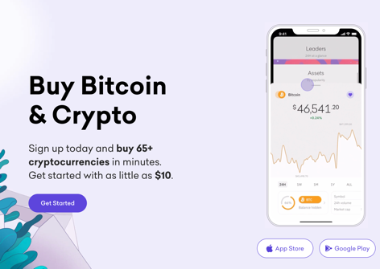
Kraken
https://www.kraken.com
https://en.wikipedia.org/wiki/Kraken_(company)
https://docs.kraken.com/rest/
https://support.kraken.com/hc/en-us/sections/360003946512-Example-API-Code
Kraken is a cryptocurrency exchange in San Francisco, CA since
Founded in 2011 by Jesse Powell
14+ Mln users, 1000+ employees,
Support for 120+ different crypto currencies including Bitcoin, Ethereum (ether), Litecoin, Namecoin, Dogecoin, Ripple, Stellar, Cardano, Polkadot, Polygon, Solana, Sushi, Uniswap
Trading can be executed between digital assets, and between digital assets and national currencies like USD, EUR, GBP, CAD and JPY
Jesse Powell
import sys, time, json, urllib.request
api_domain = "https://api.kraken.com"
# ...
api_data = "?pair=%(pair)s&since=%(since)s" % {"pair":api_symbol, "since":api_start}
api_request = urllib.request.Request(api_domain + api_path + api_method + api_data)
api_data = urllib.request.urlopen(api_request).read()
# ...
The kraken is a legendary sea monster of enormous size said to appear off the coasts of Norway.

Slide 13
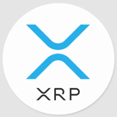

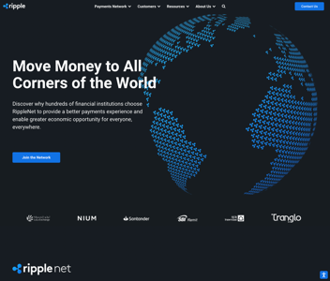




Ripple
https://en.wikipedia.org/wiki/Ripple_(payment_protocol) -
https://en.wikipedia.org/wiki/Ripple_Labs -
https://ripple.com -
https://github.com/ripple/rippled -
https://github.com/ripple/ripple-rest - REST API
https://xrpl.org/get-started-using-python.html - python
https://github.com/arsenlosenko/python-ripple-lib -
Ripple ( RippleNet ) - a real-time gross settlement system, currency exchange and remittance global network. Used by 300+ binancial institutions (banks)
XRP - native Ripple cryptocurrency, price ~ $0.76, in circulation ~48 Bln coins, traded on more than 700 markets, daily trade volume ~ $2 Bln
XRP transactions are confirmed in seconds with little cost
Ripple created by Ripple Labs Inc. (San Francisco, New York), ~ 670 employees
Ripple released in 2012
Ripple is built upon a distributed open source protocol
Ripple supports tokens representing fiat currency, cryptocurrency, commodities, or other units of value such as frequent flier miles or mobile minutes
Ripple purports to enable "secure, instantly and nearly free global financial transactions of any size with no chargebacks"
Ripple was conceived by Jed McCaleb
Original authors: Arthur Britto, David Schwartz, Ryan Fugger
Developed by Ripple Labs Inc., initial release 2012, written in C++
Jed McCaleb,
founder of Ripple, co-founder of Stellar
Arthur Britto
founder of Ripple
David Schwartz
CTO of Ripple
Ryan Fugger
early consultant

Slide 14




Stellar & Interstellar
Open source payment protocol: .. https://www.stellar.org .. https://www.stellar.org/learn/intro-to-stellar .. https://www.youtube.com/watch?v=-u2RCOWxKww – good short video .. https://github.com/stellar/stellar-core .. https://developers.stellar.org/docs/software-and-sdks/ .. https://github.com/StellarCN/py-stellar-base/tree/master/examples .. https://en.wikipedia.org/wiki/Stellar_(payment_network)
.. https://interstellar.com - Company Interstellar
Stellar, or Stellar Lumens tokens (XLM, 50 Bln in circulation) is an open source (Apache), decentralized protocol (exchange) for digital currency to fiat money low-cost transfers, which allows cross-border transactions between any pair of currencies. You can create coins around anything (tokenize). Works like stable coins.
Stellar is a decentralized exchange for crypto, forex, or securities. Users can swap between tokens using simple functions built into the protocol
Stellar is a global public blockchain, a non-stock, non-profit corporation with no shareholders, no owners and no profit motive
In 2020 - over 4.8 million users and ~ 1 Bln transactions
Release in 2014, original authors: Jed McCaleb; Joyce Kim
Written in: C++, Go, Java, JavaScript, Python, Ruby
Fast: 3 to 5-second settlements
Cheap: virtually no transaction fees ($1 for 100,000 transactions)
Scalable: process thousands of transactions per second
Compliant: built-in compliance layer and licensed partners
Secure: built-in security, best-in-class cryptographic techniques, and secure against 51% attacks
Sustainable: green decentralization of the StellarConsensus protocol (no mining or proof of stake needed) - Federated Byzanntine Agreement
Jed McCaleb,
founder of Ripple, co-founder of Stellar and Interstellar
Joyce Kim, co-founder of Stellar
Mike Kennedy
CEO, Interstellar

Slide 15
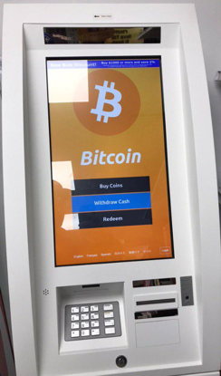
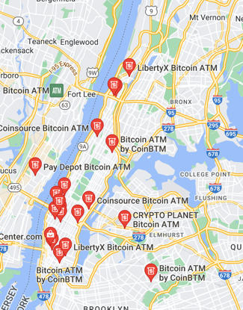
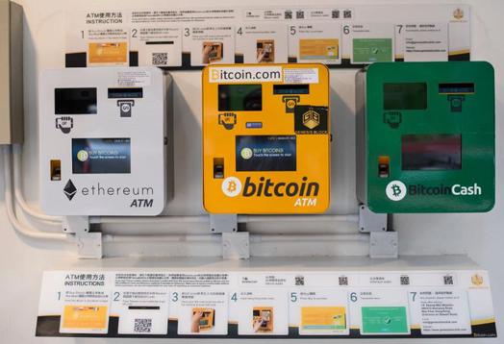
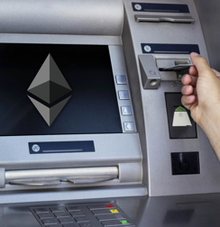
Crypto ATM
A crypto ATM is an Internet-connected kiosk that allows customers to purchase bitcoins and/or other cryptocurrencies with deposited cash and make blockchain-based transactions that send cryptocurrencies to the user's digital wallet, often via the use of a QR code.
There are currently (Summer 2021) more than 14,000 bitcoin ATMs in operation around the world.
A bitcoin ATM is not the same as an automated teller machine (ATM) that allows bank customers to physically withdraw, deposit, or transfer funds in one's bank account.

Slide 16

KuCoin
https://www.kucoin.com/
1 Out of 4 Crypto Holders Worldwide Is with KuCoin

Slide 17
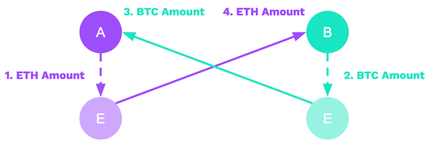
Cryptocurrency exchange / swap
You can buy Ethereum with Bitcoin on nearly any cryptocurrency exchange.
This is because most of the global Ethereum trading volume is actually
done in the ETH/BTC pair, and not the ETH/USD pair.
Coinbase – convert - https://www.youtube.com/watch?v=bzLd7V2ZLp8
BitPay does not directly buy or sell cryptocurrency, therefore, if you want to sell your cryptocurrency (cash your funds out), you need to do it with a third party (an exchange). BitPay can convert Crypto to regular currency - https://bitpay.com/exchange-rates/
https://medium.com/@mark.lasia/how-to-exchange-bitcoin-and-tokens-into-eth-ether-with-shapeshift-io-6a326b339c12
https://www.buybitcoinworldwide.com/ethereum/buy/
https://letsexchange.io/exchange/btc-to-eth
https://simpleswap.io/crypto-to-crypto/btc-eth
https://liquality.io/blog/atomic-swaps-explained/
https://liquality.io/blog/hash-time-locked-contracts-htlcs-explained/
etc. etc.
Atomic Swaps - Swapping Cryptocurrencies Without Trusted Third Party Mediation
using programmable Escrows
(HTLCs = Hash Time Locked Contracts)

Slide 18
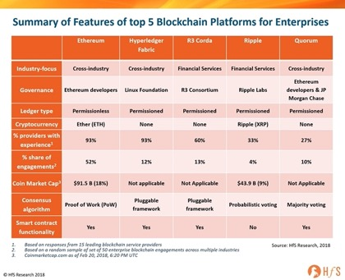
Blockchain networks, platforms, companies
Page Under Construction
Number of nodes (2022):
Bitcoin: ~50K (15K+ full nodes)
Ethereum: 300,000 validators
Some Blockchain companies
BRD
BitMEX
Chainalysis
Coinme
Netki
Paxful
Republic
Spring Labs
SALT Lending
TQ Tezos
Mythical Games
Gemini
Circle
Coinbase
Chronicled
IBM
Voatz
Steem
Shipchain
Some Blockchain Platforms:
IBM Blockchain
Corda
Ethereum
MultiChain
Tron
Stellar

Slide 19
Blockchains
Page Under Construction
public blockchains
- https://www.gartner.com/reviews/market/blockchain-platforms
BitCoin
Etherium
Solana
IBM Blockchain
Hyperledger Fabric
Binance Smart Chain
NEO (Antshares)
WAVES
EOS
Stellar
Monero (XMR)
Bitcoin Cash (BCH)
Ripple ?
private blockchains
consortium blockchains
hybrid blockchains

Slide 20
Pay for Goods using Crypto
Amazon doesn't accept crypto yet (beginning of 2022),
but you can use a debit or gift card.
Load them on BitPay:
BitPay debit card – can be loaded using Bitcoin, Dogecoin, Ethereum, Bitcoin Cash, etc.
Amazon gift card – can be purchased directly in the BitPay Wallet app or Extension
Some companies already accept crypto,
for example:
AT&T
CheapAir.com
Dallas Mavericks
Etsy
Home Depot (using Flexa)
Lush
Microsoft
Namecheap
Newegg
Overstock
Pacsun
PayPal
Rakuten
Starbucks
Tesla
Travala.com
Twitch
Whole Foods (using Flexa)
Wikipedia
BitPay count by wallet:
BitPay
Trust Wallet
Exodus Wallet
Coinbase
Electrum Wallet
Metamask
Blockchain Wallet
Ledger Wallet
Coinbase Wallet
BitcoinCore
Other
BitPay accepts invoice payments in:
Bitcoin (BTC),
Bitcoin Cash (BCH),
Ethereum (ETH),
Wrapped Bitcoin (WBTC),
Dogecoin (DOGE),
Litecoin (LTC),
Shiba Inu Coin (SHIB)
5 USD-pegged stablecoins (GUSD, USDC, USDP, DAI, BUSD)

Slide 21

The Giving Block
- https://thegivingblock.com
Helps to accept donations in Bitcoin, Ethereum, etc.
Automatic conversion to US Dollars
Marketing support
Founded in 2018, Washington DC
1000+ nonprofits use it - https://thegivingblock.com/resources/nonprofits-accepting-crypto-donations/
Donors get big tax incentive when donating cryptocurrencies directly to nonprofits. The IRS classifies cryptocurrencies as property, so cryptocurrency donations to 501c3 charities receive the same tax treatment as stocks
Community to raise awareness of crypto’s potential to fuel social good causes
Viral campaigns that empower nonprofits to connect with this new pool of donors
Example:
Action Against Hunger USA
Accepts regular payments on their website:
https://www.actionagainsthunger.org/
https://www.actionagainsthunger.org/story/donate-crypto
https://thegivingblock.com/donate/action-against-hunger/

Slide 22
How to Accept Donations
Crypto is private
Crypto can have tax advantages
Crypto donations can be cheaper for organizations to process
Stablecoins can make crypto giving less volatile
Which nonprofits accept crypto
Most donations are in Bitcoin (~90%)
Big websites have wizards to create donation pages:
Coinbase Commerce
- https://www.coinbase.com/learn/crypto-basics/how-to-donate-crypto
BitPay
https://bitpay.com/docs/donations
etc.

Slide 23
BitPay API
You can use REST API:
https://bitpay.com/api/#rest-api
To accept payments via BitPay you need to create a business BitPay account
and link your business bank account to it.
Then you get BitPay or test.bitpay merchant account.
You can start here:
https://bitpay.com/dashboard/signup
https://github.com/bitpay - 200+ repositories
https://github.com/warpi/BitPay - android app
https://github.com/bitpay/python-bitpay-client – bitpay client
...
curl -X POST \
-H "X-Accept-Version: 2.0.0" \
-H "Content-Type: application/json" \
--url "https://bitpay.com/tokens" \
-d @- <<'EOF'
{
"id":"someID",
"label": "merchantwebsite.com",
"facade":"merchant"
}
EOF
Alternatively you can use "bitpay" module which allows you to implement blockchain payments on your e-commerce website, authenticate with BitPay, create/retrieve invoices.
https://bitpay.com/integrations/python
https://github.com/bitpay/python-bitpay-client/blob/master/GUIDE.md
# pip3 install bitpay
import bitpay # client config env exceptions models tokens utils
# bitpay.client
Bill LedgerEntry Rate
BillCreationException LedgerQueryException RateQueryException
BillDeliveryException os Rates
BillQueryException Payout Refund
BillUpdateException PayoutBatch RefundCancellationException
BitPayException PayoutBatchCancellationException RefundCreationException
Client PayoutBatchCreationException RefundNotificationException
Config PayoutBatchNotificationException RefundQueryException
Currency PayoutBatchQueryException RefundUpdateException
CurrencyQueryException PayoutCancellationException RESTcli
Facade PayoutCreationException Settlement
Invoice PayoutNotificationException SettlementQueryException
InvoiceCancellationException PayoutQueryException Subscription
InvoiceCreationException PayoutRecipient SubscriptionCreationException
InvoiceNotificationException PayoutRecipientCancellationException SubscriptionQueryException
InvoicePaymentException PayoutRecipientCreationException SubscriptionUpdateException
InvoiceQueryException PayoutRecipientNotificationException Tokens
InvoiceUpdateException PayoutRecipientQueryException Wallet
json PayoutRecipients WalletQueryException
Ledger PayoutRecipientUpdateException
from bitpay.client import Client
# myurl = "https://bitpay.com"
myurl = "https://test.bitpay.com"
client = Client(api_uri=myurl)
client.pair_pos_client("abcdefg")

Slide 24
blockonomics.co - Bitcoin payment gateway & merchant processor. Accept bitcoin payments from your e-commerce shop directly to your wallet.

