Slide 1

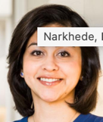


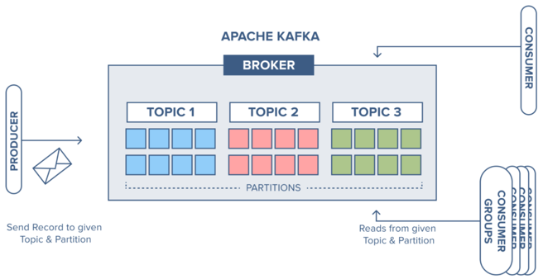
Apache Kafka
.. https://kafka.apache.org
.. https://en.wikipedia.org/wiki/Apache_Kafka
.. https://www.confluent.io
.. cloudkarafka.com/blog/part1-kafka-for-beginners-what-is-apache-kafka.html
Apache Kafka is a message bus.
It is an open-source software platform for parallel high-throughput low latency processing of streams for real-time data feeds.
Kafka can connect to external systems (for data import/export) via Kafka Connect.
Kafka provides Kafka Streams, a Java stream processing library.
Kafka was originally developed at LinkedIn, and was subsequently open sourced in early 2011.
Original authors - Jay Kreps, Neha Narkhede and Jun Rao.
Jay Kreps named ths framework "Kafka" after the author Franz Kafka because it is "a system optimized for writing", and he liked Kafka's work.
Kafka is one of several technologies available for continuous flow ETL (Kafka Streams, Apache Spark Streaming (micro-batches), NiFi, Apache Flink (continous flow), Google DataFlow (serverless), Apache Beam)
Jay Kreps
co-founder of Confluent
Neha Narkhede
Confluent co-founder
Jun Rao
Confluent co-founder
Request/Response chaining:
possible chaining of timeouts
possible inconsistencies
Publish / Subscribe (Publisher / Subscriber) model:
we add message broker between publish/subscribe nodes (Kafka, RabbitMQ, etc.) to decouple them
Event-Driven (on each step use log of events)
Push vs Pull
Distributed data sync and distributed transactions
Main idea - have at least 3 servers to get consensus of at least 2.
We need two thirds.
If M servers fail, we need (2M+1) working servers to "vote".

Slide 2
Messaging & Streaming
microservices, loosely-coupled systems
producers/subscribers
brokers - process messages (between producers and subscribers)
short-term persistence
Kafka:
message - immutable array of bytes
topic - a feed of messages
producer - publishes messages to a topic
consumer (single-threaded subscriber)
broker - one of the servers that comprise Kafka cluster
Kafka'a topic is basically a pipe, a messaging bus
When topic gets big - we replicate it into several partitions.
each partition topic has its own broker
messages distributed between partitions using consisten hashing
Within each partition we can maintain order of messages, but we lose order globally
New ideas:
add more calculation ability inside Kafka.
For example, instead of moving data through Kafka to a database,
and then doing query calculations in this database,
why can't we do these calculations in Kafka (or nearby microservices)
and get rid of the database ?
Lambda architecture:
database - slow complete batch processing
events queue - fast summaries from streams

Slide 3
Streaming Architecture
All parts exchange messages
There is no central database, no batch loading
There is just message bus (Kafka)
There are just topics in central streaming
/-- long term bounded analysis, high latency \
/ cassandra + spark \
kafka => cassandra
\ /
\-- temporary queue, unbounded, low latency /
event Framework
Kafka:
producers, consumer, topics
producers put messages into topics
consumers take messages out of topics
topics live on broker
if many topics and messages - broker needs to be partitioned (cluster).
Say, one topic is partitioned between 3 servers.
Then we lose ordering within topic, we only have ordering in each server.

