Slide 1
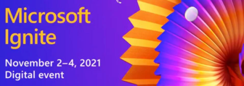

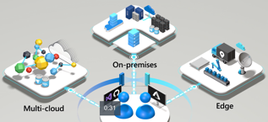
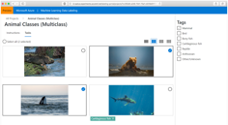
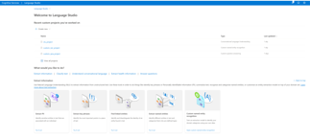
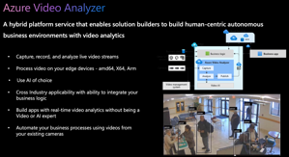
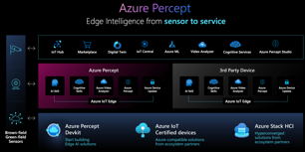

Azure Updates November 2021
Microsoft Ignite - an annual conference for developers .. https://news.microsoft.com/november-2021-ignite/
Azure Open AI Service (Preview) language models (large, pre-trained, even GPT3) .. https://azure.microsoft.com/en-us/services/openai-service/ .. https://www.youtube.com/embed/mD_tJMZmZ7U
Azure Data Labeling https://docs.microsoft.com/en-us/azure/machine-learning/how-to-label-data
Azure Arc - Unify on-premises, hybrid, and multicloud infrastructure with Kubernetes based deployment .. https://azure.microsoft.com/en-us/services/azure-arc
Azure video analyzer platform extract actionable insights from videos, whether stored or streaming .. https://azure.microsoft.com/en-us/products/video-analyzer/
Azure Language Studio .. https://docs.microsoft.com/en-us/azure/cognitive-services/language-service/language-studio
Container Apps Preview managed serverless container service – deploy containers .. https://azure.microsoft.com/en-us/updates/public-preview-azure-container-apps/ .. https://www.youtube.com/embed/fmGHEJL81rU
Azure Percept (for Edge apps) .. https://azure.microsoft.com/en-us/services/azure-percept/
Arc – Kubernetes deployment
Data Labeling
Language
Video Analyzer
Percept for Edge
Container Apps

Slide 2
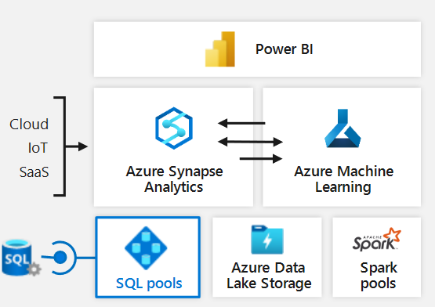
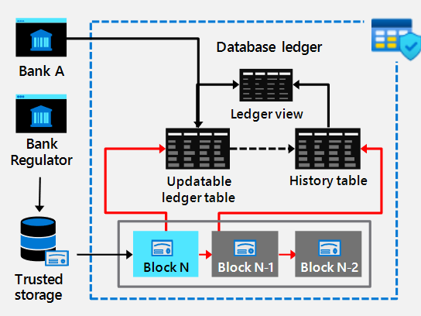
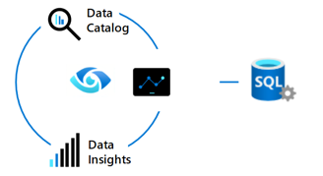
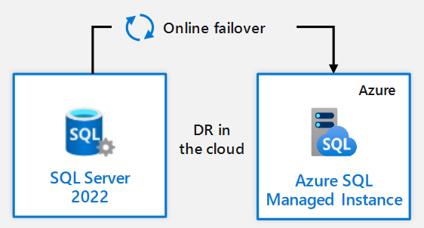
SQL Server 2022 – "Azure Enabled"
Announced November 2, 2021 fro private preview
https://www.sqlshack.com/sql-server-2022-private-preview-announcement/
SQL Server 2022 integrates with:
Azure Synapse Link ( avoid big ETL jobs between SQL Server and Azure Synapse)
Azure Purview
Failover back/forth from SQL Server 2022 and Azure SQL DB Managed Instances. Including restoring versionless databases from Azure SQL DB Managed Instances down to on-premises SQL Server 2022
SQL Server Ledger – blockchain immutable histories of tables
Performance! Parameter-sensitive plan optimization that caches multiple plans per stored procedure
Azure Synapse Link

