Slide 1
System Design Architectures
(Interview Prep)
p00 Main Concepts
p01 System_Design_Interviews_Intro
p02 URL_Shortening_service
p03 Pastebin
p04 Instagram
p05 Dropbox
p06 FB_Messenger
p07 Twitter
p08 Youtube_or_Netflix
p09 Typeahead_Suggestion
p10 API_Rate_Limiter
p11 Twitter_Search
p12 Web_Crawler
p13 Facebook_Newsfeed
p14 Yelp_or_Nearby_Friends
p15 Uber_backend
p16 Ticketmaster

Slide 2
Systems Design Main Concepts
Data Partitioning:
- Horizontal (Data Sharding) - by zip code, by type, ...
- Vertical (by feature), ex: profile, friends, photos
- Directory-based (flexibly add paths to more servers)
- Partitioning Criteria: key or hash, list, round robin, composite
- problem - joins difficult, use denormalization
- problem - referential integrity (check/reinforce in code)
- problem - rebalancing (some pieces grow bigger)
Indexes: - faster queries, but slower writes
Proxies: - Proxy = intermediate hardware/software server
- filter, log, transform, cache. Hides real IP address.
- Closed Proxy - servicing a group - to limit traffic.
- Open Proxy - open to anybody. (Anonymous, Transparent)
- Reverse Proxy - from service side
[client => proxy] ==> [services]
[client] ==> [reverse proxy ==> services]
Redundancy and Replication: - duplication of critical components, duplicating data, removing Single Point of Failure
SQL vs NoSQL:
- SQL - vertically scalable, ACID (Atomicity, Consistency, isolation, Durability).
- NoSQL: horizontally scalable, not ACID compliant.
- NoSQL types: Key:Value Stores (Redis, Voldemort, Dynamo), Document DB (CouchDB, MongoDB), Wide-Column DB (Cassandra, HBase), Graph DBs (Neo4J, InfiniteGraph).
CAP Theorem (Consistency, Availability, and Partition):
- Statement: You can not have all 3 at the same time.
Consistent Hashing:
- hashing on a circle - for distributed services to handle when servers failed (removed) or added. Ideas: 2^160 hash range, hash-move_clockwise, use 200 virt replicas for each server.
Long-Polling, WebSockets, Server-Sent Events:
- http-request, ajax-polling (frequent), http long-polling (server responds when data available or on timeout), websockets = full-duplex channel,SSE (Server-Sent Events) - persistent long-term sending data in one direction: Server --> Client
System Design Basics:
- pieces, how they work together, tradeoffs to choose.
Key Characteristics of Distributed Systems:
- Scalability (horizontal - more servers, vertical - bigger server)
- Reliability, Availability
- Efficiency - response time (latency) vs throughput (bandwidth)
- Manageability - early detect, easy diag, easy & fast fix
Load Balancing (LB):
- user---webserver, webserver---app, app---DB
- higher throughput
- can route to healthy servers avoiding downtime
- can route consistently (maintain state)
- predictive analytics - elastic growth
- various methods of distributing traffic: round-robin, weighted round-robin, IP Hash, send to least-loaded ( sort servers by N_connections, response_time, bandwidth
- Redundant LB (Master-Slave or Consistent Hashing)
Caching:
- Idea - recently requested data is likely to be requested again. - Can cache in memory or on disk.
- CDN (Content Distribution Network) - serve static media (images, video, etc.) from a separate (sub)domain.
- Cache Invalidation - 3 ways:
- write-through cache ( -->C, -->DB at same time) - good consistency, slower writes
- write-around cache (-->DB, then later DB-->C) - cache may have old data (cache miss)
- write-back cache (-->C, then later C-->DB) - very fast, risk of data loss
- Cache-eviction policies: FIFO, LIFO, LRU (Least Recently Used = not used recently), MRU (Most Recently Used), LFU (Least Frequently Used), RR (Random Replacement)

Slide 3
p01 System_Design_Interviews_Intro
Clarify – and write down requirements
Estimate scale (users, events, traffic, storage, ...)
Define system interfaces, for example:
postTweet(user_id, tw_data, tw_location, user_location, timestamp, …)
generateTimeline(user_id, current_time, user_location, …)
markTweetFavorite(user_id, tw_id, timestamp, …)
Define data model (entities)for example:
User: UserID, Name, Email, DoB, CreationData, LastLogin, etc.
Tweet: TweetID, Content, TweetLocation, NumberOfLikes, TimeStamp, etc.
UserFollow: UserdID1, UserID2
FavoriteTweets: UserID, TweetID, TimeStamp
Draw a high-level diagram, for example:
More detailed design:
How to partition data?
How to handle "big" users?
How to store data according to recency?
How to use cache?
How to improve load balancing?
How to mitigate SPFs (Single Points of Failure)?
How to mitigate several simultaneous outages (for all serivces)?
How to monitor performance?
How to alert about degrading or failure?

Slide 4
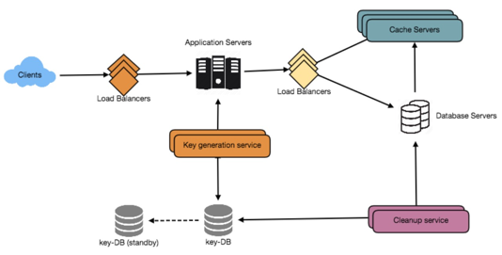
p02 URL_Shortening_service
Generating URL hash keys:
1. In advance (offline) - provide random keys as a service
2. generate online from row_id in DB
3. generate online from URL using some hash function and base62 encoding. The URL may need to be preprocessed for that (to make it not sensitive to url-encoding).
Requirements:
1. Generate short URL for a given long URL (on website, or via API).
Given: http://somedomain.com?some_very_long_tail
Generate: https://tinyurl.com/y74lpq94 (not guessable !)
or using custom alias: http://tinyurl.com/KindleWireless
2. Redirect short links to original links (HTTP 302 Redirect).
3. Have expiration (default or custom).
4. HA (High Availability), low latency, Monitoring and Analytics.
5. Protection against abuse ?
------------------
Capacity Estimation:
500M new URLs / month (~ 200/sec), URL life ~ 5 years
50B redirections/month (~20K/sec) (100:1 read/write ratio)
Storage: 500M * 5 years * 12 months = 30 B records
1 record = 0.5KB, so total storage = 15 TBytes
writing: 200*0.5KB/sec = 100 KB/sec
reading: 20K*0.5KB/sec = 10 MB/sec
Memory cache: use 80-20 rule: cache 20% of URLs which generate 80% of traffic (cache duration ~ 1 day):
20K reads/sec * 3600 sec * 24 hrs * 0.5KB * 20% = 170 GB memory
API:
createURL(api_dev_key, original_url, custom_alias=None, user_name=None, expire_date=None)
deleteURL(api_dev_key, url_key)
DB partitioning and replication for reads (using range-partitioning or consistent-hashng partitioning)
DB partitioning for writes
load-balancing
- Between Clients and App. servers
- Between App. Servers and DB servers
- Between App. Servers and Cache servers
caching (memcached) for reads
expiring service for caches
expiring service for DB
Telemetry
Security and Permissions
DB Table: URL
key: hash: varchar(16)
key: OriginalURL: varchar(512)
CreationDate:datetime
ExpirationDate:datetime
UserID:int
DB Table: User
key: UserID: int
Name: varchar(20)
Email: varchar(32)
CreationDate: datetime
LastLogin: datetime
NoSQL DB like DynamoDB, Cassandra, or Riak

Slide 5
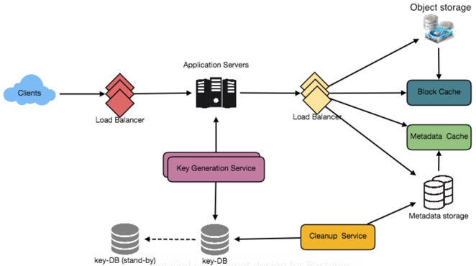
p03 Pastebin
Application layer: App servers, service to generate 6-letter random string - key of paste - KGS (Key Generation Service) which uses its own database ("keydb") with 2 tables: used and not-used. Also make master/slave.
Purging or DB Cleanup
Data Partitioning and Replication
Cache and Load Balancer
Security & Permissions
store plain text, generate unique URL to access it like https://pastebin.com/
Requirements:
1. upload (paste) text (<10MB), get unique/custom URL, expiration (custom?).
2. Reliable (no data loss), HA (High Availability), low latency, URLs - not guessable
3. Monitoring and Analytics, API, Protection against abuse ?
------------------
Capacity Estimation:
ReadsWrites = 5/1
1M new / day = 12/sec writes, 58/sec reads, 3.6 B pastes/10years
10KB average paste * 1M/day => 10GB/day, *10years => 36TB /10years
ID: 6 chars in base64 encoding [A-Z,a-z,0-9,.,-]: 64^6 = 69 B unique strings
ID storage: 3.6B * 6bytes = 22GB
Bandwith estimates: 12*10KB = 120KB/s write, 58*10KB/s = 0.6MB/s read
Cache: 80/20 rule: 5M reads/day => 10GB,
API:
addPaste(api_dev_key, paste_data, custom_url=None,
user_name=None, paste_name=None, expire_date=None) -> url
getPaste(api_dev_key, api_paste_key)
deletePaste(api_dev_key, api_paste_key)
Storage: keydb, metadata, object storage
NoSQL DB like DynamoDB, Cassandra, or Riak
DB Table: Paste; key: hash: varchar(16), ContentKey:varchar(512),
CreationDate:datetime, ExpirationDate:datetime, UserID:int
DB Table: User: key: UserID: int, Name: varchar(20), Email: varchar(32),
CreationDate: datetime, LastLogin: datetime

Slide 6
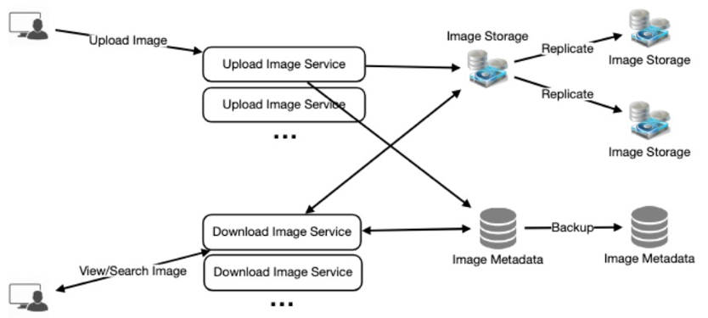
p04 Instagram
Application layer: uploads - slow, downloads - fast
Data Sharding - partition by UserID (UserID % 10).
Problem - possible imbalance.
Maybe partition based on PhotoId (64bit),shard = PhotoId % 10
For redundancy make 2 KeyGeneratingServers
Include date into PhotoId - to make it easy to pull most recent photos.
Ranking and newsfeed: get list of followers, get lists of their recent photos, rank them based on recency, likeness, etc., return to user. We can pre-generate newsfeed - and store in "UserNewsFeed" table. Pull data for NewsFeed, Push (using long-poll requests). Hybrid - pull for hot users, push for "small" users. Another approach - limit max rate of updates.
We need caching, CDNs for photos, memcache, 80/20 intelligent caching
Purging or DB Cleanup
Data Partitioning and Replication
Cache and Load Balancer
Security & Permissions
Requirements:
1. upload/dpownload/view photos & videos
2. search by title
3. users can follow other users
4. generate News Feed - top photos from followed.
------------------ not in scope - tags & comments
reliability (never lose data), High availability,
low latency for photos, fast NewsFeed in 200ms
Monitoring and Analytics, API, Protection against abuse ?
------------------
Capacity Estimation:
Reads/Writes = 5/1, 500M users, 1M daily users,
2M new photos/day,23 new photos/sec, 200KB average photo,
400GB/day photos, 1,500TB/10 years
Estimate of Metadata/day: 0.5GB/day, 4TB/10years
HDFS or S3 for photos
NoSQL for metadata
DB Table: Photo: key: PhotoID: int, UserID:int,
PhotoPath:varchar(256), PhotoLatitude: int,
PhotoLongitude: int, UserLatitude: int,
UserLongitude: int, CreationDate:datetime
DB Table: UserFollow: key: UserID: int, PhotoID: int
DB Table: UserFollow: key: UserID1: int, key: UserID2: int
DB Table: User: key: UserID: int, Name: varchar(20),
Email: varchar(32), CreationDate: datetime,
LastLogin: datetime

Slide 7
p06 Facebook Messenger
- one-to-one conversations, keep track of online/ofline status, persist chat history
- min latency, consistency, high availability
group chats, push notifications when offline
Capacity Estimation
500M daily users * 40 messages = 20B messages/day; 2 TB/day, 3.6 PB / 5 years
If one server can handle 50K connections, we need 10,000 servers.
Load balancer should maintain state (user to server mapping).
Each message comes with timestamp(s) – to maintain order.
Messages can be stored in HBase, which supports quick small updates, and range based searches. Note: in 2018 Facebook Messenger was switched from HBase to RocksDB (fast key-value store) as a MySQL storage engine. Note – RocksDB is based on a log-structured merge-tree (LSM tree) data structure.
The servers can broadcast the online status of a user to other relevant users. Clients can pull status updates for users who are visible in the client’s viewport on a less frequent basis.
Partitioning based on UserID.
Cache – 15 recent messages.
Load Balancing – in front of chat servers.
Fault tolerance & Replication.

Slide 8
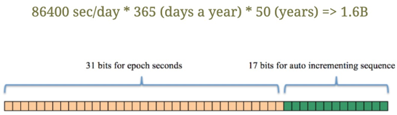
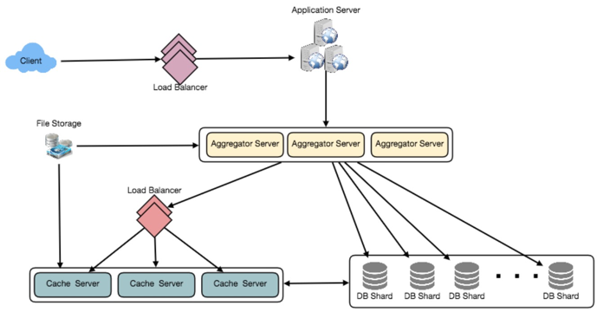
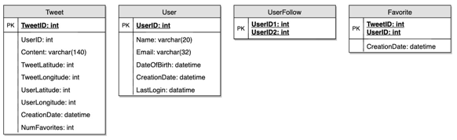
p07 Twitter
Sharding by combined TweetID and TweetCreatoinTime.
Cache, LRU (Least Recently Used) eviction , 80/20 intelligent (based on read traffic), cache last 3 days (100GB) - most tweets will be served from there.
key - ownerID, value - double-linked list from that user for last 3 days.
Replication, Fault Tolerance, Load Balancing, Monitoring, Analytics,
Requirements:
1. post tweets, follow users, mark favorites, create users' timeline (top tweets from followed), tweets can contain photos and videos.
HighAvail, Reliable (no loss), latency < 0.2s, relaxed consistency
Searching tweets, replying to a tweet, trending (hot topics/searches), tagging users, tweet notification, suggestions who to follow, moments.
------------------
Capacity Estimation:
200 M daily active users, 100 M new tweets daily, 1B favorites, tweets/day = 28 B/day
Stoage - 100M * 310 bytes = 30GB/day
For photos and videos ~24TB/day, ~300MB/sec uploads, 35GB/sec downloads
------------------
API: tweet(api_dev_key, tweet_data, tweet_location, user_location, media_ids)

Slide 9
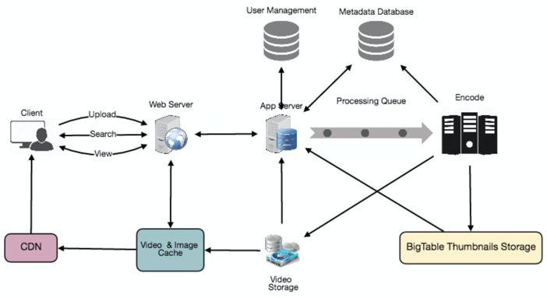
p08 YouTube Netflix
processing queue (encoding, thumbnail, storage)
encoder
thumbnail generator
storage (video and images)
user DB
video metadata DB
----------------------------------------------------------
segregate read / write traffic
thumbnails - store in BigTable
Sharding videos based on VideoID (hashing)
Centralized index and ranking servers
Cache for hot videos, 80/20 intelligent
Video de-duplication - video matching algorithms (Block Matching, Phase Correlation)
Load Balancing, Consistent Hashing
CDNs replicate content, use cache
Consistent Caching for Fault Tollerance.
Requirements:
Upload videos, view, share
search based on titles
likes/dislikes, number of views, etc.
comments
HA, Reliable, no lag on videos
Not in scope - recommendations, popularity, channels, subscriptions, watch later, favorites, etc.
------------------
Capacity Estimation:
1.5 Bln users, 800 M daily, 5 vid/day, 46K videos/sec views, 1TB/sec outgoing traffic
230 videos/sec upload (25GB/sec)
------------------
API:
uploadVideo(api_dev_key, video_title, vide_description, tags[], category_id, default_language, recording_details, video_contents)
searchVideo(api_dev_key, search_query, user_location, maximum_videos_to_return, page_token)
streamVideo(api_dev_key, video_id, offset, codec, resolution)
Tables:
VideoID: title, description, user, likes, dislikes, etc.
CommentID: videoID, UserID, comment, ...
UserID: Name, email, ...
Video storage: HDFS or GlusterFS

Slide 10
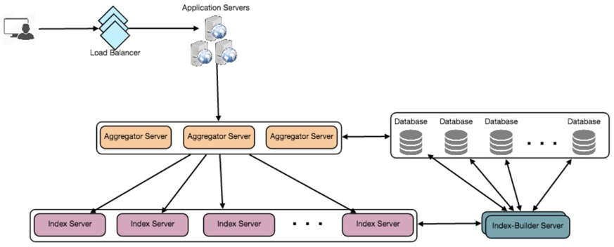
p11 Twitter Search
system-wide unique TweetID
730 Billion tweets in 5 years. So we need at least 5 bytes (50 bits) for ID.
Let's use 6 bytes (48 bits): 31 bits epochseconds and 17 bits increment (reset it every second).
Building index. 500K words at 5 bytes each = 2.5MB. Let's index 2 years of tweets - ~300 Billion tweets,
~ 1,500 GB on tweet IDs. index: key = word, value - tweets' IDs. Total size estimate for that - 21TB
If each server has ~150 GB memory, we need 152 server to keep the index in memory.
How we partition it? By words? - it will be very unbalanced. Consistent hashing?
Sharding based on TweetID.
We have two sharded systems: tweets DB servers and index servers. How we map them to each other?
Our index-building server will hold this info as a hash: Index_server : all_its_tweet-IDs. Cache - memcached
Load Balancing
Ranking the search by social graph distance, popularity, relevance, etc.
We can store ranking with each tweet in the index.
Requirements:
1. post tweets, follow users, mark favorites, create users' timeline
(top tweets from followed), tweets can contain photos and videos.
HighAvail, Reliable (no loss), latency < 0.2s, relaxed consistency
Searching tweets, replying to a tweet, trending (hot topics/searches),
tagging users, tweet notification, suggestions who to follow, moments.
------------------
Capacity Estimation:
800 M daily active users, 400 M new tweets daily, 730 B in 5 years
500 M searches/day, 120GB/day, 1.4MB/sec
search: text, AND,OR
How to store/query tweets?
------------------
API: search(api_dev_key, search_terms, maximum_results_to_return,
sort, page_token)

Slide 11
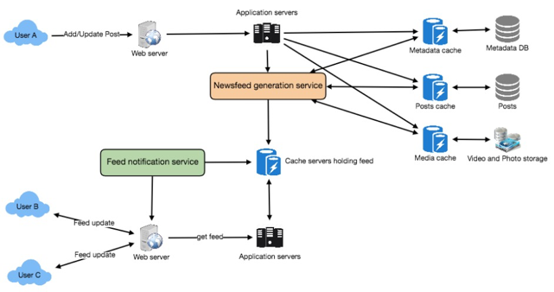
p13 Facebook Newsfeed (NF)
Retrieve IDs of all users and entities that user follows.
Retrieve latest / popular / relevant posts for those IDs.
Rank posts (recency, Nlikes, Ncomments, Nshares, video? image?, relevance to User, etc ...), store in Feed Cache. Tune ranking using user stickiness, retention, ads revenue, etc.
Note: Feed generation can be done in advance (offline) based on user hotness, patterns
Note: slow user's activity can be fan-out to their friends, "hot" posts - pulled on request
On request return top (or next) 20 posts to client.
Client: request feed (on load, on reaching the end)
Feed for active user - every 5 min check/add new posts (if any) - and notify client.
Client, WebServer, AppServer
DB_&_Cache - users, pages, groups
DB_&_Cache - posts
Storage_&_Cache - Video & Photo
Service: NF generation (gather & rank posts, store in cache)
DB_&_Cache - Feed
Service: NF notification to user about new items DB partitioning and replication (sharding, consistent hashng), load-balancing, caching (memcached), expiring service for caches, expiring service for DB, Telemetry, Security and Permissions
Requirements:
1. Generate NF (in 1-2 sec) for a user based on posts & pages of people and groups this user follows. Feed may contain images, videos, or just text.
2. New posts should become available to NF in less than 5 sec
------------------
Capacity Estimation:
average user has 300 friends and follows 200 pages
300M daily active users fetching NF 5 times/day, or 1.5B/day (~18K/sec)
NF =~ 500 posts (in cache), each ~1KB, so 500KB /user, or 150TB memory for active_users. If 1 server can keep 100GB, we need 1,500 servers.
------------------
API: getUserFeed(api_dev_key, user_id, since_id, count, max_id, exclude_replies) -> returns JSON object
DB Table: User: key: UserID: int, Name: varchar(20), Email: varchar(32), DateOfBirth: datetime, CreationDate: datetime, LastLogin: datetime
DB Table: Entity: key: EntotyID: int, Name: varchar(20), Type: tinyint, Description: varchar(512), CreationDate: datetime, Category: smallint, Phone: varchar(12), Email: varchar(32)
DB Table: UserFollow: key: UserID: int, key: EntotyOrFriendID: int, Type: tinyint
DB Table: FeedItemr: key: FeedItemID: int, UserID: int, Contents: varchar(256), EntityID: int, LocationLatitude: int, LocationLongtitude: int, CreationDate: datetime, NumLikes: int
DB Table: FeedMedia: key: FeedItemID: int, key: MediaID: int
DB Table: Media: key: MediaID: int, Description: varchar(256), Path: varchar(256), LocationLatitude: int, LocationLongtitude: int, CreationDate: datetime

Slide 12
p13 Facebook Newsfeed Ranking
xxxx
2004 - FB is born
2006 - Newsfeed added
2007 - Like button
2009 - Sorting order in newsfeed (algorithm) based on post popularity
2010 - EdgeRank algorithm using sum(u*w*d), where u – user affinity (to another user or content), w – content weight (popularity, what action user takes), d – time-based decay 2015 - "See First" feature
2016 - Priority based on user time spent
2017 - Reactions weighted more than Likes
2018 - Post that receive comments weigh more (meaningful interactions)
2019 - "Why am I seeing this?" tool
https://blog.hootsuite.com/facebook-algorithm/

Slide 13
p14 Yelp
Quad Tree
Requirements:
1.
------------------
Capacity Estimation:
xxx
API:
xxx
DB Table: XXX
xxx
Sharding based on LocationID
Algorithms:
DB partitioning and replication
Load-Balancing
Caching (memcached) for reads
Expiring service for caches, for DB
Telemetry
Security and Permissions

Slide 14
p15 Uber Backend
Algorithms:
DB partitioning and replication
Load-Balancing
Caching (memcached) for reads
Expiring service for caches, for DB
Telemetry
Security and Permissions
Requirements:
1.
------------------
Capacity Estimation:
xxx
API:
xxx
DB Table: XXX
xxx

Slide 15
pXX Title
Algorithms:
DB partitioning and replication
Load-Balancing
Caching (memcached) for reads
Expiring service for caches, for DB
Telemetry
Security and Permissions
Requirements:
1.
------------------
Capacity Estimation:
xxx
API:
xxx
DB Table: XXX
xxx

