Slide 1
Management – Project, Product, Team, Career, ...
Main Ideas:
Crystal clear understanding of the requirements. Involve all business stakeholders into the planning process. Make sure they agree on the plan.
Crystal clear understanding of priorities: what is important – and what is "nice to have".
Concentrate only on important features, sacrifice the rest.
Simplifty, simplify, simplify.
Split big job into small pieces, small steps.
Grow project as a child from few features to full-featured product.
Military style hierarchical management is not effective. Respect workers, leverage their brains, give them freedom to be effective, to communicate and collaborate.
Give people tasks that match their abilities.
Create safe and engaging atmosphere.

Slide 2
Table of Contents:
Begin with the end in mind
Splitting Big Problems Into Small Doable Steps
Split project into "buckets" (write book in 2 weeks)
First Principles Thinking
Simplicity, sacrifice for simplicity
Unix – simplicity
Unix – toolbox vs monolitic application
Dinosaurs, Distributed Systems, Simple vs Right
Simplicity vs politics
Growing a project as a child
Hacker vs Architect
Create "Clickable Dummy"
from Waterfall to Agile
Scrum (restart)
Project Mаnagement Process
DevOps
Simple PM tools
Vision and Enthusiasm
Unique Abilities
Managing Career - Get Promoted into Leadership
Parkinson Law
Brooks Law
Peter Drucker
One Minute Manager
One Minute Manager Meets the Monkey
Power and Mindset
"Getting Things Done" - by David Allen
7 Characteristics of Weak Product Management
Quotes about managing people
Self-management, Holacracy
Thomas F. Gilbert - Human Performance Technology

Slide 3
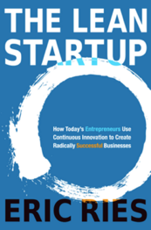
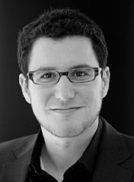
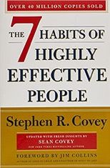
Begin With the End in Mind
Eric Ries
Ries has experienced two startups failures, and attribute the error in both cases as "working forward from the technology instead of working backward from the business results you're trying to achieve."
Habit 2: Begin With the End in Mind
from "The 7 Habits of Highly Effective People" by Stephen Covey
All 7 habits:
be proactive
begin with the end in mind
put first things first
think win-win
seek first to understand, then to be understood
synergize
sharpen the saw
Main ideas in his book:
One must begin with the customers in the form of interviews and research discovery
Building an MVP (Minimum Viable Product) and then testing and iterating quickly
Ries also recommends using a process called the Five Whys, (Why ..., Why ..., Why ..., Why ..., Why ...) a technique designed to reach the core of an issue

Slide 4
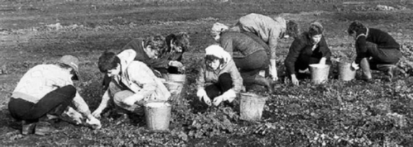
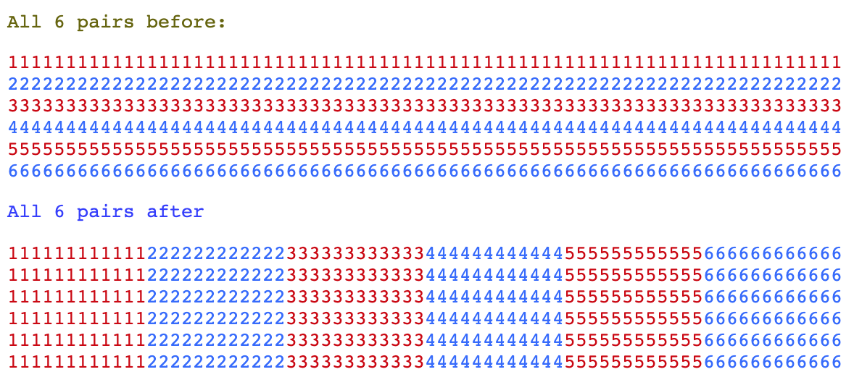
Splitting Big Problems Into Small Doable Steps
When I was a student (in Moscow, Russia, 1975), we were sent to suburbs to collect vegetables (carrots). The task was simple. We were separated in pairs, and each pair had a ~120 meters long row of carrots to collect in 1 day. There was 6 pairs starting side-by-side like runners at a sport competition. At the end of the day nobody finished even 50% of their norm. It was taking 2 days to finish the norm.
This continued for several days, and then our manager (who was a 1st year post-graduate student) made a very simple and very magical change. He simply split one long row into 6 short rows. Each pair of students now received a set of 6 rows 20 meter each.
You can ask – what's the difference?
Well, this day the whole field was finished by 2 pm !
It took only 5 hours to do what before was taking 2 full days (16 hours) !
This is 3-times increase in productivity.
Without any incentives !
I can tell you how it felt.
You start working on one row - and pretty soon you see that you can reach its middle in a short time. So you decide to take a break at the middle.
But when you reach it - you could see that it is actually very easy to finish the row - and then take a break. And when you finished the 1st row - you see that now only 5 left. So you estimated how long it took you to finish the previous row - so you can tell when you will finish the next row. etc.
The work started to feel manageable. And everybody rather enjoyed the process. It was addictive.
Do you want to increase effectiveness 3-fold? Then plan your work as a set of simple manageable self-contained and self rewarding steps.

Slide 5

Split Project into "Buckets"
Similar approach is used by teachers in schools with "slow" kids.
If you ask a child to draw a picture of a ship, he will not be able to do it and will get upset.
But you can make a simple step-by-step plan for the child:
.. get a box of pencils
.. sharpen the pencils
.. get a sheet of paper
.. get a book with pictures of ships
.. select a picture you like
.. etc.
The child can now follow this plan.
Result – he successfully creates a picture. And he is happy and proud.
I remember a wonderful course by Steve Manning:
"How To Write A Book On Anything
In 14 Days or Less… GUARANTEED!!"
His approach was:
Create a title
Create a list of ~10 chapters
Create a list of ~10 topics (buckets) inside each chapter (each topic requires approximately ¾ of a page of text) – so you have total of ~100 "buckets".
Fill the buckets with some content. Do NOT edit. Do not return back. Just type something into those "buckets". Fill them in random order.
Edit buckets one at a time in reverse direction (start from the end of the book and move towards the beginning). This way each bucket could stay on its own.
Do more editing ...
You can use similar approach when creating any kind of documents (PowerPoints, Project Plans, etc.).
Different "Bucket Sizes" for Different People:
Some team members can execute the high level command ("draw a ship") all by themselves. They can figure out the steps – and execute them.
But most of people need to receive a step-by-step plan. Some people require a very detailed plan.
A good manager should calibrate the size of the steps individually for each team member to make them effective workers.

Slide 6
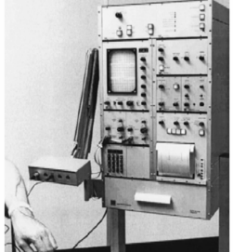
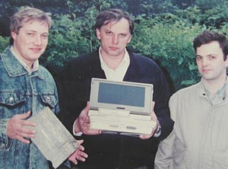
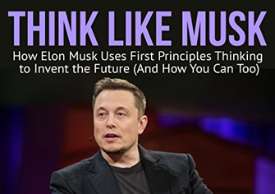
First Principles Thinking
First principles thinking (FPT) is thinking from scratch, actively questioning every assumption. FPT means to reverse-engineer complicated problems, break them down into basic elements, and then reassemble them from the ground up.
FPT requires courage and going against rules (fresh thinking):
"Never be afraid of doing tasks you are not familiar with. Noah's Ark was built by an amateur. Professionals have built the Titanic."
"The safest way to go on strike and achieve nothing is to do everything by existing rules."
In 1989-1991 I participated in designing a first in Russia portable myograph. As you see, the device was very small and integrated with a laptop computer. Compare it with a prototype which was the size of a table (b/w photo on the left).
We managed to make it small by thinking from scratch and moving as much functionality as possible from hardware to software.
We didn't have a lot of resources and couldn't do things right. But we knew the key requirements, and all other pieces eventually fell into place.
Our competitors having literally 100 times more resources (money, people, etc.) had never finished the project. Because they wanted to make things right. So they drew a plan, distributed responsibilities, debated and agreed on a 5-year budget - and they have never (NEVER) delivered a final product.
The first time I've heard about FPT was from an interview with Elon Musk. He uses this type of thinking to design a cheap rocket from scratch, to re-engineer electric cars, to everything he does.

Slide 7
Simplicity
"There are two ways of constructing a software design; one way is to make it so simple that there are obviously no deficiencies, and the other way is to make it so complicated that there are no obvious deficiencies. The first method is far more difficult." - C. A. R. Hoare
"Make everything as simple as possible, but not simpler. " - Albert Einstein (1879-1955)
"Thank you, Lord, for making all necessary things simple, and all complicated things unnecessary" - H. S. Skovoroda (1722-1794)
"Any intelligent fool can make things bigger, more complex, and more violent. It takes a touch of genius -- and a lot of courage -- to move in the opposite direction." - Albert Einstein (1879-1955)
KISS principle - Keep It Simple, Stupid - is largely used by military, and is attributed to Clarence Leonard 'Kelly' Johnson (1910-1990), who worked for Lockheed Martin
"You can see that [with a simpler toolkit] the amount of extension programming goes up considerably. What you don't see is that the total implementation effort may be much lower because the underlying toolkit is much simpler. There the programmers need spend much less time reading documentation, fitting their new software into the old, etc. Sometimes less is more. " - Philip Greenspun, https://philip.greenspun.com

Slide 8
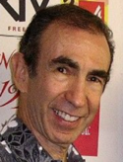
Prioritization is the key
Warren Buffett 5/25 rule:
Write down 25 tasks you think are important.
Choose just the top five – and do only them.
Many projects failed because their architects failed to make things simple. They tried to make things right. As a result they have built systems which were never quite operational and couldn't survive change.
Find simple ways to do things.
Try to find a way to complete project in two weeks. If you can't see that you can complete the project in 2 weeks - don't do it immediately. Think first.
Because if you think it takes 2 weeks - it will take 2 months.
And if you think it will take 2 months - it will take a year.
And in the middle you or your boss will realize that it should be done differently - thus you will never finish it.
Your success depends on being focused on the most important tasks/features.
Your success depends on cutting off all tasks/features which are secondary.
Common reason of failure is that people spend time on doing things which shouldn't have been done at all in the first place.
F**k it, we don't need it
Simplify the design, sacrifice some features
"Do we really need it ?" Often 10% of features takes 90% of your programming time. By sacrificing them you may make your project 10 times simpler.
Same principle can be applied to the features of programming architecture. Trying to make perfect code may make your project 10 times more complex.
The legendary marketer Joe Sugarman had a little formula for judging any project he gets involved in. He called it “ELF” (Easy, Lucrative, and Fun).
Make your project an ELF project.
Joe Sugarman

Slide 9
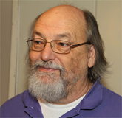
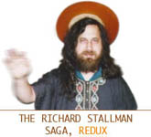
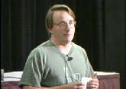
Unix – Example of Simplicity of Design
Unix is the dominating OS (~2 Bln android devices, ~1 Bln iOS devices, ~1 Bln servers in clouds, 100 Mln Macs, etc.).
Ken Thompson has created Unix OS in 1969.
Nowadays he works at Google as one of creators of the “Go” language:
- https://www.youtube.com/watch?v=sln-gJaURzk -
In this article ( http://www.linfo.org/thompson.html ) you will learn how
Ken Thompson has developed the UNIX operating System in assembly
language (to assist himself in playing and creating computer games)
in ~1969, then created the B-language, and later rewrote it’s
kernel in C-language developed by Dennis Ritchie in ~1972
First UNIX was running on computer with only 4K of memory!
Then Thompson returned to UCB (University California Berkeley)
and while being there in 1975-76, he introduced people there to Unix,
which started the UCB clone of Unix (BSD = Berkeley Software Distribution).
This later became the foundation of Mach OS for Steve Job’s NeXT Station,
which was later acquired by Apple, and is the heart of modern MacOS and iOS.
Linux is an independent open source POSIX implementation of Unix.
Android OS is a Google’s version of Linux (android phones & tablets).
1980s - Richard Stallman creates a free software movement (GNU project)
which led to development of numerous software tools.
1991 - Linus Torvalds, young student at the University of Helsinki in Finland,
releases (posts on the Internet under GNU license) the first version
of Linux's kernel (Ver. 0.02), which he developed as a hobby.
Ken Thompson (born 1943)
Linus Torvalds

Slide 10

Unix – a toolbox vs finished application
Unix was designed as a minimalistic set of small basic utilities and ways you can combine them to make more complex systems. Simplicity allowed it to be very reliable, extensible and maintainable. And eventually to win against all other operating systems.
You have to decide very carefully whether you really need to deliver a finished application, or if the client will be much happier with a toolbox (set of tools and modules) giving him functionality he needs.
It is ~100 times more difficult to deliver a finished application, because you have to test it on all supported platforms, provide documentation and customer service, work out all small details. On the other side, finished application is not flexible and may not fit customer needs. The bigger the client - the more flexibility he may require.
Thus it makes no sense to spend too much time on making a turn-key application for a big client. Instead you may design a set of modules which allow to easily construct custom applications for the client. Working with many clients you will add more modules to the system making it more valuable to your market.
Each individual module can be small, manageable and reliable. The custom application as a whole will be probably built by the client, so you don't have to provide customer support on it's quality.
Thus by shifting your goal from making a compiled product to making a toolbox, you made your work 10..100 times simpler and easier - and you made yourself 10 times more valuable to the marketplace.

Slide 11



Simplicity vs Dinosaurs
Simple vs "right"
Big complex systems remind me of dinosaurs. Do you remember what happened to them? And who is now dominating the Earth?
Today (as always) we face 2 conflicting requirements:
- systems get larger and more complex
- systems need to change more often - and changes should be made faster
When things change faster and faster - simplicity becomes a "live or die" requirement.
In many situations you literally don't have enough time to make things "right" or complex. Or even "completely finished".
What do you prefer - a simple system which does the job - or a system which is architectured "correctly", - but never quite works, and can't be adapted to your requirements fast enough?
So don't try to make things right. Make things simple instead.
Distributed Systems and Simplicity
In big organizations you can't get all departments to use the same programming language, the same systems, the same versions of software.
All you can do is establish some pretty liberal general guidelines and rules of communication.

Slide 12


Multitasking is bad
A
Rip benefits: make money, used by other teams, etc.
Single tasking is good:
focused, effective
start benefit from projects faster (make money)
no wasted time on switching
less reporting
Under-performance: With too many tasks, you spend more time rotating between them then actually doing something productive.
And you can not think productively !
B
Rip benefits
C
A
Multitasking:
no benefits until the very end
lost time and opportunity
delayed work of other teams
wasted time on switching
more management / reporting
B
CrazyBusy: Overstretched, Overbooked,
and About to Snap! Strategies for Handling Your Fast-Paced Life (2007)
by Edward M. Hallowell M.D.
Video:
https://www.youtube.com/watch?v=HhoXGXtShGs
C

Slide 13
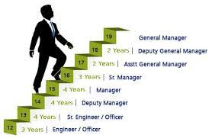
Simplicity vs Politics
Be carefull when offering simple solutions to managers of big organizations.
An individual developer usually will select a simple solution.
But a manager at a big organization will, on the contrary, almost always select the political solution, which is usually more complex and expensive.
Please note, that managers are NOT stupid. They are doing the right political move in order to survive and grow in the organization, get more people under them, get promoted, increase visibility and weight of their department, etc. Yes, they are doing the right thing for them !
This right thing may not be the best thing for the organization or the product, but managers will never admit that. And they usually will get promoted despite losing millions of dollars and failing to build effective systems.

Slide 14
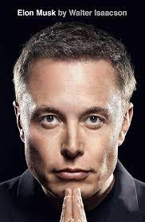
Elon Musk's Algorithm
The 5 steps of Musk's algorithm to bust bureaucracy at his production
Question every requirement, who specifically created it and why. "Requirements from smart people are the most dangerous because people are less likely to question them. Always do so, even if the requirement came from me. Then make the requirements less dumb."
Delete any part of the process you can. Deleting just a bit more than you feel comfortable with. "You may have to add [parts or processes] back later. In fact, if you do not end up adding back at least 10% of them, then you didn't delete enough."
Simplify and optimize. "A common mistake is to simplify and optimize a part or a process that should not exist."
Accelerate cycle time. "Every process can be speeded up," says Musk. "But only do this after you have followed the first three steps. In the Tesla factory, I mistakenly spent a lot of time accelerating processes that I later realized should have been deleted."
Automate. Musk: "[Automate] comes last. The big mistake in [my factories] was that I began by trying to automate every step. We should have waited until all the requirements had been questioned, parts and processes deleted, and the bugs were shaken out."
"Elon Musk"
by Walter Isaacson
September 12, 2023

Slide 15

Growing a Project as a Child
Let's say you started a web site with just one page.
Then you added some more.
You working one page at a time.
Each page is a finished product.
Together pages make a system - your web site.
This system growth is stable.
You always succeed, because each step is simple enough and rewarding enough.
This is example of evolutionary development.
You start from a simple bare bones single function utility.
Then you write another one. And another.
You add features. You combine them together - and finally you have a product.
You allow the program to grow as a child. When the child is born - you don't know exactly what it will grow into.
May be the product itself will not be a success - but one of the components will.
The art is to structure the development process into a set of easy and rewarding small steps.
The art is to structure the development process so that the product starts to be useful at early stages. And then it grows and improves with the feedback from users.
If software is simple and useful - it can start with a 2-week project - and then grow as a child.
If software is not simple or not useful - it will be very difficult for it to grow or even survive, regardless of how much time and money were originally invested, or how "right" was its design.
I wrote this - and then found that I was not the first who formulated this. See for example www.dreamsongs.com/WorseIsBetter.html - "Worse Is Better" by Richard P. Gabriel.

Slide 16
Hacker vs Architect
Example. Let's say you need a report. So you asked two programmers ( John Hacker and Bob Architect ) to create it.
John Hacker hacked a script in one hour and emailed you the report.
You looked at the result - and realized that your original requirements were not correct. So you asked to make changes, which John emailed you in the next 10 min.
After going back and forth 5-10 times you were completely satisfied.
You could customize the reports providing some simple parameters on the command line or in a short text file. John sent you all the scripts along with a short README instructions text file.
He also put the scripts on the web server and made a simple web page for you to run the report in the browser – and either download it – or receive via email.
Bob Architect, on the other hand, is a true believer that if you do things right - it will save you effort in the long run. (wrong) So he started with drawing UML diagrams using Rational Rose or TogetherJ to make proper Object Oriented design of the "report engine".
He also decided to make a proper GUI interface.
At the time when John Hacker went through 10 revisions, Bob Architect was still busy thinking about distributing responsibilities between his classes and interfaces, and was very proudly telling you about his elegant design of "request manager", "cache manager" and "report manager".
Finally he made the application work - but it took him 10 times longer.
And when he finally finished, you already needed a different report. So you asked him to change the reports. He said that it will take him long time because your new requirements don't fit well into his object model, so he will have to start from scratch.
Does all this sound familiar?
In this scenario, first programmer sacrificed some features (GUI, OO design), which allowed him to complete the job much faster, and then to use user's feedback to make multiple changes to make the "product" good and easily maintainable.

Slide 17
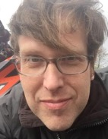
Create "Clickable Dummy"
Projects have three basic components:
cost, schedule, scope
But figuring them out (specifying what to do,
the actual scope, cost, and schedule)
may take 30-50% of the project.
Jesse Erlbaum recommends to agree
with clients on a two-phase approach:
1st phase - 30-50% of cost/effort preparing specifications and estimate (create "clickable dummy" of an app.)
2nd phase - 70-50% of cost/effort actually implementing
Jesse Erlbaum
Erlbaum Group,
New York
http://www.erlbaum.net

Slide 18
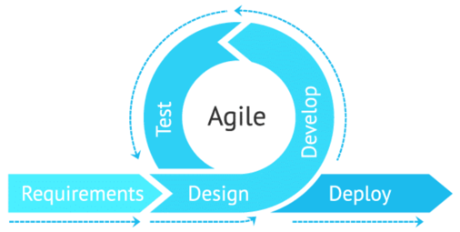



From Waterfall to Agile
Waterfall
Agile
The Waterfall methodology has its origins within the manufacturing and construction industries, ... however, the term “Waterfall” wasn't used.
A paper written in 1976 by T.E. Bell and T.A. Thayer is when the term may have been first used.
In 2001, a team of 17 visionary software developers held a meeting in Utah to discuss industry problems and possible solutions.
They later created what is known throughout the industry as the Agile Manifesto.
Analysis
Requirements
Design
Development
Testing & Integration
Deployment
Maintenance

Slide 19
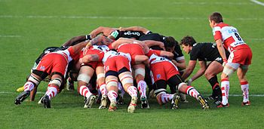
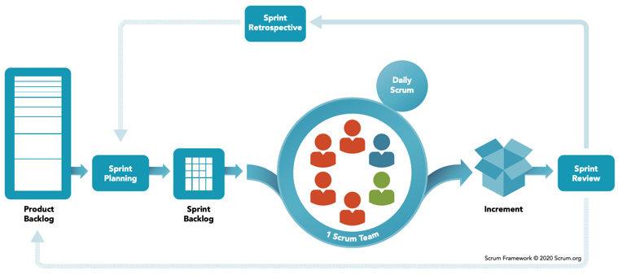
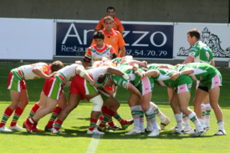
Scrum
A scrum (short for scrummage) is a method of restarting play in rugby football that involves players packing closely together with their heads down and attempting to gain possession of the ball.
Scrum is a framework for developing, delivering, and sustaining products in a complex environment.
It is simple and effective.
Importan components are:
product backlog
planning sprints (sprint backlog)
daily scrum meetings
sprint review and retrospective

Slide 20
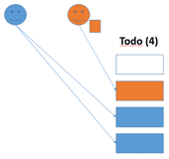
CONWIP - Constant Work In Progress
“Stop starting and start finishing”
Better approach - limit the total number of tasks in the Kanban board instead of just limiting tasks per column.
CONWIP – use "tickets".
Each key account manager gets two "Todo tickets" to use on the Kanban board. Once placed on the board, the ticket would then be stuck to the task, until it had travelled all the way to the Done column. Only then would it be released back to the owner.
2017 by Thorbjørn Sigberg
https://www.miles.no/case-study-the-pursuit-of-flow-part-1/
https://www.miles.no/case-study-the-pursuit-of-flow-part-2/
https://kanbanize.com/blog/patrick-steyaert-customer-kanban/
The goal – to improve throughput and quality of the team efforts by limiting
the number of tasks on the Kanban board.
First improvement – set smaller WIP (Work In Progress) limits on columns.
The new board had up to 40 tasks in the following columns:
Backlog (invisible) | Todo(10) | In progress(20) | Acceptance(10) | Done
We reduced 12 (!) different classes of service down to the following four:
Normal, Fixed deadline, Urgent, Critical
New tasks were selected based on priority, capacity and competence
Focus on unblocking and finishing existing tasks before starting new ones
Do not start new task without enough information/resources to complete it
Completed tasks are moved to “Acceptance”. It is not moved to “Done” until the customer accepted it.
In addition, each of 7 account managers would get an extra (3rd) ticket for small, urgent tasks. So we had 14-21 tickets on the board. Also bugs/problems would not require a ticket, to ensure priority.
For faster rotation of tickets, account managers started to slice their tasks into smaller chunks. They were also more eager to help out with blocked tasks and helping to get customer's acceptance.
The effect was dramatic – more done in less time:
cycle time reduced from 10 to 4 days
lead time reduced from 4 weeks to 1 week
much less stress, less tasks in progress at any given time

Slide 21
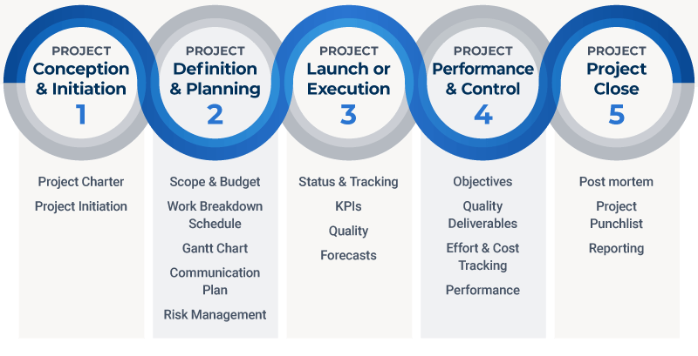
Project Management Process
Project Management:
Formal project management structure (processes, procedures, and tools)
Invested and engaged project sponsor(s) (executives promoting the project)
Clear and objective goals and outcomes
Documented roles and responsibilities
Strong change management (protect from "scope creep")
Risk management
Mature value delivery capabilities (project tools, processes, and procedures)
Performance management baseline (for cost, schedule, and scope)
Communication plan

Slide 22
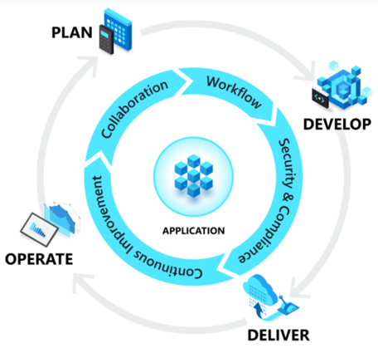

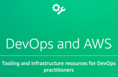

DevOps
What is DevOps
DevOps = Development (Dev) + Operations (Ops)
DevOps is the union of people, process, and technology.
DevOps enables formerly siloed roles
development
IT operations
quality engineering
security
to coordinate and collaborate to produce better, more reliable products.
By adopting a DevOps culture, practices and tools,
teams gain the ability to better respond to customer needs, increase confidence in the applications they build, and achieve business goals faster
Azure DevOps - a Microsoft product that provides version control, reporting, requirements management, project management, automated builds, testing and release management capabilities. It covers the entire application lifecycle, and enables DevOps capabilities
AWS
Google

Slide 23
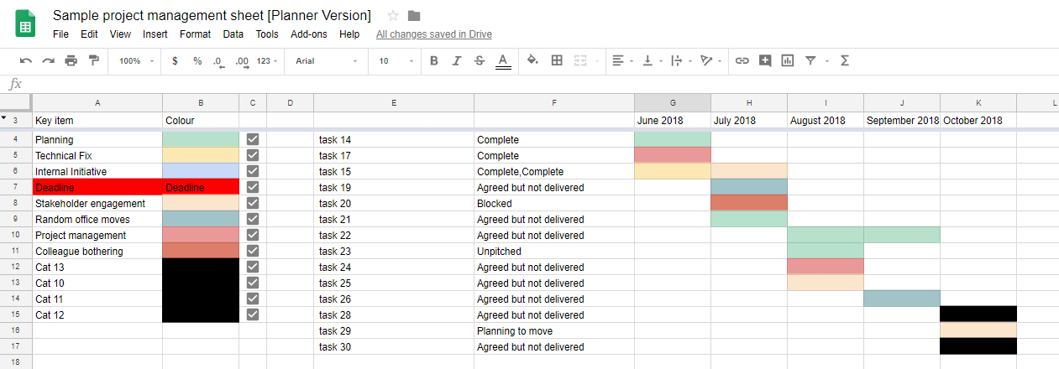
Simple PM Tools
Some software similar to JIRA:
ClickUp
Binfire
Basecamp
Pivotal Tracker
Clubhouse
Trello - https://trello.com
ProofHub
Kanbanize
Notion
Wrike
Bitrix24
Azure DevOps - https://dev.azure.com
Jira - https://www.atlassian.com/software/jira
SmartSheet - https://www.smartsheet.com
Asana - https://asana.com – good
ProjectLocker - https://www.projectlocker.com (based on Trac - https://en.wikipedia.org/wiki/Trac)
See long ( ~40 ) list of DevOps & bug-tracking tools here:
.. https://en.wikipedia.org/wiki/Comparison_of_issue-tracking_systems
Note that for small scale projects people successfully use use Google Docs/Sheets:
- https://moz.com/blog/visualising-time-using-google-sheets

Slide 24
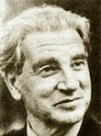
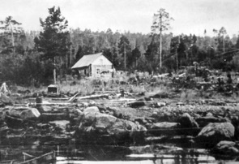

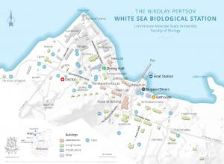

Vision and Enthusiasm
According to Peter Diamandis, successful people (self-made billionaires) tend to have an attitude which can be expressed as following: "We will build it – and it will be great !"
In 1951 Nikolai Pertsov was appointed as a Director of White Sea Biological Station of Moscow State University. When he arrived at the place designated as Belomorskaya Biostation MSU, there was nothing there except for a small shed – a "cabin" and several tents.
Nikolai Pertsov launched intense activity. He didn't have the necessary funds. But he was good at captivating people with enthusiasm. He has built a laboratory and homes, got hold of the present fleet of several boats, laid electric and telephone lines through miles of "taiga" (forest), provided necessary scientific and educational equipment.
Nowadays hundreds of students and staff are coming to the bio-station every year. Dozens of books, thousands of scientific articles, hundreds of PhD degrees, thousands of trained professionals - this is the result of the activity led by Nikolai Pertsov's bio-station.
The really interesting fact about the history of the station is that almost all construction work was done by volunteers. Nikolai Pertsov had an amazing skill of making people enthusiastic about the project and making them willingly work on it.
- https://en.wikipedia.org/wiki/White_Sea_Biological_Station
- https://persona.rin.ru/eng/view/f/0/21543/pertsov-nikolai-andreevich
Nikolai Pertsov (1924–1987)

Slide 25
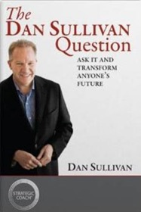
Unique Abilities
Unique Abilities:
It is very important to align the roles of team members with their personal skills, preferences, and career goals.
Some people like to work with software, others like to do system configurations and networking/security. Some people like math and data analysis, others like graphical design. Some people enjoy creating architectures and making PowerPoint presentations, others are great at managing people.
It is a good idea to ask a "Dan Sullivan Question":
"If we were having this discussion three years from today, and you were looking back over those three years, what has to have happened in your life, both personally and professionally, for you to feel happy with your progress?"
Answer to this question will help you to "match" a person with the roles in the team. This will make team members more effective and happier.
The Dan Sullivan Question
by Dan Sullivan, 2009
If a person is asked to do a task which he can't do or doesnt' like, it will be bad both for him and for the task.

Slide 26

Managing Career - Get Promoted into Leadership
https://sambambo.medium.com/8-reasons-within-your-control-youre-not-being-promoted-into-leadership-77f1a8863aac
https://medium.com/@dubai_32404/8-habits-of-employees-that-get-promoted-da7dabdd9c20
Understand the bigger picture, the business model of your company, and the role of your team and other teams. Volunteer to work on the most urgent or important initiatives.
Provide vision, propose solutions (make PPTs). Offer to implement them. Behave like a leader.
Be present. Listen to concerns. Resolve doubts. Avoid complaining, communicate constructively.
Talk to your manager and other leaders about your career. Ask for honest feedback and help. Set personal career vision and goals, discuss your achievements with your manager. Be direct and explicit.
Be a role model for leadership behaviours like reliability, consistency, collaboration, clear communication and kindness. Build genuine, curious and positive relationships with your colleagues across levels of seniority. Put in regular time with them, even just for a coffee.
Make your impact visible. Regularly present at the company meetings or town halls. Share your work in an engaging and interesting manner in public channels. Ask your manager or another leader to amplify your reach, especially on leadership forums where you could and should be presenting.
Ask for feedback - from peers on different levels. Identify and aquire the skills needed at this moment for that company. Change the team and role if needed.

Slide 27
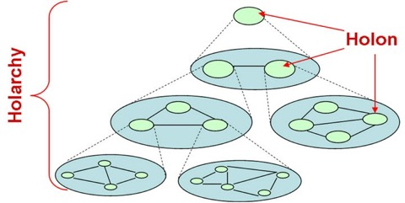

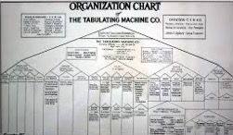
Self Management, Holacracy
Silos
Hierarchical Pyramid
Holacracy is a method of decentralized management and organizational governance.
It claims to distribute authority and decision-making through a holarchy of self-organizing teams rather than being vested in a management hierarchy. - https://www.holacracy.org
Holacracy is opposed to old hierarhical organization developed for manufacturing and construction businesses. Nowadays every industry today involves complex knowledge work. But IT and Data work doesn't fit well into hierarchy. Even modern factory workers need to contribute in ways that prior generations couldn’t imagine.
Holacracy can be seen as a greater movement within organisational design to cope with increasing complex social environments, that promises a greater degree of transparency, effectiveness and agility.
GlassFrog is the official software to support and advance your Holacracy practice. Made by HolacracyOne, it's the most robust tool available. - https://www.glassfrog.com/
A holarchy is a connection between holons,
where a holon is both a part and a whole.
The term was coined in Arthur Koestler's 1967 book
"The Ghost in the Machine".
Holarchy is commonly referred to as a form of hierarchy; however, unlike hierarchy, it doesn't have an absolute top and bottom.
Note:
Many companies use non-hierarchical approach.
For example, Facebook has hierarchy, but also uses product teams, which span multiple silos (multiple departments).

Slide 28
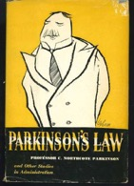
Parkinson Law
Here is the essense of some of Parkinson's main laws:
Work expands so as to fill the time available for its completion. This law has many consequences. For example, it shows why the British Colonial Office has grown in number of employees as the actual number of colonies declined - so that it employed more people when the number of colonies had been reduced to zero than when they were at their highest number.
Expenditure rises to meet income. ( Unit costs of public services tend to increase to consume the available funding. Data expands to fill the space available for storage. Network traffic expands to fill the available bandwidth, etc. Unfortunately this law is not applicable to our wallet nor to its contents. Pity.)
Expansion means complexity, and complexity - decay.
Policies designed to increase production increase employment; policies designed to increase employment do everything but.
Democracy equals inflation (people vote for higher pay rather than for increased production)
Delay is the deadliest form of denial.
The matters most debated tend to be the minor ones where everybody understands the issues.
Committees become less effective after they grow larger than 8 members.
Book "Parkinson's Law" by C. Northcote Parkinson
Classic - witty, brilliant.
Professor Northcote Parkinson (1909-1993) - British historian, author, and formulator of "Parkinson's Law," the satiric dictum that "Work expands to fill the time available for its completion."
"Administrators make work for each other, he said, so that they can multiply the number of their subordinates and enhance their prestige."
His second law was intended as a jibe at government functionaries, who he thought were inclined to expand their own ranks indefinitely, so long as taxes could be raised.
Written in a deadpan but mercilessly funny style, Parkinson's Economist essays were issued in book form in Parkinson's Law, or The Pursuit of Progress (1958). Apart from the books that made him famous, Parkinson wrote numerous historical works, including the critically acclaimed The Evolution of Political Thought (1958).s.

Slide 29
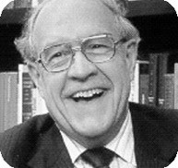

Brooks Law
Main ideas in the book:
The mythical man-month (adding more people will make the project later)
No silver bullet
The second-system effect (tend to make it too complex)
The tendency towards irreducible number of errors
Progress tracking (incremental slippages)
Conceptual integrity (separate architecture from implementation, keep things simple)
The manual (document external specs)
The pilot system (throw-away system)
Formal documents (needed)
Project estimation (work will take 3-times more than required for programming)
Communication (continuous clarifications with the architect and other groups)
The surgical team (very small team creats the main components)
Code freeze and system versioning
Specialized tools (good to share by team)
The Mythical Man-Month - by Frederick Brooks
Classics - based on experience from 1960s at IBM.
A required reading (a "bible") in most SE (Software Engineering) and CS (Computer Science) courses.
Brooks received the Turing Prize in 2000 ( often called "the Nobel Prize of Computing").
One of the main ideas (also called "The Brooks's Law") is that you can not estimate how long the project will take by simply multiplying Npeople * Nmonths.
"Adding manpower to a late software project makes it later. Artists cannot be rushed, and too many cooks will surely spoil the broth."
See good summary here:
https://en.wikipedia.org/wiki/The_Mythical_Man-Month
Brooks Law and open software projects:
Jamie Zawinski: Apache project, Linux Kernel, and other large software projects, the bulk of the work is done by a few dedicated members or a core team -- what Brooks calls a "surgical team." "In most open source projects," says Zawinski, "there is a small group who do the majority of the work, and the other contributors are definitely at a secondary level, meaning that they don't behave as bottlenecks." ... "Most of the larger open source projects are also fairly modular, meaning that they are really dozens of different, smaller projects. So when you claim that there are ten zillion people working on the Gnome project, you're lumping together a lot of people who never need to talk to each other, and thus, aren't getting in each others' way."
Brian Behlendorf (Apache & Collab.net): "We don't consciously think about it, but I think that the philosophy of keeping things simple and pushing out almost anything extraneous or nonessential to external modules has been followed fairly carefully in Apache. We've also been fairly successful (I think) in 'federalizing' the Apache process to sister projects."

Slide 30
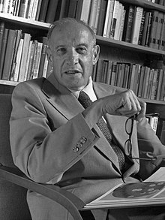
Peter Drucker
Peter Ferdinand Drucker was a management consultant, educator, and author, named "the founder of modern management".
- https://en.wikipedia.org/wiki/Peter_Drucker
Key Ideas:
Decentralization and simplification is better than "command and control".
The prediction of the decline of the "blue color" worker.
The concept of "outsourcing" ("front room" and "back room").
The importance of the nonprofit sector (third sector).
Respect for the worker. People are an organization's most valuable resource. A manager's job is both to prepare people to perform and to give them freedom to do so.
The need for "planned abandonment" of old methods.
A belief that taking action without thinking is the cause of every failure.
The importance of volunteering
The need to manage business by balancing a variety of needs and goals, rather than subordinating an institution to a single value.
A company's primary responsibility is to serve its customers. Profit is not the primary goal, but rather an essential condition.
"Do what you do best and outsource the rest" is a business tagline first "coined and developed" in the 1990s by Drucker.
Peter Ferdinand Drucker
(1909-2005)
Peter Drucker on marketing:
"Because the purpose of business is to create a customer, the business enterprise has two - and only two - basic functions: marketing and innovation. Marketing and innovation produce results; all the rest are costs. Marketing is the distinguishing, unique function of the business."

Slide 31
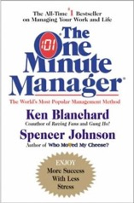
One Minute Manager
Book "The One Minute Manager"
by Spencer Johnson & Kenneth H. Blanchard
Classical bestseller.
How to achieve incremental improvement
using 3 tools:
1. One minute goals (on single sheet of paper)
2. One minute praise
3. One minute reprimand
3. Give one minute reprimands (re-directs) to address mistakes
First half-minute – reprimand
Do it as soon as possible
Confirm the facts first
Review the mistake together, be specific
Express how you feel about the mistake and its impact on results
Pause... Be quiet for a moment to allow people time to feel concerned about what they've done.
Second half-minute – re-connect
Let them know that they're better than their mistake, and that you think well of them as a person
Remind them that you trust in them, and support their success
Realize that when the reprimand is over, it's over
2. Give one minute praisings
Praise people as soon as possible.
Be specific about what they did right
Tell people how good you feel about what they did right, and how it helps
Pause for a moment to allow people time to feel good about what they've done
Encourage them to do more of the same
Make it clear you have confidence in them and support their success
1. Set one minute goals
plan the goals together, have people write them on a single page, with due dates.
ask them to review their most important goals each day
ask them to periodically check if their behavior matches their goals. If not - rethink their behavior or goals.

Slide 32
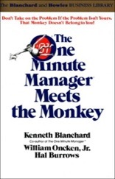
One Minute Manager Meets the Monkey
Book "The One Minute Manager Meets the Monkey"
by William, Jr. Oncken, et al
Humorous and highly effective way to learn how to start delegating business tasks.
Monkey is the next move ...
Who owns the monkey?
The book describes many situations when subordinates put monkeys on their boss's back. And teaches tips and tricks on how managers can avoid these leaping monkeys and put them back on the suborinates backs.
Example, a person goes to the boss and says "Boss, we have a problem".
This is a dangerous situation, because a monkey representing this problem may leap from subordinate back to boss's back – if the boss agrees to do something about this problem.
How to avoid those leaping monkeys?
Here is an example:
"Stop right there!
We can never have a problem.
It is either you have a problem – and I will advise you what to do.
Or I have a problem – then I will tell you what you will need to do for me.
In any case you will be the one doing all the work.
So, what's the problem?"

Slide 33
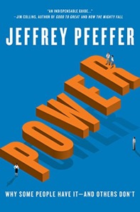

Power & Growth Mindset
Power: Why Some People Have It - and Others Don't
by Jeffrey Pfeffer
How to become more powerful.
Jeffrey Pfeffer, professor of organizational behavior at Stanford University, states that intelligence, performance, and likeability alone are not the key to moving up in an organization.
He asserts that vital factors are:
self promotion
building relationships
cultivating a reputation for control and authority
perfecting a powerful demeanor
Mindset: The New Psychology of Success
by Carol S. Dweck
Carol Dweck has coined the term "Growth Mindset"
If you reward correct results, people will learn to avoid risk and failure.
If you reward efforts, attempts, invention, and do not punish for failure - people will become much more effective and in the end achieve better results.

Slide 34
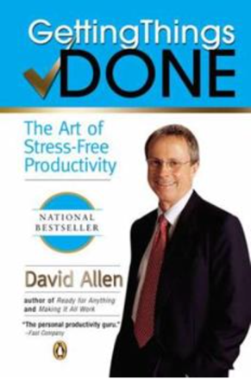
"Getting Things Done" by David Allen
"You mind is for having ideas, not for holding them" – David Allen
GTD is a manual for stress-free productivity.
It teaches you to set up a system of lists, reminders and weekly reviews, in order to free your mind from having to remember tasks and to-dos and instead let it work at full focus on the task at hand.
The book was published in 2001 (20 years ago). Nowadays 20-years later you can easily spot the similarity between the system proposed in the book with modern practices of software development (Agile/Scrum methods).
Here is a good short summary of the book:
- https://fourminutebooks.com/getting-things-done-summary/ -
David Allen proposes a system based on two principles:
define the next executable action for every theme
log your actions in a system which can be trusted.
Main principles:
Use a “collection bucket” to store things outside your mind.
Create a “next actions” list for all your projects.
Do a weekly review of everything, or else!
Specifically the system consists of 5 steps:
collecting
processing
organizing
reviewing
executing

Slide 35

7 Characteristics of Weak Product Management
By David Pereira
- https://medium.com/serious-scrum/7-characteristics-of-weak-product-management-eb0a3ca15d1b -
Problems:
Problem 1: Solutions over Problems. It is meaningless to talk about solutions without knowing the problems.
Problem 2: Output over Outcome. What to do next over what impact to deliver.
Problem 3: Roadmap over Goals. Delivering features doesn’t mean you are delivering value.
Problem 4: Immortal Features. Not removing old irrelevant features (not brining value).
Problem 5: Stakeholders’ Wishes over User Feedback.
Problem 6: Certainty over Assumptions. Being overconfident.
Problem 7: Two Drivers: Product Owner and Product Manager
David Pereira
Product Owner:
" ... a product should have only one person responsible from end to end.
Adding more people increases complexity and creates silos. Confusion is the only possible result when responsibilities are shared between two people.
For example, one person is responsible for finding the right thing to do, and another person responsible for implementing the thing right. This is a perfect recipe for disaster."
How organizations prevent tallented people from being effective:
Micromanagement. Unskilled managers limit talents by telling them what to do.
Complex processes and bureaucracy impede talents from doing what should be done.
Obsession for certainty blocks talents from discovering what could work better for the company’s business.
Unwillingness to embrace the unknown leads to sub-optimal incremental improvements.

Slide 36
Quotes
From book "HBR's 10 Must Reads on Managing People"
Daniel Goleman: There are six leadership styles - coercive, authoritative, affiliative, democratic, pacesetting and coaching. The most effective leaders are able to change between these styles when appropriate.
Frederick Herzberg: Punishments and rewards are ineffective tools for motivating people. Instead, try enriching their jobs by removing controls, giving employees more information, and giving access to greater challenges.
Manzoni and Barsoux: Employees who are viewed as weak performers often live down to expectations because the supervisor's attempts at performance management result in worse rather than better performance.
Carol Walker: New managers often perform poorly because they have not learnt the skills of delegating, getting support from above, projecting confidence, focusing on the big picture, and giving constructive feedback.
Marcus Buckingham: Great managers do not try to change their employees. Instead, they tweak roles to capitalize on individual strengths, create personalised incentives, and tailor coaching to unique learning styles.
Kim and Mauborgne: Harmony in the workplace required fair process, including inviting input from employees affected by a decision, explaining the thinking behind decisions, and providing clear expectations.
Chris Argyris: An organization's smartest and most successful people are often poor learners because they have not had the opportunity for introspection that comes with failure.
Banaji, Bazerman and Chugh: Everyone has unconscious biases which affect decisions. To counteract these biases, gather better data, get rid of stereotypical cues, and broaden your mind-set.
Katzenbach and Smith: A good team has a meaningful common purpose, specific performance goals, a mix of complementary skills, a strong commitment to how the work gets done, and mutual accountability.
Gabarro and Kotter: To have a good relationship with your boss, focus on compatible work styles, mutual expectations, information flow, dependability and honesty, and good use of time and resources.

Slide 37
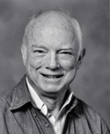
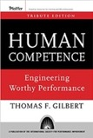
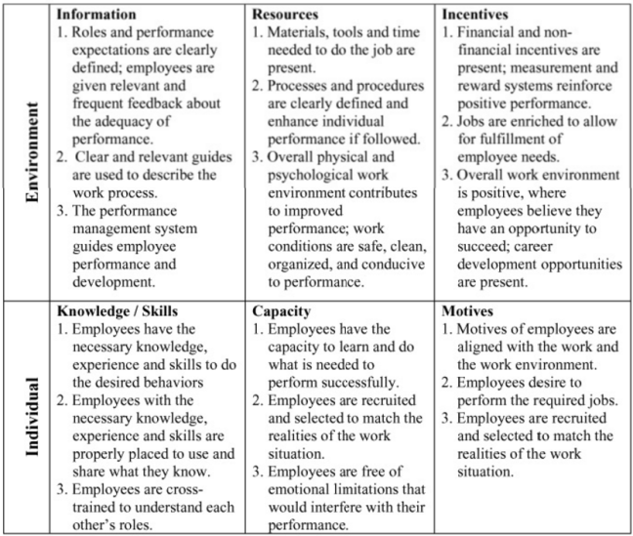
Thomas F. Gilbert
psychologist, founder of Performance Engineering ( a.k.a. Human Performance Technology (HPT) )
book "Human Competence: Engineering Worthy Performance".
realized that formal learning programs often only change knowledge, not behavior.
worked with the behavioral psychologist B. F. Skinner at Harvard University and with Ogden R. Lindsley in Lindsley's laboratory at Metropolitan State Hospital in Waltham, Massachusetts
specialized in statistics, testing and measurement.
https://en.wikipedia.org/wiki/Thomas_Gilbert_(engineer)
Thomas F. Gilbert
(1927–1995)
BEM Example:
Gilbert classified important and manageable factors affecting performance
in a 2 × 3 matrix that he called his Behavior Engineering Model (BEM).
BEM identifies six variables necessary to improve human performance:
+-------------+-------------+-----------+-------------+
| | Stimulus | Response | Consequence |
+-------------+-------------+-----------+-------------+
| Environment | information | resources | incentives |
+-------------+-------------+-----------+-------------+
| Individual | knowledge | capacity | motives |
+-------------+-------------+-----------+-------------+
Simple Performance Model:
Quality (Accuracy, Class, Novel)
Quantity (Rate, Timeliness, Volume)
Cost (Labor, Material, Management)

Slide 38

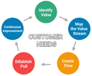
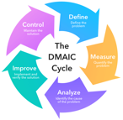
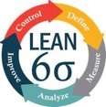
Human Performance Technology (HPT)
Human Performance Technology (HPT),
a.k.a. Human Performance Improvement (HPI)
or Human Performance Assessment (HPA)
Process improvement methodologies such as:
Lean management - https://en.wikipedia.org/wiki/Lean_manufacturing -
Six Sigma (tools to improve business processes) - https://en.wikipedia.org/wiki/Six_Sigma -
Lean Six Sigma - https://en.wikipedia.org/wiki/Lean_Six_Sigma -
organization development
motivation
instructional technology
human factors
learning
performance support systems
knowledge management
training
- https://en.wikipedia.org/wiki/Human_performance_technology
International Society for
Performance Improvement (ISPI)
- https://ispi.org/default.aspx -
DMAIC Cycle
Define-Measure-Analyze-Improve-Control
The origins of HPT can be primarily
traced back to the work of
Thomas Gilbert
Geary Rummler
Karen Brethower
Roger Kaufman
Bob Mager
Donald Tosti
Lloyd Homme
Joe Harless

Slide 39
Project Management
What we have learned:
Crystal clear understanding of the requirements. Involve all business stakeholders into the planning process. Make sure they agree on the plan.
Crystal clear understanding of priorities: what is important – and what is "nice to have".
Concentrate only on important features, sacrifice the rest.
Simplifty, simplify, simplify.
Split big job into small pieces, small steps.
Grow project as a child from few features to full-featured product.
Military style hierarchical management is not effective. Respect workers, leverage their brains, give them freedom to be effective, to communicate and collaborate.
Give people tasks that match their abilities.
Create safe and engaging atmosphere.

