Slide 1
Job Searching
Marketing Yourself

Slide 2

About me:
Lev Selector, Ph.D. – Mathematical Modeling
1977 - first programming project: Fortran, punch-cards
1977 - 1994 - math. modeling in biophysics
1994 – 2017 – Software Engineering, Data Storage & Processing, Databases, ETL, Financial Quantitative Research, Analytics (Wall Street firms, mostly consulting)
2017 - present – Data Science, Machine Learning & AI.
1995 – present – student of marketing

Slide 3


Job Searching – Marketing Yourself
There is no stability. Average job duration was less than 2 years for a long time.
The technologies change fast. You need to learn new stuff to be marketable. You have to change, to adapt, to educate yourself into employment.
You need to be on the front of the wave to receive high rate/salary. New job types become commoditized (and salaries drop) in just few years.
Most people don't educate themselves until they are forced to do so. So they are not increasing their salary. In fact, their effective compensation may go down, and competition get tougher.
Nowadays you have to also compete against remote outsorcing to other countries and against outsourcing to computers (automation, cloud, AI)
Many jobs are becoming extinct (for example, the number of human traders at financial companies has fallen down to about 1% of what it used to be).

Slide 4

Tactics and Strategy
Strategy is a long-term (several years) direction. A vision.
Tactics is short-term, specific, paying bills this month.
People tend to concentrate on tactics and not setting long-term strategic direction.
People tend to overestimate what they can do short term (in 3 months), and under-estimate what they can achieve long-term (in 3-5-10 years).
You need to set a strategic direction. For me it is new technologies (Data Science, ML & AI, Crypto)
Once you decided on your strategic direction, you need to find examples of people who you can use as role models.
The easiest way to achieve success is to follow someone else's steps. Venturing into a new field is like stepping on a minefield. You don't know where the mines are. But if you have someone who knows how to cross the field, then you can repeat his success simply by following his steps.
Educate yourself. Some knowledge you can find by searching (googling) for it. For some knowledge you should pay. But this is always a good investment.
Interesting example - Prashant Reddy: - http://www.cs.cmu.edu/~ppr/ - https://www.linkedin.com/in/prashantreddy - https://www.facebook.com/prashantreddy
In ~2009 he has left his 7-figure income at Morgan Stanley, and has become a Ph.D. student at Carnegie Mellon in the area of Machine Learning.
He has later gone to Google and J.P. Morgan.
This is a very interesting example of selecting and staying on strategic course. Usually people don't want to sacrifice their high salaries. But - he did.

Slide 5
Educate yourself "in advance". Be proactive
If you educate yourself proactively in advance:
you will be ahead of the crowd
You will have little or no competition - and will receive higher salary
Think in terms of studying in a college.
If you learn 1 weeks in advance - you get high grades.
If you learn 1 weeks late - you get low grades.
Over a period of 4 years the shift of 2 weeks is only 2/(4*50) ~ 1 percent.
But this 1% shift in timing may
result in 100% .. 500% shift in salary in real life.
Year 1
Year 2
Year 3
Year 4
Late
Ahead

Slide 6
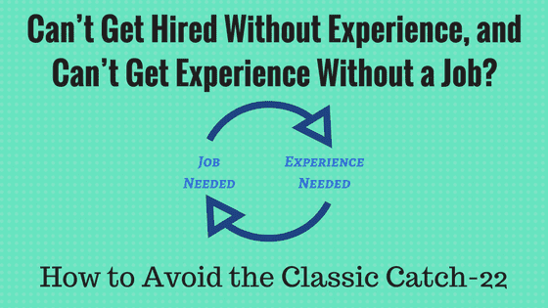
Catch-22
Catch-22:
to get a job you need experience,
to get experience you need a job.
Everyone gets this problem:
when getting into a new field
when interviewing for a higher position
when technologies change
There are only two ways to break out of this catch-22 cycle:
Method 1: get real experience
Method 2: sell your enthusiasm. Get some education, and convince that you are really excited and can do the job
In most cases I was using 2nd method.

Slide 7
Stop studying – and start interviewing
I had a friend who always felt that he needs to study more.
To get more courses, more certifications.
But if you don't go out and do the interviews, nothing happens.
Suppose you have studied for 3 months and now you are 70% ready.
If you study for another 3 months - you may be 75% ready.
But if you instead spend this time on going on interviews,
you would probably get a job by now.
More studying will increase your chances by 5%.
More interviewing will increase your chances by 100%.
I knew a guy who was absolutely useless at work,
but he was complaining that he is not paid enough,
so he was constantly going on interviews.
Result - he was getting high-paying jobs.
And adding them to his resume.
So he was paid more than people around him.
Although he was useless at work, not productive.
Those who study - don't get jobs.
Those who go on interviews - get jobs and earn more.
Note that once you get a job - you will learn new stuff
on the job while getting paid.
So, do not procrastinate - just start interviewing.
Bottleneck is usually not in your incomplete knowledge. Nobody is perfect.
Bottleneck is usually in not doing enough marketing, selling and interviewing.

Slide 8

Interview is NOT a test,
but an educational session
You need to accept the fact that during the interview
there will be questions which you will not know the answers to.
You can never prepare for everything.
Never.
Just accept that.
Look at interviews as a learning experience.
Ask questions, take notes, write down terms,
then go home and google them, learn about them,
maybe add to your resume.
Going on interviews is like a free education.
You meet with experienced high-paid professionals
who talk and ask questions about your area of interest.
This is a great opportunity to learn from them.

Slide 9


Interview is the transfer of energy
Interview is the transfer of energy.
You must have energy, excitement.
Your top-paying skills are NOT your technical skills, but your enthusiasm.
I have learned this lesson almost 20 years ago from Charly McAliley
He was making $300/hour when I was making $115/hour.
He has explained to me why he was paid much more.
It was quite eye opening.
Same idea is explained very well in this famous book:
"How I Raised Myself from Failure to Success in Selling"
by Frank Bettger
.. https://www.amazon.com/Raised-Myself-Failure-Success-Selling/dp/067179437X
Charly McAliley
- https://www.legacy.com/us/obituaries/atlanta/name/charles-mcaliley-obituary?n=charles-mcaliley&pid=86229824
During the face-to-face interview you can do the following:
smile, be positive, feel good
be attentive and supporting listener
be a cheerleader for the other person
be happy and relaxed
radiate bubbling positive energy
build trust, be authentic
be excited and curious about the person, technology, project, company

Slide 10

Technical Worker vs Leader/Visionary
Compare two accountants
Follower
Leader
Senior accountant
low salary
high competition
VP of Tech (moving accounting into Cloud and AI)
high salary
in high demand

Slide 11

It is much easier to pass the interview for new technologies
It is much easier to pass the interview for skills/technologies which are NEW.
The older is the technology - the stronger the competition,
and more detailed and difficult is the interview.
But for a new technology you can pass the interview
by simply talking in general terms.
Think about it.
Managers need a specialist in a new technology.
They have a problem/headache which they can not resolve themselves.
They don't know this technology themselves.
And they have difficulty finding specialists.
Sometimes if you demonstrate that you are really excited about
this new technology, it is enough toget hired.
And if you know the basics (what it is, terminology, people, vendors,
tools, use cases, ...), your chances are very high.
So here is the formula:
- do research - find new and in high-demand skills
- learn basics - terminology (dictionary), ... to be able
to answer basic questions. This takes 1-60 days depending on complexity.
This will allow you to pass the interview.
And then in 3 months on the job you will get real experience!

Slide 12


You can not move forward while looking back
Do NOT be afraid of learning new stuff.
Do NOT try to grow incrementally from your previous experience.
Rather make your research, find what is needed - and pull yourself to it.
Most people define themselves by their prior experience.
This is a huge mistake.
Because the progress is disruptive.
In order to make space for new stuff - you need to get rid of old stuff.
It is possible/easy to re-define and re-position yourself in just few months.
Remember - you don't need to become a true experienced specialist.
You just need to become a "reporter" who knows about the subject,
can navigate terminology, and can demonstrate excitement.
Old familiar, commodity, routine
New, exciting, unknown, a bit scary
You

Slide 13
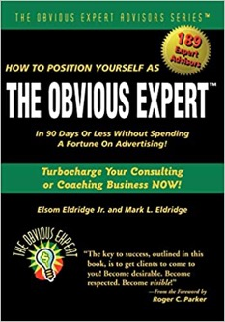



Market yourself by your positioning,
not by chasing opportunities
Position yourself as "obvious expert" so that people can find you.
Publish materials on your subject:
- book(s), articles, posts
- youtube videos, podcasts, other social media
- LinkedIn posts, articles, etc.
- courses
- conferences (videos, abstracts)
- GitHub
- etc.
Most people never do that.
So by doing this you immediately put yourself in the top 0.01%
and way ahead of the competition.
(I am guilty of not doing this enough myself.)
Teaching others is a great way to educate yourself.
Become an educator, an evangelist of new stuff.
It is easier to learn new stuff together.
Over the years I have done it in various ways:
- Learning together (book reading club, courses, ... )
- Making presentations - and publish (website, blog, github, youtube, ...)

Slide 14
Looking for a job is about time management
Looking for a job is all about time management.
You need to create your marketing funnel.
N1 people found you
N2 people contacted/spoke with you
N3 people submitted you for a job
N4 companies invited you for an interview
N5 companies invited for a 2nd interview
N6 companies gave you a job offer
Apparently N1 >> N2 > N3 ... > N6
Majority of your time will be spent on N1..N3
You need to automate N1-N3 as much as possible (for time management).
Big N1 number is the key.
Good way to automate – increase your visibility (Linkedin Posts, YouTube videos, Medium articles, etc.).
If you get enough N1 traffic, then job offers will follow automatically.
N1
N2
N3
N4
No No No No No No No No No No No No No No No No No No No No No No No No No No No No No No No No No No No No No No No No No No No No No No No No No No No No No No No No No No No No No No No No No No No No No No No No No No No No No No No No No No No No No No No No No No No No No No No No No No No No No No No No No No No No No No No No No No No No No No No No No No No No No No No No No No No No No No No No No No No No No No No No No No No No No No No No No No No No No No No No No No No No No No No No No No No No No No No No No No No No No No No No No No No No No No No No No No No No No No No No No No No No No No No YES
N5
N6
You Job Search Marketing Funnel

Slide 15


To look for a job is a Full-Time job in itself.
Searching for "job search" on amazon books returns over 10,000 results
To look for a job is a profession in itself.
It is a skill that you need to learn, to educate yourself.
How many books have you read on the subject of looking for a job?
Have you passed any exams/tests on the subject?
Suppose you need to undergo a brain surgery.
And you find that your surgeon hasn't read even a single book about medicine.
Will you be willing to pay him to do a surgery on you?
So how can you become successful in finding jobs
if you haven't educated yourself in how to do it?
You don't need to be a superhero to find a job.
All you need is to follow certain proven steps.
You need to know what to do.
You need to learn it.

Slide 16


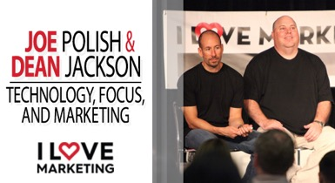
The technology of finding jobs changes
Just 20 years ago people used to answer ads in newspapers,
sending envelopes in mail, or calling employers or agents on the phone.
Nowadays people mostly use Internet.
But - there are different methods here as well.
Which methods are more effective today ?
I recommend this book:
"What_Color_Is_Your_Parachute"
.. https://en.wikipedia.org/wiki/What_Color_Is_Your_Parachute%3F
"It has been in print since 1970 and has been revised annually since 1975, sometimes substantially."
.. https://www.facebook.com/richardnbolles
Also you need to study marketing.
I recommend to follow Joe Polish:
- https://ilovemarketing.com
- https://geniusnetwork.com/giverbook/
1970 - present

Slide 17
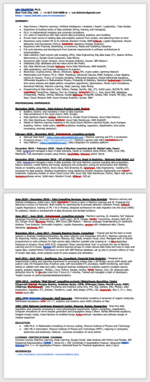
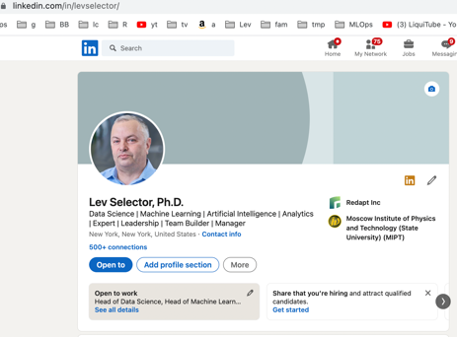
Your Resume and Your Linkedin Profile
resume
Nowadays companies search candidates on Linkedin.
If you recommend someone to HR (Human Resource), they will immediately search this person on Linkedin.
Resume and Linkedin should correspond to each other.
Both should contain a short summary at the top. Spend 90% of your effort on this top summary. Because nobody reads the whole resume or Linkedin profile. But people read the top (summary). So spend most of your attention on the title and summary. This is your positionning.
Fill them with keywords on which you want people to find you when doing search

Slide 18
Self-fulfilling prophecy
Give yourself a title that corresponds
to what you want to become.
For example, if you are looking for a position of a Data Scientist,
name yourself as a Data Scientist.
Once you start talking about yourself as a Data Scientist,
your outlook changes, your confidence increases, etc.
Convince yourself that you are a Data Scientist.
What does it mean to be a Data Scientist ?
It doesn't mean to go to college and get a degree.
It simply means that you can do what average Data Scientists are doing.
A minimalistic definition - you need to know how to:
- get data - SQL or from CSV file
- explore data (Excel, Jupyter notebook, etc.)
- run some simple model (Linear Regression)
- evaluate model quality (accuracy, confusion matrix, precision,
recall, ROC curve, etc.)
- make PowerPoint presentation
There are multiple projects on Github, Medium, etc.
Take one of them, reproduce step-by-step.
Done.
You are a minimalistic Data Scientist.
My current title on Linkedin:
Lev Selector, Ph.D.
Data Science | Machine Learning | Artificial Intelligence | Analytics | Expert | Leadership | Team Builder | Manager

Slide 19

Writing your experience in resume/linkedin
Make simple custom Linkedin URL (example: https://www.linkedin.com/in/levselector/ )
Use the active language of achievement when talking about your experience (designed, built, trained, increased, improved, proposed, ... ). You need to demonstrate accomplishments.
Include keywords on which you want people to find you when they do search on Linkedin

Slide 20

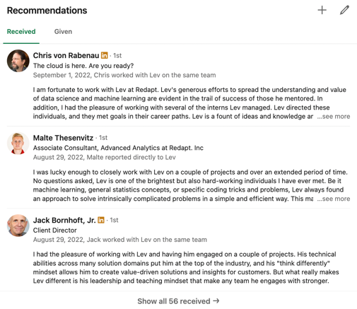
Get recommendations for your Linkedin profile
Get recommendations for your Linkedin profile.
At least 5-10, but 40-50 is better.
People trust when they see positive reviews (recommendations).
This is similar to a trust people experience when
they see positive 5-star reviews on amazon.
So - present yourself as a 5-stars "product" using recommendations.

Slide 21
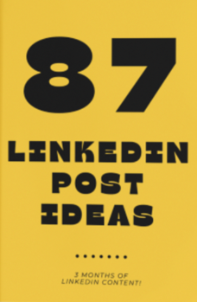
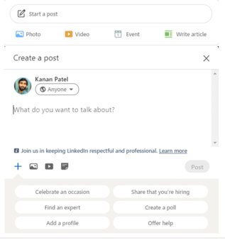
Get visibility by writing posts on Linkedin
Make a list of 10-20 posts.
Write 1-2 posts every week – it takes just few minutes.
Post in Linkedin groups.
Add animated image to a post to attract attention.

Slide 22
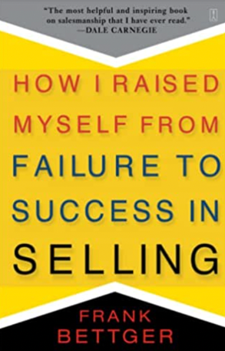
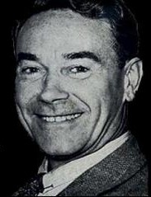
The One Book You MUST buy
"How I Raised Myself from Failure to Success in Selling" by Frank Bettger
Interviewing for jobs is contact selling.
Thus this book is what you need.
It is short and systematic tutorial of "contact selling".
It is written as a set of stories – interesting to read.
Bettger played Major League Baseball.
He was demoted from one team because "he lacked enthusiasm".
From that moment on, he played with vigorous enthusiasm.
After injury he has become a very successful at selling life insurance.
At first he was failing.
But then he started acting enthusiastically
(and more strategically – as described in the book),
and ahs become very successful.
Frank Bettger 1888 - 1981

