Slide 1
Marketing
Marketing = Selling in Advance
Marketing educates,
builds repo,
creates trust,
creates comfort
Marketing can do this prep work automatically and cost-effectively
Selling is easy when prospects are already pre-interested, pre-motivated, pre-qualified, & pre-disposed to do business with you
Uphill
Hard work
building repo
Downhill
Easy sales
for a Cold Prospect
we are "Annoying Pest"
for a good client
we are "Welcome Guest"

Slide 2
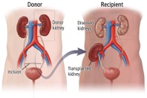


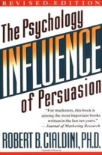
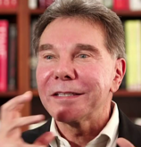
Marketing as an Engineering Project ...
Multi-step Marketing Process
Kidney Donors
Budget
Robert Cialdini

Slide 3
Typical Marketing Funnel
for Expensive Service
Information Hooks
Hundreds/thousands of
YouTube Videos
Linkedin Posts
Mewdium Articles
Quora
StackOverflow
Facebook
Instagram
etc.
Email Capture:
Website Landing Pages
10-20 website landing pages
Offer Free Reports in exchange for email address.
The Free Repots explains how to avoid costly mistakes, how to do things easier, cheaper, faster, more effectively, etc.
Email Autoresponder
10-20 targeted sequences
Builds relationship
Educational Marketing
Build trust, Triggers Sales
Sales People
Closing Sales
Subscriptions
Marketing is All About
Building Relationships
and Building a Community of Loyal Fans

Slide 4

Marketing Funnels
SIngle Step
Long sales letter sent to a mailing list
Sales Letter
24 hour recorded message phone line
(capture address)
Multi-Step
Small Classified ad
Monthly Newsletter
More Sales
Linkedin Post or YouTube video
Landing Web Page offerring a bribe PDF
Email Autoresponder
More Sales

Slide 5
Market by Attracting, not by Chasing
Hard ineffective way of selling – chasing clients (cold calling)
Easy effective way of selling – position yourself as an obvious choice and attract people via educational and entertaining materials, as well as community building
Position Your Business as "obvious choice" so that people can find you.
Publish materials on your subject:
- book(s), articles, posts
- youtube videos, podcasts, other social media
- LinkedIn posts, articles, etc.
- courses
- conferences (videos, abstracts)
- GitHub
- etc.
Most businesses never do that.
So by doing this "educational" marketing you immediately put yourself in the top 0.01% - and way ahead of the competition.
Teaching others is a great way to educate and promote.
Become an educator, an evangelist.
Create Community / Movement
Build a dedicated customer base that not only purchases, but also promotes your brand or product
Foster engagement, loyalty, and advocacy among consumers
Use interactive platform, personalized content, authentic messaging
Connect with the audience, cultivate a sense of belonging
Transform customers into your brand ambassadors, amplify word-of-mouth marketing, boost retention
The key is consistent, value-driven interaction to foster a vibrant, loyal community that propels the brand forward.

Slide 6
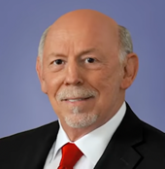
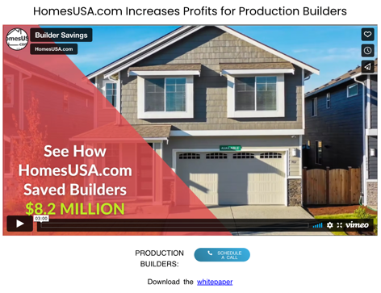
Market by Attracting, not by Chasing
Selling x200 Times More Than National Average
On average, a real estate agent working full time sells 15 homes in one year. Up to 50 with a F/T assistant.
Ben Caballero is the most productive individual real estate agent in the United States. His website provides MLS (Multiple Listing Service) with 63+ home builders.
In 2016 – sold 3,556 homes
In 2018 – sold 5,801 homes totaling $2.27 billion in volume
In 2020 – sold 6,438 homes totaling $2.46 billion in volume
Guinness World Records has recognized him three times for "most annual home sale transactions through MLS by an individual sell side real estate agent." His company was founded in 2007 and has ~35 employees.
https://homesusa.com
Ben Caballero
Ben's first meeting every day is
with Sales and Marketing Team

Slide 7
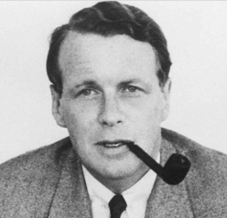
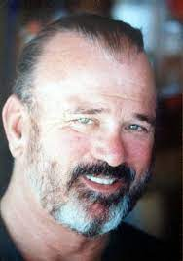
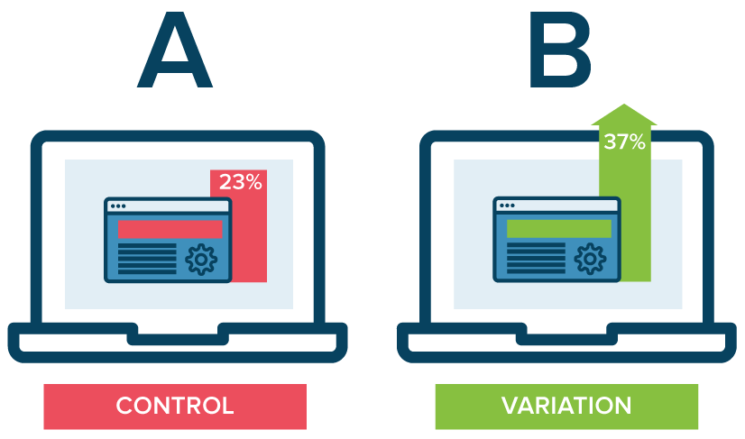
Direct Response
Direct response marketing
a.k.a "results required marketing" (Dan Kennedy):
A marketing strategy where the goal is to encourage an immediate response from propsects or consumers
The response can be any action such as visiting a website, making a purchase or even just sharing a post on social media.
Direct response allows to measure, test, and improve effectiveness of your advertising very quickly.
Direct Response has its roots in mail order marketing.
Direct response contrasts with marketing activities that have long-term goals such as building a brand identity or raising awareness.
"Only mail order people know
what they are doing"
David Ogilvy
"You’re NOT in the marketing business. You’re in the ARITHMETIC business. If your arithmetic doesn’t add up, you won’t have a business for very long. Start counting."
Gary Halbert
What you can measure – you can improve
A/B split testing

Slide 8
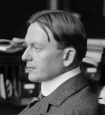
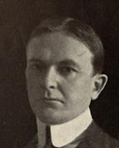
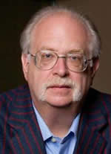
Three Things ...
Robert J Collier (1876 – 1918)
https://en.wikipedia.org/wiki/Robert_Collier_%28author%29
Dan Kennedy
Copywriting - science and art.
Who is Choosing Who ?
"Always enter the conversation already occurring in the prospect's mind."
(This was famously stated in 1937 by Robert Collier in one of the best classic marketing books available: "The Robert Collier Letter Book".)
There are three things you need
in order to sell something…
Market (targeted mailing list)
Message (sales letter)
Media (delivery mechanism)
YouTube, LinkedIn posts, Facebook, other social media, blogging
Host-parasite relationships: partnerships, celebrities, thought leaders
Paid online advertising (Facebook, Google, Linkedin, Advertising exchanges, ...
Television, radio
Paper/Print: classified ads, ads in magazines and newspapers
Mailing lists (SRDS catalog)
Direct mail - letters, postcards
Subscriptions – monthly newsletter, e-magazine, email autoresponder
Multi-step marketing funnel (small ad => pre-recorded message => free report => ...)
Message
Delivery
Offer
Market

Slide 9
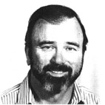
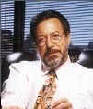
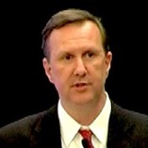
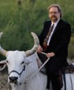

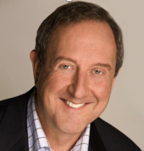
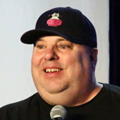

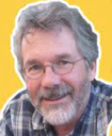
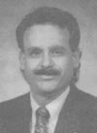
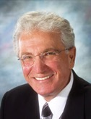
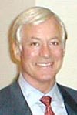
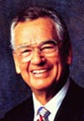
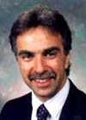
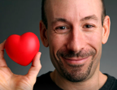
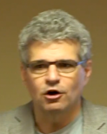


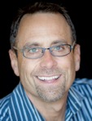

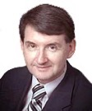

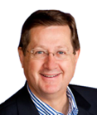

Some Marketing People to Know ...
Gary Halbert
Jay Abraham
Ken McCarthy
Dan Kennedy
Joe Sugarman
Gary Bencivenga
Robert Cialdini
Joe Polish
Dean Jackson
Ten Nicholas
John Carlton
Paul Hartunian
Jeff Paul
Joe Girard
Brian Tracy
Zig Ziglar
Brian Kurtz
Bob Serling
Frank Kern
Stuart Goldsmith
Alex Mandossian
Jeffrey Lant
Bill Myers
https://www.bmyers.com
Robert Allen
Mike Enlow

Slide 10
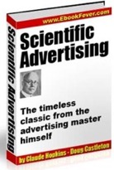
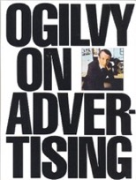
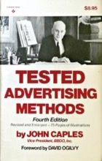
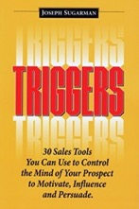
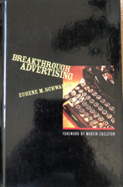
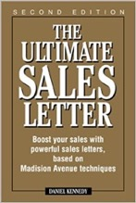
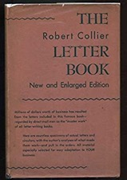
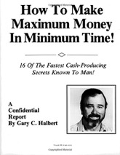
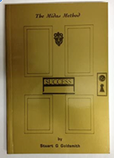
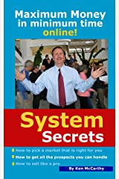

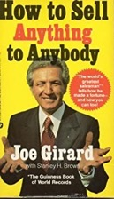
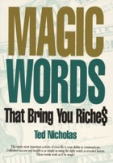
Some Books ...
Claude Hopkins
David Ogilvy
John Caples
Joe Sugarman
Eugene M. Schwartz
Dan Kennedy
(many books)
Robert Collier
Gary Halbert
Stuart Goldsmith
Ted Nicholas
Ken McCarthy
Robert Cialdini
Joe Girard

Slide 11


Direct Response – multi-step optimization
Step1
In
Out
Step2
Leads
Step3
Sales
Step4
Step5
Out = In * conv1 * conv2 * conv3 * conv4
If using A/B split testing we improve conversions between steps above, the overall sales will grow exponentially.
The $1 and $100 bills above take same amount of paper and ink to produce them.
The only difference in value between them is the message on the paper.
Step % | Overall improvement
20% | 1.2 * 1.2 * 1.2 * 1.2 = 2.1
50% | 1.5 * 1.5 * 1.5 * 1.5 = 5.06
100% | 2 * 2 * 2 * 2 = 8

Slide 12
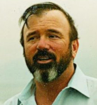

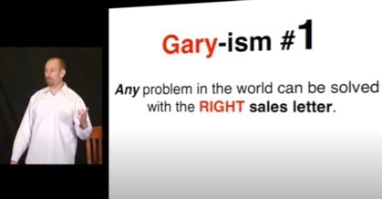
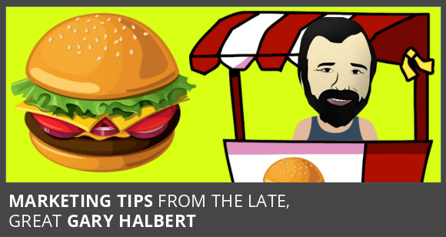
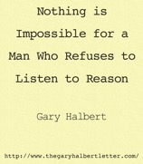
Gary Halbert
June 12, 1938 - April 8, 2007
copywriter
direct marketer
educator
Principle 1 - Any Problem in the world can be solved with the RIGHT sales letter. Copy = oxygen of marketing. Without good copy, there is no good marketing. Job of marketing – building trust.
Principle 2 - One elegant idea is worth more than 1000 semi-good ideas. Idea of sales letter: "Can and copy yourself". "The best way to help the poor is to not be one of them"
Principle 3 - The money is not in your service or product, but in selling it. Definition of Selling: "Selling is getting someone intellectually engaged in a future result that is good for them and getting them to emotionally commit to take action to achieve that result" (Dan Sullivan).
Principle 4 - Add Theatre to your Marketing. Examples of Theatre: Theatre is impact, 24 h free recorded message at the end of a book, Flip videos, Adding celebrities and audio to your marketing, Grabbers, Photos, sense of urgency, involvement mechanisms (all automated).
Principle 5 - Do not worry about offending the dogs when you are targeting the foxes. Hype used ethically. Massive enthusiasm for what you are selling. Hype used unethically, lying or bullshitting.
Principle 6 – HUNGRY CROWD is what you need the most. Hamburger stand story. Generate hungry leads.
Principle 7 - You are in the arithmetic business. It is much easier to sell one $50,000 project than hundred $500 units.
Educated consumers are far more powerful than un-educated consumers. Consumer guide to carpet cleaning educates consumer and builds trust into your brand.
Benefit of using 24h free recorded messages.
Three things needed to sell: Product or service, Sales pitch, Delivery system
Everyone is an information marketer
Joe Polish Presentation on Gary Halbert Video from Dan Kennedy SuperConference
https://www.youtube.com/watch?v=q4WotUTjLJY

Slide 13
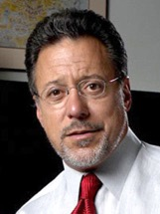
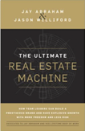
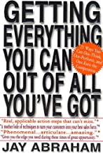
Jay Abraham
Unique Selling Proposition. Examples: FedEx. Domino Pizza.
Lifetime value of a client. Front End – Back End Marketing. Client acquisition cost. Example: Icy Hot promotion – spend 115% of the initial selling price to acquire a customer.
Become a match-maker. https://www.youtube.com/watch?v=9NNKHhapVMM
Become the trusted source, the leader in your industry. "Influencer marketing". Read "Speed of Trust".
The headline determines 80% of the success of any advertising campaign. Split-test headlines on smaller scale. A/B split testing.
Use "word pictures", use power verbs and active voice. Address your clients directly and be firm and brief.
Become a performance optimizer. In every organization, you can find areas that are under-performing. Fix them first. This may cause dramatic improvement in the overall business process.
Use the Parthenon model of business success. Every business has its impact points – areas where you can achieve the most leverage. It could be your unique selling proposition, a special offer, or an effective marketing process. The idea is to identify, optimize and automatize these “columns” and ultimately build a solid Parthenon which will generate predictable income every month.
There’s always a space for true entrepreneurs. Even in saturated markets only ~10% of competitors truly know what they’re doing. The rest 90% is on their way out of the business.
Provide value every step of the way. "Anytime you interact with anybody for any amount of time, your opportunity, responsibility and obligation is to make their life better off because you are in it".
Think about what you’ve learned after every important conversation, every book you read, every presentation you give, every project and period of your life. Every mistake can be a learning opportunity.
Fall in love with your clients, not with your own product or company. Focus on helping. "enlightened self-interest".
Life is all about the process, not just goals. Enjoy the process. Live the life of fulfillment.
CARING is the key to success. Caring creates trust. Caring makes your clients happy and loyal. It’s amazing that in today’s competitive environment, only a few companies and individuals truly care about the people they serve. To crush in the marketplace always have your client’s best interest in mind. Think about how to make their buying experience so much better than it is right now.
Use web/Amazon for market research. For example, go on Amazon and check the most successful products in your category, carefully read the reviews, try to understand what are the hidden needs of clients in your niche.
https://www.abraham.com
The 21.7 Billion Dollar Man
One of The Most Effective
Strategic Marketing &
Business Growth Experts

Slide 14






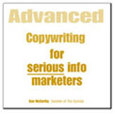
Ken McCarthy
"When people go to a web page, the thing that they want more than anything else is instant clarity." - Ken McCarthy
McCarthy is best known for his pioneering work in the movement to commercialize the Internet in 1990s – email advertising, banner ads, pay-per-click advertising, Internet video, click-through rates as the key metric
In 1994, he organized and sponsored the first conference ever held on potential commercial applications of the World Wide Web. McCarthy described in detail the new content marketing and distribution model (The Long Tail)
In 1995, McCarthy organized and sponsored a conference on the topic of using the web as a local publishing medium to assist community building. Many projects resulted from that (New York, New Orleans, etc.)
System Seminar (2000 – 2010), The System
Internet video publishing, The System Video Blog
Music industry, digital production, https://www.jazzonthetube.com
Communications consultant to Bankers Trust and First Boston
Published a large number of articles, several books
In 1999, McCarthy collaborated with filmmaker Rick Goldsmith to create an online archive[27] of the work of American investigative journalist George Seldes (1890–1995) in support of Goldsmith's Academy Award-nominated film Tell the Truth and Run: George Seldes and the American Press.
American activist, educator, entrepreneur, and Internet commercialization pioneer.
.. https://www.kenmccarthy.com
.. https://en.wikipedia.org/wiki/Ken_McCarthy
.. https://thesystemblog.com
.. https://www.thesystemclub.com
.. https://www.kenscatalog.com
.. https://www.realecontv.com/videos/in-humor-truth
.. https://www.20sjazz.com
.. https://www.jazzonthetube.com
.. etc. etc.
"Write BULLETS that wound, with the only remedy coming from buying the product." - Ken McCarthy
What the bullet bottom line?
.. Convert features to benefits to feeling
.. Bring facts to life
.. TRANSLATE
Customers don’t have time or energy to process your message…that’s your job

Slide 15
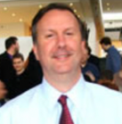
Ken McCarthy's Short List of top DM and copywriting books
1. My Life in Advertising - Claude Hopkins
2. The Robert Collier Letter Book - Robert Collier
3. Tested Advertising Methods - John Caples
4. How to Write a Good Advertisement - Victor Schwab
5. Scientific Advertising - Claude Hopkins
6. My First Sixty Years in Advertising - Max Sackeheim
7. Breakthrough Advertising - Eugene Schwartz
8. Secrets of Successful Direct Mail - Richard Benson
9. Mail Order Know-How - Cecil Hoge, Sr.
10. Mail Order Moonlighting - Cecil Hoge, Sr.
11. Million Dollar Mailings - Denny Hatch
12. Method Marketing - Denny Hatch
13. 2,239 Tested Secrets for Direct Marketing Success - Denny Hatch
14. Being Direct - Lester Wunderman
15. The Solid Gold Mailbox - Walter Weintz
16. Handbook of Direct Mail - Siegfried Vogele
17. Jump Start Your Business Brain - Doug Hall
18. Meaningful Marketing - Doug Hall
19. Jump Start Your Marketing Brain - Doug Hall
20. Which Ad Pulled Best - Philip Burton
21. Confessions of an Advertising Man - David Ogilvy

Slide 16
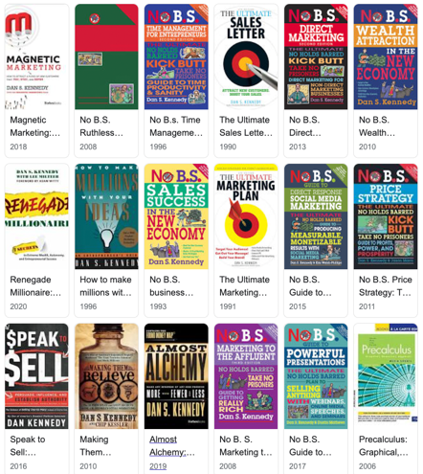


Dan S. Kennedy
Author, Strategic Advisor, Consultant, and Business Coach
DAN S. KENNEDY is a strategic advisor, consultant, business coach, and author of the popular No B.S. book series. He directly influences more than one million business owners annually.
Copywriter
Magnetic Marketing
Super Conference
Inner Circle (Glazer-Kennedy)

Slide 17


Joe Polish & Dean Jackson
The Before Unit The During Unit The After Unit
Joe Polish
Dean Jackson
https://ilovemarketing.com
https://joepolish.com
https://geniusnetwork.com
https://deanjackson.com
https://www.morecheeselesswhiskers.com
Narrow Your Focus and Select ONE Target Market (at a time)
Use Direct Response Offers to Compel Prospects to Call YOU
Patiently and Sytematically Educate and Motivate Prospects to Meet You... *When theyʼre ready
Present Your Unique Service Offer In A Way That Makes it EASY To Get Started
Deliver a “Dream Come True” Experience Designed From Your Clientʼs Perspective
Provide After Sale Service - Even After Youʼve Already Been Paid
Nurture Lifetime Relationships And Focus on Lifetime Valuec
Orchestrate Referrals By Giving Your Clients The Opportunity to Feel Great

Slide 18
More Marketing Topics
ask_campaign
audio_video
autoresponders
basics
conversion
copyrighting
direct_marketing
ebay
ebus_minisites
email_marketing
joint_ventures
affiliates
keywords
launch
law
market_research
marketing_people
membership_sites
multi_page_sale
on_offline
opt-in-page
order-page
outsourcing
pay_per_click
PR-Public-relations
product_creation
public_domain
public_speaking
search_engines
shopping-cart-billing
success
teleseminars
testing
time_management
tracking
traffic
twopage
upsell
video_on_web
wordpress
Tools:
Taplio ($470/year) - https://taplio.com – to schedule Linkedin Posts
Hypefury ($16/month) - https://hypefury.com - schedule twitter
ClickFunnels ($1,524/year) – funnels
Aweber - email autoresponder ($20/mo)
Webflow - website builder ($300/year for site, $600/year for seat)
Other tools:
HubSpot https://www.hubspot.com/pricing/suite/starter
GetResponse – All-in-one machine
Salesforce
More:
Kajabi - create and sell courses
testimonials.to - add "loveboard" to your website (videos, posts)
Systeme.io – Free plan with all the features
Kartra – Great for agencies
CartFlows – For WooCommerce users
ActiveCampaign – Excellent automation capabilities
Wishpond – Good looking templates
Thrive Suite – Good value for money
Keap – Plenty of options
Leadpages – Collect unlimited leads
Landingi – Great looking landing pages
Instapage – Sophisticated A/B testing

