Slide 1
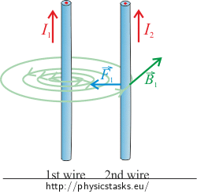
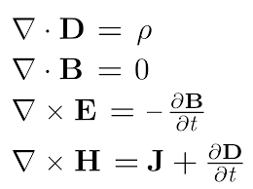
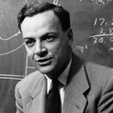
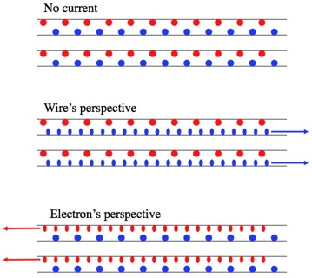
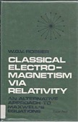
Magnetism as Relativity Effect
Two parallel wires with current flowing in the same direction attract each other.
Some history:
1785 - Coulomb's inverse-square law for force between two electrically charged particles
1873 - Maxwell equations
1895 - Lorentz force (electromagnetic force)
1940 – Leigh Page - charge density in electrostatics becomes proper charge density and generates a magnetic field for a moving observer
1964 - Richard Feynman’s textbook "The Feynman Lectures on Physics. 2. Section 13-6."
1968 - Rosser, W.G.V. Classical Electromagnetism via Relativity. Plenum Press.
Standard explanation: moving charges in 1st wire create magnetic field which act on moving charges in 2nd wire.
Relativity explanation: Lorentz length contraction along the wire causes density increase for charges moving relative to each other – thus increasing Coulomb forces between positive (p) and negative (n) charges. This changes the balance between repelling forces (p-p & n-n) and attracting forces (p-n & n-p ).

Slide 2
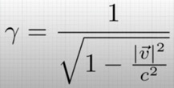

Magnetism as Relativity Effect - continued
Lorentz factor
We derived Lorentz factor from electrodynamics !!
From this video:
https://www.youtube.com/watch?v=j2AQAVIzx70

