Slide 1

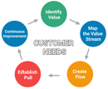
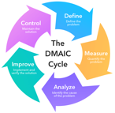
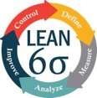
Human Performance Technology (HPT)
Human Performance Technology (HPT),
a.k.a. Human Performance Improvement (HPI)
or Human Performance Assessment (HPA)
Process improvement methodologies such as:
Lean management - https://en.wikipedia.org/wiki/Lean_manufacturing -
Six Sigma (tools to improve business processes) - https://en.wikipedia.org/wiki/Six_Sigma -
Lean Six Sigma - https://en.wikipedia.org/wiki/Lean_Six_Sigma -
organization development
motivation
instructional technology
human factors
learning
performance support systems
knowledge management
training
- https://en.wikipedia.org/wiki/Human_performance_technology
International Society for
Performance Improvement (ISPI)
- https://ispi.org/default.aspx -
DMAIC Cycle
Define-Measure-Analyze-Improve-Control
The origins of HPT can be primarily
traced back to the work of
Thomas Gilbert
Geary Rummler
Karen Brethower
Roger Kaufman
Bob Mager
Donald Tosti
Lloyd Homme
Joe Harless

Slide 2
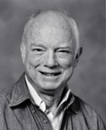
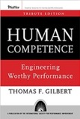
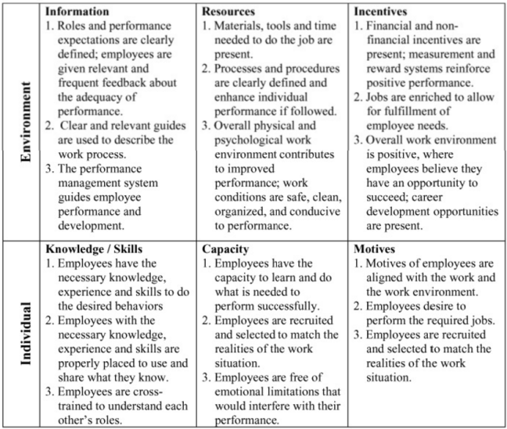
Thomas F. Gilbert
psychologist, founder of Performance Engineering ( a.k.a. Human Performance Technology (HPT) )
book "Human Competence: Engineering Worthy Performance".
realized that formal learning programs often only change knowledge, not behavior.
worked with the behavioral psychologist B. F. Skinner at Harvard University and with Ogden R. Lindsley in Lindsley's laboratory at Metropolitan State Hospital in Waltham, Massachusetts
specialized in statistics, testing and measurement.
https://en.wikipedia.org/wiki/Thomas_Gilbert_(engineer)
Thomas F. Gilbert
(1927–1995)
BEM Example:
Gilbert classified important and manageable factors affecting performance
in a 2 × 3 matrix that he called his Behavior Engineering Model (BEM).
BEM identifies six variables necessary to improve human performance:
+-------------+-------------+-----------+-------------+
| | Stimulus | Response | Consequence |
+-------------+-------------+-----------+-------------+
| Environment | information | resources | incentives |
+-------------+-------------+-----------+-------------+
| Individual | knowledge | capacity | motives |
+-------------+-------------+-----------+-------------+

Slide 3
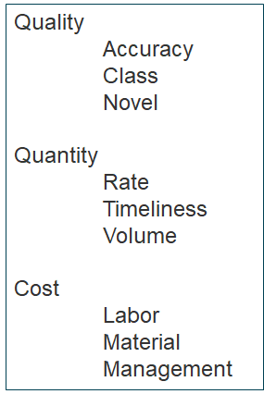
Simple Performance Model

