Slide 1
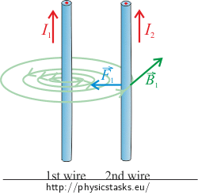
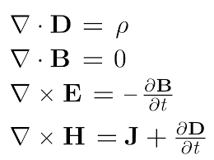
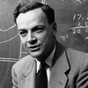
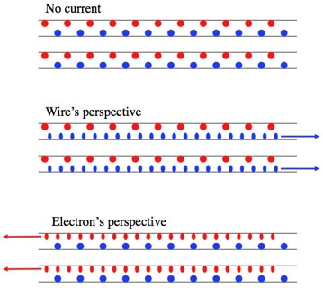
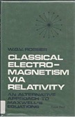
Magnetism as Relativity Effect
Two parallel wires with current flowing in the same direction attract each other.
Standard explanation: moving charges in 1st wire create magnetic field which act on moving charges in 2nd wire.
Some history:
1785 - Coulomb's inverse-square law for force between two stationary, electrically charged particles
1873 - Maxwell equations
1895 - Lorentz force (electromagnetic force)
1940 – Leigh Page - charge density in electrostatics becomes proper charge density and generates a magnetic field for a moving observer
1964 - Richard Feynman’s textbook "The Feynman Lectures on Physics. 2. Section 13-6."
1968 - Rosser, W.G.V. Classical Electromagnetism via Relativity. Plenum Press.
Relativity explanation: lorentz length contraction along the wire causes density increase for charges moving relative to each other – thus increasing Coulomb forces between positive (p) and negative(n) charges.
p-p and n-n forces don't change
p-n and n-p forces increase causing attraction of wires to each other

