Slide 1
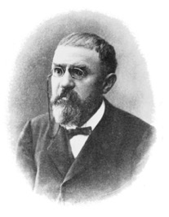
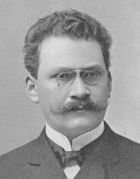
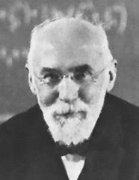
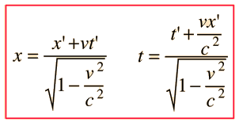
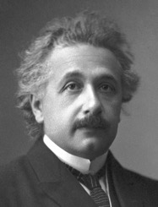
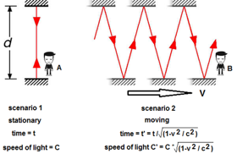
Special Relativity Theory
Some history:
Einstein was NOT the author of Special Relativity Theory.
He has read the works of
Minkowski - https://en.wikipedia.org/wiki/Hermann_Minkowski
Poincare - https://en.wikipedia.org/wiki/Henri_Poincar%C3%A9
Lorentz - https://en.wikipedia.org/wiki/Hendrik_Lorentz
and then published the summarized description (1905).
Note: even the famous E = mc² was taken from Poincare.
Henri Poincaré
1854-1912
Hermann Minkowski
1864-1909
Two main ideas:
There is no absolute frame of reference. The laws of physics are the same in all inertial frames of reference.
The speed of light c is a constant, independent of the relative motion of the source.
You can do thought experiments sending beam of light back and forth along moving train. You will realize that events which are simultaneous in one system of coordinates may be not simultaneous in the other.
Measuring the length of a moving object requires detecting both ends simultaneously. So in resting and moving frames the results will be different. This is the essence of space and time dilation.
Common example: train going through the tunnel:
- https://www.youtube.com/watch?v=Xrqj88zQZJg
Lorentz Transformation
Albert Einstein
1879-1955

Slide 2
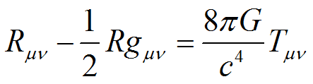
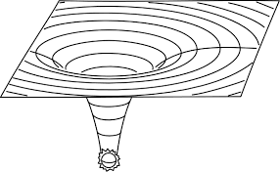
General Relativity Theory (Einstein, 1915)
Gravity is regarded as not a force but a consequence of a curved spacetime geometry where the source of curvature is the stress–energy tensor T_{μν} (representing matter, for instance).
A geodesic generalizes the notion of a "straight line" to curved spacetime. A freely moving or falling particle always moves along a geodesic.
Einstein field equations (EFE):
https://en.wikipedia.org/wiki/Einstein_field_equations
where
R_{μν} - Ricci curvature tensor
R - scalar curvature.
Geodesic Equations
https://en.wikipedia.org/wiki/Geodesics_in_general_relativity
where
G_{μν} - Einstein tensor,
g_{μν} - metric tensor
T_{μν} - stress–energy tensor
Λ - cosmological constant (expanding/contracting universe), negligible
κ - Einstein gravitational constant.
where s is a scalar parameter of motion (e.g. the proper time), and gamma are Christoffel symbols. Greek indices may take the values: 0, 1, 2, 3 and the summation convention is used for repeated indices.
The quantity on the left-hand-side of this equation is the acceleration of a particle, so this equation is analogous to Newton's laws of motion, which likewise provide formulae for the acceleration of a particle.
where
G - Newtonian constant of gravitation
c – speed of light

