Slide 1

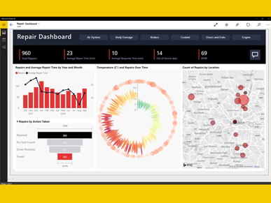
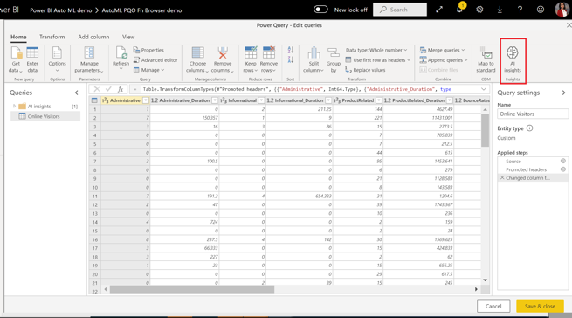
Power BI
Power Platform:
Power BI
Power Apps
Power Automate
Power Virtual Agents
https://powerbi.com
Power BI is a business analytics service by Microsoft.
It allows users to create their own reports and dashboards.
Data can come from SQL databases, spreadsheets, web pages, etc. Business Intelligence (BI) may include time series forecasting, regression, and other ML methods, even AutoML.
There are many tutorials on YouTube, for example:
- https://www.youtube.com/watch?v=TmhQCQr_DCA
No-code ML in Power BI is similar to AutoML in Azure ML Studio
Tutorial: Build a Machine Learning model in Power BI
- https://docs.microsoft.com/en-us/power-bi/connect-data/service-tutorial-build-machine-learning-model
Create a dataflow with the input data
Create and train a machine learning model
Review the model validation report
Apply the model to a dataflow entity
Using the scored output from the model in a Power BI report

Slide 2
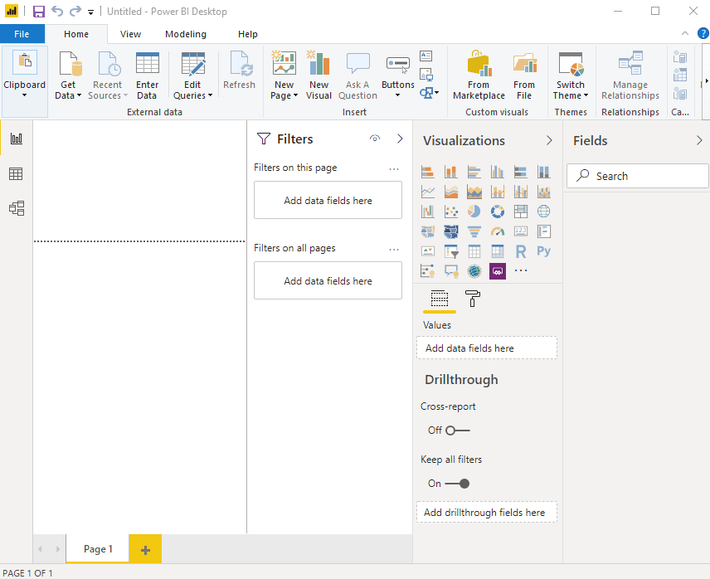
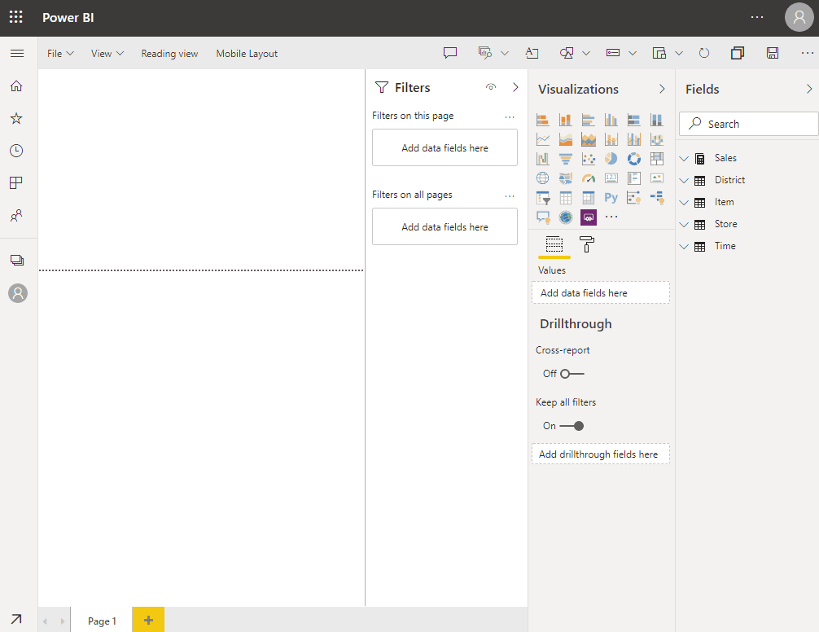
Power BI Online (in browser)
Windows – Desktop app
Power BI Desktop (a.k.a. Designer) is available ONLY on Windows.
If you are on a Mac, your choices are: - https://www.macworld.co.uk/feature/best-virtual-machine-software-3671133/
FREE - Wine ( https://www.winehq.org/ ) or VirtualBox ( https://www.virtualbox.org/ ) https://www.youtube.com/watch?v=J-S_TvtIm5Y
Parallels - $80 - https://www.youtube.com/watch?v=r89fGOM1bq0
Dual Boot (Apple's Boot Camp)
Trend.net $9/mo
Azure VM $100/mo
Available in Desktop Designer:
Data transformation, modeling, and shaping
Calculated columns
Python and DAX
RLS creation (row-level security)
in browser – online service
DAX = Data Analysis Expressions
(available only in Windows Desktop app)
Formula language with functions - similar to Microsoft Excel
Good introduction video:
- https://www.youtube.com/watch?v=waG_JhBgUpM
Measure = <some DAX function>.
Total Number = sum(TabName[ColName])
Power BI Service (online) include:
Dashboards
Sharing
RSL management
Gateway connections
Comparison: desktop vs online:
https://spreadsheeto.com/power-bi-desktop-vs-online/#desktop-vs-online

Slide 3
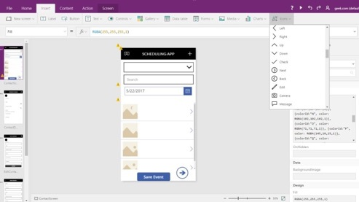
Microsoft Power Apps
Power Platform:
Power BI
Power Apps
Power Automate
Power Virtual Agents
powerapps.com
Good short demo video:
- https://www.youtube.com/watch?v=2RzCbd5XgJg
Power Apps:
rapid application development environment
build custom apps for your business needs
suite of apps, services, connectors, and data platform
responsive design - apps can run in browser, tablet, or phones
https://docs.microsoft.com/en-us/powerapps/
https://powerapps.microsoft.com/en-us/downloads/
https://create.powerapps.com/studio/#
Benefits of Power Apps:
Fast and easy App Creation (responsive custom forms)
Easy Standard Connectors (to data sources ...)
Easy integrate with Office 365, Power BI, SharePoint, ...
Mobile Ready
Microsoft Flow (process and task automation)
Low Cost
Disadvantages:
Separate apps for Android and iOS
Can retrieve only 500-2,000 items
Can't integrate JavaScript
Meant only for internal use (licensing model)
Microsoft Dataverse:
Common Data Service (CDS) has been renamed
to Microsoft Dataverse (2020)
https://docs.microsoft.com/en-us/powerapps/developer/data-platform/entities
CDM = Common Data Model
CDS = Common Data Service = Dataverse
Power Query:
data transformation and data preparation engine
graphical interface for getting data from sources
Power Query Editor for applying transformations
...

