Slide 1
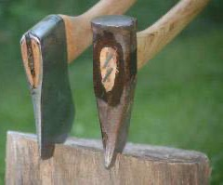
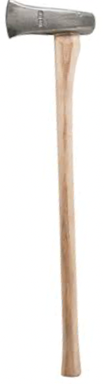
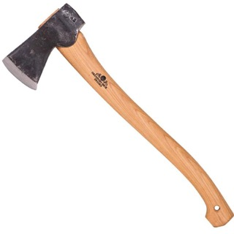
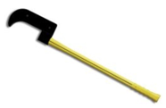
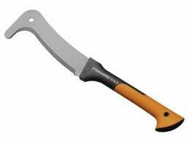
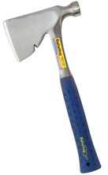
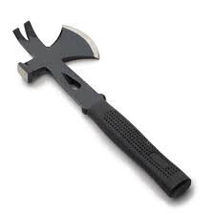

Ax – American English
Axe – British English
Hatchet – small ax (carpenter's hatchet or camper hatchet)
Maul – long-handled ax for splitting wood
Brush Hook = Bush Hook = Bill Hook
Gransfors Bruk Small Forest Axe 19.5"
$175
Ax (left) vs Maul (right)
Maul Ax
A splitting maul also known as a block buster, block splitter, chop and maul, sledge axe, go-devil or hamaxe is a heavy, long-handled axe used for splitting a piece of wood along its grain. One side of its head is like a sledgehammer, and the other side is like an axe.
Maul Ax
Hatchets

Slide 2

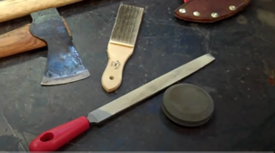
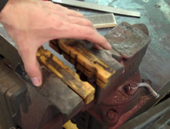
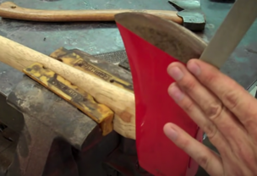
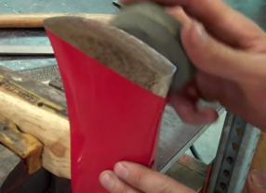
How to Sharpen an Ax or Hatchet
Ax – American English
Axe – British English
https://www.youtube.com/watch?v=JIZBwT-VDBY
Attention: never use a power grinder because it can damage the blade.
Use a vise and a medium-grade mill file. A mill file will allow for better control while you sharpen the blade.
Bastard file 12"
Use a strong stable vise.
Clamp the head of the ax with the edge facing up.
Place the medium-grade mill file flat against the blade
Draw it up towards the edge.
Lift the file off the blade at the end of every stroke.
The goal is to sharpen the blade into a convex shape while being careful not to taper the corners. The ax blade should slowly taper from a wide width down to a narrow sharpened edge.
Complete the sharpening process on both sides of the blade. Look down the length of the blade to check for uniformity, and continue to sharpen the blade accordingly.
After using the mill file, hone the ax blade, and sharpen it to perfection with a well-oiled round stone. Move the ax stone in a circular motion.
The newly sharpened ax blade should be lubricated to complete the sharpening process.

Slide 3
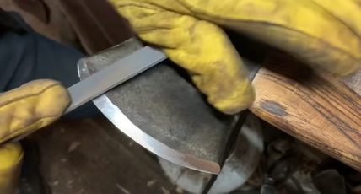
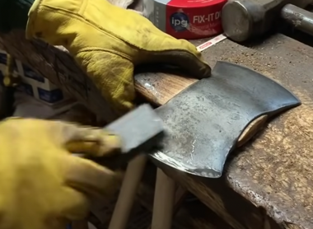
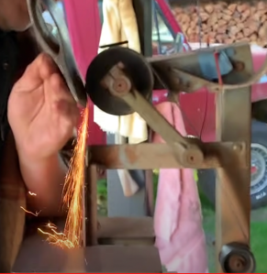
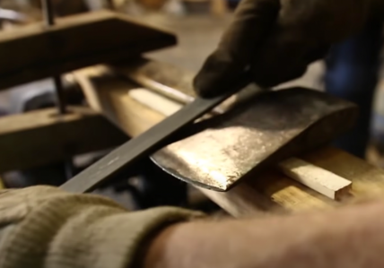
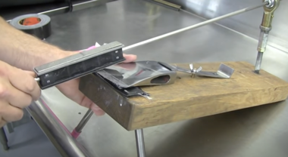
Sharpening with File, Stone, Belt
Sharpening with a stone
Sharpening with a belt
(careful – do not overheat it)
https://www.youtube.com/watch?v=AH5QCROvn28
using homemade guided knife sharpener
Sharpening with a file

Slide 4
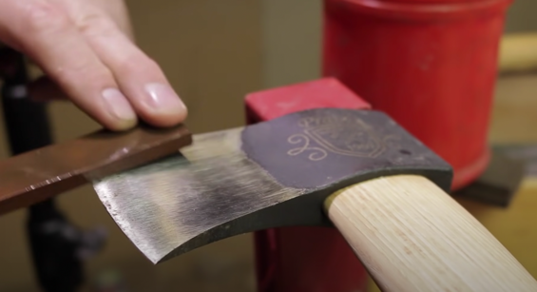
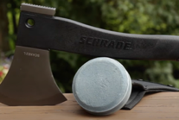
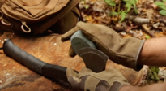
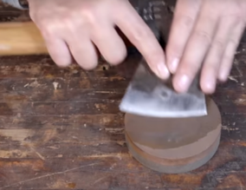
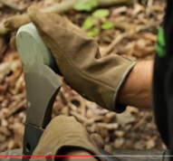
Sharpening Stone
Rounded 2-sided Sharpening Stone (a.k.a. puck)
use gloves
use with water and/or honing solution
https://www.youtube.com/watch?v=imBoBSQSQnk
How To Sharpen Your New Axe
https://www.youtube.com/watch?v=P6btjvmEUWk
using EdgePro https://www.edgeproinc.com
medium and fine
Lubricant: You can use Water, Oil, WD-40, etc.

Slide 5


Sharpening with Leather Strop and Stropping Paste
https://www.youtube.com/watch?v=Gg2w_MobIW4
A complete sharpening/stropping kit: https://amzn.to/2xh0KYs
Trend 300/1000 diamond stone: https://amzn.to/2LPNKmA
Stropping leather: https://amzn.to/2n4BDmN
Stropping paste: https://amzn.to/2Azdezc
Trend UDWS/HP/LS Honing Compound Leather Strop
Stropping paste

Slide 6
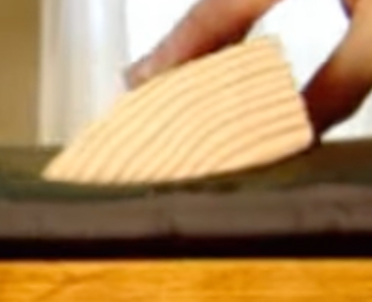
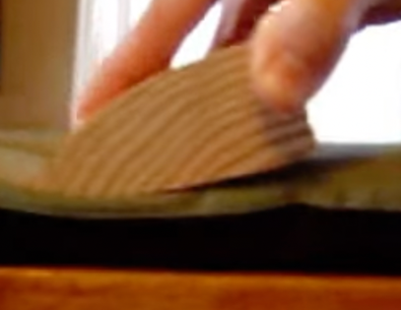
Sharpening Convex Edge With Soft Leather or Mouse Pad
and Abrasive Paste

Slide 7
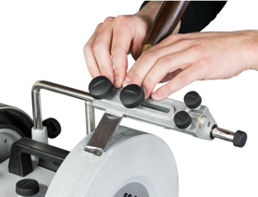

Tormek Sharpening Machine
https://tormek.com
Electric sharpener
with water-cooled wheel
Prices $500 - $2,000
There are knock-off models for much less ($150)

Slide 8
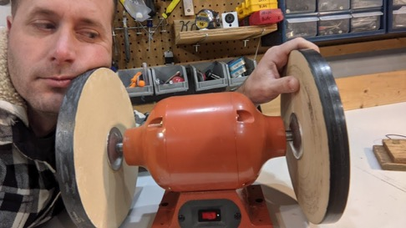
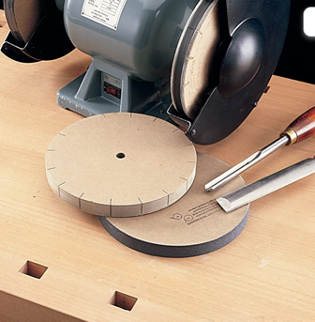
Sharpening with MDF (Medium Density Fibreboard)
https://www.youtube.com/watch?v=f2vvihhr238
I used scrap MDF and bought the the other supplies, links below.
Beeswax https://amzn.to/3nF9VdZ (wax sticks)
White Polishing Compound (akaJeweler's Rouge) https://amzn.to/37zCl3k
Silicone Carbide Grit https://amzn.to/3arvlaC (partickles)
https://www.amazon.com/Razor-Sharp-Edgemaking-System-Kit/dp/B0002IXQD8/
This most popular eight inch kit is made to fit
ordinary 5 or 6 inch bench grinder or buffer motor.
The wheels are most efficient turning over 3000 RPMs.
The wheels in a standard 8 inch
Deluxe Kit are 8 in by 3/4 in with a 5/8 in arbor hole.

Slide 9
To buy
12" Nicholson bastard file fine
12" Nicholson bastard file coarse
plastic handle over the wood
.. https://www.amazon.com/Nicholson-21474U-Universal-Handle/dp/B014IWD3OA/
Nicholson file card (wire brush to clean the file)
.. https://www.amazon.com/Nicholson-File-Card-Brush-Pack/dp/B001KVM2H2/
Lansky Sharpeners The Puck Dual Grit Multi Purpose Knife Sharpener 2 Pack
.. https://www.amazon.com/Lansky-Sharpeners-Multi-Purpose-Sharpener/dp/B017T2GG6I/

Slide 10
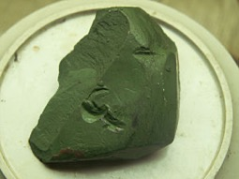
Па́ста ГОИ
Composition:
65-74 parts of trivalent chromium oxide,
1-silica gel,
10-stearin,
10 — split fat,
2-kerosene,
2-oleic acid,
0.2-bicarbonate of soda.
Па́ста ГОИ (от ГОИ — Государственный оптический институт) — шлифовальные и полировальные пасты на основе оксида хрома, используемые для шлифования и полирования стальных сплавов, цветных металлов, твёрдых пластмасс и полимеров, стёкол, оптических стёкол, керамических материалов.
Кусок пасты ГОИ
There are multiple honing and polishing pastes and compounds on amazon
No. 1 – Black paste with a green hue, with a grain size of 0.3-0.1 microns.
No. 2 - Dark green paste, with a grain size of 7-1 microns.
No. 3 - Green paste, with a grain size of 17-8 microns.
No. 4 - Light green paste, with a grain size of 40-18 microns.
The larger the "Grit" number – the smaller the size of particles. But be careful, becasue there are different Grit scales:
FEPA (Europe) and ANSI/Cami (US)
The European
P2000 - 10 microns
P4000 - 5 microns
US:
800 - 12.2 microns
1000 - 9.2 microns
1200 - 6.5 microns

Slide 11
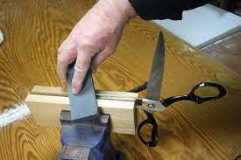
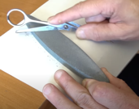
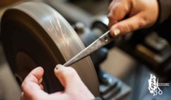
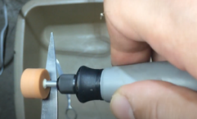

Sharpening Knives and Scissors
You can sharpen with:
File
Stone
Stationary Electric Sharpener System
Belt system
Hand-held electric grinder rotary tool

