Slide 1
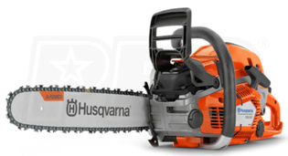
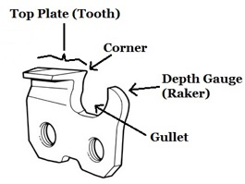
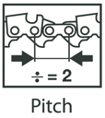
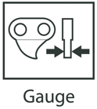
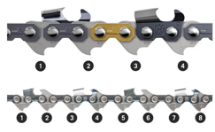
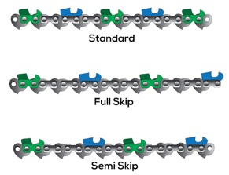
Chainsaw 18" - gas
July 2022 – bought at Chain Saws Direct:
Husqvarna 550XP Mark II (18") 50.1cc Gas Chainsaw, .325" .050" + 2 Year Extended Repair Warranty, $689.99
Husqvarna 50:1 Pre-Mixed 2-Cycle Fuel + Oil, Quart, Case of 6, $59.99
Husqvarna Classic Protective Glasses (Indoor/Outdoor), $5.99
Husqvarna Hearing Protectors, $32.99
Husqvarna chain X-Cut SP33G (pitch 0.325", gauge 0.050" (1.3mm), 72DL, bar 18", file 3/16")
Bought Oil at amazon:
Oregon Bar and Chain Oil for Chainsaws, One Quart Bottle (32 fl.oz / 946 ml) $7.50
Echo 6459007 Power Chainsaw Bar and Chain Oil - 1 Gallon, $19.50
pitch = distance
between rivets
low profile chain has shorter cutters than standard chain
narrow kerf chain has narrower cutters than standard chain
Drive Links
little teeth on the underside of the chain
72DL means that the chain has 72 of them
Full Skip – the most aggressive/fast cutting

Slide 2
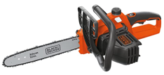
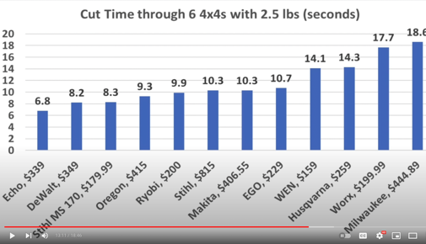
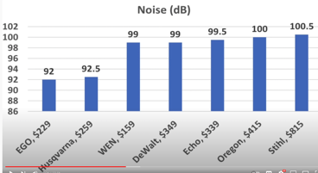

Chainsaw 12" - electric
July 2022 – bought:
BLACK+DECKER 40V Max Cordless Chainsaw, 12-Inch (LCS1240), $219.00
Replacement Oregon Chainsaw Chain for Black & Decker LCS1240 40-volt Cordless Chainsaw, 12-Inch .. pitch 3/8" .. gauge .043" .. 45 DL (Drive Links) .. bar 12-inch .. file 5/32 (small)
Some examples of electric chainsaws (in 2020):
- https://www.youtube.com/watch?v=_aBZt8m1XkQ
- https://www.youtube.com/watch?v=9WDaTwEwhTk
=============BEST===================
ECHO: https://amzn.to/37d9KRh - $395 for 16", now $300 for 18" at HomeDepot
DeWalt: https://amzn.to/3AhA0oM $330 DEWALT FLEXVOLT Chainsaw 60V 2Ah 16IN
=============Others===================
Milwaukee: https://amzn.to/35tPTeF $450
Makita: https://amzn.to/37I9hqX - $409, 16"
Ryobi: https://amzn.to/2G0HGWG
Worx: https://amzn.to/3kqHbEk
EGO: https://amzn.to/3gNXDxh - $270, 14"
Oregon: https://amzn.to/3n91B61 – $378, 16"
WEN: https://amzn.to/3oEkONk
Husqvarna: https://amzn.to/2JWMqyk $230, 14"
Stihl
Greenworks
Harbor Freight Atlas 80V 18"

Slide 3
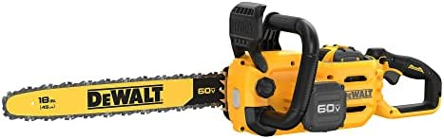
Chainsaw 18" - electric
November 2022 – ordered at https://www.cpopowertools.com
DeWalt DCCS672X1 60V MAX Chainsaw
18" Brushless Cordless Kit ($405)
includes 1 battery and charger
Replacement chain DWO1DT618: 18 in. Chainsaw Chain 62 Drive Link
Semi chisel chain. It is probably a re-branded version of Oregon 62-link chain: https://www.amazon.com/dp/B00004RA81
Replacement bar: DWZCSB18: 18" 0.050" (1.3 mm) gauge 3/8" low-profile pitch
October 2022 – research:
Best brands: Sithl, DeWalt and Greenworks
STIHL MSA 220 C-B 16" Battery-Powered Chainsaw ($420)
STIHL MSA 300 C-O 20" Battery-Powered Chainsaw ($800, not available yet)
Greenworks Pro 80V 18" Brushless Cordless Chainsaw ($300)
DeWalt DCCS672X1 60V Max Chainsaw 18" Brushless Cordless Kit ($300)
EGO Power+ 56V CS1804 18 in.Battery Chainsaw Kit (get extra 10Ah battery)
EGO Power 56V CS1800 18-inch Cordless Chainsaw (get extra 10Ah battery)
RYOBI 40V HP Brushless 18 in. Cordless Battery Chainsaw ($266)
Husqvarna - ~$1000 for 16"
Makita ?

Slide 4
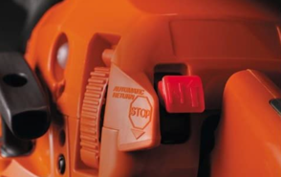
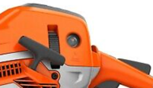
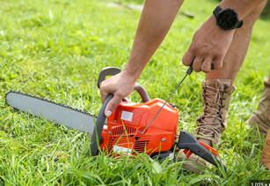
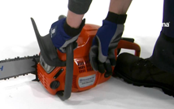
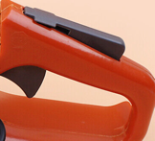
Starting Husqvarna Chainsaw
To Start:
Engage the chain brake (push the front hand guard forward)
Pull the red start/stop switch out and up to set it in choke position. (note – it has 3 positions: up(choke), middle (run), down (stop)
Press the air purge bulb 6 times (or until fuel starts to fill the bulb – it is not necessary to fill the air purge bulb fully).
Put the device on the ground, put your right foot into the footgrip on the rear handle, put your left hand on the front handle.
Pull the starter rope handle slowly with your right hand until you feel resistance.
Pull the starter rope handle quickly and with force. Do it several times until engine shows life (fires/engages once).
Disengage the choke (move red start/stop switch down into middle position).
Pull the starter rope handle several times until the engine starts.
Quickly disengage the throttle trigger lockout to set to idle speed.
Disengage the chain brake (move the front hand guard rearward).
Use the saw.
To stop:
Push the start/stop switch down to stop the engine.
Starting Husqvarna Chainsaw
https://www.youtube.com/watch?v=Mstt3POxXSo
https://www.youtube.com/watch?v=ZlvMhxAe3Es
Starting Husqvarna 550XP Mark II
https://www.youtube.com/watch?v=xjvz_5QadRc
https://www.youtube.com/watch?v=ekAPgJnmLE8

Slide 5

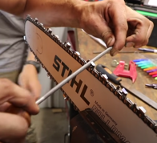
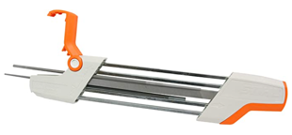
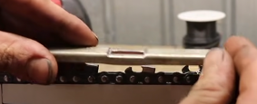
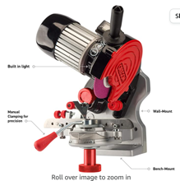
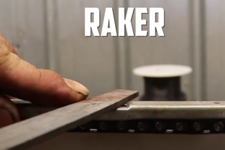
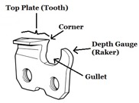
Starting Husqvarna Chainsaw
No Nonsense Guide to Chainsaw Sharpening - https://www.youtube.com/watch?v=Ca-0Yd6uAKc
CORRECT WAY To SHARPEN A Chainsaw (Step By Step) - https://www.youtube.com/watch?v=-GIxowey6IQ
How the Pro's sharpen a chainsaw - https://www.youtube.com/watch?v=MujE5tObk50
The Timberline chainsaw sharpener
https://www.youtube.com/watch?v=gRnwhopT_dc
https://timberlinesharpener.com/sizing/
STIHL 2 in 1 Easy File Chainsaw Chain Sharpener
https://www.youtube.com/watch?v=SzjmpNTVH6U
Depth Gauge
Oregon Professional Compact 120-Volt Bench Grinder, Universal Saw Chain Sharpener, for All Chainsaw Chains

Slide 6
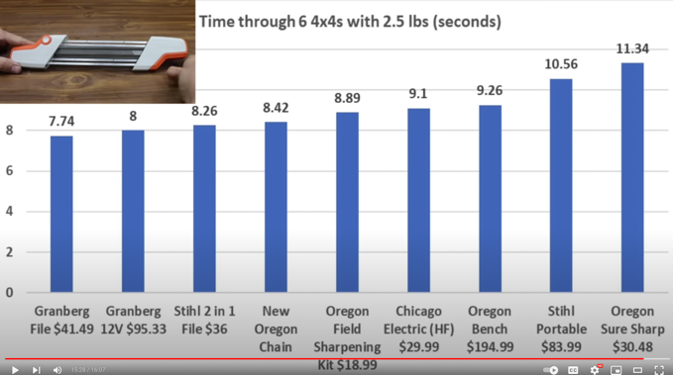
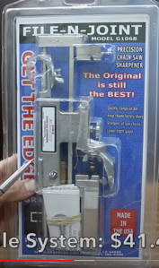
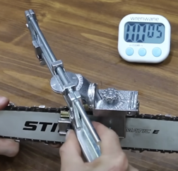
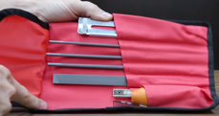
Stihl 2 in 1 $36
Granberg File System $41.49
Which Chainsaw Sharpener is Best? Let's find out!
Stihl, Granberg, Chicago Electric, Oregon
https://www.youtube.com/watch?v=BzmKwxfqjjQ
Oregon Field Sharpening Kit $19

Slide 7
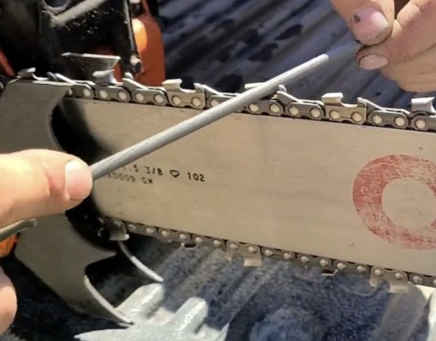
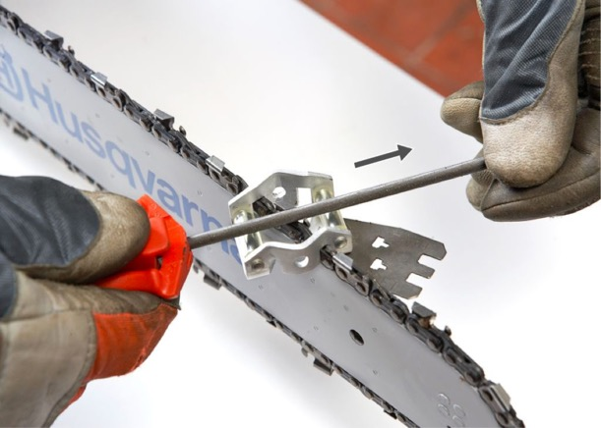
Keep the file by both hands
Always push in the direction "from" the engine (from "inside" the tooth")

Slide 8
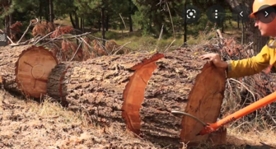
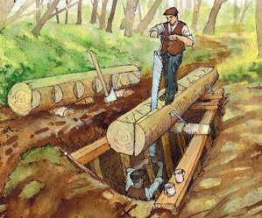
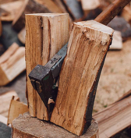
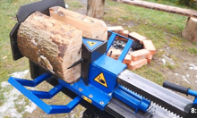
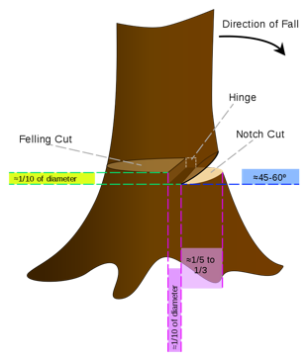
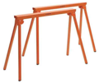
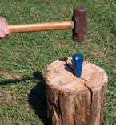
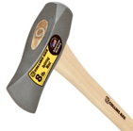
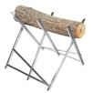
Wood / Chainsaw Operations
pruning/trimming – cutting limbs from a living tree
felling the tree (cutting the tree)
limbing - removal of branches from a downed tree
bucking - cutting the trunk of the downed tree into short stumps
Sawyer - someone who saws wood
(for example, using a pit saw and saw pit, or log on trestles above ground, or operates a sawmill).
bucking
saw pit
splitting tools:
Axe, splitting maul
splitting wedge
hydraulic log splitter
SawHorse Pair
(trestles = support structures)
Log Cutting Saw Horse
Trestle Stand

Slide 9
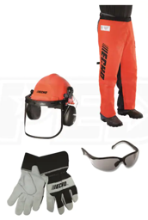
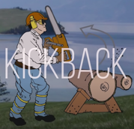
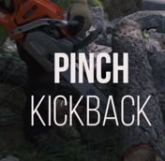
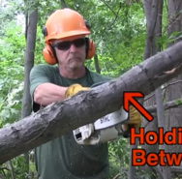

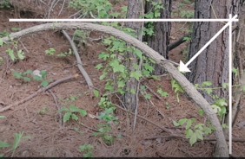

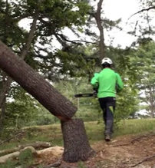
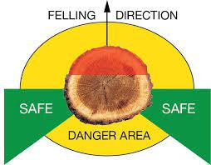

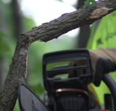
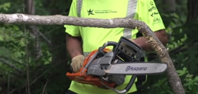
Safety Gear (PPE = Personal Protective Equipment)
Helmet/Muffs
Chaps
Bringing a hung tree down by blocking (from below)
Kickback happens when top-tip part of chain hits a hard object – which pushes the bar up towards the head of the operator
Glasses
Gloves
Use accordian cut or shave cut from below at the point of maximum tension to relieve this tension
Avoid Barber Chair

Slide 10
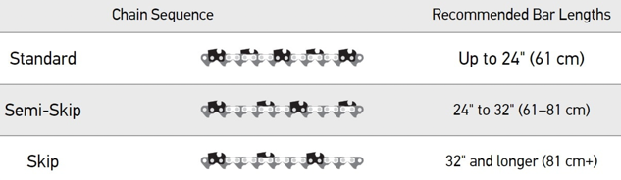
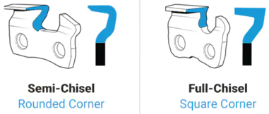
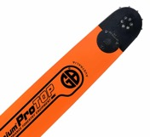
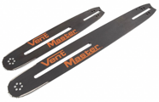
Types of Chainsaw Chains
https://www.chainsawsdirect.com/stories/1093-Replacement-Bars-and-Chains-to-Fit-Various-Models.html
Full chisel - professional, has squared, sharply pointed cutters that cut wood aggressively.
Semi chisel – homeowner, has rounded cutters. They dull more slowly when exposed to dirt and debris. So it is more "forgiving".
Types of Chain Cutter Tips
Chrome - standard
Carbide - cutting through metal, walls and roofs, icy wood, waterlogged wood in frozen rivers
Diamond - cut rocks and concrete and should be used only with bars and saws designed for that purpose
Chainsaw Bars: Solid vs. Laminated
solid bars are made from one solid piece of steel
laminated bars are made by joining two steel rails with a steel core and a sprocket between them. They are more flexible. But usually shorter than 24".
Bars with Replaceable Sprocket Nose are the standard.
These bars feature a sprocket at the tip or nose of the bar with rivets on which the chain sits. By holding the chain securely in place, the rivets help it turn smoothly.
Bars with hard nose are just one solid piece of metal. They are excellent for dirty conditions and for jobs such as sawing fence posts that require you to use the nose to bore directly into the wood.

