Slide 1
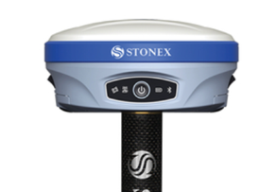
How to do survey of the area (map & mark territory)
STONEX S900+ GNSS Receiver (2..5 cm accuracy)
$7,600 .. $10,300
https://www.baselineequipment.com/stonex-s900-gnss-receiver
Best GPS Instruments for Land Surveying
https://www.baselineequipment.com/gps-land-surveying-equipment
Static GPS Baseline – This method is used to determine the coordinates for survey points by simultaneously recording GPS observations over both a known and unknown survey point for at least 20 minutes. The data is then processed to determine coordinates within 5mm accuracy.
Real-Time Kinematic (RTK) Observations – In this method, one receiver remains open over a known point (the Base Station) while another receiver moves between different positions (the Rover Station). Using a radio link, the position of the Rover Station can be calculated within a few seconds, ensuring a similar level of accuracy to baseline measurements as long as they are within 10km of the Base Station.
Continuously Operating Reference Stations (CORS) – In this system, a survey grade GPS receiver is permanently installed in a particular location as a starting point for any GPS measurements in the area. GPS survey equipment can collect field data and combine it with CORS data to accurately calculate positions.
A GPS receiver ranges from $4,000 to over $10,000, and the software itself costs upwards of $400. Additional equipment such as rover rods, poles, and tripods may increase the overall cost.
How to use GPS on your phone to land survey an area?
.. https://www.youtube.com/watch?v=aA5v17Gh4Fo Use an app "Land Survey" Also "AllTrails" app shows GPS coordinates
GNSS (Global Navigation Satellite Systems) are used by land surveyors for geodetic control networks and photogrammetric control.
A GNSS receiver uses code measurement and/or carrier phase measurement on the GNSS signal to determine the distance between receivers and satellites.
The receiver then calculates its position based on the distances to at least four satellites.

Slide 2
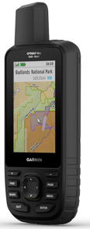
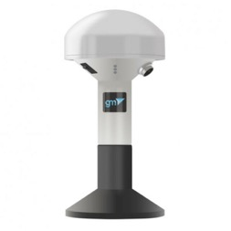
Garmin GPSMAP 66sr
$700 on amazon
GM SPIKE GNSS receiver
(external, bluetooth, works with app on mobile phone)
https://hikingguy.com/hiking-gear/garmin-gpsmap-66sr-review-test/
https://www.amazon.com/dp/B08HR5JZCY
https://www.youtube.com/watch?v=O8uCuEDJ_1E
https://gpsgeometer.com/en/

Slide 3

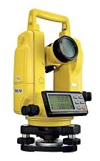
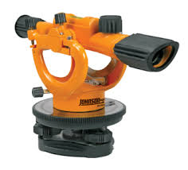
Theodolite
A theodolite survey is a survey that uses a theodolite, a precision optical instrument, to measure vertical and horizontal angles between visible points. Theodolites are often used for land surveying, but can also be used for building and infrastructure construction. They are considered the most accurate instrument for measuring angles and can be used to locate points on a line, extend survey lines, and find elevation differences.
A theodolite is a precision instrument used for measuring angles both horizontally and vertically. Theodolites can rotate along their horizontal axis as well as their vertical axis. Theodolites have a lot in common with transits. A transit is a surveying instrument that also takes accurate angular measurements.
transit
theodolite
theodolite price $200 .. $1200 .. $4200
New models are digital and use laser

