Slide 1
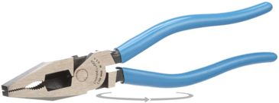
Pliers
linesman pliers
(Channellock or Knipex)

Slide 2








KNIPEX - 02 01 200 - High Leverage Combination Pliers (201200)
KNIPEX - 7112200 Tools 71 12 200, Comfort Grip High Leverage Cobolt Cutters
KNIPEX Tools 86 04 100 Pliers Wrench XS, 4", Silver
KNIPEX Tools - Mini Pliers Wrench, Chrome (8603125SBA)
KNIPEX - Pliers Wrench, Chrome (86 03 180)
KNIPEX - 8701180 Knipex 87 01 180 7-1/4-Inch Cobra Pliers
KNIPEX Tools - Mini Pliers Wrench, Chrome (8603125SBA)
KNIPEX Tools - Cobra XS Water Pump Pliers(87 00 100)
KNIPEX 8603250 10-Inch Pliers Wrench

