Slide 1
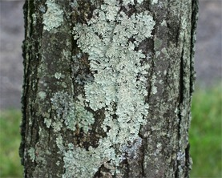
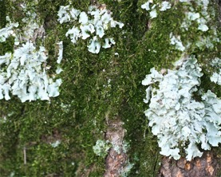
Electric Work
Tree-Dwelling Lichens https://njaes.rutgers.edu/fs1205/
Should you remove lichen from trees? https://www.rayzorsedgetreeservice.com/lichen/
Lichen = fungus (80%) + green alga + cyanobacterium
Lichen isn’t a moss
Lichen will not hurt your trees. Lichen will grow on your tree but not into your tree. A tree’s bark is just a useful surface for lichen to attach to.
The growth of lichen indicates that the air is clean (it won’t grow in polluted conditions) and moisture is available. So you shouldn’t automatically associate the appearance of lichen with negative factors affecting your trees
There’s no reason to remove lichen from your trees– except for cosmetic reasons. Lichen isn’t harming it and, more importantly for your trees, removing it may cause permanent damage to your tree.
If you absolutely must remove lichen, spray your branches with a gentle soapy solution. After wetting the lichen, you can use a natural-bristle scrub brush and gently exfoliate the lichen off. Don’t scrub hard, especially on young, thin bark. You can wash off the residue with a stream of water from your garden hose.
If you think your tree has lichen because of its poor health, the best approach is to improve your tree’s health. This could include:
adding compost around your tree,
using a foliar fertilizing spray,
ensuring your tree has enough irrigation, and
treating any other diseases that might be present on your tree.
Since lichens need a lot of sunlight to thrive, a full-leafed and shady tree crown may be the best revenge.

