Slide 1
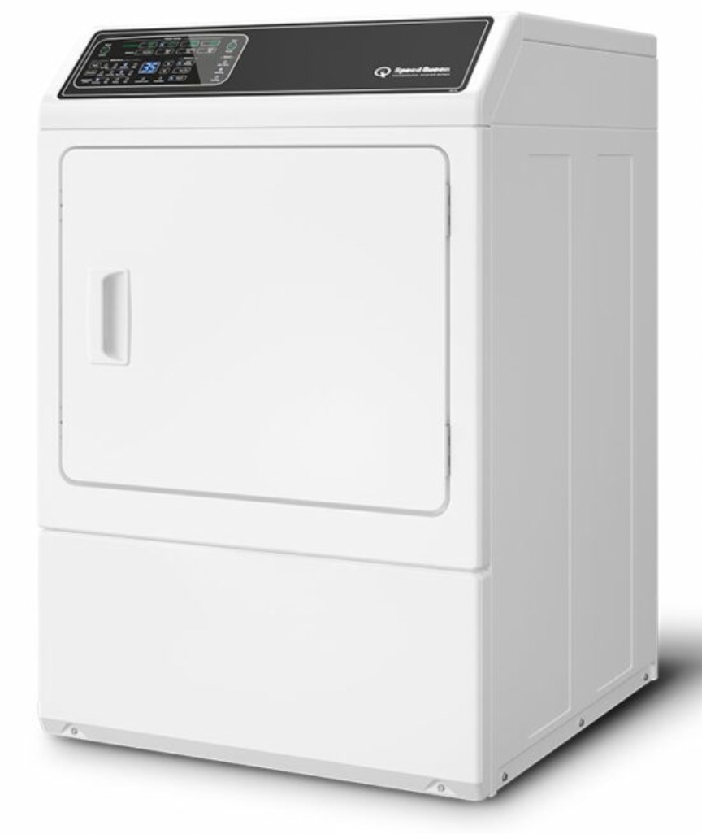
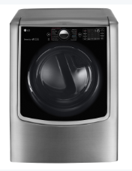
Speed Queen Dryer – recommended by Aleksey
Speed Queen Dryer DF7 - DF7000WE
7 cu. ft., 230V
5-Year Warranty
$2,229 MSRP
LG Smart Electric Dryer - DLEX9000V
9 cu. ft., 230V
$1,799.00
https://speedqueen.com/products/front-load-electric-dryers/df7000we/
https://www.usnews.com/360-reviews/home-goods/dryers/lg

Slide 2
Dryer for Washed Cloths
10 BEST Large Capacity Electric Dryers of August 2022
https://www.bestreviews.guide/large-capacity-electric-dryer
FRIGIDAIRE FFRE4120SW Dryer, White, Electric, 42-7/8" H
GE GFD85ESPNDG 28" Front Load Electric Dryer with 7.8 cu. ft. Capacity Stainless Steel Drum Built-in WiFi Sanitize Cycle and Damp
Hotpoint HTX24EASKWS 27 UL Listed Front Load Electric Dryer with 6.2 cu. ft. Capacity 4 Cycles Auto Dry Delicate Cycle Upfront Lint
GE GFD55ESSNWW 7.8 Cu. Ft. White Electric Smart Dryer
LG DLE3600V 7.4 cu. ft. Ultra Large Capacity Smart wi-fi Enabled Graphite Front Load Electric Dryer

