Slide 1

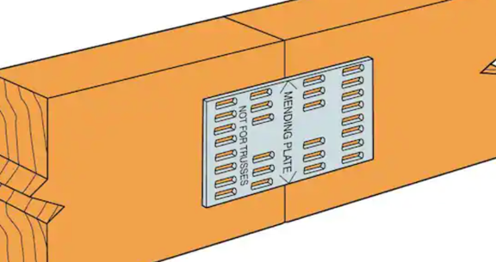
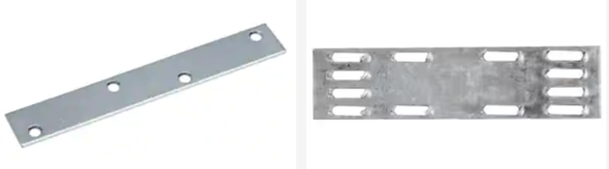
Mending Plates

Slide 2
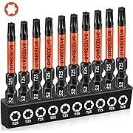
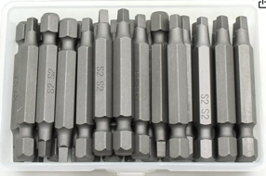
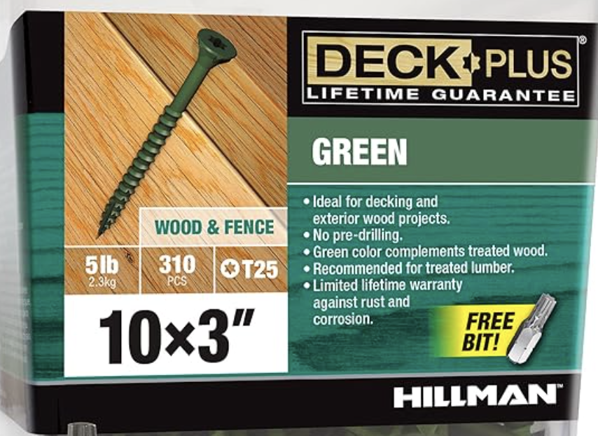
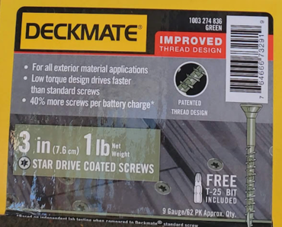

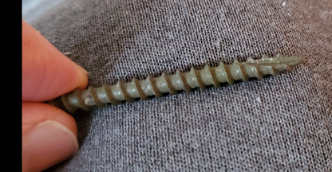
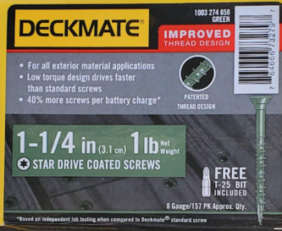
Wood Screws
Length 3 inch
Diam = 3/16" (this is called #10 or gauge 10)
Threads Per Inch = TPI = 9
tip notch:
https://boltdepot.com/Fastener-Information/Wood-Screws
https://boltdepot.com/Fastener-Information/Wood-Screws/Wood-Screw-Diameter
#10
T25 Torx Bits for Screwdriver
https://www.amazon.com/gp/product/B0D3Q4276R
or square head bits #2
https://www.amazon.com/dp/B07BX5SHKW
#9
#8
tip notch

Slide 3
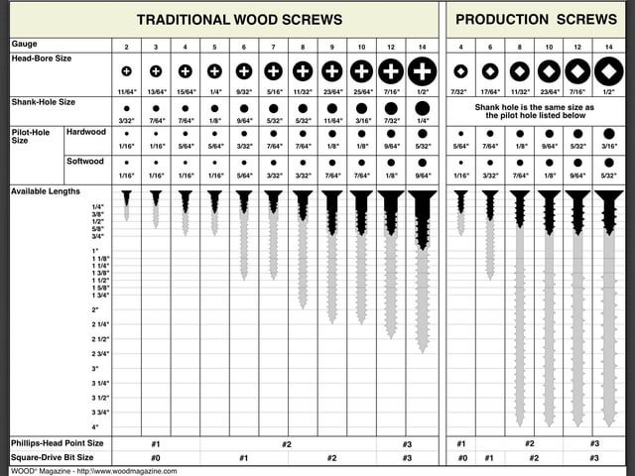

Slide 4
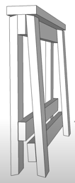
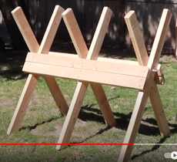
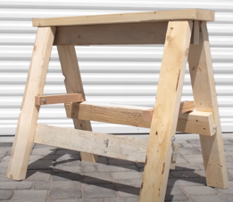
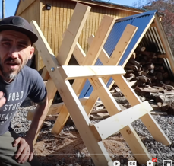
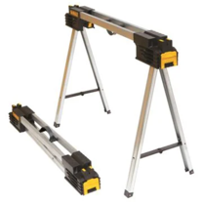
Sawbuck = Sawhorse
https://www.youtube.com/watch?v=1zbiIBZbAWI
DIY Folding Sawbuck // Chainsaw
https://www.youtube.com/watch?v=_6t4pel-hKw
HEAVY DUTY DIY Folding Sawhorses
https://www.youtube.com/watch?v=-rg5XA55qLg
Build a Foldable SAWBUCK (Sawhorse)
DEWALT Metal Folding Sawhorse

