Slide 1
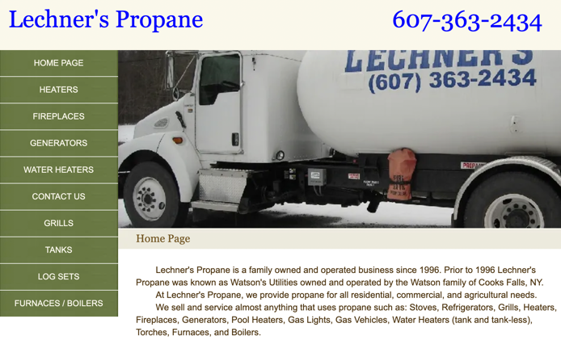
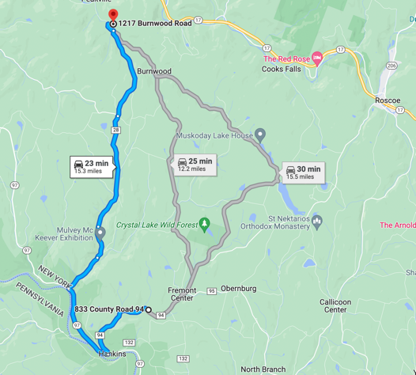
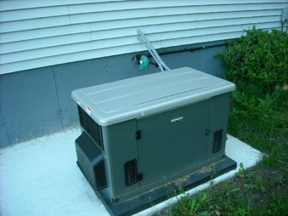
Propane
Leecher's Propane family business - George & Kevin Leecher George@LechnersPropane.com Kevin@LechnersPropane.com +1(607) 363-2434 • Work
1217 Burnwood Rd, East Branch, NY 13756-2109
https://www.lechnerspropane.com
Price (June 2022): 4.65/gallon
Expect $60 refill every 2 months
Backup Generator
min 12KW
better 20-26KW

Slide 2

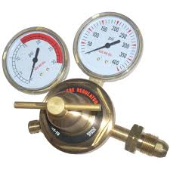
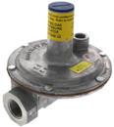

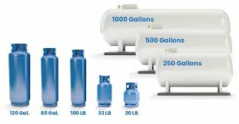
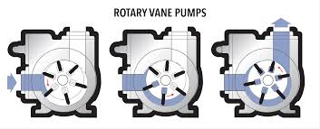
Propane
Tank has pressure 100-200 PSI (up to 250 PSI in hot weather and full tank)
Cooking stove uses 0.4 PSI
The reduction of pressure in two steps: to 10 PSI, then to 0.4 PSI
Tank should be transported only in vertical state
Tank should be filled no more than 80% (to leave some space for expansion)
A full100 lb propane tank weighs ~ 170 lbs. It holds ~23.6 gallons of propane, and propane weighs around 4.2 pounds per gallon.
Measure fulness: by weight, by sound, by temperature,
ultrasound meter - truma propane level check
Line Regulator
(pressure regulator)
To transfer propane from one tank to another one needs specialized propane transfer pump designed for LPG (Liquid Petroleum Gas), proper fittings, hoses and safety valves.
Most common pump type is a sliding vane pump. It has a rotor with sliding vanes that create sealed chambers to move the liquid propane without allowing it to vaporize.

Slide 3
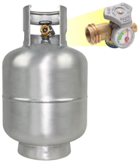
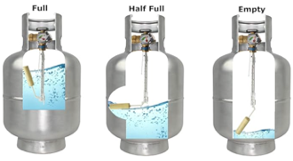
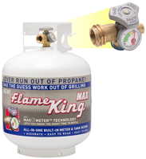
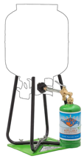
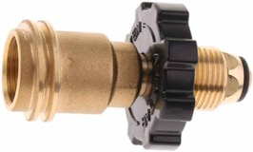
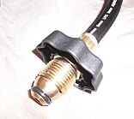

Retail Propane Tank Fittings in USA
For standard 20 lb and 100 lb propane tanks: POL fitting (CGA-510): This is the traditional fitting with a 3/4" NGT (National Gas Thread) left-hand thread at 14 threads per inch.
Note - all tanks manufactured after 2002 are required to have OPD (Overfill Protection Device) valve.
POL = Prest-O-Lite fitting, a.k.a. Compressed Gas Association designation CGA-510.
It features a small nipple in the center with a check valve that prevents gas flow when the fitting is disconnected.
Smaller tanks can use Type 1 ACME connection (a.k.a. QCC1 (Quick Closing Coupling). Very small 1 lb disposable cylinders (camping stoves) use CGA-600 connection
Hoses can be labeled as "POL," "Type 1," or "QCC1" to indicate compatibility with standard residential propane tanks.
To interconnect 2 tanks, you'll need a "tank-to-tank" transfer hose or "propane tank equalizer hose" with POL fittings on both ends. Look for hoses labeled for LP (Liquid Propane) or LPG (Liquid Propane Gas)
Flame King 20LB Aluminum - $200
Propane Tank with Gauge & OPD Valve,
POL and Type 1 ACME fitting
https://www.amazon.com/gp/aw/d/B0DR3SSBV8/
Same in steel - $60
https://www.amazon.com/dp/B08XYH6TND/
CGA-600
POL Female
POL Male
Type 1 ACME Male
Flame King Refil Kit
https://www.amazon.com/dp/B07F9LCYRT/
Male fitting to match POL valve

