Slide 1
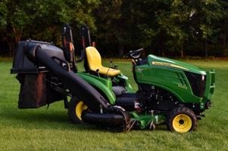
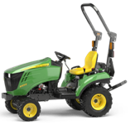

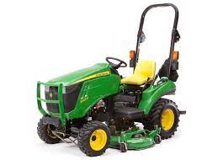
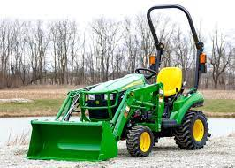
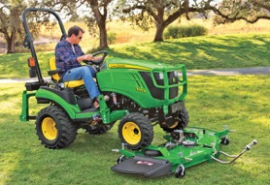
John Deere Sub-Compact Tractor
Prices in 2023:
1023E - $15,600.
1025R - $18,400
2025R - bigger wheels, longer, heavier)
https://www.deere.com/en/tractors/compact-tractors/1-series-sub-compact-tractors/1023e/
https://www.deere.com/en/tractors/compact-tractors/1-series-sub-compact-tractors/1025r/
https://www.youtube.com/watch?v=TeHIpRNJ3LU
Engine - diesel , 21.5 or 24 hp
PTO – 14.5 or 17.2 hp
weight: 610 kg or 654 kg
mower deck, 120R loader, ...
1025R is better – more PTO power, can use 3-point hitch implement, PTO precision handling, better seat, better steering
1025R base weight – 1,440 lbs
(compare with 805 lbs for jd-425)
Front loader
Quick attach
back counter-weight
mower platform + bagger
tires, dual-tires
additional hydraulics
Auto-connect mower platform

Slide 2
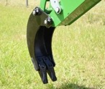
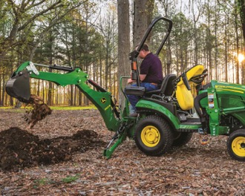
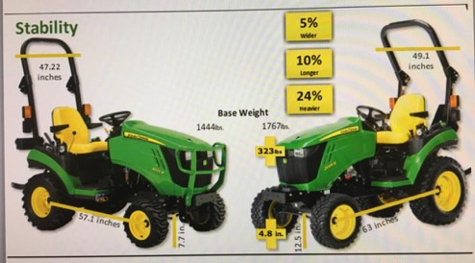
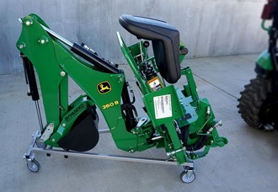
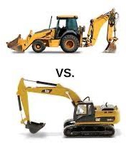
Backhoe 260b – use with 1025R
$6K
has its own seat
regular bucket, trenching bucket
trenching bucket
1025R vs 2025R
Wheeled Backhoe – smaller, lighter, more agile
Tracked Excavator - heavier duty, can dig more, father and deeper

Slide 3
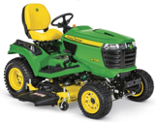
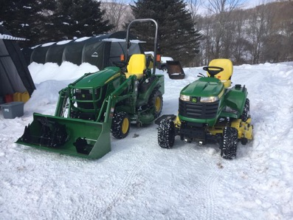
1025R. vs X758
X700 series 4WD models: X738, X739, X758
https://www.deere.com/en/mowers/lawn-tractors/x700-series/
All accept mowing decks 48, 54, 60 inches
All have power lift - two-function hydraulic lift system to raise and lower attachments (mower decks, front blades, snow blowers, or rotary brooms)
Prices: $17..$19K
X738 4wd, gas, fuel injection, V-twin, power lift, 947 lbs
X739 4wd, gas, fuel injection, V-twin, power lift, 4-wheel steer
X758 4wd, diesel, power lift , 1,038 lbs
1025R vs X758
1,444 lbs 1,038 lbs
JD-425 2wd gas carburetor
JD-445 2wd gas fuel injection
JD-455 2wd diesel - link
---------
X485 4wd gas fuel injection
X495 2wd diesel (2002-2005) - link
---------
X590 2wd gas fuel injection
X595 4wd diesel (2002-2005) - link
---------
X738, X739 4wd gas fuel injection
X740, X744 2wd diesel (2006-11)
X748, X749 4wd diesel (2006-11) - link
X750, X754 2wd diesel (2013-present) - link
X758 4wd diesel (2013-present) - link
---------
Both have diesel engine.
X758 is a garden tractor (mowing, with optional 3-point hitch and PTO)
1025R is a true sub-compact utility tractor (loader, backhoe, ...), heavier

Slide 4
Backhoe 260b – use with 1025R
1025R vs X758
1,444 lbs 1,038 lbs
X700 series 4WD models:
X738, X739, X758
https://www.deere.com/en/mowers/lawn-tractors/x700-series/
All accept mowing decks 48, 54, 60 inches
All have power lift - two-function hydraulic lift system to raise and lower attachments (mower decks, front blades, snow blowers, or rotary brooms)
Prices: $17..$19K
X738 4wd, gas, fuel injection, V-twin, power lift, 947 lbs
X739 4wd, gas, fuel injection, V-twin, power lift, 4-wheel steer
X758 4wd, diesel, power lift , 1,038 lbs
Both have diesel engine.
X758 is a garden tractor (mowing, with optional 3-point hitch and PTO)
1025R is a true sub-compact utility tractor (loader, backhoe, ...), heavier

Slide 5

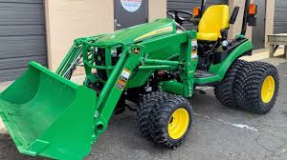
Dual Tires (Dualies)
https://www.youtube.com/watch?v=oDdR-KLIF-Q
Can potentially help in muddy conditions
Distribute the weight over a larger surface area, which can reduce ground pressure, thus preventing the tractor from sinking into soft or muddy ground
Increase traction since there are now twice the number of lugs (the raised patterns on a tire) making contact with the ground.
Downsides:
Added Weight
Turning Resistance
Cost and Installation
Wider Profile (harder to navigate)
Soil Compaction
Other solutions to consider:
tire chains
wider single tires

Slide 6
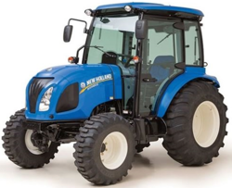
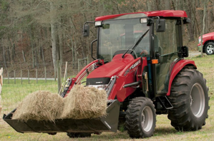
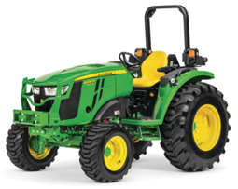
Other tractors with PTO $30-$50K
https://www.tractor.com/news/5-of-the-best-compact-tractor-choices/
Power Take-Off (PTO)
The tractor's stub shaft, often called the PTO,
rotates at 540 or 1000 rpm (9..17 times/sec)
and used to transfer power to external attachments.

