Slide 1

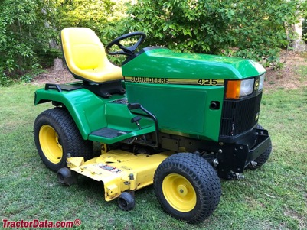
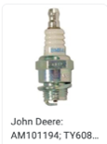
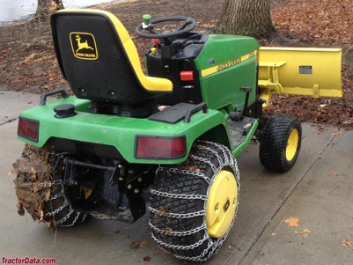
John Deere 425 (and 445)
Our JD 425 1995
Engine: Kawasaki
Liquid Cooled V-TWIN 20 HP OHV FD620D John Deere K Series
1992 - 2001
Built in Horicon, Wisconsin, USA
Original price was $8,995 in 1995
Weight – 805 lbs (365kg)
Engine: 20HP Kawasaki 617cc 2-cyl gasoline
carburetor
(model 445 has 22 hp and fuel injection)
Fuel tank: 6.5 gal (regular gasoline, no ethanol)
Oil - 10W30
Transmission: hydrostatic
Two-wheel drive, differential lock (mechanical rear)
Power Steering
425 Serial Numbers
https://www.tractordata.com/lawn-tractors/000/0/4/43-john-deere-425.html
Year. First tractor
1993 010001
1994 020001
1995 030001 M00425A-036065
1996 040001
1997 050001
1998 060001
1999 070001
2000 080001
2001 090001
Spark Plugs AM101194 (short)
https://partscatalog.deere.com/jdrc/sidebyside/equipment/73515/referrer/navigation/pgId/2523090
Note: there are two models of spark plugs:
AM101194 (short) for engine marked ASO2, BSO2, CSO2, DSO2, ESO2, FSO2
M805853 (long) for engine marked GSO2
We have the short one
On Amazon:
NGK Spark Plugs BMR4A #5728 (box of 10)
The spark plug wrench socket is 3/4"

Slide 2
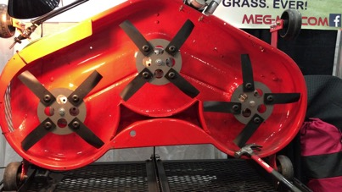
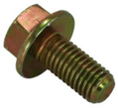

Meg-Mo blades
To order I need to provide this info:
Center hole - round
Current Blade OEM Part # M115495
https://meg-mo.com
The MEG-MO™ Rotary Mulching Blade System
John Deere Standard Mower Blade for 48" deck
Part Number: M115495
Hole in the center – round, 13/16 inch
Length of the blade (rotating diameter) 16 5/8 inch
Nut M18
Searching John Deere Parts:
.. https://partscatalog.deere.com/jdrc/navigation/equipment/73515
Then go to mower deck attachment:
.. https://partscatalog.deere.com/jdrc/navigation/equipment/78976
Then select "20 Mid-Mount Mower Decks 48-Inch and 54-Inch (For 425, 445 and 455 LGT)"
Then select "Belt Drive, Blades, Idlers and Spindles - ST561860"
.. https://partscatalog.deere.com/jdrc/sidebyside/equipment/78976/referrer/navigation/pgId/2341197
The John Deere Blade Bolt - 19M7788 (requires M18 nut driver (18mm)):
.. https://www.greenpartstore.com/John-Deere-Blade-Bolt-19M7788.html
E-Mail: sales@meg-mo.com Call (877) 625-0125
Received call from 815-625-0125
Riding mower blades should be installed between
70 and 90 foot pounds of torque
LEXIVON 1/2-Inch Drive LX-183 (10-150 Ft-lb)
https://www.amazon.com/LEXIVON-2-Inch-Torque-13-6-203-5-LX-183/dp/B07MP1Q3W8/

Slide 3
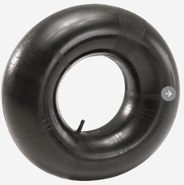
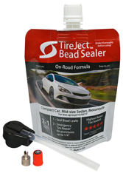

JohnDeere 425 Tires
front 16 x 7.50 - 8 (2-ply 8-12 PSI)
rear 23 x 10.50 – 12 (2-ply 6-10 PSI)
Tire "23 x 10.5 – 12":
23" = overall diameter
10.5" = width of the tire 12" = rim diameter
We may need to install Tire Tubes (~$15 each)
Tire Pressure from the manual:
Tire Size | Ply Rating | Pressure (PSI)
16 x 7.50 – 8 | 2 | 8-12
18 x 8.50 – 8 | 4 | 6-22
23 x 8.50 – 12 | 2 | 6-10
23 x 10.5 - 12 | 2 | 6-10
26 12.00 - 12 | 2 | 6-10
26 12.00 - 12 | 4 | 6-20
Tim (dealer) recommends:
LiquiTube tire sealant
Otar Recommends
TireJect Tire Sealant & Bead Sealer Kit:
https://www.amazon.com/dp/B08WKX95B9/

Slide 4
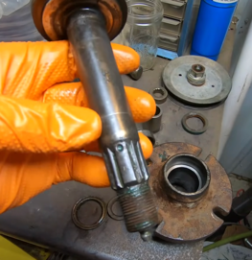
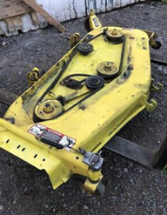
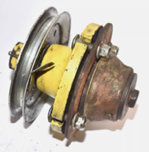

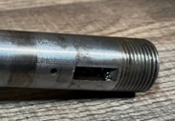
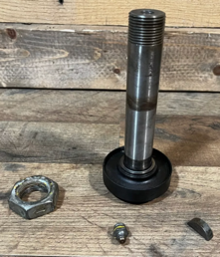


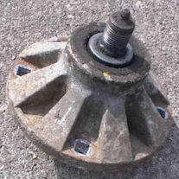

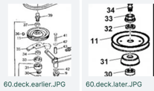

60" deck, spindles, pulley
nut
pulley
bushing
(spacer, washer)
bearing
spindle shaft
spindle hub
with pulley
deck
insert
bushing
bearing
spindle hub
Woodruff keys are semi-circular discs used to connect shaft and pulley to rotate together
spindle shaft woodruff key
spindle shaft
inserted from here

Slide 5
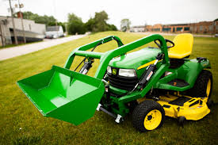
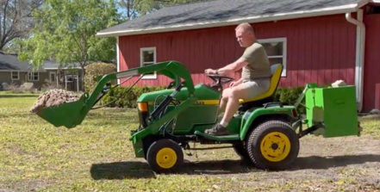

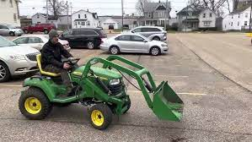
Little Bull Loader
https://www.youtube.com/watch?v=FwDi80FUzXU
https://www.littlebuckloader.com
https://www.littlebuckloader.com/shop/p/little-bull-loader-front-end-loader-john-deere
PRICE: $3,300

Slide 6

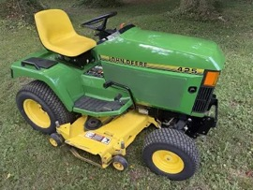
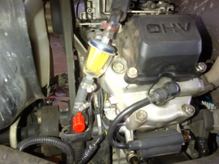
Tractor Not Starting
Using starting fluid
Spray starting fluid for 2-3 sec into air intake (remove filter) - and then try to start.
If it starts briefly and dies, that’s a strong sign you have a fuel delivery problem (carb, fuel line, filter, or stale gas) rather than an ignition problem
Most common reasons a JD 425 won’t start after 8 months:
1. Old/stale gas - Drain tank and carb, refill with fresh fuel + stabilizer
2. Gummed carburetor - remove carb, clean jets and passages with carb cleaner/compressed air
3. Weak battery, sulfated contacts - cldan, charge, test
4. Corroded/loose battery cables/grounds - wire‑brush clean, tighten
5. Fuel shutoff/line/filter restriction - open shutoff, replace fuel filter, inspect/replace cracked or collapsed lines, carburetor's fuel cut-off solenoid failing to retract properly
6. Choke/throttle or linkage issue - verify correct positions, lube linkages, adjust/repair cables as needed
7. Fouled/worn spark plugs - clean or install new
8. Ignition or safety interlock issue - check fuses, test/bypass safety switches or wiring, time-delay module, ignitor (CDI/ignition module), Ignition switch module, ...
9. Air intake or filter blocked - clean
10. Rodent‑damaged wiring, fuse, or switch - inspect, check/replace
No spark - change the "time-delay" module - provides buffer time delay to avoid shutting off from inconsistent contacts
https://www.youtube.com/watch?v=AzRyIVRD-zQ
https://www.amazon.com/dp/B07VPC328F - amazon $14
Bought on amazon:
Lisle 20580 InLine Spark Tester w/Coil On Plug Wire
Carb and Choke Cleaner Jet Spray (spray can)
STA-BIL Starting Fluid (spray can)
Ethanol Shield Fuel Stabilizer
How to prepare JD-425 for storage:
Add fuel stabilizer ("Ethanol Shield", 1oz/gal) to fresh gas before late‑season use - and run 5–10 min to pull treated fuel into carb.
Store tractor with tank either full of stabilized fuel or completely empty (avoid half‑full)
Close fuel shutoff valve (small manual valve next to the fuel filter on the right side of the engine) - and run engine until it dies (carb runs dry)
At spring startup, use fresh fuel again and crack the bowl drain or tap carb to ensure free float/needle.

Slide 7

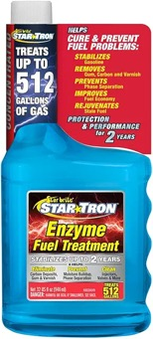
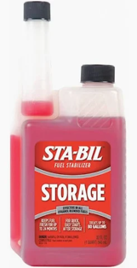
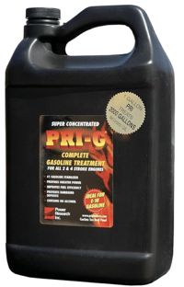
Which Stabilizer to use?
Chickanic YouTube Channel consistently recommends Ethanol Shield for stabilizing fuel in small engine equipment.
It effectively combines with water to help it pass through the carburetor and be burned off in the engine. Additionally, it contains oils that help rejuvenate rubber components like fuel lines, grommets, and carburetor diaphragms.
Mix 1 ounce of Ethanol Shield per gallon of fuel for storage
Minimize Air Exposure - because air and the resulting condensation is the primary cause of water in fuel, so fill the tank full
http://www.youtube.com/watch?v=mRGRWwPC3lA
She explicitly advises against STA-BIL
Which Stabilizer to use?
Ethanol Shield
STA‑BIL Storage Fuel Stabilizer - not recommended
Star Tron Enzyme Fuel Treatment - very popular with ethanol pump gas; many users report cleaner carbs and fewer problems over winter
PRI‑G – often recommended where people want multi‑year storage (Note: you need "G" for Gasoline, "D" for Diesel)

Slide 8
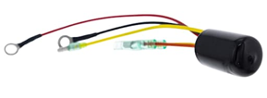
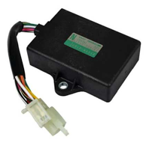
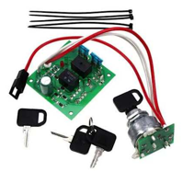
JD-425 Electronic Modules
Ignition time‑delay module (TDM)
a.k.a. “CDI” or “time delay box.”
JD part number: AM128906 (Ignition Delay Module)
Ignitor / ignition module (engine CDI box)
Function: JD calls this “IGNITOR”; it actually drives the ignition coils based on signals from the engine (CDI/ignition module). Loss of spark on one bank when hot is a classic failure.
JD part number AM105574 ignition module
Ignition switch module / dash control board
Circuit‑board module behind the key switch that routes power to the time‑delay module, ignitor, and other circuits
JD part number AM128878 ignition switch module,
often sold in kits and superseded/combined into kits like AM136681 (module + keys)

Slide 9
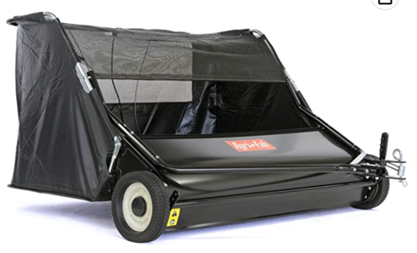
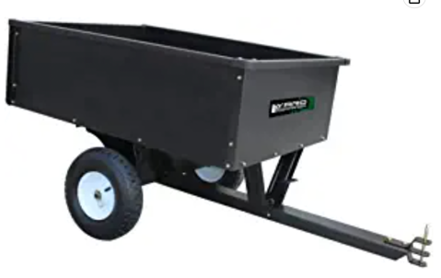
Sweeper
Dump Cart
Agri-Fab Inc 45-0546 52" Lawn Sweeper, Black
https://www.amazon.com/gp/product/B07KMX858N/
10 Cubic Feet Steel Dump Cart
https://www.amazon.com/dp/B08R95SSTJ

Slide 10
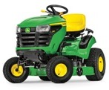
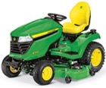
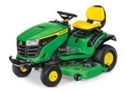
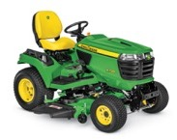
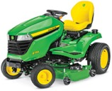
Modern JD Loan Tractors
https://www.deere.com/en/mowers/lawn-tractors/
Series S100
42,48,54" wide
$2.4 - $3.6K
Series X500
48,54" wide
$7.5K - $10K
Series S200
42,48 wide
$3.3-3.7K
X700 Signature Series
48,54, 60" wide
gas or diesel
2 or 4-wheel drive
$14K - $17K
Best: X758, $17K
weight 1,032 lbs (470kg)
Series X300
42,48" wide
$3.6K - $7.3K

