Slide 1
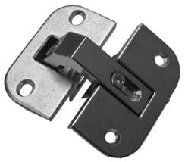
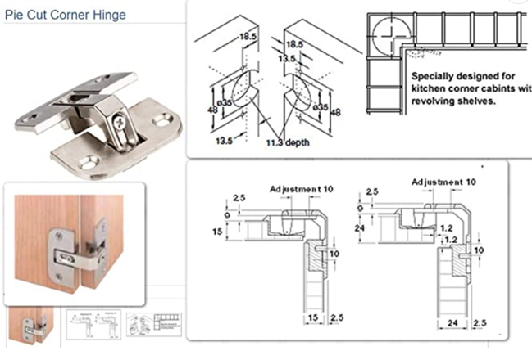
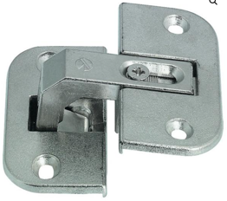
Corner Cabinet Hinges
https://www.cabinetparts.com/p/grass-hinges-european-cabinet-hinges-GHA90700-p23470
https://www.amazon.com/Pie-Cut-Corner-Hinge-Dimensional/dp/B0106BZI86
https://modernhardware.com/product/pie-cut-corner-hinge/

Slide 2
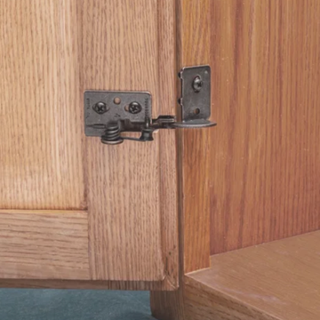
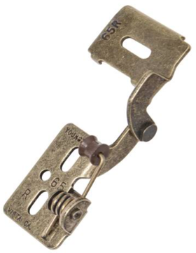
Handed #65 Youngdale Hinge

Slide 3
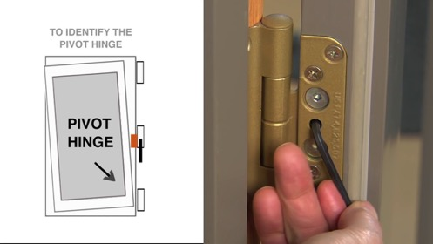
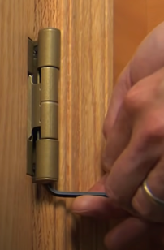
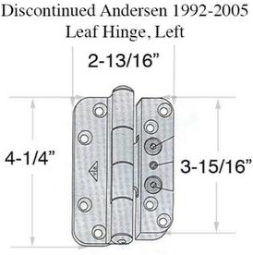
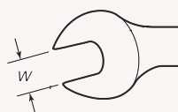

Frenchwood Inswing Patio Door (Pre-2005) | Andersen Windows
Andersen Windows & Doors - https://www.andersenwindows.com
tel: 800-426-4261
Parts - https://www.parts.andersenwindows.com
tel: 888-888-7020
Andersen Hinges - https://parts.andersenwindows.com/items_d_fwh_hng.html
need 5/32" hex wrench (=3.97mm)
https://parts.andersenwindows.com/detail_2579045__d_fwh_hng.html
Adjusting A Frenchwood Inswing Patio Door (Pre-2005)
https://www.youtube.com/watch?v=3jjh4aQmQ3Q
Adjusting an Anderson Door that Rubs
https://www.youtube.com/watch?v=sBZzJ-IhidI
There are 3 hex-head screws. The regulation is done by the central one.
1. loosen the top and bottom
2. regulate the middle (screw-in or out to decrease or increase the opening)
3. tighten the top and bottom
size of hex wrenches and nuts is measured "Across Flats" (AF).
There is also up/down adjustment of the hinge:
screw-in/out to move up/down

Slide 4
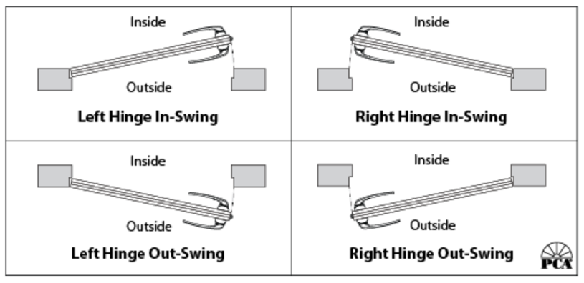
Door Thickness | Door Width | Hinge Size to Use
1-3/8 inches thick | up to 32 inches | 3 x 3 hinge
1-3/8 inches thick | between 32 and 37 inches | 4 x 4 hinge
1-3/4 inches thick | up to 36 inches | 4.5 x 4.5 hinge
1-3/4 inches thick | between 36 and 48 inches | 5 x 5 hinge

Slide 5

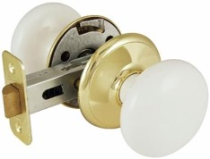
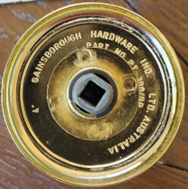
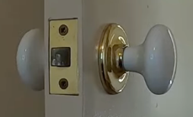
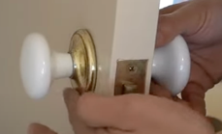
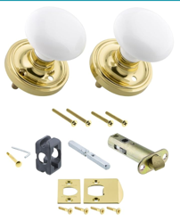
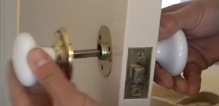
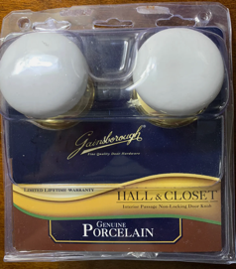
Schlage F40 V GEO 605 Georgian Door Knob, Bed & Bath Privacy Lock, Bright Brass
https://www.amazon.com/gp/product/B00002N76B/
Gainsborough Whitehall Passage Door Knob, Brass
https://www.amazon.com/Ultra-Hardware-85988-Gainsborough-Whitehall/dp/B0007XW92W
Ordered on ebay
https://www.ebay.com/itm/354102844912
Rosette - white porcelain
Back plate – gold (bright brass)
Installation drills: 9.5mm (3/8")
35mm (1 3/8")
25mm (1")
How to remove Gainsborough handle (without visible screws)
by turning (unscrewing) brass backplates
https://www.youtube.com/watch?v=FiMVcuQBrrU
Installation:
https://cdnimages.opentip.com/Docs/DLA/gains300install.pdf
Nostalgic Warehouse Classic Rosette White Porcelain Round Door Knob, privacy, $114
https://www.amazon.com/gp/product/B005W82BN4

Slide 6
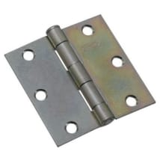
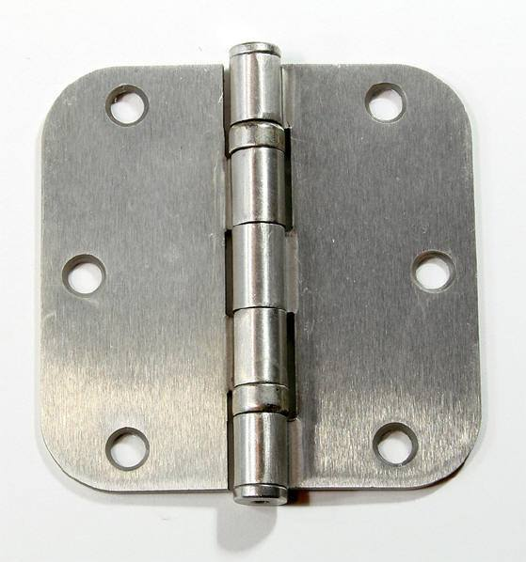
Hinges for Internal Doors
Our internal doors have standard thickness of around 1 3/8 inch
The hinges are standard – sizes either 3.5" or 3.0" depending
on the door frame. Corners are either square or ¼" rounded
The screws #8, length 1.5, 2 ¼, 2 ½ , or longer
In Manhattan – 4", square,
Screws #9
Best hinges use ball bearings
Good places to buy:
https://www.build.com
https://www.hingeoutlet.com
https://www.homedepot.com

