Slide 1
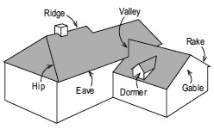
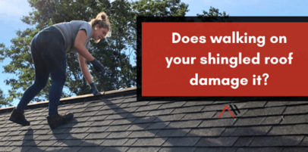
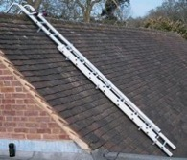
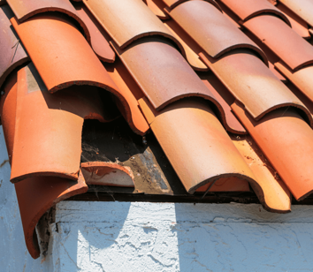
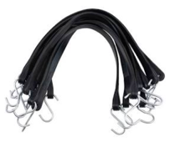
Walking Over the Shingled Roof
Asphalt Shingle Roofing: Best Overall.
Slate Roofing: Most Durable.
Metal Roofing: Most Versatile.
Wood Shingles: Most Environmentally Friendly Option.
Clay Tile Roofs: Best Curb Appeal.
TPO Roofing: Best for Flat Roof. (TPO = Thermoplastic Polyolefin, a single-ply roofing membrane)
https://joylandroofing.com/blog/damage-walking-on-shingled-roof/
roofing glossary:
https://www.owenscorning.com/en-us/roofing/tools/roofing-glossary
Roof Ladder
Shingles can withstand an occasional walk.
However, if it’s hot outside and/or direct sunlight,the asphalt base of the shingle will soften. Walking over soft shingles may damage them.
The older the shingles are, the more susceptible they become to damage from foot traffic.
Set your ladder against the gutters and use a bungee cord with hooks to secure the ladder (EPDM tarp bungee strap).
Use gloves
Wear long pants.
An old foam cushion (foam from a sofa seat) can be used to traverse your roof safely. This material really sticks to shingles well, providing a better non-slip surface. Using this also helps minimize damage to the shingles.
EPDM tarp bungee straps

Slide 2
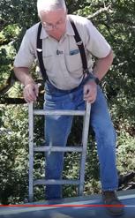
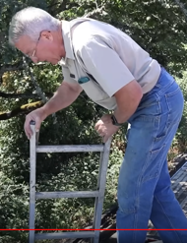
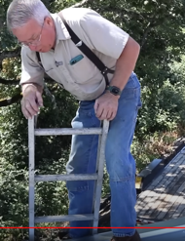
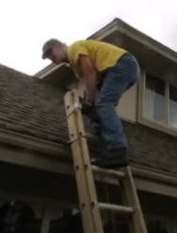
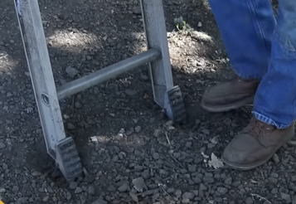
Climbing on to the Shingles Roof
https://www.youtube.com/watch?v=2z99pLPenL0
turn the ladder "feet" to dig into the ground

Slide 3
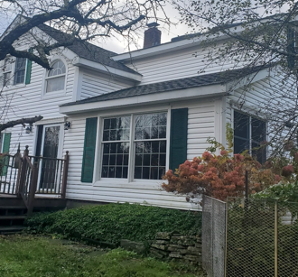
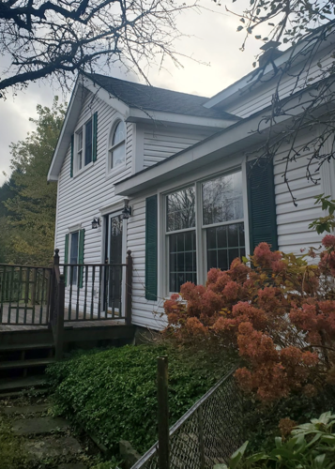
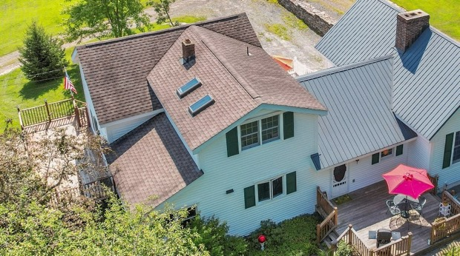
Climbing on to the Shingles Roof
Ladder to climb on roof above the dining area
Then walk to the chimney
wear gloves and dirty clothing

Slide 4

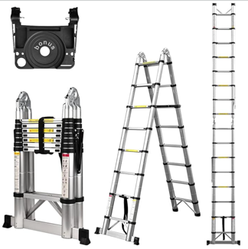
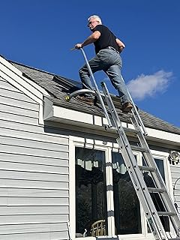
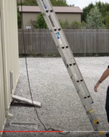
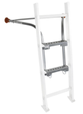


Climbing on to the Shingles Roof
Safe angle 4:1
Ladder-Max Stand-Off Stabilizer
https://www.amazon.com/dp/B0007R6L8Q/
Ladder Standoff Stabilizer
(Ladder Safety Rails) $285
https://www.amazon.com/dp/B07PRKRK2F/
Telescoping Ladder, 16.5 Ft, 330 lb $150-170
with Tool Platform and Stabilizer Bar
https://www.amazon.com/dp/B0CQ4N3QVZ/ don't like it – very heavy.
Louisville Extension Ladder 24-foot Aluminium , 300-Pound $384
https://www.amazon.com/dp/B0017ZRIG6/
Ladder Stabilizer, [Heavy Duty] https://www.amazon.com/dp/B0CKRDRBCF/
Louisville Ladder LP-2210-00 Alum Adjustable Stabilizer
https://www.amazon.com/dp/B001BIZBYK/

Slide 5
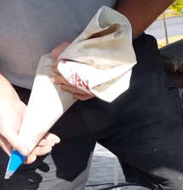
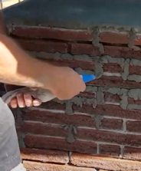
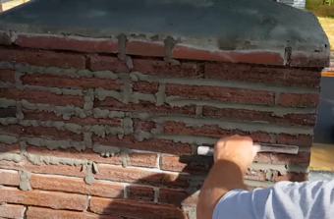
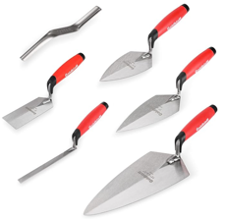
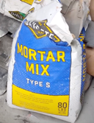
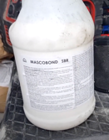
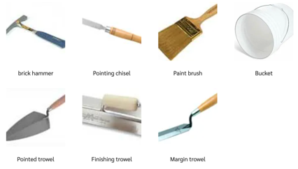
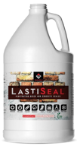
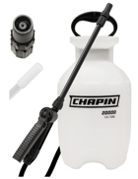
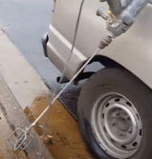
Waterproofing Chimney
Here is a demo video: Tuckpointing a Chimney https://www.youtube.com/watch?v=Y9mjAT8Gbb8 He is using "Mortar Mix type S"
He uses "Mortar Mix type S" and "Mascobond SBR" bonding agent
Instruments:
https://www.amazon.com/dp/B09VT7MBZZ/
https://www.thisoldhouse.com/masonry/21016125/how-to-repoint-brick-using-only-hand-tools
And then he sprays a sealant: https://www.youtube.com/watch?v=vNsrcGqJoYs There are many sealants, for example LastiSeal: https://www.amazon.com/dp/B007C6PQWM
https://www.amazon.com/dp/B000E28UQU - sprayer

Slide 6
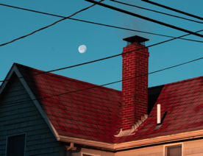
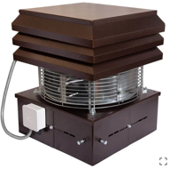
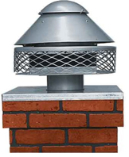
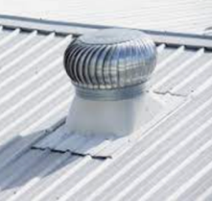
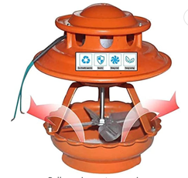
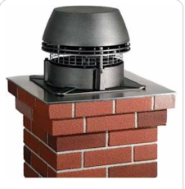
Chimney Fan Draft Inducer
Prevent wood stove exhaust from entering the room
Tip to prevent the smoke from getting into the room when you ignite the fire:
simply open the outer door or window to remove the air pressure difference between the room and outside.
Chimney Fan Buying Guide
https://www.tradepriceflues.com/blog/chimney-fan-buying-guide/
a chimney fan is a remote-controlled fan which is fitted either at the top of your chimney or to a twin wall flue system
chimney fans work by creating negative pressure within the chimney flue pulling gases from the room into the chimney
easier to light the fireplace, prevent smoke entering the room (especially in winter)
fireplace becomes 10-15% more efficient, cleaner burning, less smoke and dirt/particles
maintains consistent chimney draw, better stable performance during bad stormy weather
protection against birds (birds nests can block chimneys)
specific fans for different temperatures (up to 500ºC) and fuels (solid, gas, oil, ...)
manual or automatic control of speed to maintain draught in the chimney
fan usually uses less than 40 Watts. The wire runs from the fan down into your home. The control unit is usually installed on the wall near the fireplace

Slide 7
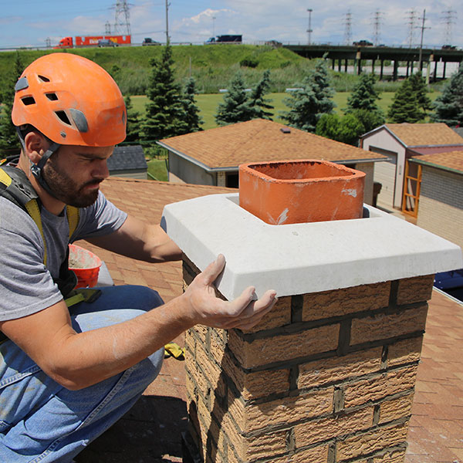
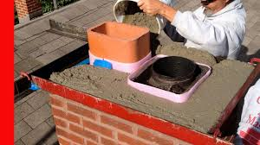
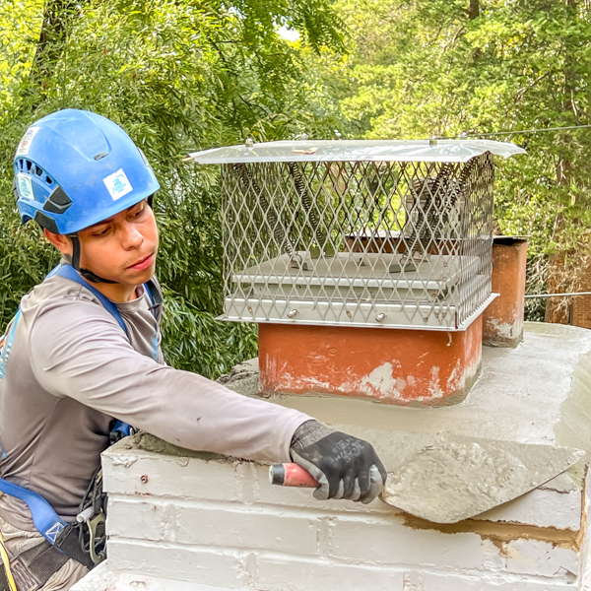
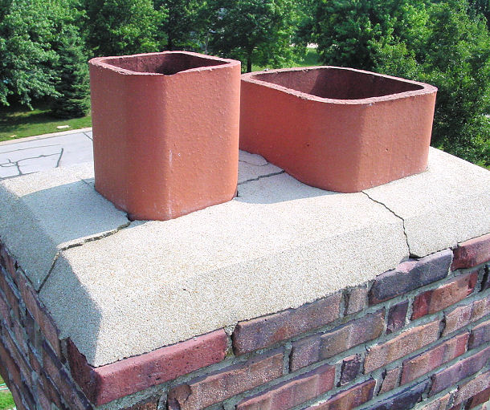
Chimney Crown
Repairing a cracked chimney crown.
few fine cracks - can be sealed with masonry silicone sealant or acrylic latex caulk .
larger cracks can be patched with quick-setting repair mortar
significan damage may require full replacement
clean with wire brush
remove loose mortar (use chisel)
lightly dampen the crown with wet cloth to help the repair materials bond better
apply sealant, caulk, or mortar using putty knife
Apply Elastomeric Sealant after the patch has dried (water-based elastomeric coating designed for chimney crowns).
Cracks in Chimney Crown

Slide 8
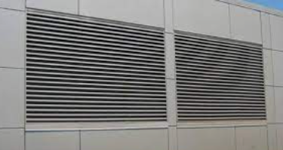
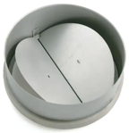
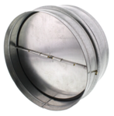
Anti-Backdraft Damper
Typically, the backdraft damper is situated into the duct system and prevents air from the outside coming into your home.
Dampers are built with blades designed to allow air to flow through in one direction out of the house, keeping cold air outside during the winter months.
A louver is a window blind or shutter with horizontal slats that are angled to admit air, but to keep out rain. The angle of the slats may be adjustable or fixed.

