Slide 1
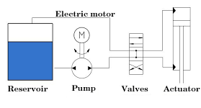
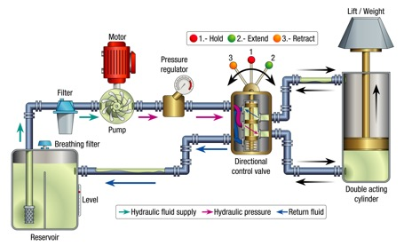
Hydraulics
Oil reservoir contains hydraulic liquid (oil) at zero pressure
A pump sucks in some of this oil to create high pressure
A valve can be used to direct high or low pressure to different parts of the actuator cylinder –pushing it in one or another direction

Slide 2
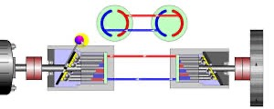
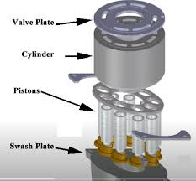
Hydrostatic Transmission
Pump,
the swash plate angled to define the direction
Motor,
the swash plate angle
is fixed
Hydrostatic transmission transfers power from the engine using pressurized oil instead of gears.
The engine spins an input shaft connected to a variable-displacement axial piston pump
Inside the pump, a rotating cylinder barrel holds a ring of pistons arranged in a circle
Each piston rides against a swash plate - a disc mounted at an angle - which pushes pistons in and out as the barrel spins
A port plate, pressed against the back face of the cylinder barrel, has two kidney-shaped slots that route oil into and out of the pistons at precisely the right moment
Pressurized oil travels through two hydraulic lines to a hydraulic motor, which has the same components - cylinder barrel, pistons, and a fixed swash plate - but runs in reverse, converting oil pressure back into shaft rotation that drives the wheels
Thrust bearings support the swash plate and absorb axial load from the pistons
Tilting the swash plate further increases flow and speed; tilting it the opposite direction reverses the motor
The oil loops continuously between pump and motor in a closed circuit.
xxx
https://www.youtube.com/watch?v=h3K_THDapTM
https://www.youtube.com/watch?v=qxZFSNITK-c
https://www.youtube.com/watch?v=BEpQFZ5BG8c
https://www.youtube.com/watch?v=MTeJWE_Ou0g

Slide 3
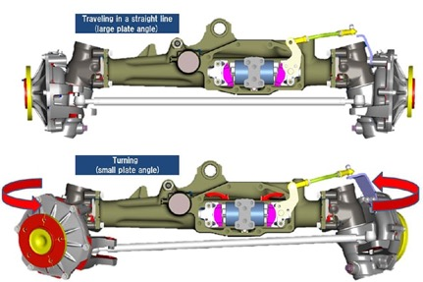
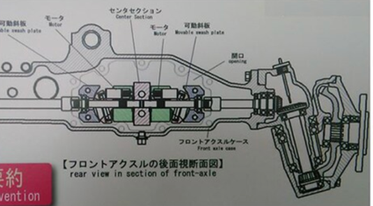
John Deere Hydraulic Front Wheel Drive - HFWD
On X758:
1. Diesel engine → rear Tuff Torq transaxle
2. Transaxle → rear wheels (hydrostatic pump/motor loop)
3. Same transaxle → two hoses forward → front axle
4. Front axle → left motor (left front wheel) + right motor (right front wheel)
5. Steering linkage → proportioning valve → automatically balances front motor speeds in turns
The front axle contains 2 independent hydraulic motors (left and right). Each motor is a small unit with pistons – exactly as in the rear transmission – but smaller
The Hydraulic Pressure does NOT come from the main Tuff Torq rear transaxle's closed loop. Instead, a dedicated hydraulic pump in the rear transaxle also supplies pressure specifically for the front axle
The axles share hydraulic fluid and are connected by 2 hydraulic pressure hoses and a balance hose running front to back under the tractor
The fluid circulates between both axles as one shared system
When you turn, your front wheels need to spin at different speeds - the outer wheel travels a longer arc than the inner wheel.
To solve this, the front axle has a proportioning valve mechanically linked to the steering linkage to adjust the swash plate angles of the two front motors - the outer wheel's motor gets more flow (faster) and the inner wheel's motor gets less (slower)
This happens automatically and continuously, with no electronic sensors involved
xxx

