Slide 1

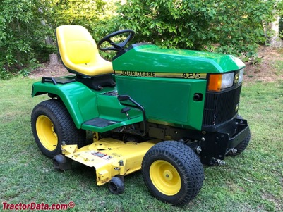
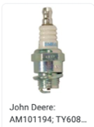
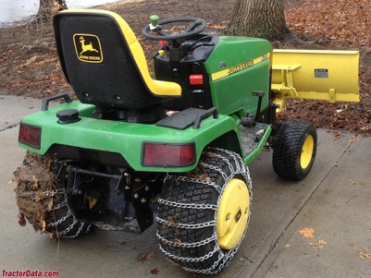
John Deere 425 (and 445)
Our JD 425 1995
Engine: Kawasaki
Liquid Cooled V-TWIN 20 HP OHV FD620D John Deere K Series
1992 - 2001
Built in Horicon, Wisconsin, USA
Original price was $8,995 in 1995
Weight – 805 lbs (365kg)
Engine: 20HP Kawasaki 617cc 2-cyl gasoline
carburetor
(model 445 has 22 hp and fuel injection)
Fuel tank: 6.5 gal (regular gasoline, no ethanol)
Oil - 10W30
Transmission: hydrostatic
Two-wheel drive, differential lock (mechanical rear)
Power Steering
425 Serial Numbers
https://www.tractordata.com/lawn-tractors/000/0/4/43-john-deere-425.html
Year. First tractor
1993 010001
1994 020001
1995 030001 M00425A-036065
1996 040001
1997 050001
1998 060001
1999 070001
2000 080001
2001 090001
Spark Plugs AM101194 (short)
https://partscatalog.deere.com/jdrc/sidebyside/equipment/73515/referrer/navigation/pgId/2523090
Note: there are two models of spark plugs:
AM101194 (short) for engine marked ASO2, BSO2, CSO2, DSO2, ESO2, FSO2
M805853 (long) for engine marked GSO2
We have the short one
On Amazon:
NGK Spark Plugs BMR4A #5728 (box of 10)
The spark plug wrench socket is 3/4"

Slide 2
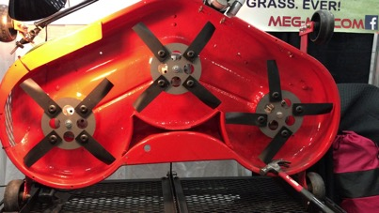
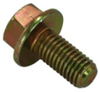
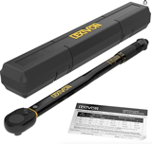
Meg-Mo blades
To order I need to provide this info:
Center hole - round
Current Blade OEM Part # M115495
https://meg-mo.com
The MEG-MO™ Rotary Mulching Blade System
John Deere Standard Mower Blade for 48" deck
Part Number: M115495
Hole in the center – round, 13/16 inch
Length of the blade (rotating diameter) 16 5/8 inch
Nut M18
Searching John Deere Parts:
.. https://partscatalog.deere.com/jdrc/navigation/equipment/73515
Then go to mower deck attachment:
.. https://partscatalog.deere.com/jdrc/navigation/equipment/78976
Then select "20 Mid-Mount Mower Decks 48-Inch and 54-Inch (For 425, 445 and 455 LGT)"
Then select "Belt Drive, Blades, Idlers and Spindles - ST561860"
.. https://partscatalog.deere.com/jdrc/sidebyside/equipment/78976/referrer/navigation/pgId/2341197
The John Deere Blade Bolt - 19M7788 (requires M18 nut driver (18mm)):
.. https://www.greenpartstore.com/John-Deere-Blade-Bolt-19M7788.html
E-Mail: sales@meg-mo.com Call (877) 625-0125
Received call from 815-625-0125
Riding mower blades should be installed between
70 and 90 foot pounds of torque
LEXIVON 1/2-Inch Drive LX-183 (10-150 Ft-lb)
https://www.amazon.com/LEXIVON-2-Inch-Torque-13-6-203-5-LX-183/dp/B07MP1Q3W8/

Slide 3
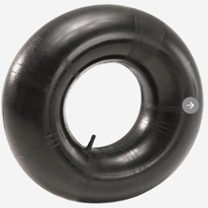


JohnDeere 425 Tires
front 16 x 7.50 - 8 (2-ply 8-12 PSI)
rear 23 x 10.50 – 12 (2-ply 6-10 PSI)
Tire "23 x 10.5 – 12":
23" = overall diameter
10.5" = width of the tire 12" = rim diameter
We may need to install Tire Tubes (~$15 each)
Tire Pressure from the manual:
Tire Size | Ply Rating | Pressure (PSI)
16 x 7.50 – 8 | 2 | 8-12
18 x 8.50 – 8 | 4 | 6-22
23 x 8.50 – 12 | 2 | 6-10
23 x 10.5 - 12 | 2 | 6-10
26 12.00 - 12 | 2 | 6-10
26 12.00 - 12 | 4 | 6-20
Tim (dealer) recommends:
LiquiTube tire sealant
Otar Recommends
TireJect Tire Sealant & Bead Sealer Kit:
https://www.amazon.com/dp/B08WKX95B9/

Slide 4
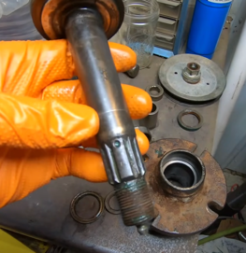
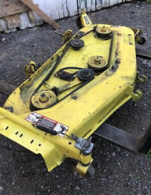
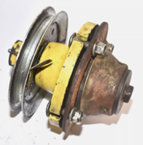

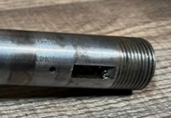
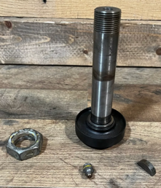


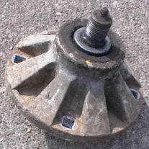

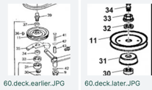

60" deck, spindles, pulley
nut
pulley
bushing
(spacer, washer)
bearing
spindle shaft
spindle hub
with pulley
deck
insert
bushing
bearing
spindle hub
Woodruff keys are semi-circular discs used to connect shaft and pulley to rotate together
spindle shaft woodruff key
spindle shaft
inserted from here

Slide 5
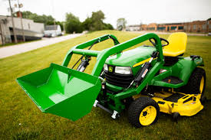
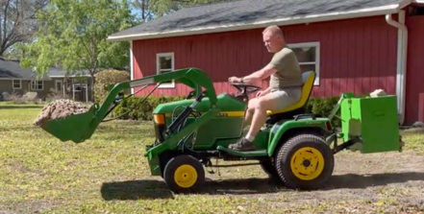

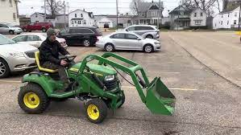
Little Bull Loader
https://www.youtube.com/watch?v=FwDi80FUzXU
https://www.littlebuckloader.com
https://www.littlebuckloader.com/shop/p/little-bull-loader-front-end-loader-john-deere
PRICE: $3,300

Slide 6
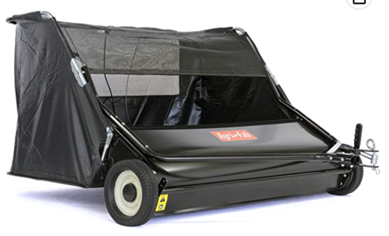
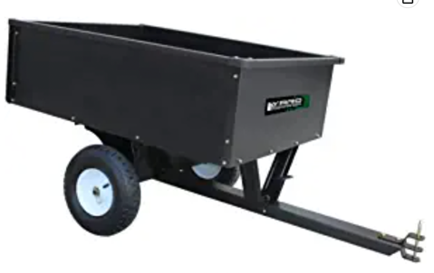
Sweeper
Dump Cart
Agri-Fab Inc 45-0546 52" Lawn Sweeper, Black
https://www.amazon.com/gp/product/B07KMX858N/
10 Cubic Feet Steel Dump Cart
https://www.amazon.com/dp/B08R95SSTJ

Slide 7
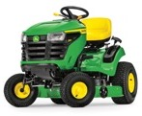
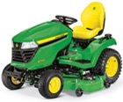
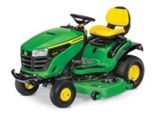
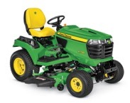
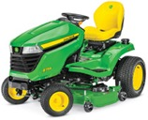
Modern JD Loan Tractors
https://www.deere.com/en/mowers/lawn-tractors/
Series S100
42,48,54" wide
$2.4 - $3.6K
Series X500
48,54" wide
$7.5K - $10K
Series S200
42,48 wide
$3.3-3.7K
X700 Signature Series
48,54, 60" wide
gas or diesel
2 or 4-wheel drive
$14K - $17K
Best: X758, $17K
weight 1,032 lbs (470k)
Series X300
42,48" wide
$3.6K - $7.3K

