Slide 1
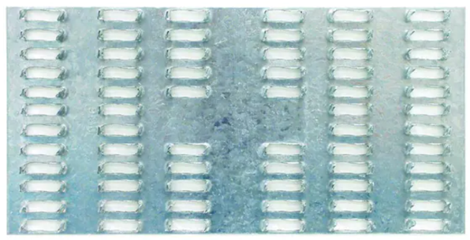
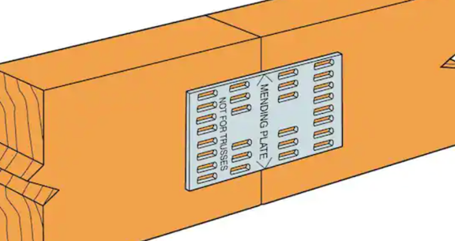
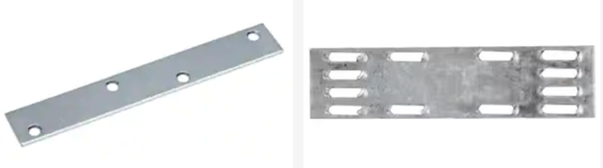
Mending Plates

Slide 2
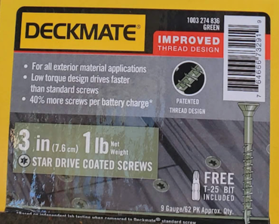

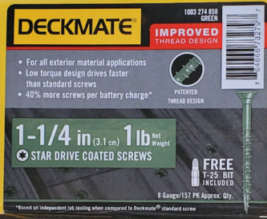
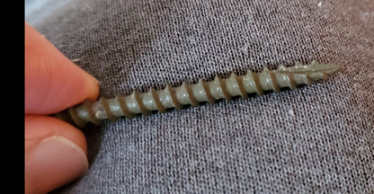
Wood Screws
Length 3 inch
Diam = 3/16" (this is called #10)
Threads Per Inch = TPI = 9
tip notch:
https://boltdepot.com/Fastener-Information/Wood-Screws
https://boltdepot.com/Fastener-Information/Wood-Screws/Wood-Screw-Diameter
tip notch

