Slide 1
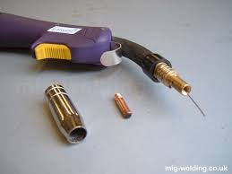
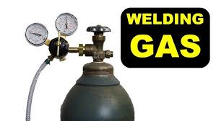
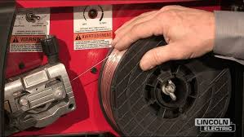
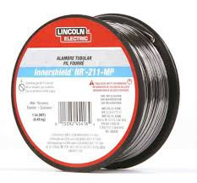
Welding
MIG & TIG Welding
MIG Welder (Metal Inert Gas welder) - arc welding using continuous solid wire as electrode and inert shielding gas (usually argon) to protect weld area.
MIG welder does not use traditional coated welding rods like those used in stick welding (SMAW).
Instead, a MIG welder uses a spool of consumable solid wire, known as MIG wire, which acts as both the electrode and the filler material during the welding process.
MIG wire is fed continuously through a gun and melts to join the metals, whereas stick welders use solid rods that are manually replaced as they are consumed.
MIG welding is easy to learn, versatile, and efficient, producing clean, strong welds with minimal cleanup. It is commonly used for welding thin to medium-thick metals, including steel, aluminum, and other non-ferrous metals.
TIG welding (Tungsten Inert Gas welding), aka Gas Tungsten Arc Welding (GTAW) uses a non-consumable tungsten electrode to create an electric arc and an inert shielding gas (usually argon) flows from the TIG torch. The operator uses one hand to guide the torch and the other hand to feed filler rod into the weld pool
Flux-Cored Welder uses a special tubular wire filled with flux that generates shielding gas during welding, which protects the weld without needing an external gas tank.
A flux-cored welder also does not use traditional welding rods. Instead, it uses a spool of tubular flux-cored wire that acts as both the electrode and the filler material. This continuous wire is fed through the welding gun, and the flux component within the wire provides the shielding needed to protect the weld pool, either with or without an external gas depending on the type of flux-cored process being used.
Flux-cored welding is often used outdoors or in windy conditions where shielding gas from a tank might be blown away
It is typically used for thicker materials, construction, and outdoor repairs, offering good penetration and toughness but usually producing more spatter than MIG welding

Slide 2
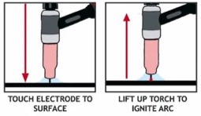
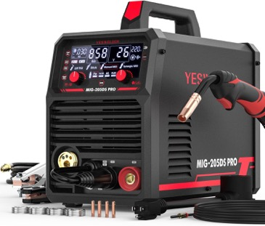
Welding
Lift TIG is a torch arc starting method used in TIG welding
The welder gently touches the tungsten electrode to the workpiece (which is safe because only a very low current flows), then lifts it slightly away
As the electrode is lifted, the welding machine detects the movement and immediately ramps up to the set welding current, creating an arc without causing the tungsten to stick or contaminate the weld
This method minimizes electrode wear and weld contamination, offering better control and cleaner starts than the older "scratch start" method, and is ideal for both beginners and professionals.
When a welder is said to be able to weld "3/16th of an inch," it means that the welder can effectively join or penetrate to this depth
It means the machine has enough power and heat output to fully melt and fuse through 3/16 inch (about 4.8 mm) thick metal in a single pass
Duty Cycle 60% - means the welder can work 60% of 10 min (6 min), and then it needs to "rest"
YESWELDER MIG-205DS PRO MIG Welder, 200Amp 110/220V Dual Voltage MIG Welding Machine, 5 in 1 Gas MIG/Flux Core MIG/Spool Gun MIG/Lift TIG/Stick Multiprocess Aluminum MIG Welder, Spool Gun Compatible
https://www.amazon.com/dp/B07TVCWDGW - $340

Slide 3
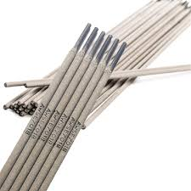
Welding rods
110V with 15A breaker – 70-90A of welding current
110V with 20A breaker – 90-120A of welding current
220A with 20A breaker – 220A of welding current
Welding rods – common sizes 3/32" and 1/8" Common types:
6011 - Excellent for welding dirty, rusty, or painted metal, commonly used for repairs and general-purpose work
6013 - Popular for clean, new metal and light fabrication. Easier to use for beginners, produces a neat weld bead
7018 - strong, smooth, and low-spatter welds. Frequently used for structural work and projects where weld quality is important

Slide 4
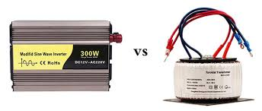
Inverter
Inverter
Transformer
Inverter: AC to DC
An inverter in welding machines is an electronic system that converts the AC (alternating current) power supply into a controlled, lower-voltage DC (direct current) output suitable for welding
Inverter welders are more compact, lightweight, and energy-efficient compared to conventional transformer-based welders
Traditional welding machines use large, heavy transformers. Inverter welders use high-frequency electronics instead, they are light and portable.
Inverters offer energy savings, the ability to work with various power sources including unstable ones, and advanced control over welding parameters
Inverters deliver a steady, stable arc with precise control over voltage and current, enhancing weld quality and efficiency
The name "inverter" was coined by engineer David Prince in a 1925 article in the GE Review
He described a device that reverses (or "inverts") the function of a rectifier - turning direct current (DC) into alternating current (AC), as opposed to a rectifier which does the opposite.
Prince explained that he took a rectifier circuit and "inverted" it so that DC was input and AC was output, hence the name "inverter".

Slide 5
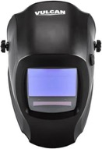

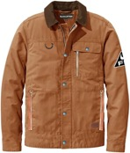
Protection
Must Have Items for the Beginner Welder
https://www.youtube.com/watch?v=V_9GZEsEVlg
Links under the video:
Stick Welder, Rods, Wire
Helmet, Gloves
Angle Grinder
Horizontal Band Saw (chop saw)
Magnets, Clamps
Anti Spatter Spray, Nozzle gel
Welding pliers
Wire Brush
Chipping Hammer
Auto-Darkening Welding Helmet
Heat-Resistant Welding Gloves
Can I Start Welding With Only $200?
https://www.youtube.com/watch?v=S0XE7qYXA2E
Welder, helmet, gloves
Grinder (kit with several disks)
Tape Measure , Square (triangle)
Magnet Squares
Chipping Hammer,
7018 Electrodes, 6011 Electrodes
Drill Press Vise
Flame-Resistant Welding Jackets
Flame Resistant Cotton Welding Jacket $56 - $78
Strongarm Unisex Arc-Rated Fire-Resistant Satin Welding Jacket $38
ARCCAPTAIN Heat Flame Resistant Leather Welding Jacket $76 - $86
More Protective Essentials
- Pants: Flame-resistant, heavy cotton or leather, never shorts or synthetics
- Footwear: Steel-toe boots, heat/spark/slip/electrical hazard resistant
- Eye Protection: Safety glasses or goggles with side shields (under helmet)
- Respiratory Protection: Recommended if working in confined spaces, with fumes, or on hazardous materials
- Ear Protection: Ear plugs or muffs for noisy environments or grinding
- Apron/Sleeves: Optional for additional coverage on heavy jobs
- Cap or Hood: To protect scalp from stray sparks

