Slide 1
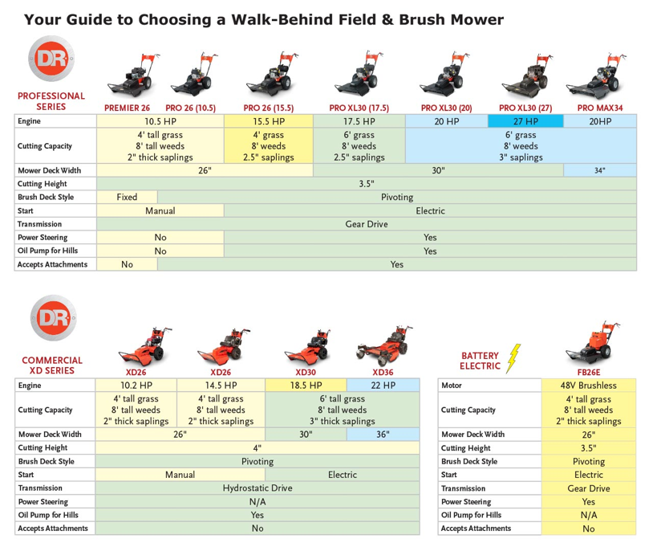
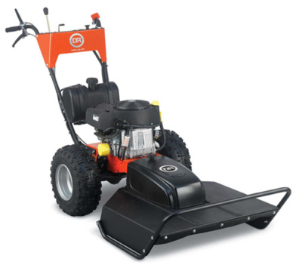
DR Field & Brush Mowers
PRO XL30 (17.5 HP) $3,400. Briggs & Stratton 300 lbs
Com XD30 (18.5HP) $5.000 Kawasaki 380 lbs
Power Steering
do a full 180° turn, without muscling the machine
width 30" deck
https://www.drpower.com/power-equipment/field-brush-mowers

Slide 2
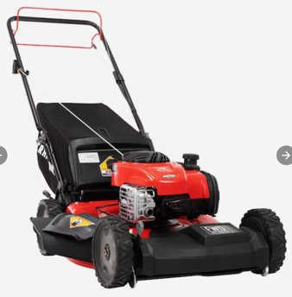
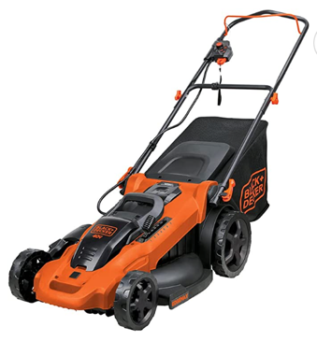
CRAFTSMAN M220 150-cc 21-in
Self-propelled Gas Lawn Mower
with Briggs and Stratton Engine
$420 new
BLACK+DECKER 40V MAX* 20-inch
Cordless Lawn Mower
with Battery and Charger Included (CM2043C)
$350 new

Slide 3
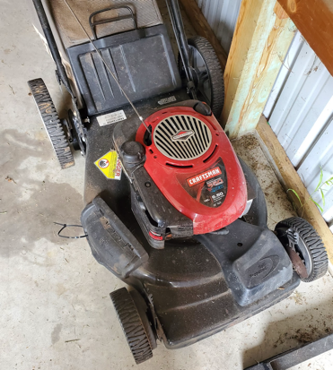
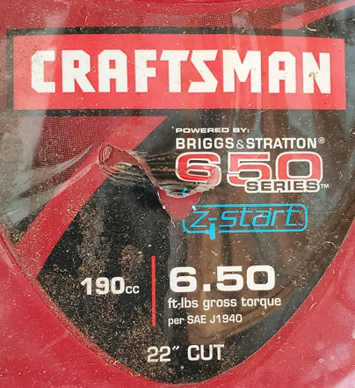
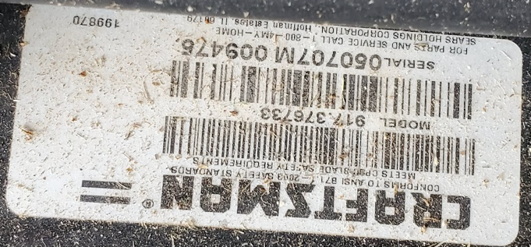
Craftsman gas mower
Model 917.376733
22" cut
Briggs & Stratton engine
Manual:
https://www.searspartsdirect.com/manual/1p048hkgcs-000247/craftsman-917376733-gas-walk-behind-mower-parts

Slide 4
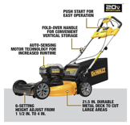
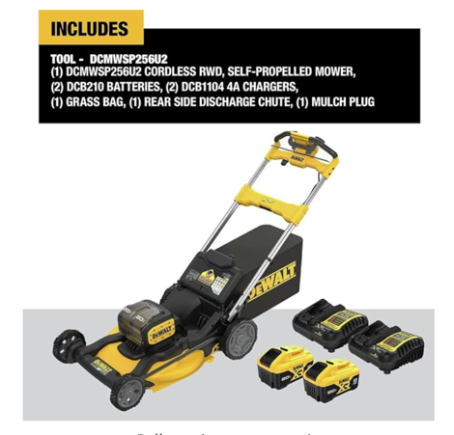
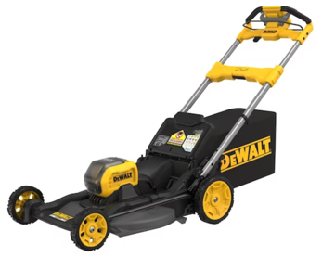
Older model: DCMWSP244U2, $700
https://www.amazon.com/dp/B09MLL5878
https://www.youtube.com/watch?v=al5DQLz1HrA
New in 2024 – Model DCMWSP650Y2 - $1,200
21.5" self-propelled, has side discharge and bag
includes two 60V 12amp batteries and 2 charges
.. https://www.youtube.com/watch?v=apEP0-2sicE
.. https://www.dewalt.com/product/dcmwsp650y2/dewalt-60v-max-cordless-brushless-rwd-self-propelled-mower-kit
.. https://www.homedepot.ca/product/dewalt-2x60v-max-flexvolt-brushless-21-5-in-rear-wheel-drive-self-propelled-mower-with-2-12ah-batteries/1001824470
New in 2024 - Model DCMWSP256U2 - $650 - $700
21.5" self-propelled, has side-discharge and bag
includes two 20V batteries and two charges
very quiet
.. https://www.amazon.com/dp/B0CVN88DQ9/
.. https://www.homedepot.com/p/DEWALT-20V-MAX-21-in-Brushless-Cordless-Battery-Powered-Self-Propelled-Lawn-Mower-Kit-with-2-10-Ah-Batteries-Chargers-DCMWSP256U2/326465401

Slide 5


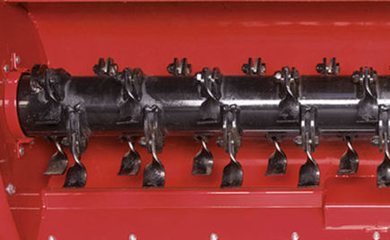
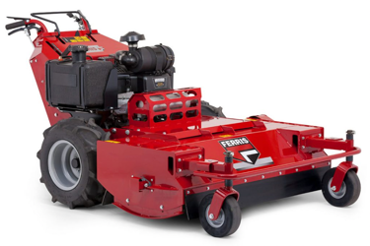
Flail Mower
ZimAni LM 100 PRO
https://www.youtube.com/watch?v=jTVUVP8ncEE
can cut 4" tree !!
Flail cutting action
Ferris FM35 Walk Behind Mower
https://www.ferrismowers.com/eu/en_gb/product-catalog/walk-behind-mowers/fm35-walk-behind-mower.html

