Slide 1
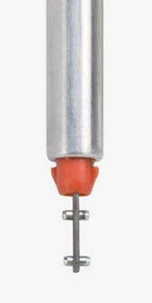
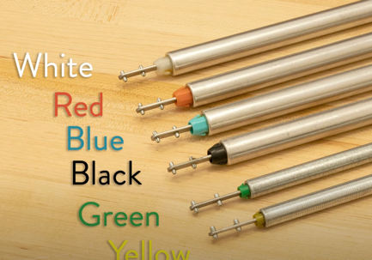
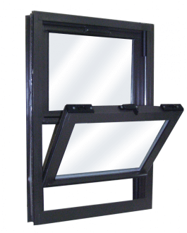
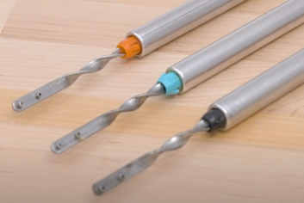
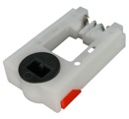
Tension Blinds for Windows
How to Install a Spiral Balance on a Tilt-In Window
https://www.youtube.com/watch?v=h4l-JHcQ-VU
What Window Balance Colors Mean
https://www.youtube.com/watch?v=skZBdIfvhVM
Aluminum Double Hung Tilt Windows
https://crystalwindows.com
Spiral Tilt Window Balance
red color = up to 25 lbs tension
Tilt Pivot Lock Shoe

