Slide 1
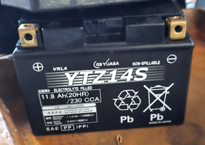
Emergency Generator
Electrical Equipment
To switch to Generator:
turn-off both "Main In" and generator outlet breakers
roll generator out, exhaust facing out, start it – let it run a bit
turn it off, connect cable from generator to outlet
start generator
turn-on the "Generator Outlet" breaker
Maintenance:
start generator once a month – and let it run
have a spare battery – and charge it
have battery cables to start generator from external battery
GS Yuasa YTZ14S motorcycle battery 12V 230 CCA (Cold Cranking Amps)
dimensions:
Length: 6 inches (150 mm)
Width: 3 7/16 inches (87 mm)
Height: 4 3/8 inches (110 mm)
uses M8 x 1.25 bolts and nuts
Type: VRLA (Valve Regulated Lead Acid)
Non-spillable design
Capacity: 11.8 Ah (20HR) or approximately 11.2Ah (10HR)
Made in Japan, filled with Electrolyte, contains lead (Pb)

Slide 2
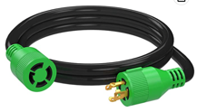
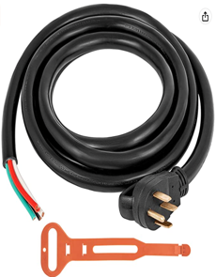
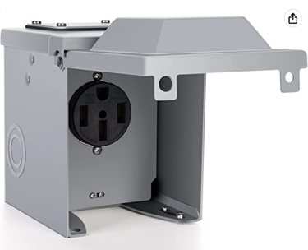

RVGUARD 4 Prong 30 Amp
NEMA L14-30P/L14-30R, 125/250V Up to 7500W
10 Gauge SJTW Generator Cord,
ETL Listed
15 Feet
$46.00
Mophorn 25Ft 50Amp Generator Extension Cord 6 Gauge STW 6/3+8/1 Generator Cord UL Listed Generator Power Cord N14-50P to Bare Wire Cut Wire Cord Extension Power Cord RV Motor Home Generator Portable
Brand: Mophorn
25'
$101.00
WELLUCK RV Power Outlet Box| 50 Amp 125/250 Volt, NEMA 14-50R Receptacle | Enclosed Lockable Outdoor Electrical Panel Weatherproof Plug for Temporary Hookup RV Camper Travel Trailer Car Generator
$36.00
Miady NEMA 14-50P Power Plug, 50-Amp 4-Prong 125/250V Straight Blade Angles Dryer Replacement Male Plug
$12

Slide 3
RVGUARD 4 Prong 30 Amp
NEMA L14-30P/L14-30R, 125/250V Up to 7500W
10 Gauge SJTW Generator Cord,
ETL Listed
15 Feet
$46.00
Mophorn 25Ft 50Amp Generator Extension Cord 6 Gauge STW 6/3+8/1 Generator Cord UL Listed Generator Power Cord N14-50P to Bare Wire Cut Wire Cord Extension Power Cord RV Motor Home Generator Portable
Brand: Mophorn
25'
$101.00
WELLUCK RV Power Outlet Box| 50 Amp 125/250 Volt, NEMA 14-50R Receptacle | Enclosed Lockable Outdoor Electrical Panel Weatherproof Plug for Temporary Hookup RV Camper Travel Trailer Car Generator
$36.00
Miady NEMA 14-50P Power Plug, 50-Amp 4-Prong 125/250V Straight Blade Angles Dryer Replacement Male Plug
$12

Slide 4
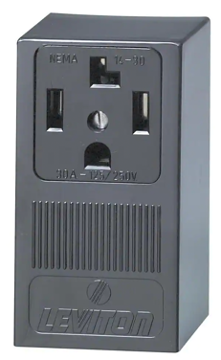
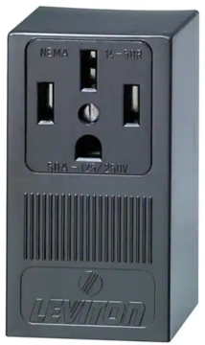
Outlet for 50A for Tesla / generator
Outlet for 30A
NEMA 14-50R. 50A Leviton Outlet
NEMA 14-30 30A Leviton Outlet

Slide 5
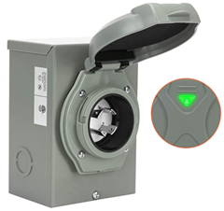
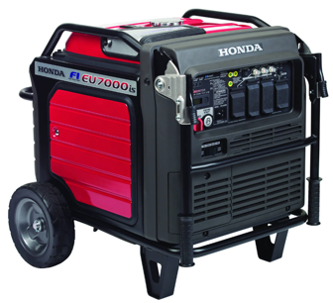

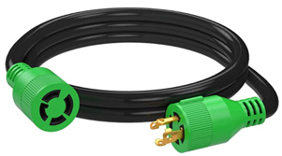
Honda EU7000is
WELLUCK 30 Amp Generator Power Inlet Box, NEMA 3R Power Inlet Box with 4 Prone, PB30, L14-30P, 125/250 Volt, 7500W Generator Inlet for Outdoor Receptacle, Generator Outlet, Weatherproof, ETL Listed
Use gasoline without Ethanol
the 24x7 CES gasoline station
276 E. Broadway, Monticello, NY
CES = Combined Energy Services
Also the main CES store:
216 East Broadway, Monticello, NY 12701
Phone: (845) 794-1210
Mon – Fri: 8 a.m. – 5 p.m, Closed Saturday
https://www.combinedenergyservices.com/engine-fuels/gasoline-ethanol-free
https://www.amazon.com/dp/B08GLJRR4K
10' $40
15' $46
25' $50
40' $89
50' $119
75' $169
100' $209
https://www.amazon.com/dp/B085H9TLCK/

Slide 6
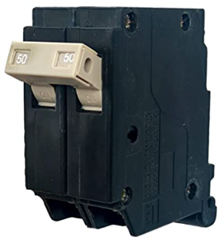
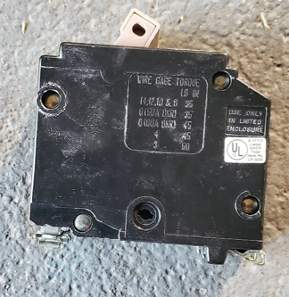
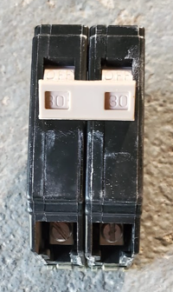
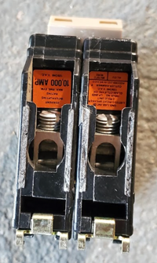
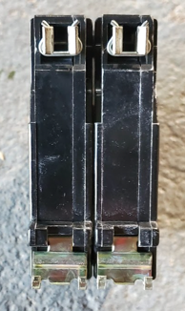
Electrical Breaker
August 2022 – bought on amazon:
CH250 2-Pole 50-Amp Circuit Breaker, Type CH 3/4-Inch Plug-On Molded Case Circuit Breaker, Thermal Magnetic Protection, 10 KAIC, 120/240V, Fit for Cutler Hammer Load Centers (3 Years Warranty)
We need 50A 2-pole breaker
The Panel is compatible with Cutler Hammer standard

Slide 7
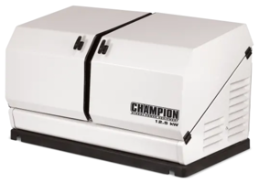
Backup Generator
Home Standbuy Generator
10-26 kW
Natural Gas or LP Propane
$2K - $7K
https://www.norwall.com/categories/Standby-Generators/
Natural gas – delivered only by pipelines where available
LP = Liquid Petroleum = Propane. .. Stored in a metal tank under pressure 850 kPa (becomes liquid). .. Provides twice more BTUs (compared to natural gas).
Champion 100179 Generator
12.5KW
$4,200 at Walmart
High-rated by Consumer Reports

