Slide 1
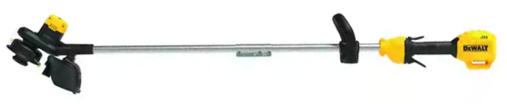
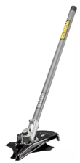
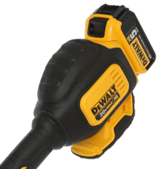
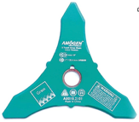
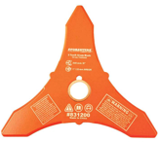
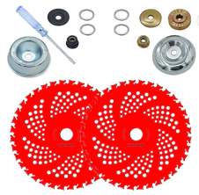
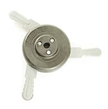
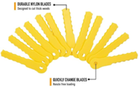
DEWALT Cordless String Trimmers
Motor
Dewalt trimmers:
DCST920 – 20V string trimmer
DCST972B string cutter $289.00 (can change attachments)
DWOAS5BC 8" brush cutter attachment $91.12
8"x3T Weed Eater Blade 1" or 20mm arbor
https://www.amazon.com/dp/B07VV3659P
NeJesZoe 9" x 36Teeth
Carbide Tip Blades Trimmer Cutter
Brush Weed Eater
https://www.amazon.com/dp/B0BK6RRMZX
Weed Warrior Brush Cutter
Weed Trimmer Blade Head https://www.amazon.com/gp/product/B0045PS4RW

Slide 2
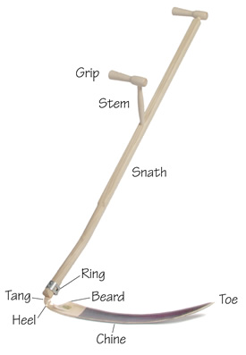
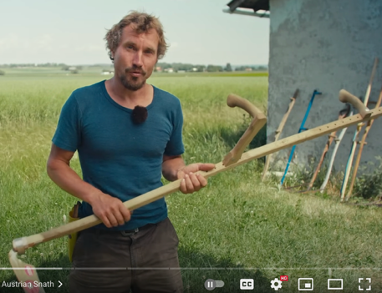
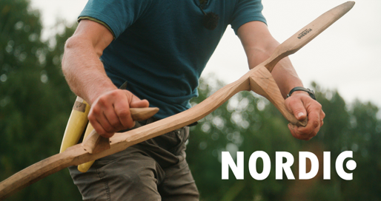
Scythe
A scythe - a traditional hand tool for grass/crops mowing
A long blade attached at an angle to a long handle.
still used for small scale mowing
https://scythesupply.com
https://byxco.com/collections/scythes-accessories
Good video: https://www.youtube.com/watch?v=VVn1kiZnldQ
https://northwestmeadowscapes.com/products/farm-and-homestead-scythe-schrockenfux-hahn-sense
Europe
https://www.scythecymru.co.uk
https://www.youtube.com/watch?v=LrkpRV4P1bM – excellent 7 min video
https://www.youtube.com/watch?v=Wt2XNZpnq5o – Nordic vs Austrian
https://www.slattergubben.se/lang-EN/products/buy-a-scythe/scythe-blade-snath-peening-equipment

Slide 3
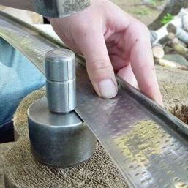
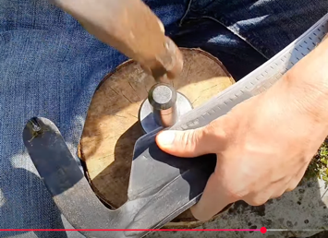
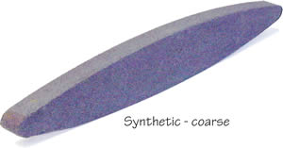
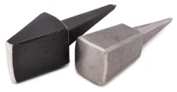
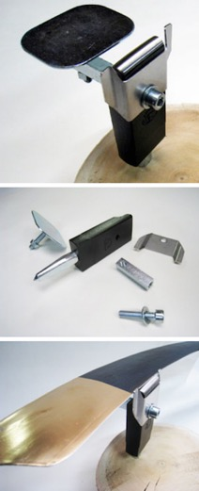
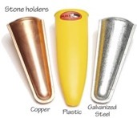
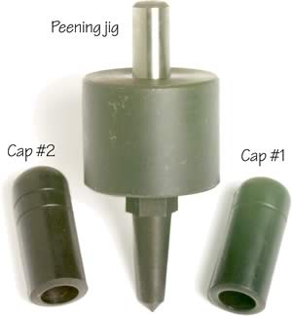
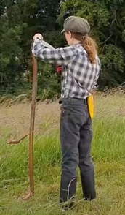
Scythe Accessories
https://scythesupply.com/equipment.html
Wet stone
Anvils
Wet stone Holders
Peening Rig
Wet stone holders
Schroeckenfux Anvil
Peening Anvil with guides and a flange for support

