Slide 1


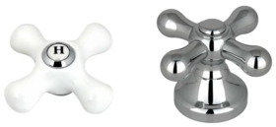
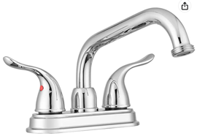
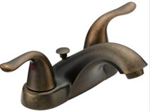
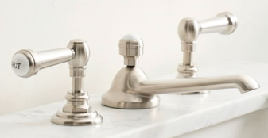
Bathroom Faucets
Cross Handle
Drain Stopper
with overflow
pop-up drain stopper
with overflow
Lever Handle
Central piece
4", 3-hole
Swivel Spout
Wide Spread

Slide 2
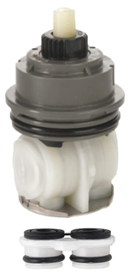
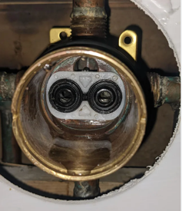
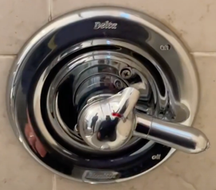
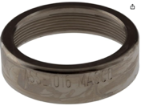
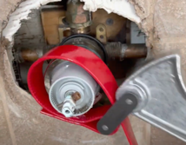
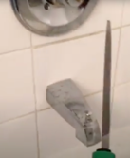
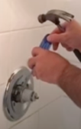
Delta Monitor shower faucet
RP46463 cartridge
Delta Monitor 1700 series shower faucet
with RP46463 cartridge – made after 2006.
Delta faucets have lifetime warranty.
Just contact Delta at the email
customerservice@deltafaucet.com
Send them the picture of the faucet.
They will send the repair parts FREE!!
RP28603 seal kit sent to me directly from Delta.
https://www.youtube.com/watch?v=PrzEz4_SJL8
Search youtube for "RP46463" to find videos explaining
how to replace, for example:
https://www.youtube.com/watch?v=nF9jWuetjYA
Used Delta RP32104 Cartridge Kit (white, for models before 2006)
https://www.youtube.com/watch?v=32SHxO1NNSA
STOP!!! Don't damage your DELTA Shower valve!
https://www.youtube.com/watch?v=meRdEynmPVo
Which delta cartridge do you have how to replace a delta cartridge
https://www.youtube.com/watch?v=mVLKFwymZL4
Delta:
https://www.deltafaucet.com/service-parts/contact-us
1-800-345-DELTA (3358)
M-F. 8am-6pm EST, Sat 9am-6pm EST
https://www.amazon.com/dp/B07G2TCSKF
Delta rp22734 bonnet nut
https://www.amazon.com/dp/B001DU0GLY
Taking off the bonnet nut using jar opener
Taking off the bonnet nut – cut with a file, then use screwdriver and hammer:
https://www.youtube.com/watch?v=qD6j2vWpP4A
https://www.youtube.com/shorts/sH63hY-eUzg

Slide 3
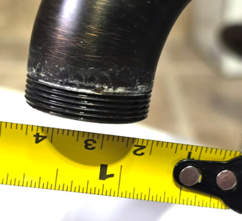
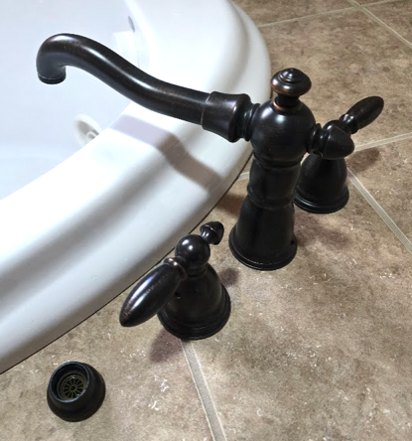
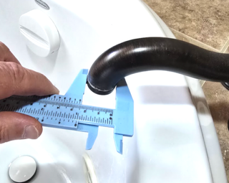
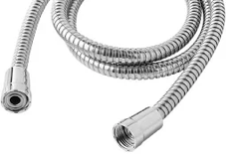
Second Faucet
"T2755RB" - Delta Tub Filler Faucet Victorian Venetian Bronze
" RP34348RB " - Spout Tip for Delta Faucet Victorian for Roman Tub, Venetian Bronze
Manual measurement: M26 x 1.0 thread
(26mm diameter, 1mm thread pitch).
We need adapter: M26 female to G1/2" male
G1/2" male is a universal standard straight-threaded fitting for shower hoses and handheld showerheads worldwide. 20.9 mm outer diameter, 14 threads per inch. It follows the BSPP (British Standard Pipe Parallel) standard, also called ISO 228. Unlike tapered pipe threads, it seals via a rubber washer or O-ring, not thread compression
Thread M26 x 1.0

