Slide 1
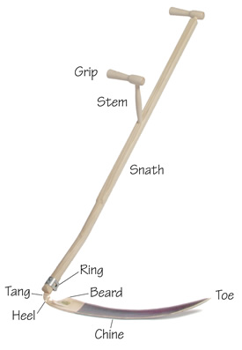
Scythe
A scythe is a hand tool used for mowing grass or reaping crops.
It has a long, curved blade attached at an angle to a long handle.
This traditional agricultural tool has been in use across the world for centuries, but it's less common today due to the advent of mechanized farming equipment.
Despite its lesser usage in agriculture today, the scythe is still used in some regions and contexts where small-scale, sustainable farming practices are valued.
https://scythesupply.com
https://byxco.com/collections/scythes-accessories
ebay
Good video: https://www.youtube.com/watch?v=VVn1kiZnldQ

Slide 2
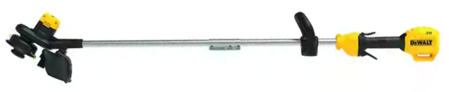
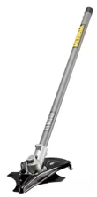
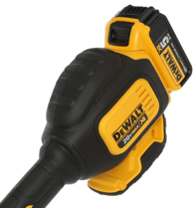
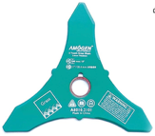
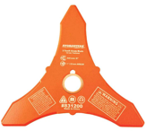
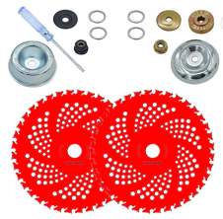
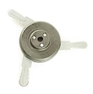
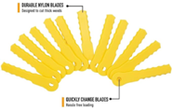
DEWALT Cordless String Trimmers
Motor
Dewalt trimmers:
DCST920 – 20V string trimmer
DCST972B string cutter $289.00 (can change attachments)
DWOAS5BC 8" brush cutter attachment $91.12
8"x3T Weed Eater Blade 1" or 20mm arbor
https://www.amazon.com/dp/B07VV3659P
NeJesZoe 9" x 36Teeth
Carbide Tip Blades Trimmer Cutter
Brush Weed Eater
https://www.amazon.com/dp/B0BK6RRMZX
Weed Warrior Brush Cutter
Weed Trimmer Blade Head https://www.amazon.com/gp/product/B0045PS4RW

