Slide 1
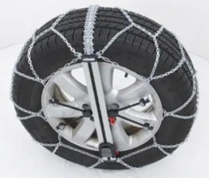
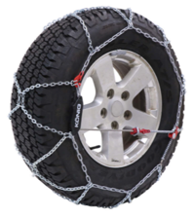
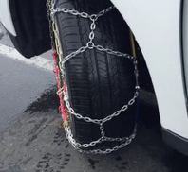
Snow Chains
Toyota Tires - 17". (235/60-17)
Snow Chains:
Dec 17, 2022: Security Chain Co - Set of 2 - $111
Jan 02, 2025: SCC Peerless Tire Traction Chain - Set of 2 - $110
Feb 18, 2025: Snow Tire Chains - Set of 8 - $65
Feb 18, 2025: SNOCATENA Snow Chains - Set of 2 - $90
Feb 25, 2025: Konig XG-12 Pro - T507 - Set of 2 - $250
Dec 20, 2025: KÖNIG Easy-FIT SUV 247 Snow Chains, Set of 2 - $580
KÖNIG Easy-FIT is terrible.
It completely broke.
It was easy to put on,
but very difficult to take off.
And it completely broke (both sides) in just few weeks.
Turn wheels to get easy access to disconnect internal blue/yellow cable
Konig XG-12 Pro is a solid choice.
I just needed to learn how to put it on and take it off. Once you know it, it is actually easier to handle than "Easy-FIT"

Slide 2
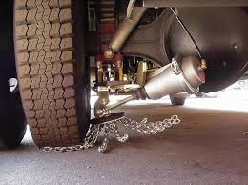
Automatic Snow Chains – only for commercial vehicle
Automatic snow chain systems like Onspot, Insta-Chain, and RotoGrip are amazing for commercial/emergency vehicles, but they're not practical for a 2016 Toyota Sienna because of cost, availability, and installation complexity.
You flip a switch in the cab, and pneumatic or electric actuators drop spinning chain wheels against the inside of the tire. The friction spins the chain wheel, and centrifugal force swings chain strands out under the tire continuously as you drive—instant traction without stopping. They work in forward or reverse and can be activated/deactivated on the fly.
They are designed for commercial/heavy vehicles. Onspot, Insta-Chain, and RUD RotoGrip are engineered for trucks (half-ton through Class 8), buses, fire trucks, ambulances, and municipal fleets—not passenger minivans. The mounting brackets, air/electric systems, and clearances assume commercial chassis and heavy-duty suspension.
These systems typically run $1,500–$3,500+ per axle installed, and you'd need custom fabrication to retrofit a Toyota Sienna. That's very expensive and a massive overkill.
Also the manufacturers don't list passenger minivans in their fitment guides; you'd be DIY-engineering a mount, routing air lines, wiring switches, and hoping for adequate tire clearance.

Slide 3
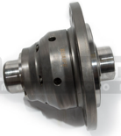
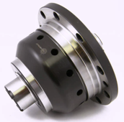
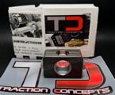
Traction Control
Quaife helical LSD for U660E ($1,500)
https://www.monkeywrenchracing.com/product/quaife-helical-lsd-lotus-evora-ips-automatic-toyota-3-5-auto/
Full replacement helical torque‑biasing differential (no clutches), widely used in FWD performance and snow/track builds.
It is sold for “Toyota 3.5 U660E 6‑speed” and explicitly listed for other 2GR‑FE FWD applications;
It is a true helical LSD with smooth, maintenance‑free operation (no clutch packs).
Excellent street/snow manners and durability;
biases power to the wheel with better grip without locking.
Toyota Sienna 2016 FWD has a standard open differential. This means it sends power to the wheel with least resistance – so it may spin fast while the other wheel doesn't spin.
Limited-slip differentials (LSDs) and locking differentials that force both wheels to receive power are far more effective at maintaining forward momentum when one wheel encounters a slick patch.
LSD adds an internal mechanism (clutch packs, cones, viscous fluid, or helical gears) that resists a big speed difference between the two wheels.
When one wheel starts to spin faster (loses grip), that resistance “pushes back,” sending more torque to the wheel with better traction.
It still allows some speed difference for turning, but it “limits” how far that difference can go - hence the name.
Other torque‑biasing LSDs (e.g., Wavetrac) - typically $1,500
https://www.speedfactoryracing.net/products/wavetrac-limited-slip-differential
Full replacement gear‑type LSDs similar in concept to Quaife, with proprietary wave‑cam preload systems for low‑traction conditions.
Excellent behavior, higher cost, and you must verify fitment.
Aftermarket companies sell LSD conversion kits specifically for the Sienna’s U660E transaxle, and they describe these as upgrades that convert the non‑LSD open differential to limited‑slip.
Traction Concepts LSD conversion (spring/plate kit - $350)
https://www.tractionconcepts.com/Toyota-Sienna-U660E-Limited-Slip-Conversion-Kit-p/tcxty8041.html
Insert‑style kit that converts your existing open differential into a 1‑way limited‑slip using springs and plates installed inside the stock carrier
It is specifically listed for 2011–2016 Toyota Sienna FWD 6‑speed automatic U660E.
Requires differential removal and careful setup; you’re paying for significant labor.
Not a full new diff; it modifies the OEM open unit, so ultimate strength and behavior will differ from a purpose‑built helical LSD.

Slide 4
Modern Sienna: brake-based traction control
Since 2021 Toyota Sienna is hybrid and its AWD system is "electronic on demand". It has multiple sensors (wheel speed, steering angle, throttle position, and yaw rate sensors) to monitor driving conditions and adjust power delivery in real-time
Neither the front nor rear wheels have independent left-right torque vectoring capability; both axles use open differentials with brake-based traction control
Sienna has one gas engine and 3 electric motors (2 front, 1 back)
Front wheels are NOT controlled independently—the two front electric motors (MG1 and MG2) work together through the eCVT transaxle but do not provide independent left-right torque control. MG1 primarily functions as a generator and starter, while MG2 is the main drive motor for the front wheels
Rear wheels are interconnected using an open differential. When one rear wheel begins to slip, the system uses brake-based traction control to slow down the slipping wheel, which redirects power to the wheel with better grip
Both front and rear differentials are open-type differentials. Instead of a mechanical limited-slip differential (LSD), the Sienna relies entirely on electronic brake-based traction control to manage wheel slip. When a wheel loses traction, the system applies the brake to that specific wheel, which forces torque to transfer to the wheel with better grip.

