Slide 1
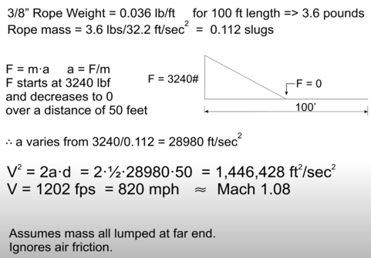
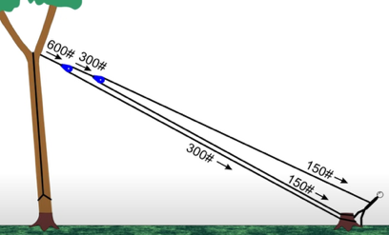
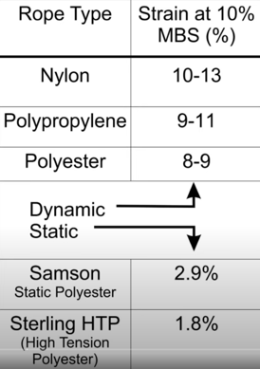
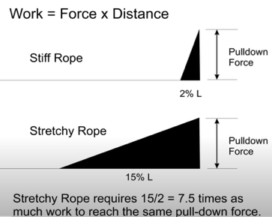
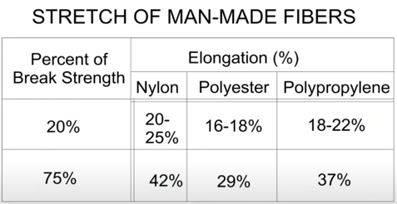
Tree Pulling
https://www.youtube.com/watch?v=Y4Vke_-cWYg

Slide 2
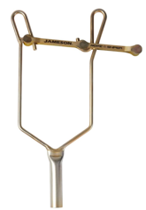
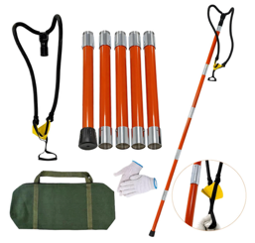
Jameson Rope Sniper
Jameson Rope Sniper™ (RS-TC-1) is a tool with a swinging frame/guide to place the rope around a branch or a pole.
The tool is $75 on amazon.
You mount it on the end of a standard Jameson extension pole (or any compatible 1¼" ferrule pole).
You load your rope into the swinging frame/guide, extend the pole up to the branch or utility pole, and release, dropping the rope precisely where you want it
It works with throwlines, climbing ropes, and rigging ropes up to 1" in diameter.
Other option - Arborist Slingshot - allows to throw the line rope. It is attached to the end of the pole.
Another option is to simply throw a weight with rope attached.
Another option is to have a nail at the end of long pole, and hang a heavy nut with rope onto this nail. Lift it up around the branch, then turn the pole so that nut slip down from the nail – thus pulling the rope around the branch and down

