Slide 1
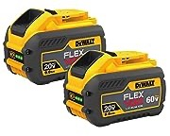
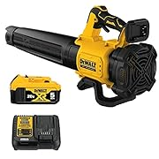
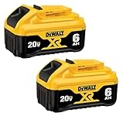

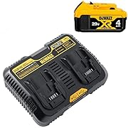




DeWalt
DEWALT FLEXVOLT 20V/60V MAX* Batteries, 9.0-Ah, 2-Pack (DCB609-2)
DEWALT 20V MAX Battery, Premium 6.0Ah Double Pack (DCB206-2)
DEWALT 20V MAX* XR Leaf Blower, 125-MPH, 450-CFM (DCBL722P1)
Includes 20V Max DCB115 charger
and 20V 5ah battery
DEWALT 20V MAX* XR® Brushless Cordless Pole Saw (8" chain)
60V MAX Brushless Lithium-Ion 18 in. Cordless Chainsaw Kit (9 Ah)
kit DEWNDCCS672X1 contains:
60V MAX Chainsaw - DCCS672
9 Ah FLEXVOLT Battery - DCB609
Charger - DCB115
DEWALT 20V MAX* Charging Station for 4Ah Battery Pack (DCB102BP)
Chargers for FlexVolt batteries:
DCB115 - $40
DCB118 - $55 (yellow, faster)
DEWALT 20V MAX 8 in. Brushless Cordless Battery Powered Pruning Chainsaw (8" chain)

