Slide 1
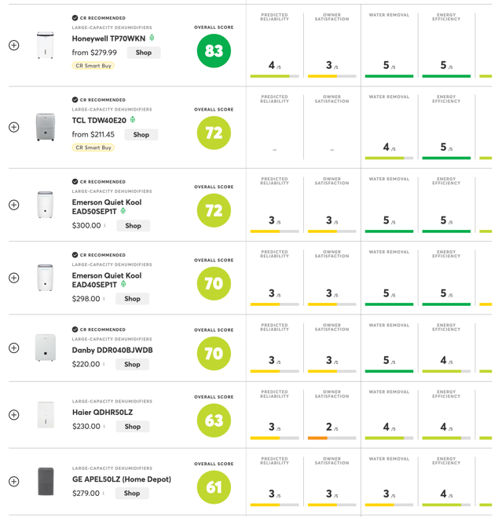
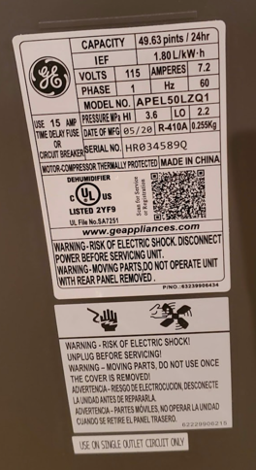
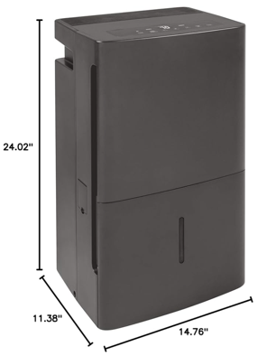
Dehumidifiers
we need 50 pints (or more)
Consumer Reports doesn't rate it very high.
And it is not very energy
Owner
Satisfaction
Water
Removal
Energy
Reliable
We currently have GE 50 pint model APEL50LZQ1 from HiomeDepot
50- pts/day (tank size 15 pints), built-in pump, drain hose included, Auto Re-start.

Slide 2
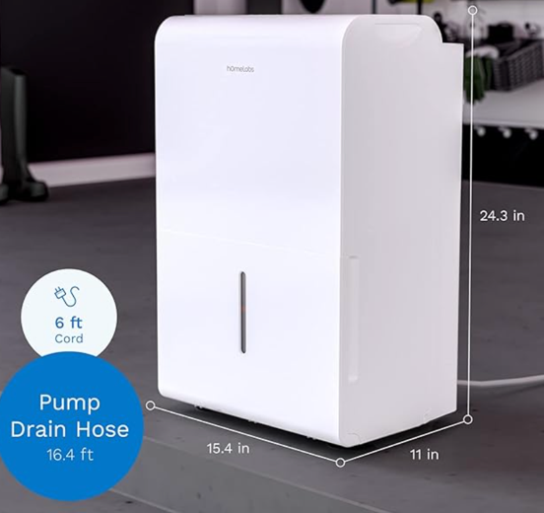
So I have considered following:
Honeywell TP70WKN - top rated in Consumer Reports
Frigidaire 50 pint
Frigidaire 60 pint – has WiFi,
hOmeLabs HME020391N – 50 pints, hugely popular on Amazon
Decided on hOmeLabs - $310
https://www.amazon.com/gp/product/B08MWTPS9T
hOmeLabs HME020391N

