Slide 1
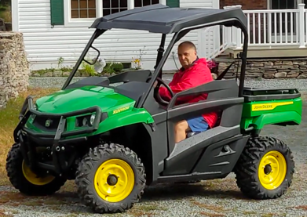
John Deere Gator UXV590M
This is not a tractor.
It is called Gator or "Side-by-side"
This specific model is UXV590M
UXV = Utility Crossover Vehicle
UTV = Utility Task Vehicle
October 8 - received basic John Deere Gator
XUV590M Power Steering Winch Ready
(Model Year 2023)
On Order For Future Installation:
.. Windshield + wiper
.. Ops Kit (OPS = Occupant Protection System) – lights & wires
.. Bumper (rear)
.. Snow Blade
.. Winch Kit
Tires:
26” Maxxis Bighorn 2.0 extreme terrain radial tires on 14” Yellow Steel Wheels
Pressure:
.. front: 14 PSI
.. rear: 32 PSI
Winch:
How To Get Your UTV unstuck in seconds - UTV winch basics https://www.youtube.com/watch?v=5BqKBDXpihM
Winching techniques beginners to Advanced https://www.youtube.com/watch?v=OXxLh8shMu8
Buying rear view mirrors on amazon:
The top bar and side bars are 1.75" diameter.

Slide 2
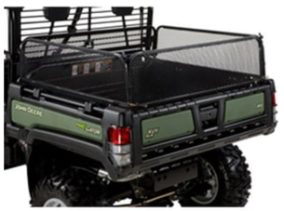
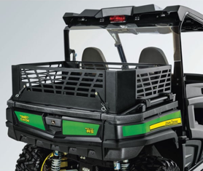
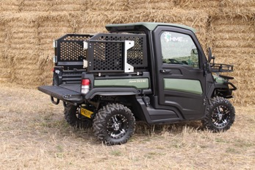
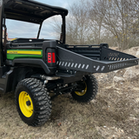
John Deere Cargo Box Side Extension Kit – Part # BM24901 (was Part # BM22774)
https://www.greenpartstore.com/John-Deere-Cargo-Box-Side-Extension-Kit-BM24901.html
$678
John Deere Cargo Box Extension Kit - Part # BM23384
https://www.greenpartstore.com/John-Deere-Cargo-Box-Extension-Kit-BM23384.html
$475
Large Side Extensions-Gator
WP001268
https://www.hme.co.uk/product/large-side-extensions/
£595
John Deere Gator Bed Extension - $699.00
https://rancharmorutv.com/john-deere-gator-bed-extension-rear-basket/

