Slide 1
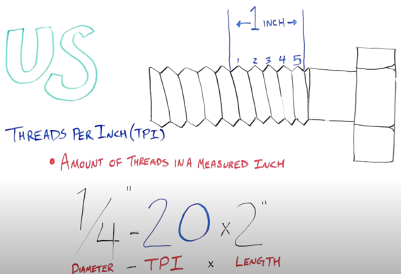
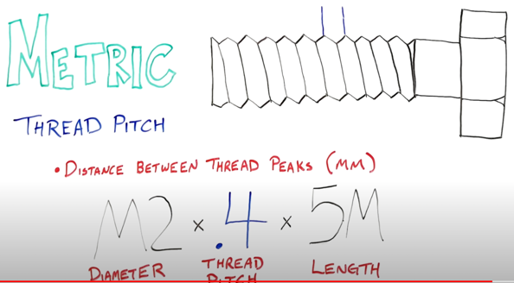
Bolt Threads
1/4 = Diamater in inches
20 = TPI (Threads Per Inch)
2" = bolt length in inches from under the head to the end
Thread Pitch = distance between threads in mm
M2 = Diameter in mm
.4 = distance between threads is 0.4mm
5M = bolt length in mm from under the head to the end

Slide 2
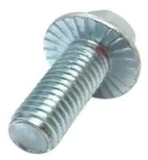
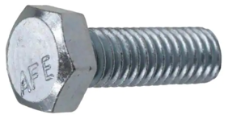
Bolt Examples
M8-1.25 x 20 mm
Hex head 5/16 in.-18 x 1 in.

