Slide 1
How to Remove A Scratch from Your Car Paint

Slide 2

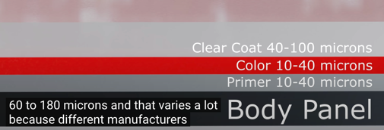
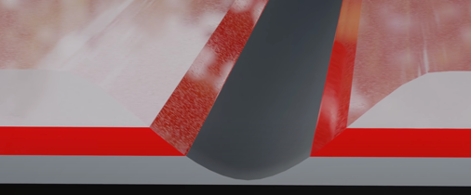
How to Remove A Scratch from Your Car Paint
Abrasive tip removes loose paint and rust
One Coat Prime and Paint Formula
Pen tip for fine scratches
Brush end for larger chips
Clear coat to seal & protect
Deep Scratch Repair
https://www.youtube.com/watch?v=Zl_iSYYGBiY
Steps: Clean, Sand, Paint, Blend
Isopropyl Alcohol 91%
soapy water (ChrisFix Soapy Wooder)
rasor
masking tape
microfiber towels
kitchen sponge
sand paper (2,000 , 4,000, 5,000)
polish
polishing pad
paint pen

Slide 3
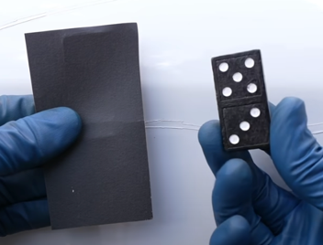
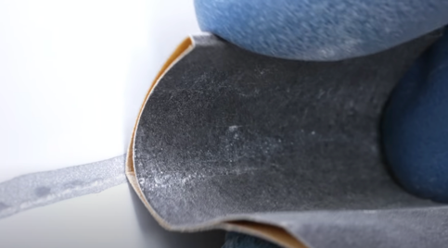
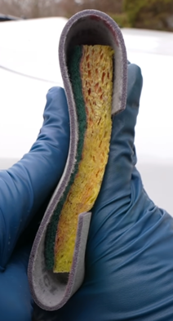
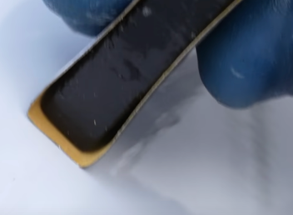
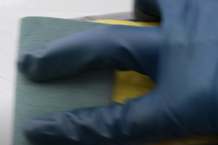
How to Sand the scratch to smoothen the edges

Slide 4
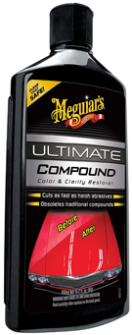
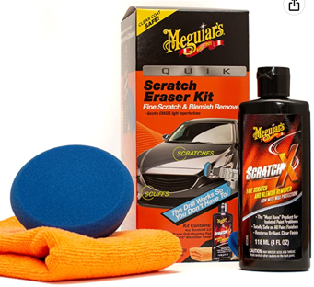
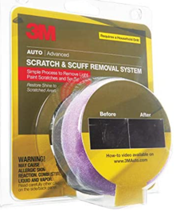
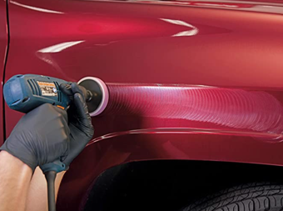
Best Car Paint Scratch Remover (for shallow scratches)
Best Car Paint Scratch Remover (for shallow scratches)
https://www.youtube.com/watch?v=m8OU5J6OSt0
Meguiar's Ultimate Compound: https://amzn.to/3j8KUp5
3M Auto Scratch & Scuff Removal System: https://amzn.to/325FAM9
Meguiar's Scratch Eraser Kit: https://amzn.to/322JLIy

