Slide 1
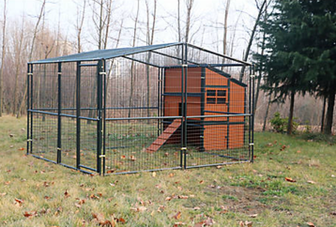
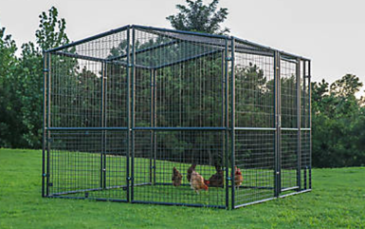
Chicken Coops & Pens
Chicken Coop (Hen House)
Poultry Pen

Slide 2
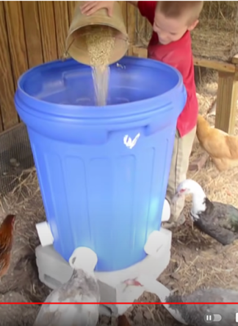
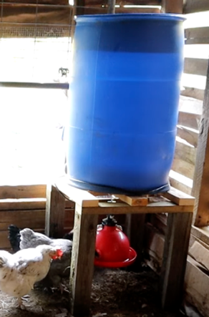
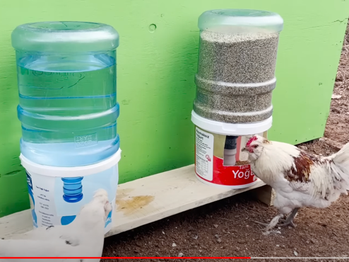
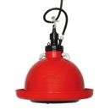
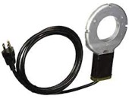
Chicken Food & Water Feeders
DIY Water & Food Feeders
made of plastic buckets and plastic bottles
https://www.youtube.com/watch?v=cNNqJy1lj6Y
DIY Food Feeder
Water Feeder using
"Plasson Broiler Drinker"
Also need submerged electric heater/de-icer with thermostat to keep water from freezing in winter https://www.amazon.com/dp/B01I57ZFEU/

Slide 3
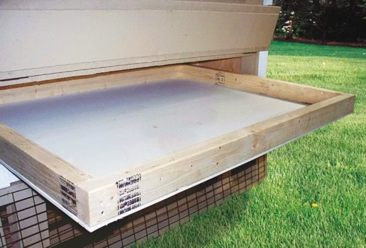
Chicken Easy-Cleaning Coop
Main Ideas:
pull out the floor to clean it
make floor from wire mesh allowing poop to fall through
"deep litter" method

Slide 4
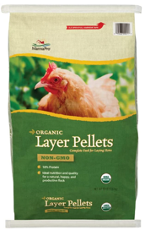
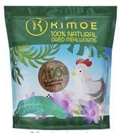
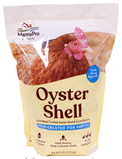
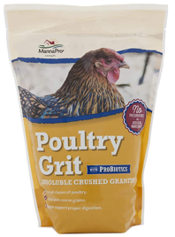
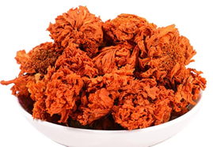
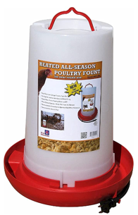
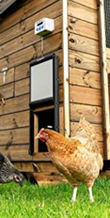
Chicken foods
.. https://www.youtube.com/watch?v=XQZo86MLwdw
.. https://oakabode.com/what-do-chickens-eat/
LAYER FEED: https://www.amazon.com/dp/B00TPN7CRW (We frequently change brands but I prefer pelleted feed like this over crumble)
MEALWORMS: https://amzn.to/3ppHX7J
OYSTER SHELLS: https://amzn.to/3vOyBVD
GRIT: https://amzn.to/34HSkKy
MARIGOLD PETALS: https://amzn.to/3ph9fwW (These supposedly help create darker yolks if your birds don't free range -- I write more about this in the blog post above!)
AUTOMATIC CHICKEN DOOR: https://amzn.to/3xkeMGN
HEATED CHICKEN WATERER: https://amzn.to/2T07LeE
Dried Marigold Whole Flower

Slide 5
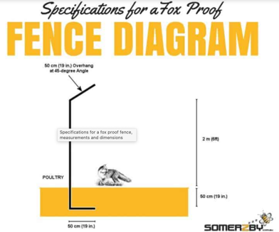
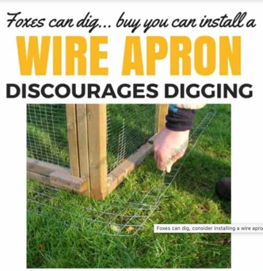

How to Protect against Foxes
https://www.somerzby.com.au/blog/fox-proof-chicken-coop/
Fence 2m high:
inclined outside
goes 50 cm deep into ground
to prevent digging under

Slide 6
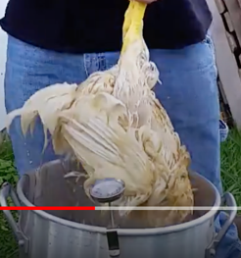
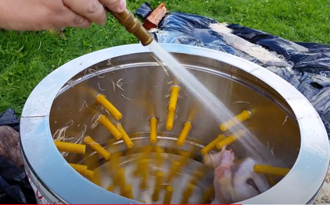
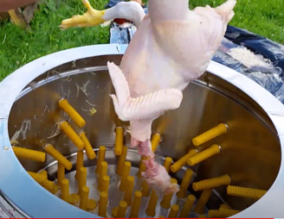
Chickens Plucker
Plucking – removing bird's feathers (by mechanical pulling).
Put bird in a bucket with hot water (150 F = 66 C) for a minute,
then put it in a mechanical plucker bucket where typically the bottom rotates and walls stationary – and both have flexible rods which help to remove feathers. Use water from garden hose.

Slide 7
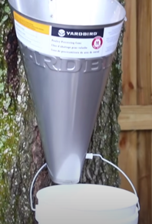
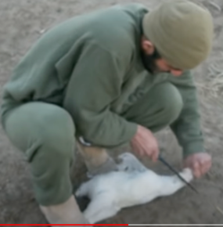

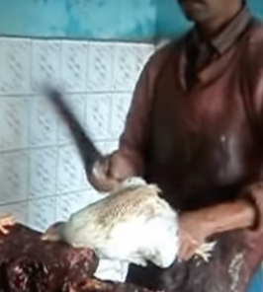
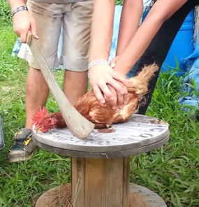
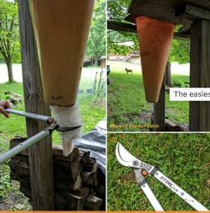
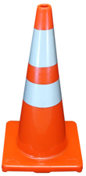
How to kill a chicken
On big farms chicken killed by electricity or CO₂ .
Birds are hanged by their legs and lowed into water connected to .electricity.
Birds placed into a chamber – and it is filled with CO₂ for 5 minutes.
On small farms people cut chicken's head with a knife or meat cleaver
(or an axe, or even a pair of tree loppers).
Chicken should be immobilized:
using a cone ("hugging" cone or "killing" cone) – can use a red roadside cone
fixing head between two parallel rods/nails,
or simply by hand (holding chicken's legs & wings)
Immediately after cutting head, the body is placed into a bucket until it dies.
"hugging" cone
fixing by foot and hand
meat cleaver
traffic cone + tree loopers
fixing by holding legs and wings
fixing head between two vertical nails

